Slide 1


Domestic and family violence in NSW
An Aboriginal focus
This pack presents a range of descriptive information that may be useful to communities and policy makers working to reduce domestic violence experienced by Aboriginal people
May 2022

Slide 2

Contents
Background – closing the gap 4-11
DFV assault against Aboriginal women 12-19
DFV assault against Aboriginal children 20-24
Adult Aboriginal DFV assault offenders 25-32
Aboriginal DFV assault young offenders 33-38
Summary 39

Slide 3

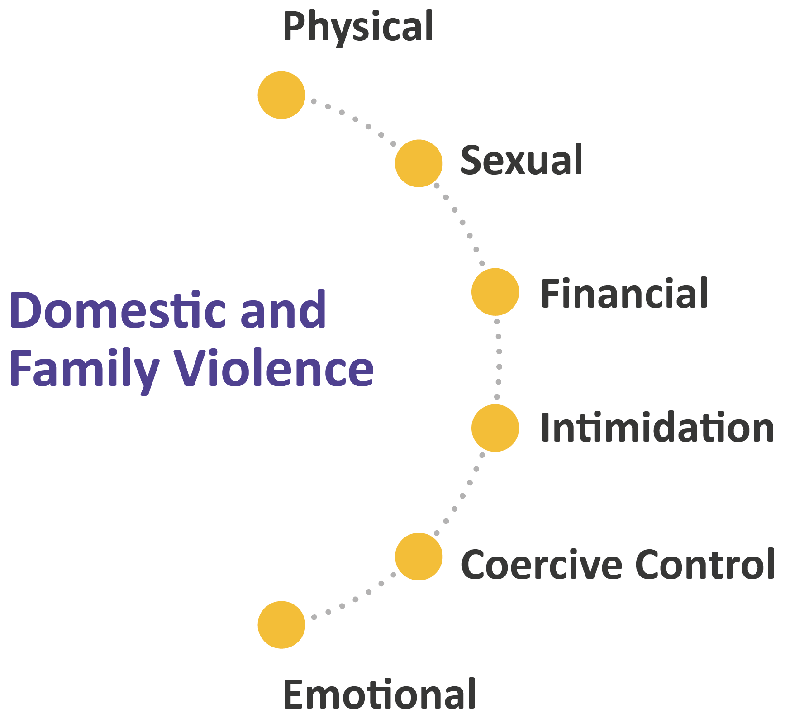
Introduction: Forms of DFV
This presentation will focus on physical violence

Slide 4
Background
Over representation of Aboriginal women as victims of DFV
Closing the Gap targets for DFV reducing violence
Definition of DFV
Trends in recorded DFV assault
Regional view

Slide 5
Over representation as victims of violence
DFV is much higher for Aboriginal women
10%
of Aboriginal women reported experiencing physical violence in the past 12 months from a family member or partner
of all Australian women reported experiencing physical assault in the past 12 months. Over half of of these were from an intimate partner.
Source: ABS, 2016
3%
Source: ABS, 2017
Hospitalisations for interpersonal violence are 7x higher for Aboriginal women
Rate of hospitalization, per 100,000
Source: NSW HealthStats
9%
of adult victims of DFV assault reported to NSW Police in 2021 were Aboriginal; 2.2% of the NSW adult population were Aboriginal
Source: NSW Bureau of Crime Statistic and Research
Note: changes in data over time may be effected by changes recording over time
Notes:
Sources:
Australian Bureau of Statistics (2016). National Aboriginal and Torres Strait Islander Social Survey, 2014-15. https://www.abs.gov.au/ausstats/abs@.nsf/mf/4714.0
Australian Bureau of Statistics (2017). Personal Safety Survey 2016. ABS cat. no. 4906.0. Canberra: ABS.
NSW HealthStats (2021) Interpersonal violence hospitalisations retrieved from http://www.healthstats.nsw.gov.au/Indicator/inj_violhos/inj_violhos_perp
Notes:
ABS Relationship definitions: Intimate partner: Current partner (husband/wife/defacto), Previous partner (husband/wife/defacto), Boyfriend/girlfriend/ex-boyfriend/ex-girlfriend, Date

Slide 6

Closing the Gap targets: Justice
    Adult incarceration
    Domestic Violence
10
    Youth detention
13
11
By 2031, reduce the rate of Aboriginal* adults held in incarceration by at least 15%
By 2031, reduce the rate of Aboriginal young people (10-17 years) in detention by 30%
By 2031, the rate of all forms of family violence and abuse against Aboriginal women and children is reduced at least by 50%, as progress towards zero
13
Aboriginal women and children: Reported number of DFV and sexual violence incidents*
50%
Reduction of 50% by 2031
Notes:
Source:
NSW Bureau of Crime Statistics and Research (2022) unpublished data. CTG Headline Snapshot
Note: Target rate: 50% below the 2019 baseline. The Target is the target number, calculated by applying target rate to ABS population estimate and projection by June 2024. * Police recorded Aboriginal female and child victims of murder, domestic-violence related assault, and sexual assault..

Slide 7
What do we know and how to track progress?
Victim surveys tell us that DFV is under-reported to police
82%
of Australian women who experience violence from their
current partner do not report it to the police
of Australian women who experience violence from a
former partner do not report it to the police
65%
Source: ABS (2017) Personal Safety Survey 2016
But ….police recorded crime data is useful for identifying:
trends
locations
some victim and offender characteristics
Notes:
Source: Australian Bureau of Statistics (2017). Personal Safety Survey 2016. ABS cat. no. 4906.0. Canberra: ABS.

Slide 8
How is DFV defined in NSW?
DFV data recorded by NSW Police includes:
Intimate partner violence: Current and ex spouses, current and ex partners, current and ex boyfriend/girlfriend.
Family violence: Parents, children (including step, and foster), siblings, other family members (including kin).
Other domestic relationship: Persons living in the same household/residential facility, carer, person in authority, other domestic relationship (e.g. partner’s ex partner).
Based on Crimes (Domestic and Personal Violence) Act 2007
Aboriginal women and children, victims of DFV assault, NSW
Notes:
Source:
NSW Bureau of Crime Statistics and Research, 2021. File ref:DvAssaultVictims_FirstPoiProcAgainst_UnitRecordData21Q1.csv
Victim Cohort April 2020 to Mar 2021. Unique victim records with victimisation between Jan to Dec 2021.
Notes:
*Remoteness Areas divide Australia into 5 classes of remoteness on the basis of a measure of relative access to services. Remoteness Areas are intended for the purpose of releasing and analysing statistical data. Access to services are measured using the Accessibility and Remoteness Index of Australia (ARIA+), produced by the Hugo Centre for Migration and Population Research at the University of Adelaide.
Definition: Intimate partner: Current partner (husband/wife/defacto), Previous partner (husband/wife/defacto), Boyfriend/girlfriend/ex-boyfriend/ex-girlfriend
Family member: Parent, child, sibling, other family member
Other: carer, housemate, persons in authority, other (e.g. ex-partner of partner)
Remoteness classification: Australian Bureau of Statistics (2018) Australian Statistical Geography Standard (ASGS): Volume 5 - Remoteness Structure, July 2016

Slide 9

Trends in DFV – Aboriginal women and children
Aboriginal women and children, victims of DFV incidents
Trends in DFV assault over 5 years
3.0% Annual average increase in DFV assaults over 5 years
13.6% Annual average increase in DFV intimidation over 5 years
Note: Not a count of unique victims
DFV Intimidation
DFV Assault
Trends in apprehended domestic violence orders (ADVO)
ADVOs protecting an Aboriginal woman or child
3.5% Annual average increase in number of ADVOs protecting an Aboriginal woman or child over 5 years
Note: Count of orders
ADVOs granted
Notes:
Source:
NSW Bureau of Crime Statistics and Research (2022) unpublished data.

Slide 10


Regions with highest numbers of victims
Local Government Areas with highest DFV assault victim counts for Aboriginal women and children Jan – Dec 2021
In LGAs with high victim counts of Aboriginal women and children
the number of family violence assaults is similar to intimate partner violence
In Moree Plains, Blacktown, Central Darling and Bourke and Shoalhaven there is more family violence against Aboriginal woman and children than intimate partner violence
IPV
Family
Other domestic relationship
Note: excludes missing relationship
Notes:
Source: Source: NSW Bureau of Crime Statistics and Research, 2022. unpublished data.
File ref:DvAssaultVictims_FirstPoiProcAgainst_UnitRecordData21Q1.csv
Unique victim records with victimisation recorded January to December 2021.
Notes:
Definition: Intimate partner: Current partner (husband/wife/defacto), Previous partner (husband/wife/defacto), Boyfriend/girlfriend/ex-boyfriend/ex-girlfriend
Family member: Parent, child, sibling, other family member
Other domestic relationship: other known person no relationship, not known to victim, person in authority, household member and carer). Based on first incident in the reference period. Excludes unknown/not stated relationship status

Slide 11

Victims living in remote areas
Assault by remoteness of victims’ residence, Aboriginal women and children Jan 2021 – Dec 2021
More than 75% of DFV assaults against Aboriginal
women and children happen outside major cities
38% of DFV assaults against Aboriginal
women and children happen in outer regional or remote/very remote locations
Note: excludes missing data
Notes:
Source: Source: NSW Bureau of Crime Statistics and Research, 2022. unpublished data.
File ref:DvAssaultVictims_FirstPoiProcAgainst_UnitRecordData21Q1.csv
Unique victim records with victimisation recorded January to December 2021.
Notes:
*Remoteness Areas divide Australia into 5 classes of remoteness on the basis of a measure of relative access to services. Remoteness Areas are intended for the purpose of releasing and analysing statistical data. Access to services are measured using the Accessibility and Remoteness Index of Australia (ARIA+), produced by the Hugo Centre for Migration and Population Research at the University of Adelaide.
Remoteness classification: Australian Bureau of Statistics (2018) Australian Statistical Geography Standard (ASGS): Volume 5 - Remoteness Structure, July 2016

Slide 12
Taking a closer look at DFV assault against Aboriginal women
Age of victims
Relationship to offender
Place of incident (premise type)
When DFV incidents occur
Repeat victimisation

Slide 13

Victim characteristics
Of all Aboriginal victims of DFV assault reported to NSW Police between Jan and Dec 2021:
Age of Aboriginal DFV assault victim by gender
Jan – Dec 2021
2,627 unique persons
70% of victims are female
16% of victims are under 18
19 yrs is the most common age of female victims
17 yrs is the most common age of male victims
85% of victims had one recorded incident of DFV assault with 12 months*
4% of victims had recorded 3 or more DFV assaults 12 months* (accounting for 11% of incidents)
Age
Notes:
Sources: Source: NSW Bureau of Crime Statistics and Research, 2022. unpublished data.
File ref:DvAssaultVictims_FirstPoiProcAgainst_UnitRecordData21Q1.csv
Unique victim records with victimisation recorded January to December 2021.
*NSW Bureau of Crime Statistics and Research (2021) Unpublished data. Ref dk21-20310
Notes:
* Aboriginal victims of DV assault recorded by NSW Police, March 2020 to April 2021.

Slide 14

DFV assault against: Aboriginal women
DFV assault against Aboriginal women*
Jan – Dec 2021
75% Offender legally proceeded against
81% Offender was male
83% Offender was Aboriginal
37% Alcohol was a factor
Victims also recorded as perpetrators^
4% of Aboriginal woman were also recorded as an offender for the same DFV assault incident (i.e. both a victim and offender) by NSW Police
16% of Aboriginal women were recorded as a DFV assault offender within the past 12 months by NSW Police
 | Female victim | Male victim
Recorded as offender and victim in same incident | 4% | 9%
Recorded as a DFV assault offender within 12 months | 16% | 31%
Note: Offender details relate to the first offender proceeded against during the reference period. Characteristics of offender are available for persons legally proceeded against. * includes females aged 18 and over
Notes:
Source: Source: NSW Bureau of Crime Statistics and Research, 2022. unpublished data.
File ref:DvAssaultVictims_FirstPoiProcAgainst_UnitRecordData21Q1.csv
Unique victim records with victimisation recorded January to December 2021.
Notes:
# this may be an underestimate as incidents reported at the end of the reference period may have resulted in a legal action against a person of interest after
Offender details relate to the first offender proceeded against during the reference period.
Characteristics of offender are available for persons legally proceeded against.
Women include Aboriginal females aged 18 and over.
^Includes all adult Aboriginal victims of DFV assault.

Slide 15


Relationship to offender
73%
of Aboriginal adult victims are female
More females experience IPV than family violence
More males experience family violence than IPV
Adult Aboriginal victims of DFV by gender and violence type*
* Excludes missing relationship status. Based on first incident in the reference period.
Notes:
Source: Source: NSW Bureau of Crime Statistics and Research, 2022. unpublished data.
File ref:DvAssaultVictims_FirstPoiProcAgainst_UnitRecordData21Q1.csv
Unique victim records with victimisation recorded January to December 2021.
Note:
Definition: Intimate partner: Current partner (husband/wife/defacto), Previous partner (husband/wife/defacto), Boyfriend/girlfriend/ex-boyfriend/ex-girlfriend
Family member: Parent, child, sibling, other family member
Other domestic relationship: person in authority, household member, carer and other (e.g. ex partner of current partner).
Based on first incident in the reference period.
Excludes missing relationship status.

Slide 16

Relationship to offender: Aboriginal women
59% of perpetrators are an intimate partner.
Boyfriend/girlfriend (including ex) is the most common relationship type.
Aboriginal women victims Jan – Dec 2021
Excludes missing relationship status.
Notes:
Source: Source: NSW Bureau of Crime Statistics and Research, 2022. unpublished data.
File ref:DvAssaultVictims_FirstPoiProcAgainst_UnitRecordData21Q1.csv
Unique victim records with victimisation recorded January to December 2021.
Note:
Definition: Intimate partner: Current partner (husband/wife/defacto), Previous partner (husband/wife/defacto), Boyfriend/girlfriend/ex-boyfriend/ex-girlfriend
Family member: Parent, child, sibling, other family member
Other domestic relationship: person in authority, household member, carer and other (e.g. ex partner of current partner).
Based on first incident in the reference period. Excludes missing relationship status.
Women include Aboriginal females aged 18 and over.

Slide 17

Place of victimisation: Aboriginal women
84%
Residence is the most common location for DFV assault against Aboriginal women (This is also found for IPV, family violence and other types of DV assaults)
Location of DFV assault against Aboriginal women Jan – Dec 2021
IPV
Family
Other domestic relationship
Other* includes: Other relationship, other known person no relationship, not knowns to victim and person in authority, household member and carer). Based on first incident in the reference period.
Notes:
Source: Source: NSW Bureau of Crime Statistics and Research, 2022. unpublished data.
File ref:DvAssaultVictims_FirstPoiProcAgainst_UnitRecordData21Q1.csv
Unique victim records with victimisation recorded January to December 2021.
Note:
Definition: Intimate partner: Current partner (husband/wife/defacto), Previous partner (husband/wife/defacto), Boyfriend/girlfriend/ex-boyfriend/ex-girlfriend
Family member: Parent, child, sibling, other family member
Other domestic relationship: person in authority, household member, carer and other (e.g. ex partner of current partner).
Based on first incident in the reference period. Excludes missing relationship status.
Women include Aboriginal females aged 18 and over.

Slide 18


When DFV occurs: Aboriginal women
Intimate partner violence
Family violence
Concentrated over the weekend from Friday evening to Sunday evening
Spread across the week, and most likely to occur on weekends
Most likely to occur on a Friday/Saturday evening after 6pm
Most likely to occur in the evening after 6pm
Day of week and time, IPV Jan – Dec 2021 *
Day of week and time, Family violence Jan – Dec 2021 *
 |  | Mon | Tues | Wed | Thu | Fri | Sat | Sun
12am to <6am |  | 2% | 1% | 2% | 3% | 3% | 4% | 6%
6 am to < 12pm |  | 2% | 4% | 3% | 3% | 3% | 4% | 3%
12pm to <6pm |  | 2% | 4% | 4% | 4% | 5% | 3% | 4%
6pm to <12pm |  | 3% | 3% | 4% | 4% | 6% | 6% | 3%
 |  | Mon | Tues | Wed | Thu | Fri | Sat | Sun
12am to <6am |  | 2% | 1% | 2% | 2% | 2% | 5% | 5%
6 am to < 12pm |  | 3% | 3% | 3% | 2% | 3% | 4% | 4%
12pm to <6pm |  | 4% | 4% | 2% | 4% | 4% | 5% | 6%
6pm to <12pm |  | 3% | 3% | 5% | 4% | 3% | 7% | 5%
* First incident of DV assault for each victim. Based on first incident in the reference period.
Notes:
Source: Source: NSW Bureau of Crime Statistics and Research, 2022. unpublished data.
File ref:DvAssaultVictims_FirstPoiProcAgainst_UnitRecordData21Q1.csv
Unique victim records with victimisation recorded January to December 2021.
Note:
Definition: Intimate partner: Current partner (husband/wife/defacto), Previous partner (husband/wife/defacto), Boyfriend/girlfriend/ex-boyfriend/ex-girlfriend
Family member: Parent, child, sibling, other family member
Other domestic relationship: person in authority, household member, carer and other (e.g. ex partner of current partner).
Based on first incident in the reference period.
Excludes missing relationship status.
Women include Aboriginal females aged 18 and over.

Slide 19
Prior victimisation: Aboriginal women
Aboriginal women who are victims of DFV assaults reported in 2021, by prior DFV assault victimisation
36% Aboriginal women had a prior
DFV assault victimisation within
past 2 years
69% Aboriginal women had a prior
DFV assault victimisation within
past 10 years
In the past 2 years Aboriginal adult female victims of IPV were more likely to have experienced prior victimisation
(39% IPV v 31% Family violence)
Notes:
Source: Source: NSW Bureau of Crime Statistics and Research, 2022. unpublished data.
File ref:DvAssaultVictims_FirstPoiProcAgainst_UnitRecordData21Q1.csv
Unique victim records with victimisation recorded January to December 2021.
Note:
Women include Aboriginal females aged 18 and over.

Slide 20
Taking a closer look at DFV assault against Aboriginal children
Relationship to offender
Place of incident (premise type)
When DFV incidents occur
Notes:
Includes children aged less than 18 years at time of incident.

Slide 21

DFV assault against: Aboriginal children
57%
of Aboriginal child victims are female
Family violence is the vast majority of DFV against children
Juvenile Aboriginal victims of DFV by gender and violence type*
Excludes missing relationship status.
Notes:
Source: Source: NSW Bureau of Crime Statistics and Research, 2022. unpublished data.
File ref:DvAssaultVictims_FirstPoiProcAgainst_UnitRecordData21Q1.csv
Unique victim records with victimisation recorded January to December 2021.
Notes:
Definition: Intimate partner: Current partner (husband/wife/defacto), Previous partner (husband/wife/defacto), Boyfriend/girlfriend/ex-boyfriend/ex-girlfriend
Family member: Parent, child, sibling, other family member
Other domestic relationship: person in authority, household member, carer and other (e.g. ex partner of current partner).
Based on first incident in the reference period. Excludes missing relationship status.
Includes children aged less than 18 years at time of incident.

Slide 22
Relationship to offender: Aboriginal children
78% of perpetrators are a family member.
Parent/child is the most common relationship type.
Aboriginal child victims Jan- Dec 2021
Notes:
Source: Source: NSW Bureau of Crime Statistics and Research, 2022. unpublished data.
File ref:DvAssaultVictims_FirstPoiProcAgainst_UnitRecordData21Q1.csv
Unique victim records with victimisation recorded January to December 2021.
Notes:
Definition: Intimate partner: Current partner (husband/wife/defacto), Previous partner (husband/wife/defacto), Boyfriend/girlfriend/ex-boyfriend/ex-girlfriend
Family member: Parent, child, sibling, other family member
Other domestic relationship: person in authority, household member, carer and other (e.g. ex partner of current partner).
Based on first incident in the reference period. Excludes missing relationship status.
Includes children aged less than 18 years at time of incident.

Slide 23
Place of victimisation: Aboriginal children
81%
Residence is the most common location for DFV assault against Aboriginal children
11%
Outdoor/public place is the next most common location for DFV assault against Aboriginal children
Location of DFV assault against Aboriginal child victims Jan – Dec 2021
IPV
Family
Other domestic relationship
Excludes missing relationship status.
Notes:
Source: Source: NSW Bureau of Crime Statistics and Research, 2022. unpublished data.
File ref:DvAssaultVictims_FirstPoiProcAgainst_UnitRecordData21Q1.csv
Unique victim records with victimisation recorded January to December 2021.
Includes all Aboriginal victims of DFV assault.
Notes:
Definition: Intimate partner: Current partner (husband/wife/defacto), Previous partner (husband/wife/defacto), Boyfriend/girlfriend/ex-boyfriend/ex-girlfriend
Family member: Parent, child, sibling, other family member
Other domestic relationship: person in authority, household member, carer and other (e.g. ex partner of current partner).
Based on first incident in the reference period. Excludes missing relationship status.
Includes children aged less than 18 years at time of incident.

Slide 24
When family violence occurs: Aboriginal children
Family violence against Aboriginal children most commonly occurs during the afternoons (12-6pm)
Family violence related assaults against Aboriginal children are spread throughout different days of the week.
Day of week and time of assault Jan – Dec 2021*
12am to <6am | 3% | 2% | 2% | 0% | 2% | 4% | 2%
6 am to < 12pm | 3% | 4% | 6% | 3% | 2% | 4% | 3%
12pm to <6pm | 7% | 8% | 4% | 5% | 5% | 4% | 8%
6pm to <12pm | 3% | 2% | 2% | 4% | 3% | 2% | 4%
* First incident of assault by a family member for each victims
Notes:
Source: NSW Bureau of Crime Statistics and Research, 2022. unpublished data.
File ref:DvAssaultVictims_FirstPoiProcAgainst_UnitRecordData21Q1.csv
Unique victim records with victimisation recorded January to December 2021.
Includes all Aboriginal child victims of DFV assault.
Family member: Parent, child, sibling, other family member
Based on first incident of family violence in the reference period. Excludes missing relationship status.
Includes children aged less than 18 years at time of incident.
Includes children aged less than 18 years at time of incident.

Slide 25
Taking a closer look at adult Aboriginal DFV assault offenders
Age of offender
Rate of reoffending
Relationship to victim
Offending history
Court outcomes & penalties
DFV and custody

Slide 26
Offender characteristics
3,111 Aboriginal persons were proceeded against by police in NSW for DFV assault in the 12 months to June 2019
Aboriginal persons proceeded against by police for DFV assault Jul 2018 - Jun 19
73% male offenders
61% 18-35 years
9% less than 18 years
31 years average age
Aboriginal people proceeded against for a DFV assault by age
Notes:
Source: NSW Bureau of Crime Statistics and Research (2020). Unpublished data.
Ref: mr 21-198630.csv POI Cohort July 2018 to June 2019. Unique POI records with reference offence between July 2018 to June 2019.
Note:
*‘Offender’ is used to refer to a person of interest legally proceeded against by the NSW Police Force for a domestic violence related assault as applied in the Premier’s Priority to reducing domestic violence reoffending

Slide 27
DFV offending & reoffending: Aboriginal adults
3% of Aboriginal adult DFV assault offenders assaulted more than one victim during the first incident in the reference period
16% reoffended with another DFV assault within 12 months
Males reoffended at a higher rate than females 18% v 11%
60% of reoffenders assaulted the same victim in the subsequent 12 months
Adult Aboriginal offenders of DFV by gender and reoffending rate July 2018 – June 2019 cohort
Notes:
Source: NSW Bureau of Crime Statistics and Research (2020). Unpublished data.
Ref: mr 21-198630.csv POI Cohort July 2018 to June 2019. Unique POI records with reference offence between July 2018 to June 2019.
Note:
*‘Offender’ is used to refer to a person of interest legally proceeded against by the NSW Police Force for a domestic violence related assault as applied in the Premier’s Priority to reducing domestic violence reoffending

Slide 28

Relationship to victim: Aboriginal adults
Relationship to victim
62% of adult Aboriginal DFV assault offenders commit the offence against an intimate partner
33% of assault victims are current spouse
or partners
Aboriginal DFV assault adult offenders, relationship to victim July 2018 - June 2019 cohort
Excludes missing relationship status.
Notes:
Source: NSW Bureau of Crime Statistics and Research (2020). Unpublished data.
Ref: mr 21-198630.csv POI Cohort July 2018 to June 2019. Unique POI records with reference offence between July 2018 to June 2019.
Note:
*‘Offender’ is used to refer to a person of interest legally proceeded against by the NSW Police Force for a domestic violence related assault as applied in the Premier’s Priority to reducing domestic violence reoffending.
Definition: Intimate partner: Current partner (husband/wife/defacto), Previous partner (husband/wife/defacto), Boyfriend/girlfriend/ex-boyfriend/ex-girlfriend
Family member: Parent, child, sibling, other family member
Other domestic relationship: person in authority, household member, carer and other (e.g. ex partner of current partner).

Slide 29

Offending history: Aboriginal adults
A high proportion of Aboriginal adult DFV assault offenders have an offending history
Prior imprisonment 41%
Prior DV assault offence* 16% in past 2 years
30% in past 5 years
Prior DV (any) offence* 29% in past 2 years
45% in past 5 years
Any prior offence* 60% in past 2 years
74% in past 5 years
Prior proven offending of adult Aboriginal DFV assault offenders July 2018 - June 2019 cohort
Notes:
Source: NSW Bureau of Crime Statistics and Research (2020). File ref: mr 21-198630.csv
POI Cohort July 2018 to June 2019. Unique POI records with reference offence between July 2018 to June 2019.
Note:
‘Offender’ is used to refer to a person of interest legally proceeded against by the NSW Police Force for a domestic violence related assault.
*Includes prior proven court appearances.

Slide 30
Court outcomes & penalties: Aboriginal adults
Court outcomes & penalties for Aboriginal adult DFV assault defendants^
81% Guilty of at least 1 offence
12% All charges withdrawn
Of offenders with a DV assault as principal proven offence
39% of offenders received a supervised community sentence
31% of males were sentenced to custody
7% of females sentenced to custody
59% of offender with custodial penalties received a
non parole period of less than 6 months
Adult Aboriginal DFV assault offenders, principal penalty Jan to Dec 2021
^ Disposal includes a DV assault charge
Notes:
Source: NSW Bureau of Crime Statistics and Research (2022). Unpublished Criminal Court statistics. Ref kf22-21259
Note:
The persons included in the chart above are not a count of unique people. Each person appears only once for each finalised proven court appearance but if a person has more than one finalised proven court appearance in the reference period they will appear in the table multiple times.

Slide 31
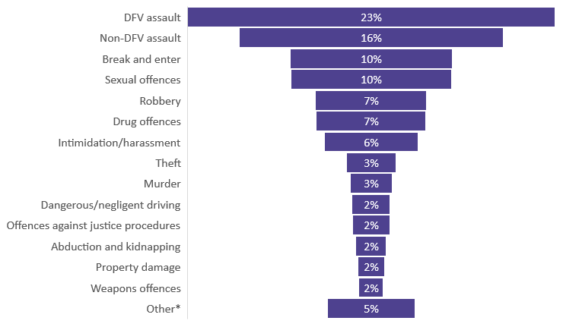
Custody: Aboriginal adults
DFV accounts for a substantial proportion of Aboriginal people in custody.
Most serious offence for Aboriginal adults in custody on remand:
23% DFV assault (288 persons)
34% any DFV offence (433 persons)
The number of Aboriginal adults in remand for a DFV assault increased 22% from 31 Dec 2020 to 31 Dec 2021.
NSW adult Aboriginal remand^ custody population, most serious offence, 31 December, 2021
NSW adult Aboriginal remand^ custody population with DFV assault as most serious offence, 31 Dec 2018 to 31 Dec 2021
^ Total Aboriginal adult remand population 31 December 2021 n=1,258
* ‘Other’ includes fraud, homicide, public order offences, other acts intended to cause injury, traffic offences, unknown and miscellaneous
Notes:
Source: NSW Bureau of Crime Statistics and Research (2022). Unpublished Custody statistics Ref kf22-21259
Note:
Count of unique persons in custody on 31 December 2021.

Slide 32
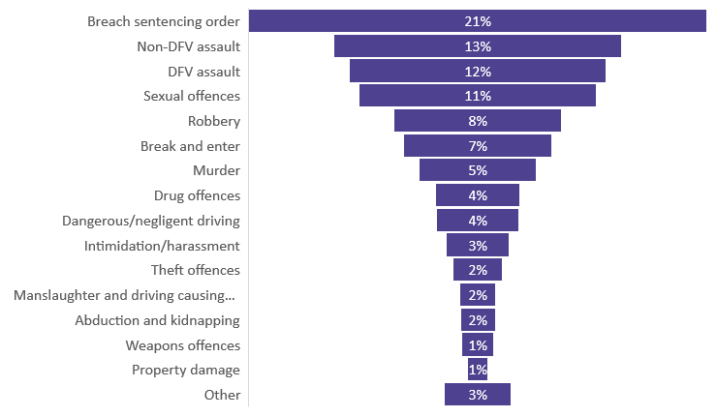
Custody: Aboriginal adults
Most serious offence for sentenced Aboriginal adults in custody:
12% DFV assault (250 persons)
19% any DV offence (400 persons)
NSW adult Aboriginal sentenced^ custody population, most serious offence, 31 December, 2021
There has been little change year-on-year in the number of Aboriginal adults in sentenced custody for a DFV assault from, 31 Dec 2018 to 31 Dec 2021.
NSW adult Aboriginal sentence^ custody population with DFV assault as most serious offence, 31 Dec 2018 to 31 Dec 2021
^ Total Aboriginal adult sentenced population 31 December 2021 n=2,088
* ‘Other’ includes fraud, other homicide, public order offences, traffic offences, unknown and miscellaneous and other acts intended to cause injury
Notes:
Source: NSW Bureau of Crime Statistics and Research (2022). Unpublished custody statistics Ref kf22-21259
Note:
Count of unique persons in custody on 31 December 2021.

Slide 33
Taking a closer look at DFV assault by Aboriginal young offenders (age 10 - 17 years)
Rate of reoffending
Relationship to victim
Offending history
Methods proceeded against by police
Court outcomes & penalties

Slide 34
DFV offending & reoffending: Aboriginal young people
8% of Aboriginal DV assault young offenders assaulted more than one victim during the incident.
23% reoffend with another DFV assault within 12 months.
Male young people had a slightly higher rate of reoffending.
Aboriginal young offenders of DFV by gender and reoffending rate
July 2018 – June 2019 cohort
Notes:
Source: NSW Bureau of Crime Statistics and Research (2020). Unpublished data.
Ref: mr 21-198630.csv POI Cohort July 2018 to June 2019. Unique POI records with reference offence between July 2018 to June 2019.
Notes:
*‘Offender’ is used to refer to a person of interest legally proceeded against by the NSW Police Force for a domestic violence related assault, as applied in the Premier’s Priority to reducing domestic violence reoffending.
Young people includes persons aged 10-17 years

Slide 35
Relationship to victim: Aboriginal young people
Relationship to victim
62% of Aboriginal DFV assault young offenders commit the offence against a
family member
29% of assault victims are a parent
or child
Aboriginal DFV assault young offenders, relationship to victim July 2018 - June 2019 cohort
Excludes missing relationship status.
Notes:
Source: Ref: mr 21-198630.csv POI Cohort July 2018 to June 2019. Unique POI records with reference offence between July 2018 to June 2019.
Notes:
*‘Offender’ is used to refer to a person of interest legally proceeded against by the NSW Police Force for a domestic violence related assault as applied in the Premier’s Priority to reducing domestic violence reoffending.
Definition: Intimate partner: Current partner (husband/wife/defacto), Previous partner (husband/wife/defacto), Boyfriend/girlfriend/ex-boyfriend/ex-girlfriend
Family member: Parent, child, sibling, other family member
Other domestic relationship: person in authority, household member, carer and other (e.g. ex partner of current partner).
Based on first incident in the reference period. Excludes missing relationship status.
Young people includes persons aged 10-17 years

Slide 36

Offending history: Aboriginal young people
A high proportion of Aboriginal young offenders have a prior history of contact with the criminal justice system
46% Any prior proven court appearance for any offence type in past 2 years
23% Prior proven court appearance for DFV offence in past 2 years
14% Prior proven court appearance for DFV assault offence in past 2 years
Prior proven offending of Aboriginal DFV assault young offenders July 2018 - June 2019 cohort
Notes:
Source: NSW Bureau of Crime Statistics and Research (2020). File ref: mr 21-198630.csv
POI Cohort July 2018 to June 2019. Unique POI records with reference offence between July 2018 to June 2019.
Notes:
*‘Offender’ is used to refer to a person of interest legally proceeded against by the NSW Police Force for a domestic violence related assault as applied in the Premier’s Priority to reducing domestic violence reoffending.
Young people includes persons aged 10-17 years

Slide 37

Police legal proceedings: Aboriginal young people
Method of police proceeding against Aboriginal young people for DFV assault event
73% proceeded against to court
24% received a caution
4% were proceeded against to Youth Justice Conferencing
Aboriginal DFV assault young offenders*, method proceeded against, Jan- Dec 2021
Notes:
Source: NSW Bureau of Crime Statistics and Research (2022). Unpublished recorded crime statistics Ref kf22-21259
Notes:
*‘Offender’ is used to refer to a person of interest (POI) legally proceeded against by the NSW Police Force for a domestic violence related assault.
POIs are not a count of unique offenders. Where an individual is involved in multiple criminal events throughout the year they will appear as a POI multiple times.
Young people includes persons aged 10-17 years

Slide 38

Court outcome & penalties: Aboriginal young people
Court outcomes & penalties for Aboriginal DFV assault^ young defendants
70% were guilty of at least one charge
13% withdrawn by prosecution
Of the Aboriginal young offenders with a DV assault as principal proven offence
42% offenders received a supervised order as a penalty
2% offenders received a custodial penalty
Principal court penalty for Aboriginal DFV assault young offenders Jan to Dec 2021
^ Disposal includes DV assault charge
Notes:
Source: NSW Bureau of Crime Statistics and Research (2022). Criminal Court statistics. Ref kf22-21259
Notes:
The persons included in the chart above are not a count of unique people. Each person appears only once for each finalised proven court appearance but if a person has more than one finalised proven court appearance in the reference period they will appear in the table multiple times.
Young people includes persons aged 10-17 years

Slide 39
Summary
There is a need to address both family violence and intimate partner violence.
The volume of DFV is largely in regional/rural areas, where the victim and offender are both Aboriginal.
IPV victimisation is rarely an isolated occurrence for Aboriginal women victims – most have a prior experience of DFV victimisation reported to police within the past 10 years.
Criminal proceedings commenced against a perpetrator for 75% of incidents of DV assault against adult female Aboriginal victims.
Many adult Aboriginal DFV assault offenders had multiple contacts with the criminal justice system:
  46% had a DFV related proven offence in the past 5 years
  43% had a previously received a prison sentence (for any offence type) .
  16% reoffended with a DFV assault within 12 months
Almost one in four Aboriginal adults in remand had DFV assault as their most serious charge.

Slide 40


For more information
www.bocsar.nsw.gov.au

