Slide 1
Can traineeships reduce recidivism?
Winter seminar series
Session 3
Thursday, 19 August 2021

Slide 2
Introduction

Slide 3

Introduction
In this study, we set out to answer the following research question:
“What is the relationship between participating in a prison-based traineeship and recidivism?”
Why did we study traineeships?
Research indicates a link between obtaining post-release employment and a reduction in recidivism.
But ex-inmates face barriers to finding a job (low education, sporadic work history, stigma).

Slide 4
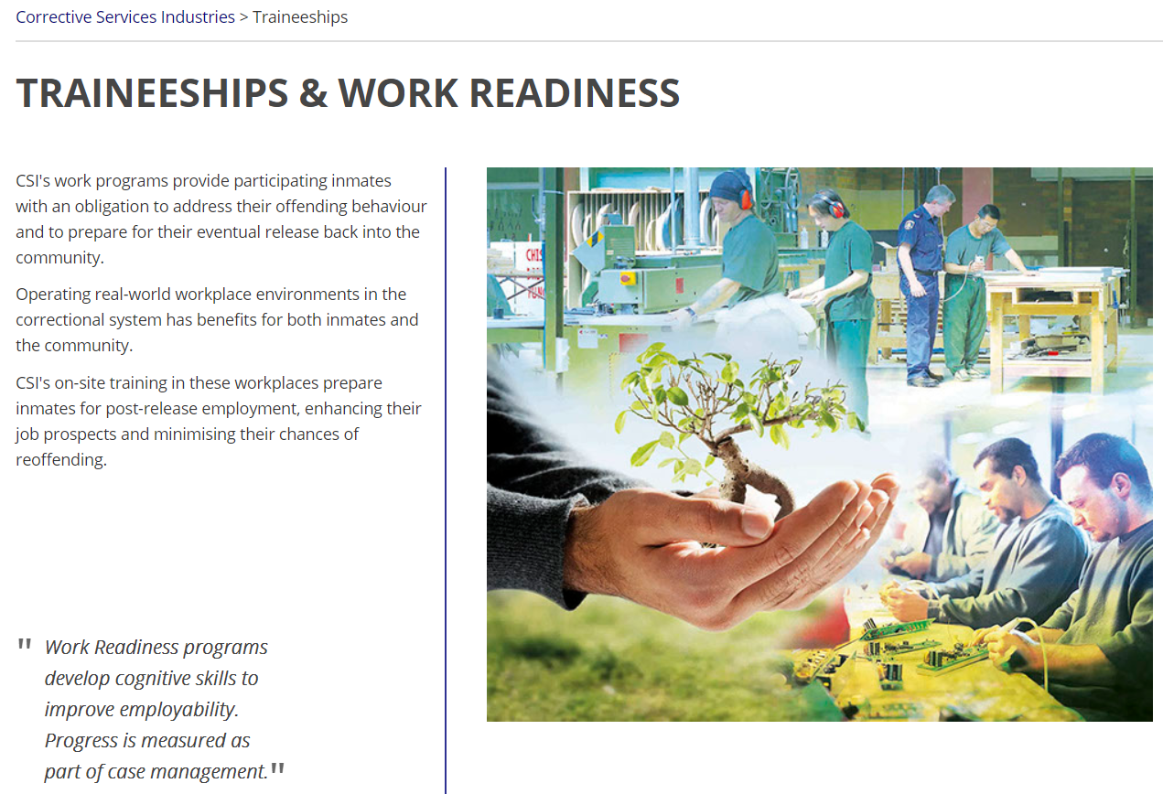

What is a traineeship?

Slide 5
Research design

Slide 6
Research design
How do we measure recidivism?
There are four outcomes measured within 12 or 24 months of release from prison:
‘Re-conviction’: the probability of committing a new, proven offence;
‘Premier’s priority’: the probability of committing a personal, property, or serious drug offence (PPD);
Property offending: the probability of committing a new and proven property offence, and;
‘Re-imprisonment’: the probability of being sentenced to prison at re-conviction.

Slide 7
Research design
Our aim is to measure how traineeship participation alone impacts these four measures of recidivism.
But there are other risk factors that predict recidivism (prior criminal history, prosocial attitudes, social networks, etc).
And, each individual inmate has a unique mix of these factors.
How do we account for these other factors?
A thought experiment. Compare recidivism between two groups of identical inmates, except one group participates in the traineeship and the other does not.

Slide 8


Research design
Impact of traineeships
Difference in recidivism
Trainees group.
What % re-offended within 12 months of release?
Comparison group.
What % re-offended within 12 months of release?

Slide 9
Research design
In practice, inmates are carefully screened to participate in a traineeship.
Inmates must satisfy a range of eligibility criteria.
Pass an interview and successfully complete a placement trial.
Consequently, trainees are different to the rest of the inmate population.
This complicates the estimation of the relationship between traineeship participation and recidivism.

Slide 10
Research design
Statistical model.
Our solution was to adjust for as many factors as possible (demographics, prior offending history, and so on).
The analysis included a variety of regression model specifications to find the ‘adjusted’ difference in recidivism.
Data.
NSW CRES provided data on every traineeship participant released from prison between 2010 and 2019.
This was combined with BOCSARs Re-offending Database, which includes a wide variety of factors to adjust for in the statistical modelling.

Slide 11
Results

Slide 12
Results: Full dataset
No difference
Trainees are less likely to re-offend

Slide 13
Results: Aboriginal trainees
No difference
Trainees are less likely to re-offend

Slide 14
Results: Non-Aboriginal trainees
No difference
Trainees are less likely to re-offend

Slide 15
Results: Males older than 40
No difference
Trainees are less likely to re-offend

Slide 16
Results: Trainees released in Sydney metro
No difference
Trainees are less likely to re-offend

Slide 17
Results: Trainees with an LSI-R of Medium or above
No difference
Trainees are less likely to re-offend

Slide 18
Results: Trainees with an LSI-R below Medium
No difference
Trainees are less likely to re-offend

Slide 19
Results
Additional results:
Trainees were also less likely to re-offend 24 months after release from prison.
But, male trainees aged 40 or below were not less likely to re-offend.
Trainees from a socioeconomically disadvantaged background were not less likely to re-offend.

Slide 20
Summary

Slide 21
Summary
Trainees are less likely to re-offend, particularly for Premier’s priority offences (16.5%) and property offences (45.13%).
Why does participating in a traineeship reduce recidivism?
Does it help ex-inmates find steady employment/income?
Does further education improve their cognitive ability?
However, it is possible that there remain differences between the two groups.
These findings should be interpreted as an associative relationship.

Slide 22
THANK YOU
The full report is available at the BOCSAR website
GET IN TOUCH
Henry Deane Building
20 Lee St, Sydney NSW 2000
Acknowledgements
(02) 8346 1100
CSI (Rachael Harper), NSW CRES (Simon Corben), Anne-Marie Martin, Leon Taylor, Luke Grant, and Joanna Wang.
bcsr@justice.nsw.gov.au
https://www.bocsar.nsw.gov.au/
@BOCSAR

