Slide 1

What is behind the fall in the number of Aboriginal young people in custody?
Donnelly, Ramsey, Poynton & Fitzgerald (2021)

Slide 2
Introduction
Young Aboriginal people are significantly overrepresented in prisons across Australia.
In 2019 the incarceration rate for Aboriginal young people in NSW was 20 times higher than the rate for non-Aboriginal young people (19.7 vs. 1.5 per 10,000 persons; AIHW, 2020).
Since 2015 there has been a steady decline in the number of Aboriginal young people in custody in NSW.

Slide 3
Composition of the Aboriginal youth custody population
Both the Aboriginal remand and sentenced populations declined significantly over this period.
The Aboriginal monthly remand population dropped from 87 in 2015 to 69 in 2019 (5.9%) and the Aboriginal sentenced population dropped from 73 in 2015 to 52 in 2019 (8.2%).
The non-Aboriginal sentenced population decreased BUT the remand population increased by 6.7%.

Slide 4
Trends in receptions and discharges for Aboriginal young people
 |  | 2015 | 2016 | 2017 | 2018 | 2019 | 60-month trend
Receptions | Total | 1,495 | 1,366 | 1,530 | 1,563 | 1,490 | Stable
 | Remand | 1,387 | 1,304 | 1,485 | 1,503 | 1,436 | Stable
 | Sentenced | 108 | 62 | 45 | 60 | 54 | -15.90%
Discharges | Total | 1,498 | 1,379 | 1,543 | 1,544 | 1,512 | Stable
 | Remand | 1,186 | 1,086 | 1,299 | 1,313 | 1,320 | 2.70%
 | Sentenced | 312 | 293 | 244 | 231 | 192 | -11.40%
No change in the total number of Aboriginal young people received into custody on remand (almost all young people enter custody on remand)
Custodial receptions directly into sentenced custody are infrequent, but fell for Aboriginal young people
Increased number of remandees being released
Fall in sentence discharges largely reflects the fall in sentenced receptions

Slide 5
Length of time spent in custody (discharges)
Significant increase in the percentage of young Aboriginal people who spent one day or less on remand from 51.8% in 2015 to 61.3% in 2019
Excluding those who spent 1 day or less on remand no change in median length of stay for Aboriginal remandees
No change in median days spent in sentenced custody

Slide 6
So between 2015 and 2019:
Sentenced population 8.2%
Remand population 5.9%
Receptions (remand) Stable
Remand discharges 2.7%
Short-term remand 7.1%
Time in custody Stable
Total custody population 6.9%

Slide 7

Understanding the decline

Slide 8
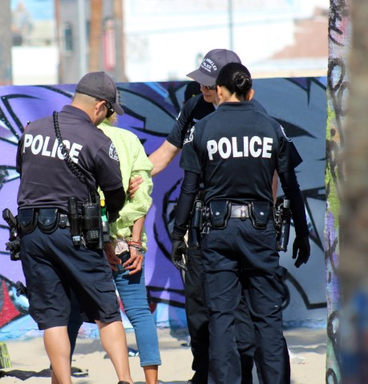
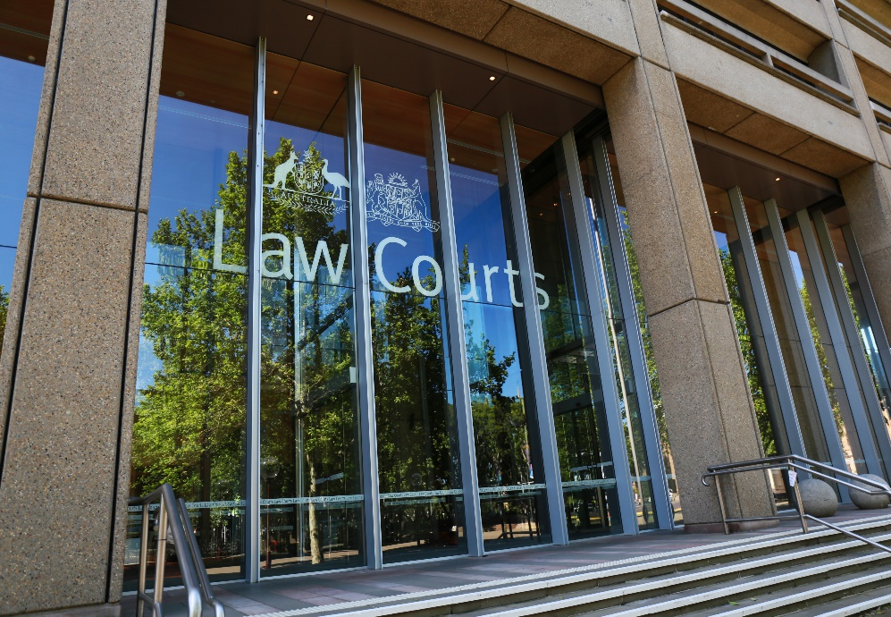

  ARREST RATES
  Young people proceeded against by the police
  Seriousness of young people’s offending
  BAIL
  Bail refusal by police and courts
  Bail revocations
SENTENCING
  Sentences imposed by the courts
TOTAL CUSTODY POPULATION

Slide 9
Arrest rates

Slide 10
Are fewer Aboriginal young people being arrested?
YES
Significant downward trend in Aboriginal young people proceeded against by police (drop of 2.6%)
Decline mostly due to fewer young people proceeded against to court (drop of 2.5%)
No change in number of young Aboriginal people being diverted through cautions or YJCs

Slide 11
Are Aboriginal young people committing less serious offences?
YES
Break and enter had the largest decline over the 5-year period (7.4% decline).
Significant declines also for property damage offences (down 8.3%) and Traffic offences (down 13%).
No change in trends in other high volume offence categories such as assault, robbery, other theft and offences against justice procedures.

Slide 12
Bail

Slide 13
Are fewer Aboriginal young people being refused bail?
NO (at least for PBR)
Significant increase in % of young Aboriginal people refused bail by police; increasing by 5.3%.
Volume of Aboriginal young people bail refused by police rose by 2.9%, despite overall decline in charges.
No change in the number or rate of bail refusal by the courts.

Slide 14
Are fewer Aboriginal young people having their bail revoked?
YES
Steady increase (6.4%) in the number of established bail breaches for Aboriginal young people (similar trends seen for non-Aboriginal young people).
BUT while police are detecting more bail breaches the proportion of these breaches resulting in bail revocation has fallen.
Overall a decrease (6.4%) in the number of Aboriginal young people that have had their bail revoked

Slide 15
Sentencing

Slide 16
Are fewer Aboriginal young people being sentenced to control orders?
YES
Proven finalisations significantly declined from 2,896 in 2015 to 2,198 in 2019
Significant decline in the number of Aboriginal young people sentenced to a control order from 404 in 2015 to 221 in 2019.
Importantly the % of Aboriginal young people sentenced to a control order also significantly declined from 14.0% in 2015 to 10.1% to 2019
Interestingly, similar changes in proven finalisations or sentencing outcomes not apparent for non-Aboriginal young people

Slide 17
Are Aboriginal young people being sentenced for less serious offences?
YES
Decline in proven court appearances for property offences and robbery but no change in % with a control order.
Decline in proven court appearances for breach of a community-based orders AND also significant decline in the percentage of young people who received a control order (from 15.8% to 5.7%).
No change in control orders for other offences or for non-Aboriginal young people.

Slide 18
Conclusion

Slide 19
Key findings for Aboriginal young people
Downward trend in;
the number in remand (by 5.9%) and sentenced custody (by 8.2%);
the number proceeded against to court by police;
the number sentenced to a control order (due to fewer convicted in court and a fall in the % receiving a control order).
Upward trend in;
the number and % refused bail by police BUT no change in court bail refusal rates;
the % in short-term remand (due to higher police bail refusal rates);
the number of bail breaches BUT a fall in bail revocations.
Conclusion: Recent drop in the number of young Aboriginal people in custody due to both a decline in the number of Aboriginal young people appearing in court and fewer control orders being imposed.

Slide 20
Discussion
Drop in serious offending and control orders for Aboriginal young people encouraging.
BUT increased police bail refusal rates has resulted in more short-term remand episodes for Aboriginal young people. This appears to be largely due to increases in bail breaches.
Unable to determine whether more young people are failing to comply with their bail conditions or, alternatively, whether police are more proactively targeting bail breaches by young people.
Two possible explanations for drop in control orders for Aboriginal young people :
  the establishment of the Youth Koori Court in 2015 (BOCSAR evaluation of the Court has commenced);
  recent efforts to improve the domain knowledge of non-specialist judicial officers through a 3-month rotation program through the Children’s Court.

Slide 21
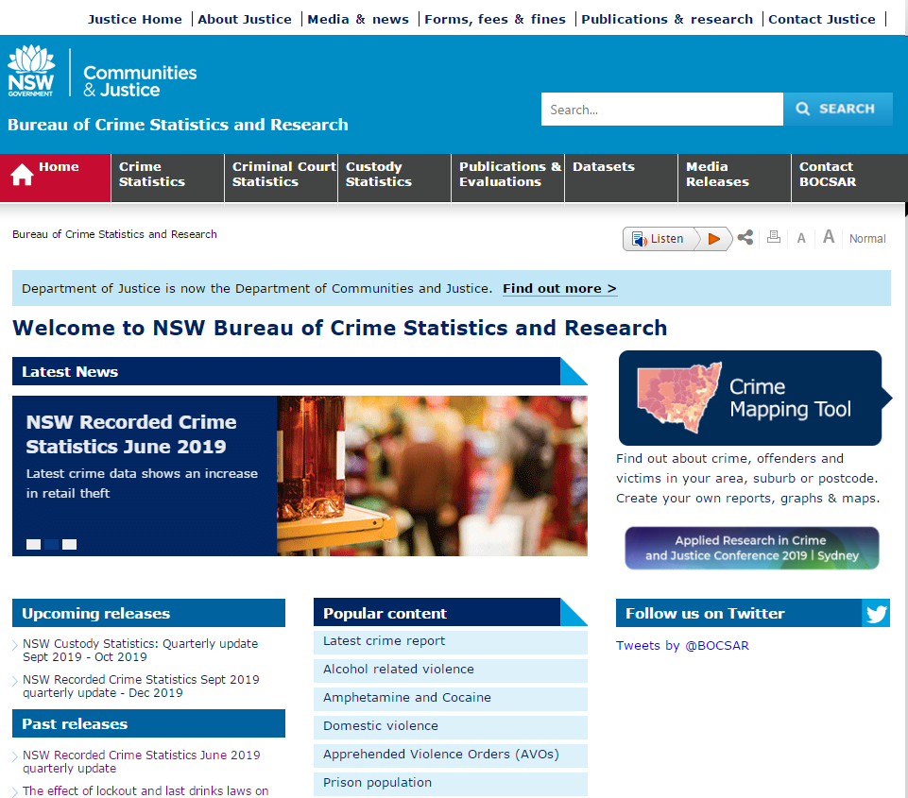
CONTACT BOCSAR
Henry Deane Building
20 Lee St, Sydney NSW 2000
(02) 8346 1100
bcsr@justice.nsw.gov.au
https://www.bocsar.nsw.gov.au/
@BOCSAR

Slide 22
THANK YOU

