Slide 1

The victimisation of people with disability in NSW:
Results from the National Disability Data Asset Pilot
National Disability Data Asset Pilot
NSW Justice Test Case

Slide 2
This work was supported by the Commonwealth Government through the NDDA pilot project.
Project team
Research team NSW Bureau of Crime Statistics and Research (BOCSAR)
Suzanne Poynton (Principal Investigator), Clare Ringland, Stewart Boiteux
Research team Centre Forensic Behavioural Science (CFBS), Swinburne University of Technology
Rachael Fulham, Anne Sophie Pichler, Caleb Lloyd, Margaret Nixon
Aboriginal Perspectives Expert Panel
Deborah Nanschild (Facilitator), Caroline Atkinson (We Al-Li), Damian Griffis (First Peoples Disability Network), Eileen Baldry (UNSW), Peta Macgillivray (Aboriginal Legal Service Board Yuwaya Ngarra-li Partnership), Mark Munnich (Aboriginal Legal Service)
Implementation teams
Celia Walker (NSW DCS), Ana Sartbayeva (DSS), Jo Maning (DSS), Seb Dunne (AIHW), Ximena Camacho (NPT)
Advisory project team members
Julian Trollor (UNSW), Philip Snoyman (NSW Corrective Services)

Slide 3
BACKGROUND
METHOD
QUESTION 1
QUESTION 2
What proportion
of people with
disability are
victims of crime?
What proportion of victims of crime have a disability?
What is the
National Disability
Data Asset Pilot?
How did we
identify people
with disability?

Slide 4


There were two cohorts of interest for this study.
All people in contact with at least one core disability service and support between 2009 and 2018: National Disability Insurance Scheme (NDIS), state-based disability services (pre-NIDS) and Disability Support Pension (DSP).
Disability Cohort
All people who were recorded as a victim of a crime reported to the NSW Police Force.
Victim data were obtained from the NSW Computerised Operational Policing System (COPS) and for this study included incidents that occurred between 2014 and 2018.
Victim Cohort

Slide 5
There were several research questions for each cohort.
What proportion of people with disability are victims of crime?
What factors are associated with an increased risk of a person with disability being a victim of crime?
Disability Cohort
What proportion of victims of crime have a disability?
What are the characteristics of incidents involving people with disability (cf. those with no disability identified)?
Are incidents involving people with disability as likely to result in a person being proceeded against by police?
Are people with disability more likely to experience repeat victimization than people with no disability identified?
Victim Cohort

Slide 6
There were several key research questions for each cohort.
What proportion of people with disability are victims of crime?
What factors are associated with an increased risk of a person with disability being a victim of crime?
Disability Cohort
What proportion of victims of crime have a disability?
What are the characteristics of incidents involving people with disability (cf. those with no disability identified)?
Are incidents involving people with disability less likely to result in a person being proceeded against by police?
Are people with disability more likely to experience repeat victimization than people with no disability identified?
Victim Cohort

Slide 7
BACKGROUND
METHOD
QUESTION 1
QUESTION 2
What proportion
of people with
disability are
victims of crime?
What proportion of victims of crime have a disability?
What is the
National Disability
Data Asset Pilot?
How did we
identify people
with disability?

Slide 8
The final study sample includes records for 1.4 million individuals.
92,370 people (aged 15+ at 31/12/2013)
receiving disability services/supports
AND victims of a crime reported to NSW police
542,388 people
receiving disability
services or supports between 2009-2018
890,138 people
with a victim incident between 2014-2018
17.0% of people with disability were victims of crime

Slide 9

People with disability who are victims of crime: disability type
(%)
1 in 5 people with cognitive or psychosocial disability were a victim of crime between 2014-2018
Nearly 1 in 10 people with cognitive or psychosocial disability were victims of violent crime

Slide 10
People with disability who are victims of crime: Aboriginality
1 in 3 Aboriginal women with disability were a victim of crime within the 5-year period
Aboriginal males also had higher rates of victimisation than non-Aboriginal males and females

Slide 11
People with disability who are victims of crime: Age
Rates of victimisation decreased with increasing age
22% of 15-19 year olds with disability were a victim of crime within the 5-year period
10% of 60-69 year olds with disability were a victim of crime within the 5-year period

Slide 12
BACKGROUND
METHOD
QUESTION 1
QUESTION 2
What proportion
of people with
disability are
victims of crime?
What proportion of victims of crime have a disability?
What is the
National Disability
Data Asset Pilot?
How did we
identify people
with disability?

Slide 13
The final study sample includes records for 1.4 million individuals.
96,112 people receiving disability services/supports
AND victims of a crime reported to NSW police
542,388 people
receiving disability
services or supports between 2009-2018
890,138 people
with a victim incident between 2014-2018
11.0% of all victims of crime were identified with disability

Slide 14

Victims of crime who have a disability
11% - 18% of victims of crime were identified as having a disability
12% - 28% of victims of violent crime were identified as having a disability
15% - 32% of victims of DV crime were identified as having a disability

Slide 15





Victims of crime who have a disability: characteristics of incidents
VIOLENT OFFENCES
RESIDENCE
SOCIOECONOMIC STATUS
Incidents involving people with disability more often violent and DV-related
Victims residing in regional areas more likely to have a disability
Victims residing in areas of greater socioeconomic disadvantage more likely to have a disability
ALCOHOL
ABORIGINALITY
Incidents involving people with disability more likely to be flagged as alcohol related
Aboriginal victims of crime more likely to have a disability

Slide 16
Victims of crime who have a disability: Aboriginality
Using the expanded indicator, in around 40% of incidents involving an Aboriginal victim the victim was identified with disability
This compares with 23% of incidents where the victim was a non-Aboriginal person

Slide 17
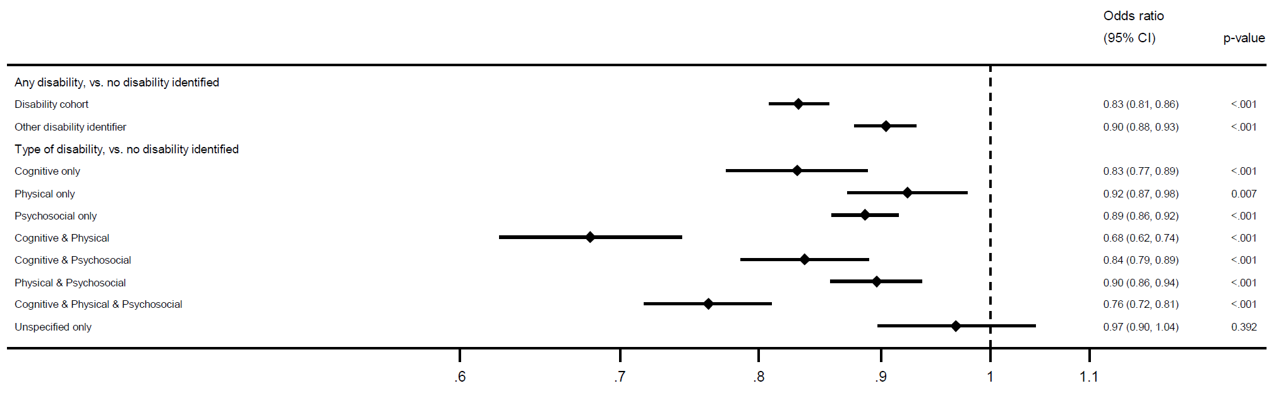
Victims of violent crime who have a disability: police proceedings
38% of incidents involving people in the disability cohort, 42% involving other people with disability, and 43% of those with no disability identified resulted in a POI being proceeded against.
Percentages were lower for incidents involving victims with cognitive disabilities (alone or in combination with other disability types) versus those with physical and/or psychosocial, or unspecified disabilities.
*
Logistic regression model
*Adjusted for year, Aboriginality, age, area of residence, incident type, reporting date, number of victims, number of incidents, prior victimisation, prior offending, prior health contacts

Slide 18
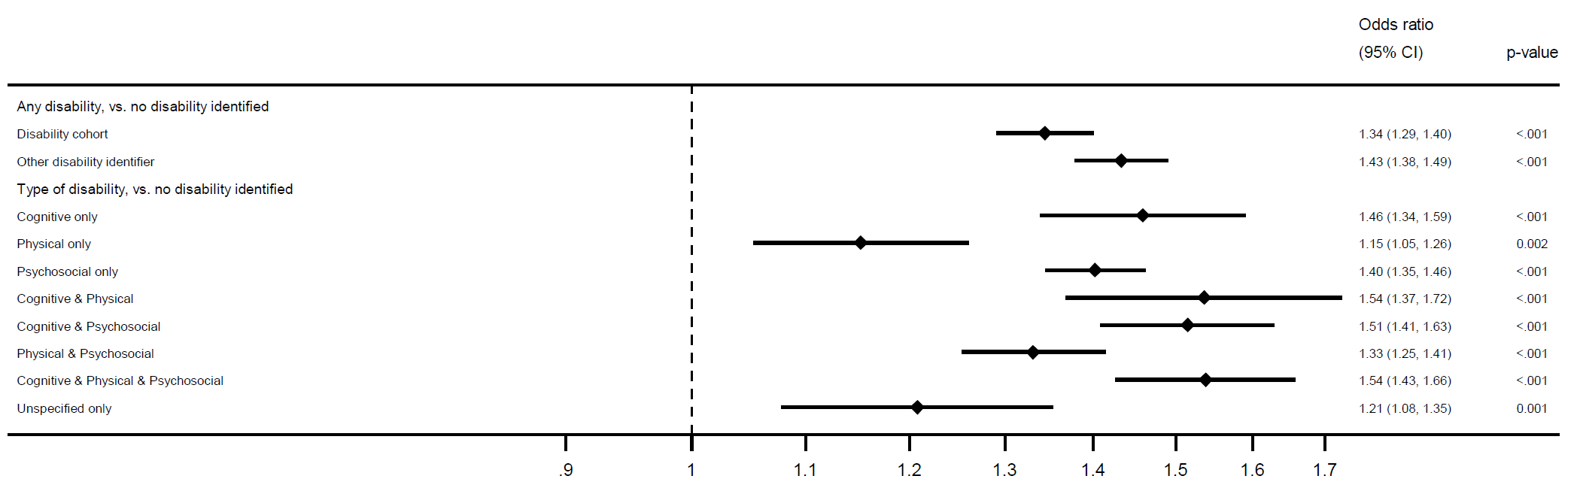
Victims of violent crime who have a disability: revictimisation
Nearly 1 in 5 victims of violent crime who have a disability experienced another incident within 12 months
Rates of violent revictimization highest for those with both cognitive and psychosocial disability (25-26%)
*
Logistic regression model
*Adjusted for year, Aboriginality, age, area of residence, incident type, reporting date, number of victims, number of incidents, prior victimisation, prior offending, prior health contacts

Slide 19
BACKGROUND
METHOD
QUESTION 1
QUESTION 2
What proportion
of people with
disability are
victims of crime?
What proportion of victims of crime have a disability?
What is the
National Disability
Data Asset Pilot?
How did we
identify people
with disability?

Slide 20
QUESTION 1
What proportion of people with disability are victims of crime?
Of all people with disability in NSW:
  17% were a victim of any crime (20% for cognitive/psychosocial disorders)
  7% were a victim of violent crime (9% for cognitive/psychosocial disorders)
  4% were a victim of DV-related crime (5%-6% for cognitive/psychosocial disorders)
Of all Aboriginal people with disability in NSW:
  34% of women were a victim of crime (18% violent, 19% DV related)
  29% of men were a victim of crime (15% violent, 9% DV related)
Of all people with disability aged 15-19 in NSW:
  22% were a victim of crime (13% violent, 8% DV related)

Slide 21
QUESTION 2
What proportion of victims of crime experience disability?
People with disability comprised:
  11%-18% of all victims of crime
  12%-28% of all victims of violent crime
  15%-32% of all victims of DV-related crime
  Around 40% of all Aboriginal victims of crime
Persons of interest were less likely to be proceeded against when incidents involved people with disability (esp. violence)
  Differences in police action rates particularly pronounced for people with both cognitive and physical disabilities.
People with disability more likely to experience violent and DV-related revictimisation
  Those with cognitive and/or psychosocial disabilities at greater risk of revictimisation than those with other or no known disabilities.

Slide 22
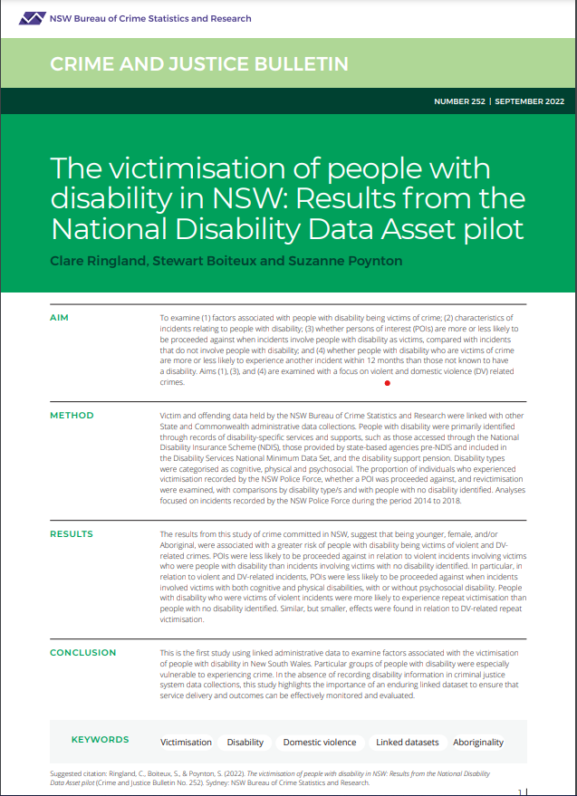
GET IN TOUCH
6 Parramatta Square
Level 5, 10 Darcy St, Sydney NSW 2000
(02) 8346 1100
bcsr@justice.nsw.gov.au
https://www.bocsar.nsw.gov.au/
@BOCSAR
NSWBOCSR

Slide 23
THANK YOU

