Slide 1
Monitoring reports for the NSW Drink and Drug Driving Reforms
BOCSAR Winter Series Presentation
July 2022
Kirsten Sterling, Research and Evaluation Safety Environment and Regulation (SER)
transport.nsw.gov.au

Slide 2
Transport pays respect to Elders past and present, and recognises and celebrates the diversity of Aboriginal peoples and their ongoing cultures and connections to the lands and waters of NSW.
Acknowledgement of Country

Slide 3
Drink and Drug Driving Reforms
Key reform elements
Penalty and suspension notices for first time lower-range* drink & drug offences (May 2019)
Extension of MAIP to mid-range first offenders (December 2018)
Option for vehicle sanctions (December 2018)
*Through the report, lower-range includes low, novice, and special range PCA offences

Slide 4
Evaluation of the Reforms
Monitoring is part of a larger program of work to evaluate implementation and impact
An Evaluation Working Group (EWG) has been formed, with members including staff from across TfNSW and other NSW Government agencies.
The EWG provides input and guidance across all phases of monitoring and evaluation.
  Planned evaluation activities include:
  Operational Review and development of Monitoring & Evaluation Plan (Completed in 2020)
  Process Evaluation (2021-2023)
  Outcome Evaluation (2023-2025)
  Regular monitoring reports (6 month intervals)

Slide 5
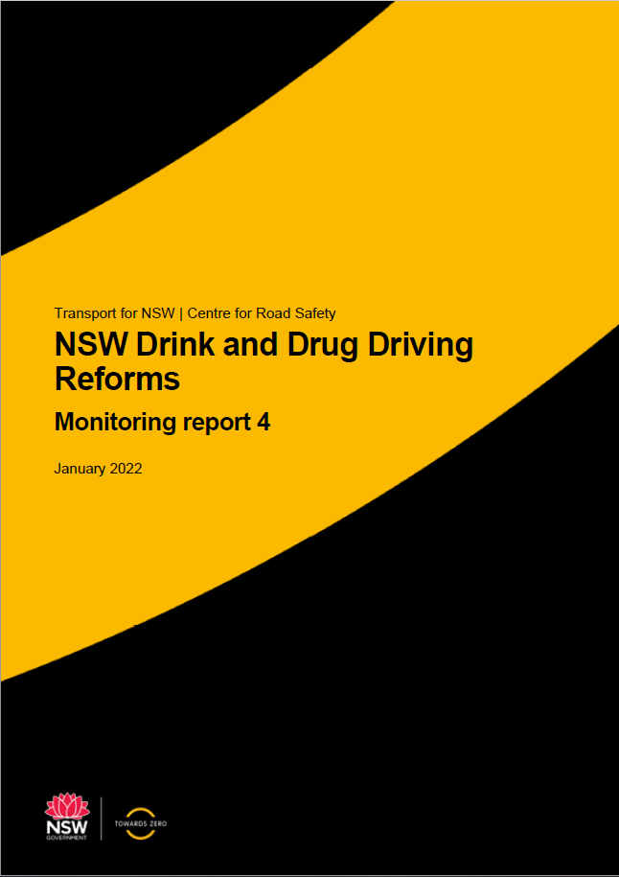
Monitoring approach
Reports bring together data from TfNSW and other NSW Government agencies
  Data sources include TfNSW, BOCSAR, Revenue NSW and NSW Police Force
  Assesses implementation of key areas of the reforms
  Developed to enable ongoing operational improvements and inform future evaluation activities
  Published on CRS website every 6 months
  Will incorporate metrics for new combined offence (commenced 28 June 2021) as they become available

Slide 6
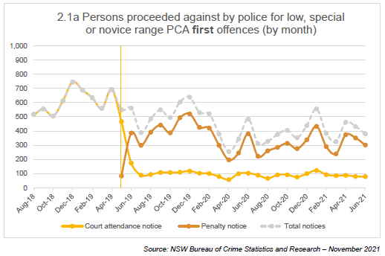
Penalty notices for first-time offences (PCA)
Introduction of penalty notices

Slide 7
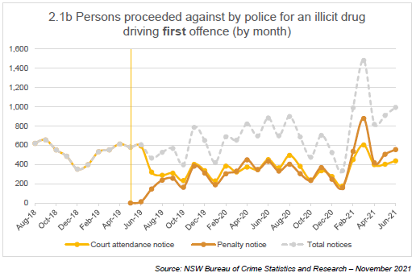
Penalty notices for first-time offences (illicit drug)
Introduction of penalty notices

Slide 8
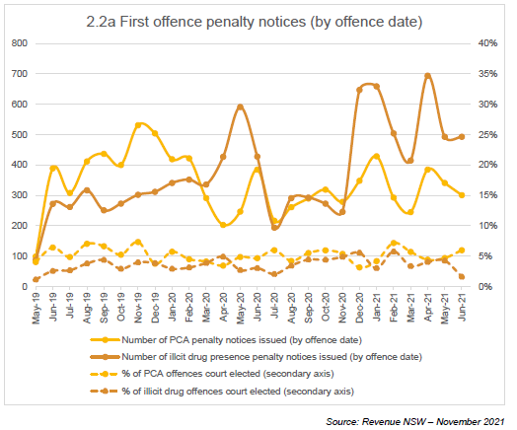
Penalty notices and court elections

Slide 9
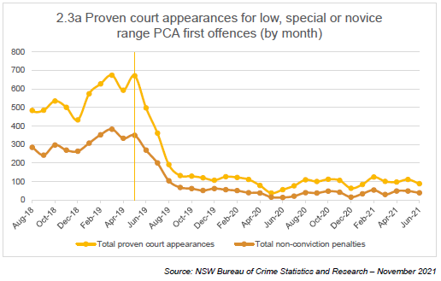
Non-conviction penalties for PCA first offences

Slide 10
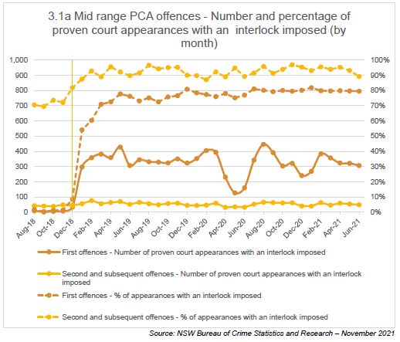
Mid-range PCA and interlock orders
Extension to first offences

Slide 11
Key learnings
Monitoring and evaluation of the reforms
Findings from the earlier monitoring reports were used to inform the Operational Review of the program completed in 2020.
The review found that:
Most reform elements are being implemented as planned. The exception to this is vehicle sanctions for high-risk drink driving offenders.
There are some challenges in gathering data for further phases of evaluation, due to the variety of data systems relied upon and ability to access date from those systems
Next steps
  It is planned that monitoring reports will be produced through 2025.
  Further data sources are being explored and added when possible
  A review of key metrics included in the reports is planned for 2022.

Slide 12
Thank you
Questions?
  Please feel free to contact me: Kirsten.Sterling@transport.nsw.gov.au
  Full reports available at: https://roadsafety.transport.nsw.gov.au/research/reports/index.html

