Slide 1
The Impact of Covid-19 Stay-at-Home Orders on Domestic Violence
Jake Graceffo

Slide 2
Overview
1

Slide 3
Domestic violence: What is it and what does the data show
Domestic violence refers to the behaviours that intend to cause harm or fear often used to intimidate, manipulate or control others.
Prevalence of DV since age 15
1 in 4 women
1 in 8 men
Domestic violence is not always physical and can take multiple forms:
Female victims of DV
Physical
Verbal
Social
Financial/economic
Sexual
Emotional
75% of victims are female
2022-23 deaths from DV
1 woman every 11 days
1 man every 91 days

Slide 4



Domestic violence: Historical overview
DV assaults have been trending upwards
Average annual change of 3 per cent between 2015 and 2025
DV has seasonal trends:
Peaks in summer/holidays
Lows in mid year
Source: BOCSAR (2025)

Slide 5
COVID and domestic violence: Literature
Country | Paper | Findings | Data
Australia | Moslehi et al. (2021) | Increase | Police recorded DV assaults
U.S. | Leslie and Wilson (2020) | Increase | Calls for service
Chile | Bhalotra et al. (2021) | Increase | DV hotline, public shelter occupancy, police reports
U.S. | Bullinger et al. (2021) | Decrease | DV calls for service
India | Ravindran and Shah (2020) | Increase | DV complaints
11 countries | Berniell and Facchini (2021) | Increase | Google DV related searches
Mexico | Hoehn-Velasco et al. (2021) | Decrease | Recorded DV incidents
U.K. | Ivandic et al. (2020) | Increase | Recorded DV incidents and calls for service
U.S. | Miller et al. (2021) | Decrease | DV crime reports and calls for service

Slide 6
Research
2

Slide 7
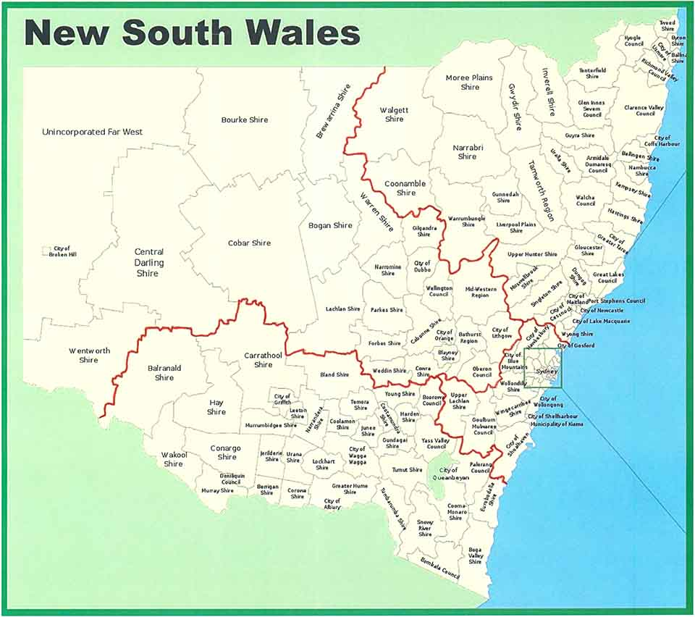
Study and motivation
Research question
The effect of Covid-19 stay-at-home (SAH) orders on domestic violence assaults for NSW.
stay-at-home order of 2021 rather than lockdowns of 2020.
LGA level
daily level
Demographic differences
I use a staggered difference in difference method.
Mixed results from existing literature
Limited research for Australia and NSW
Media articles indicating increases
Motivation

Slide 8
Why just SAH Orders?
2020 Lockdowns
2021 Stay-at-home orders
Most severe lockdown occurred from March 31st, 2020 –April 14th, 2020.
Gatherings of 2 people in public areas
Weddings and funerals
Travel between households of relatives
2021 SAH’s had greater restrictions:
Limited reasons to leave homes
Fines
Weddings halted
Non-essential businesses closed or operating as takeaway
No visitors at households
Working from home if possible

Slide 9
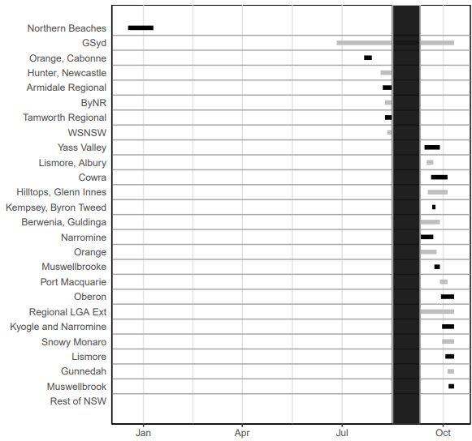
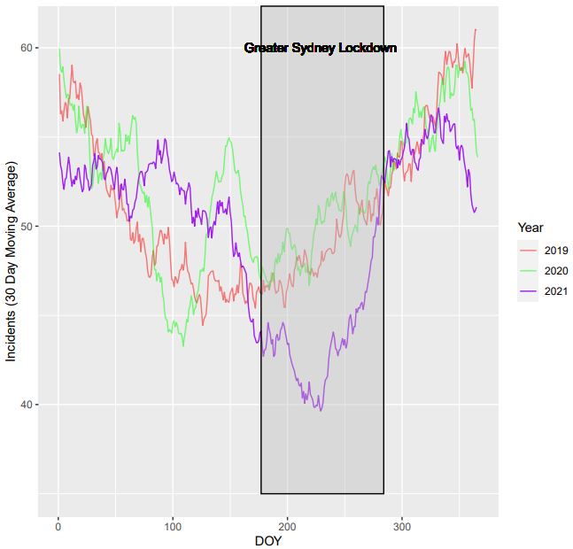
SAH timelines and data

Slide 10
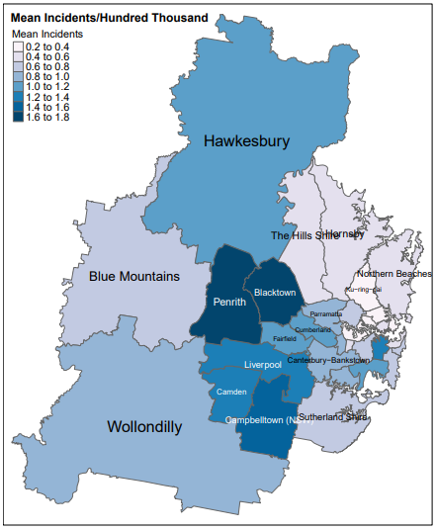
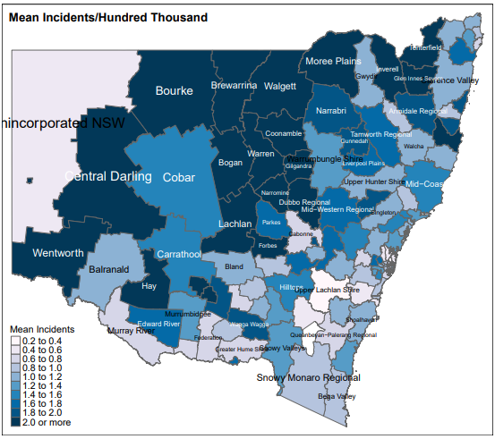
Domestic violence assault data
Daily mean incidents per hundred thousand: Greater Sydney LGAs
Daily mean incidents per hundred thousand: New South Wales LGAs

Slide 11
Results and discussion
3

Slide 12
Results
Domestic violence assaults decrease by 0.33 incidents per 100,000 per day an LGA was subject to SAH orders.
This is equivalent to a 21% decline from pre 2021 baseline incidence levels
As a robustness measure – models at a weekly frequency show an impact of ~7 times the daily result.
 | Daily | Weekly
Effect | -0.330 | -2.212
Baseline* | 1.596 | 11.09
Change (%) | -21% | -20%
Variable | Value
Population | 8,500,000
Impact | -0.33 per hundred thousand
Daily total | -28
Weekly total | -196
*The baseline is the average incidents per day prior to 2021

Slide 13






Why did domestic violence decline?
Various factors may have caused declines in domestic violence:
Household power dynamics
Alcohol consumption
Living situations
Mental aspects
Sporting events
While other factors may have impacted results:
Under reporting

Slide 14
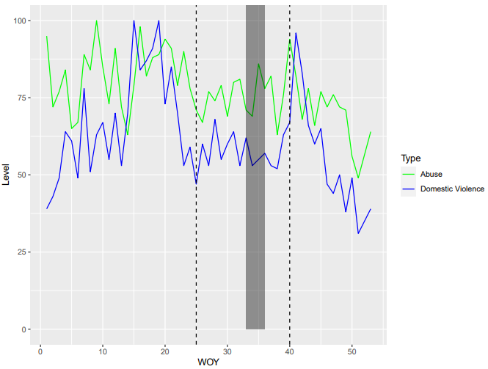
Under reporting
Google trends data used as a proxy.
Terms related to DV remain stable and below pre and post restriction period.
Alleviation of greater Sydney restrictions indicate increases in number of people seeking information or help.
Aligns with reopening of bars and clubs, recommencement of sport etc.
Other relevant search terms reveal similar trends
Google trends data for DV related search terms
Source: Google trends (2022)

Slide 15
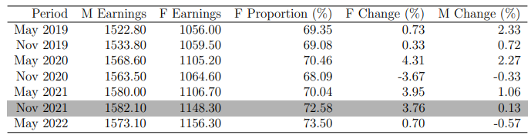
Household power dynamics: Income
Research suggests even marginal increases in female earnings and employment are associated with reductions in DV.
ABS average weekly earnings show:
Female earnings increased 3.76 per cent from May 2021 to November 2021
Potential reasons:
Longer hours in female dominated industries – healthcare
Increased working hours with working from home
Working from home may provided better opportunities to work while caring for children
Weekly earning change May 21 – Nov 21
Female → 3.76%
Male → 0.13%

Slide 16
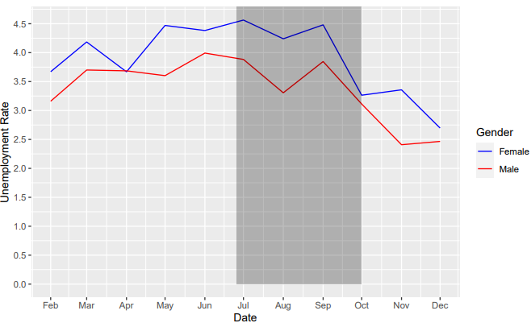
Household power dynamics: Employment
Unemployment rates by gender for individuals in a relationship show support for increased power dynamics.
In the second half of Greater Sydney restrictions, unemployment of females in relationships declined in contrast to male unemployment.
Research shows greater uncertainty in job retention for males can create significant impacts on household power dynamics with males reducing violence due to greater fear of job loss in contrast females.
During SAH orders it is possible males would be unsure of their job retention.
Unemployment rates by gender for individuals in a relationship
Source: ABS (2022)

Slide 17
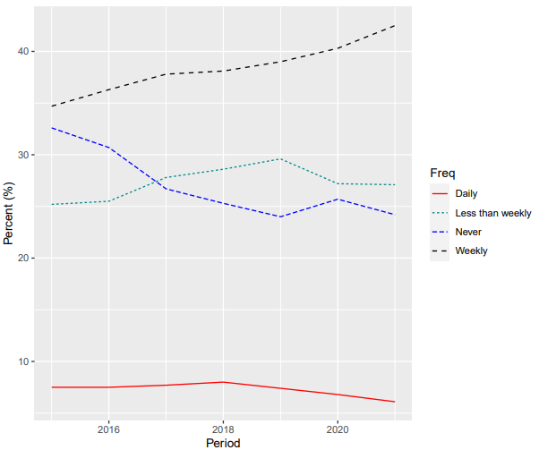
Other factors
Alcohol
Sporting events
There is strong evidence between alcohol and DV.
Alcohol consumption increased at a weekly frequency but declined at a daily frequency. Drive decline in daily DV assaults
Sporting events, both professional and social, have been strongly linked to DV.
Livingston (2018) indicate an approximate 40% increase in DV incidents on days of state of origin events.
With SAH orders seeing both local and professional sporting games cancelled this may be associated with reductions in DV.
Living situations
Another factor associated with DV is risk perceived by the perpetrator
This can include the risk of third-party reporting
With SAH orders in place the chance of third-party reporting could have increased, particularly in high density areas.
Source: Health NSW (2022)

Slide 18
Results
Low income LGA’s saw substantial declines in DV assault compared to high income LGA’s
LGA’s where females make up a larger proportion of total employment saw significant reductions in DV assault.
 | Income level |  | Proportion of female employment
 | Low | High | Low | High
Effect | -1.173 | 0.012 | -0.184 | -0.539
Baseline | 1.596 | 1.596 | 1.596 | 1.596
Change (%) | -60% | 1% | -14% | -29%

Slide 19
What does this mean
While under reporting is a concern evidence suggests this did not impact results.
Several factors may have supported declines in domestic violence assaults:
Government support – JobKeeper payments may have alleviated financial and mental pressures on households
Increased risk of being reported mitigated increased offences
Governments could assess the importance of financial support for mitigating DV.
This could prove critical for understanding how to best alleviate pressures on households and provide support to individuals in violent relationships.
Governments could identify methods to increase risk factor of committing DV offences:
Better reporting methods
Harsher penalties
Consideration:
DV assaults declined but other forms of DV may not have.

