Slide 1

Did a High Court decision on doli incapax shift court outcomes for 10-13 year olds?
Applied Research in Crime and Justice Conference 2025
Jonathan Gu
Senior Data Analyst
  5 August 2025

Slide 2
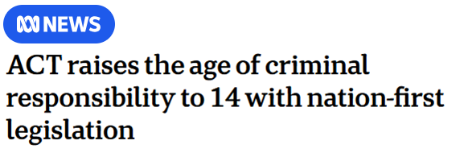
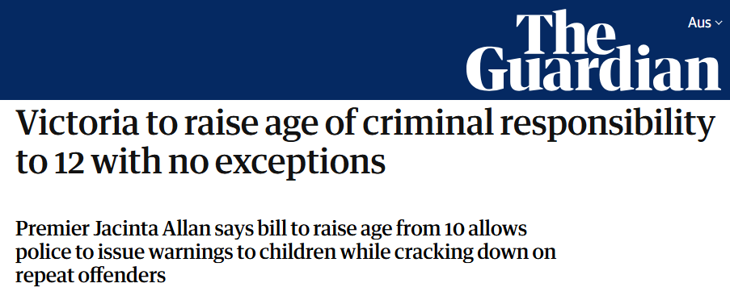
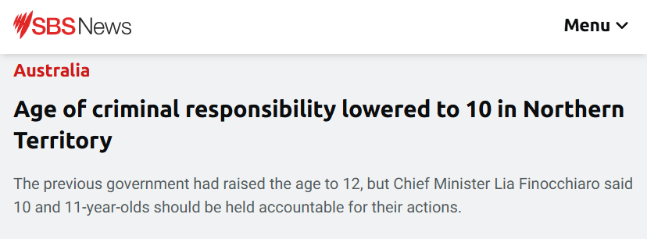
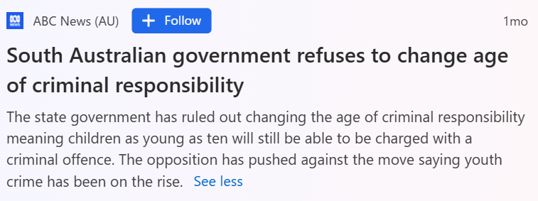

Slide 3
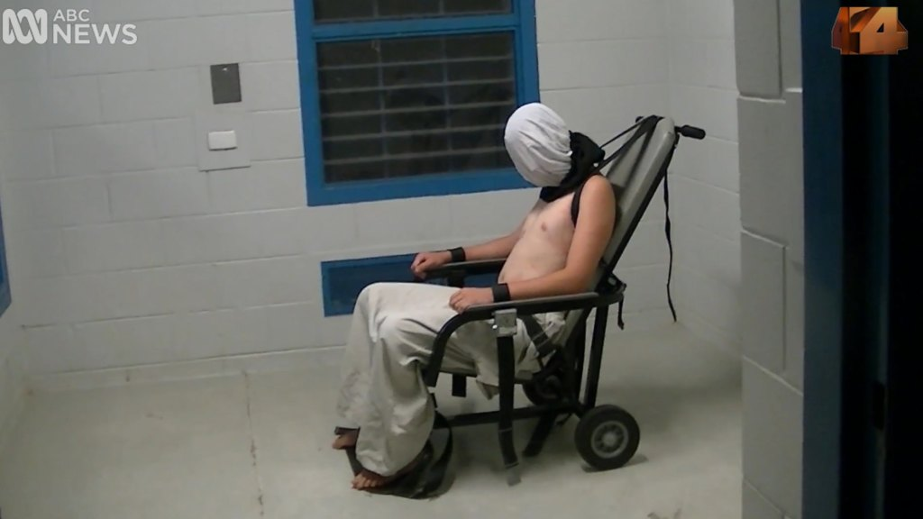
Australia’s
Shame
Australia’s Shame aired on 25 July 2016 and precipitated a national reckoning on youth detention, leading to a Royal Commission and several state-based inquiries into juvenile detention facilities

Slide 4






Doli incapax in NSW
Rebutting doli incapax
Children under 10 years old cannot be found guilty of a criminal offence
Abridged principles from RP v The Queen (Dec 2016)
1. The prosecution must show that the child understood what they were doing was “seriously wrong” rather than being merely naughty
Children aged 10-13 are presumed to be incapable of being criminally responsible by doli incapax, but this can be rebutted by the prosecution
2. The prosecution cannot rebut doli incapax by referring to how the acts in question were “obviously wrong”
3. The prosecution must prove beyond a reasonable doubt that doli incapax does not apply
Children aged 14+ can be found guilty of a criminal offence, and are not protected by doli incapax
We believe that RP may have had the practical effect of making it harder to prosecute 10-13 year olds
4

Slide 5



How could a High Court decision on doli incapax impact outcomes for 10-13 y.o.?
Police officers influence whether court proceedings are initiated against a 10-13 year old
Prosecutors determine whether to proceed to Children’s Court or whether to withdraw charges
Magistrates determine whether the offence has been proven or not proven
Defence lawyers advise their clients on whether to enter a plea of guilty or not guilty

Slide 6
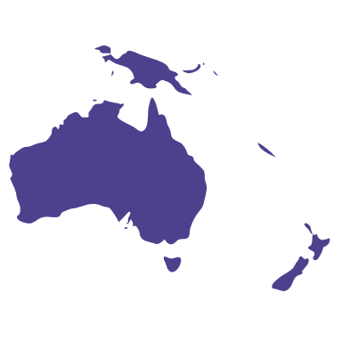
How could a High Court decision on doli incapax impact outcomes for 10-13 y.o.?
Police officers influence whether court proceedings are initiated against a 10-13 year old
Prosecutors determine whether to proceed to Children’s Court or whether to withdraw charges
Magistrates determine whether the offence has been proven or not proven
Defence lawyers advise their clients on whether to enter a plea of guilty or not guilty
While doli incapax is not uniformly applied across the rest of Australia, there should be signs of some national impact from RP

Slide 7
Research questions
How do NSW trends compare to the rest of Australia? Can RP explain national trends?
Are the NSW trends explained by specialist Children’s Court Magistrates?
1
3
5
Did RP influence recent trends in the NSW Children’s Court?
2
Are the NSW trends explained by changes in the offending profile?
4
What are the trends in court penalties imposed on 10-13 year olds?

Slide 8


Datasets
NSW data
Defendants aged 10-13
11 763 cases finalised in the NSW Children’s Court
Outcomes, penalties and demographic variables from the Re-offending Database (ROD) (2010-2023)
Defendants aged 14-17
85 103 cases finalised in the NSW Children’s Court
Comparing trends between defendants aged 10-13 and 14-17
Whole of Australia data
Defendants aged 10-13
23 279 defendants in cases finalised by Children’s Courts across the rest of Australia
ABS Criminal Courts data for Children’s Courts, 2013-14 to 2022-23 financial years
Defendants aged 14-17
162 539 defendants in cases finalised by Children’s Courts across the rest of Australia

Slide 9
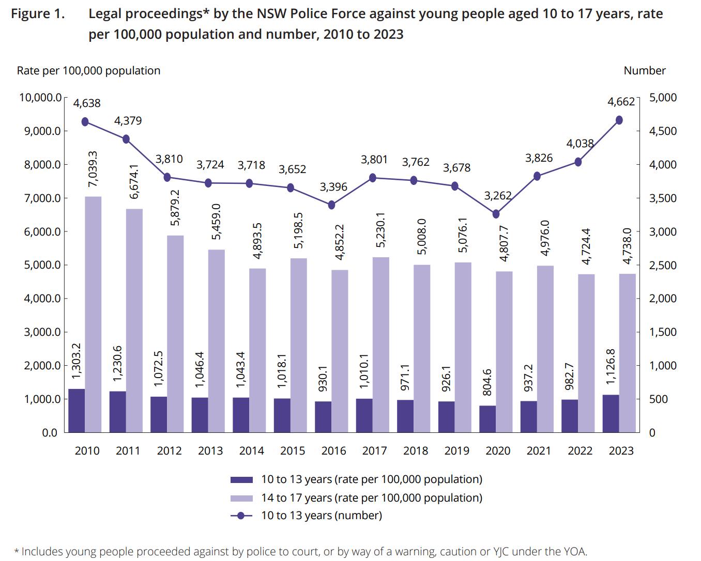
Prior work
The rate of legal proceedings has decreased for 14-17 year olds, while the number and rate of proceedings has increased for 10-13 year olds (Freeman & Donnelly, 2024)

Slide 10
RP and trends in NSW Children’s Court proceedings
1

Slide 11
We would expect RP to have lowered court proceedings with 10-13 year olds …
Expected change in outcomes since 2016 (from RP)
Police officers influence whether court proceedings are initiated against a 10-13 year old
↓ volume of finalised court appearances

Slide 12
But most of the decline in finalisations for 10-13 year olds precedes RP
Volume of finalised court appearances by age of the defendant
Age refers to age at earliest offence date

Slide 13
But most of the decline in finalisations for 10-13 year olds precedes RP
Volume of finalised court appearances by age of the defendant
Age refers to age at earliest offence date

Slide 14
RP is expected to have decreased proven cases for 10-13 year olds
Expected change in outcomes since 2016 (from RP)
Magistrates determine whether the offence has been proven or not proven
↓ proven cases

Slide 15
Proven cases have plummeted for 10-13 year olds
Percent of finalised court appearances that concluded with at least one charge proven

Slide 16
RP is expected to increase withdrawn cases, lower guilty pleas, and increase acquittals
Expected change in outcomes since 2016 (from RP)
↓ proven cases
Magistrates determine whether the offence has been proven or not proven
↑ acquittals (at defended hearings)
Prosecutors determine whether to proceed to Children’s Court or whether to withdraw charges
↑ withdrawn charges
Defence lawyers advise their clients on whether to enter a plea of guilty or not guilty
↓ guilty pleas

Slide 17
The drop has been driven by fewer guilty pleas and more withdrawn cases and acquittals
Detailed outcomes for finalised appearances in the NSW Children’s Court

Slide 18
The drop has been driven by fewer guilty pleas and more withdrawn cases and acquittals
Detailed outcomes for finalised appearances in the NSW Children’s Court

Slide 19
Trends in proceedings with defendants aged 10-13 (NSW vs rest of Australia)
2

Slide 20

RP is expected to have shifted trends in court outcomes in the rest of Australia
Expected change in outcomes since 2016 (from RP)
In the rest of Australia:
Doli incapax is not uniformly applied across the rest of Australia, but there should be signs of a national impact from RP
↓ proven cases
↑ withdrawn charges
but smaller than NSW
The impact of RP should be strongest in NSW, Victoria, and SA, which rely on common law for doli incapax (Moritz & Tuomi, 2023; see also Crofts, 2018)
In Victoria and SA:
↓ proven cases
↑ withdrawn charges

Slide 21
RP is expected to have shifted trends in court outcomes in the rest of Australia
Expected change in outcomes since 2016 (from RP)
In the rest of Australia:
Doli incapax is not uniformly applied across the rest of Australia, but there should be signs of a national impact from RP
↓ proven cases
↑ withdrawn charges
but smaller than NSW

Slide 22
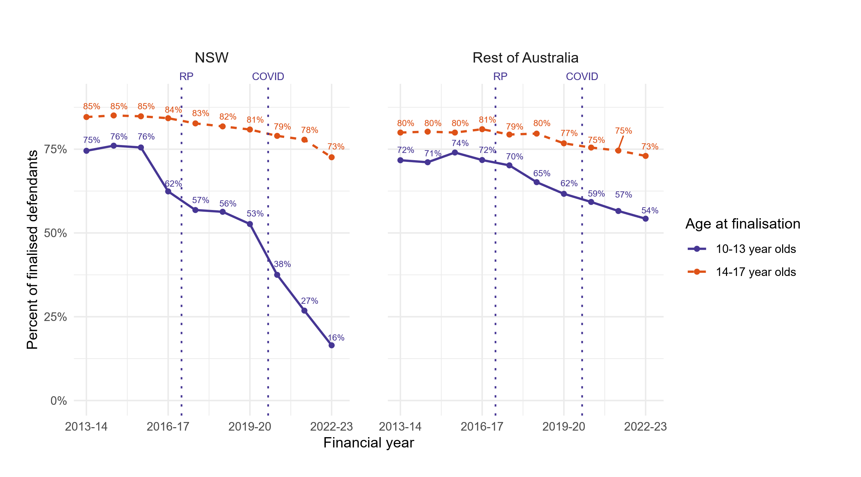
Proven cases have declined across Australia
Percent of finalised defendants with a proven outcome, NSW vs. the rest of Australia
Percent of finalised defendants with a proven outcome

Slide 23
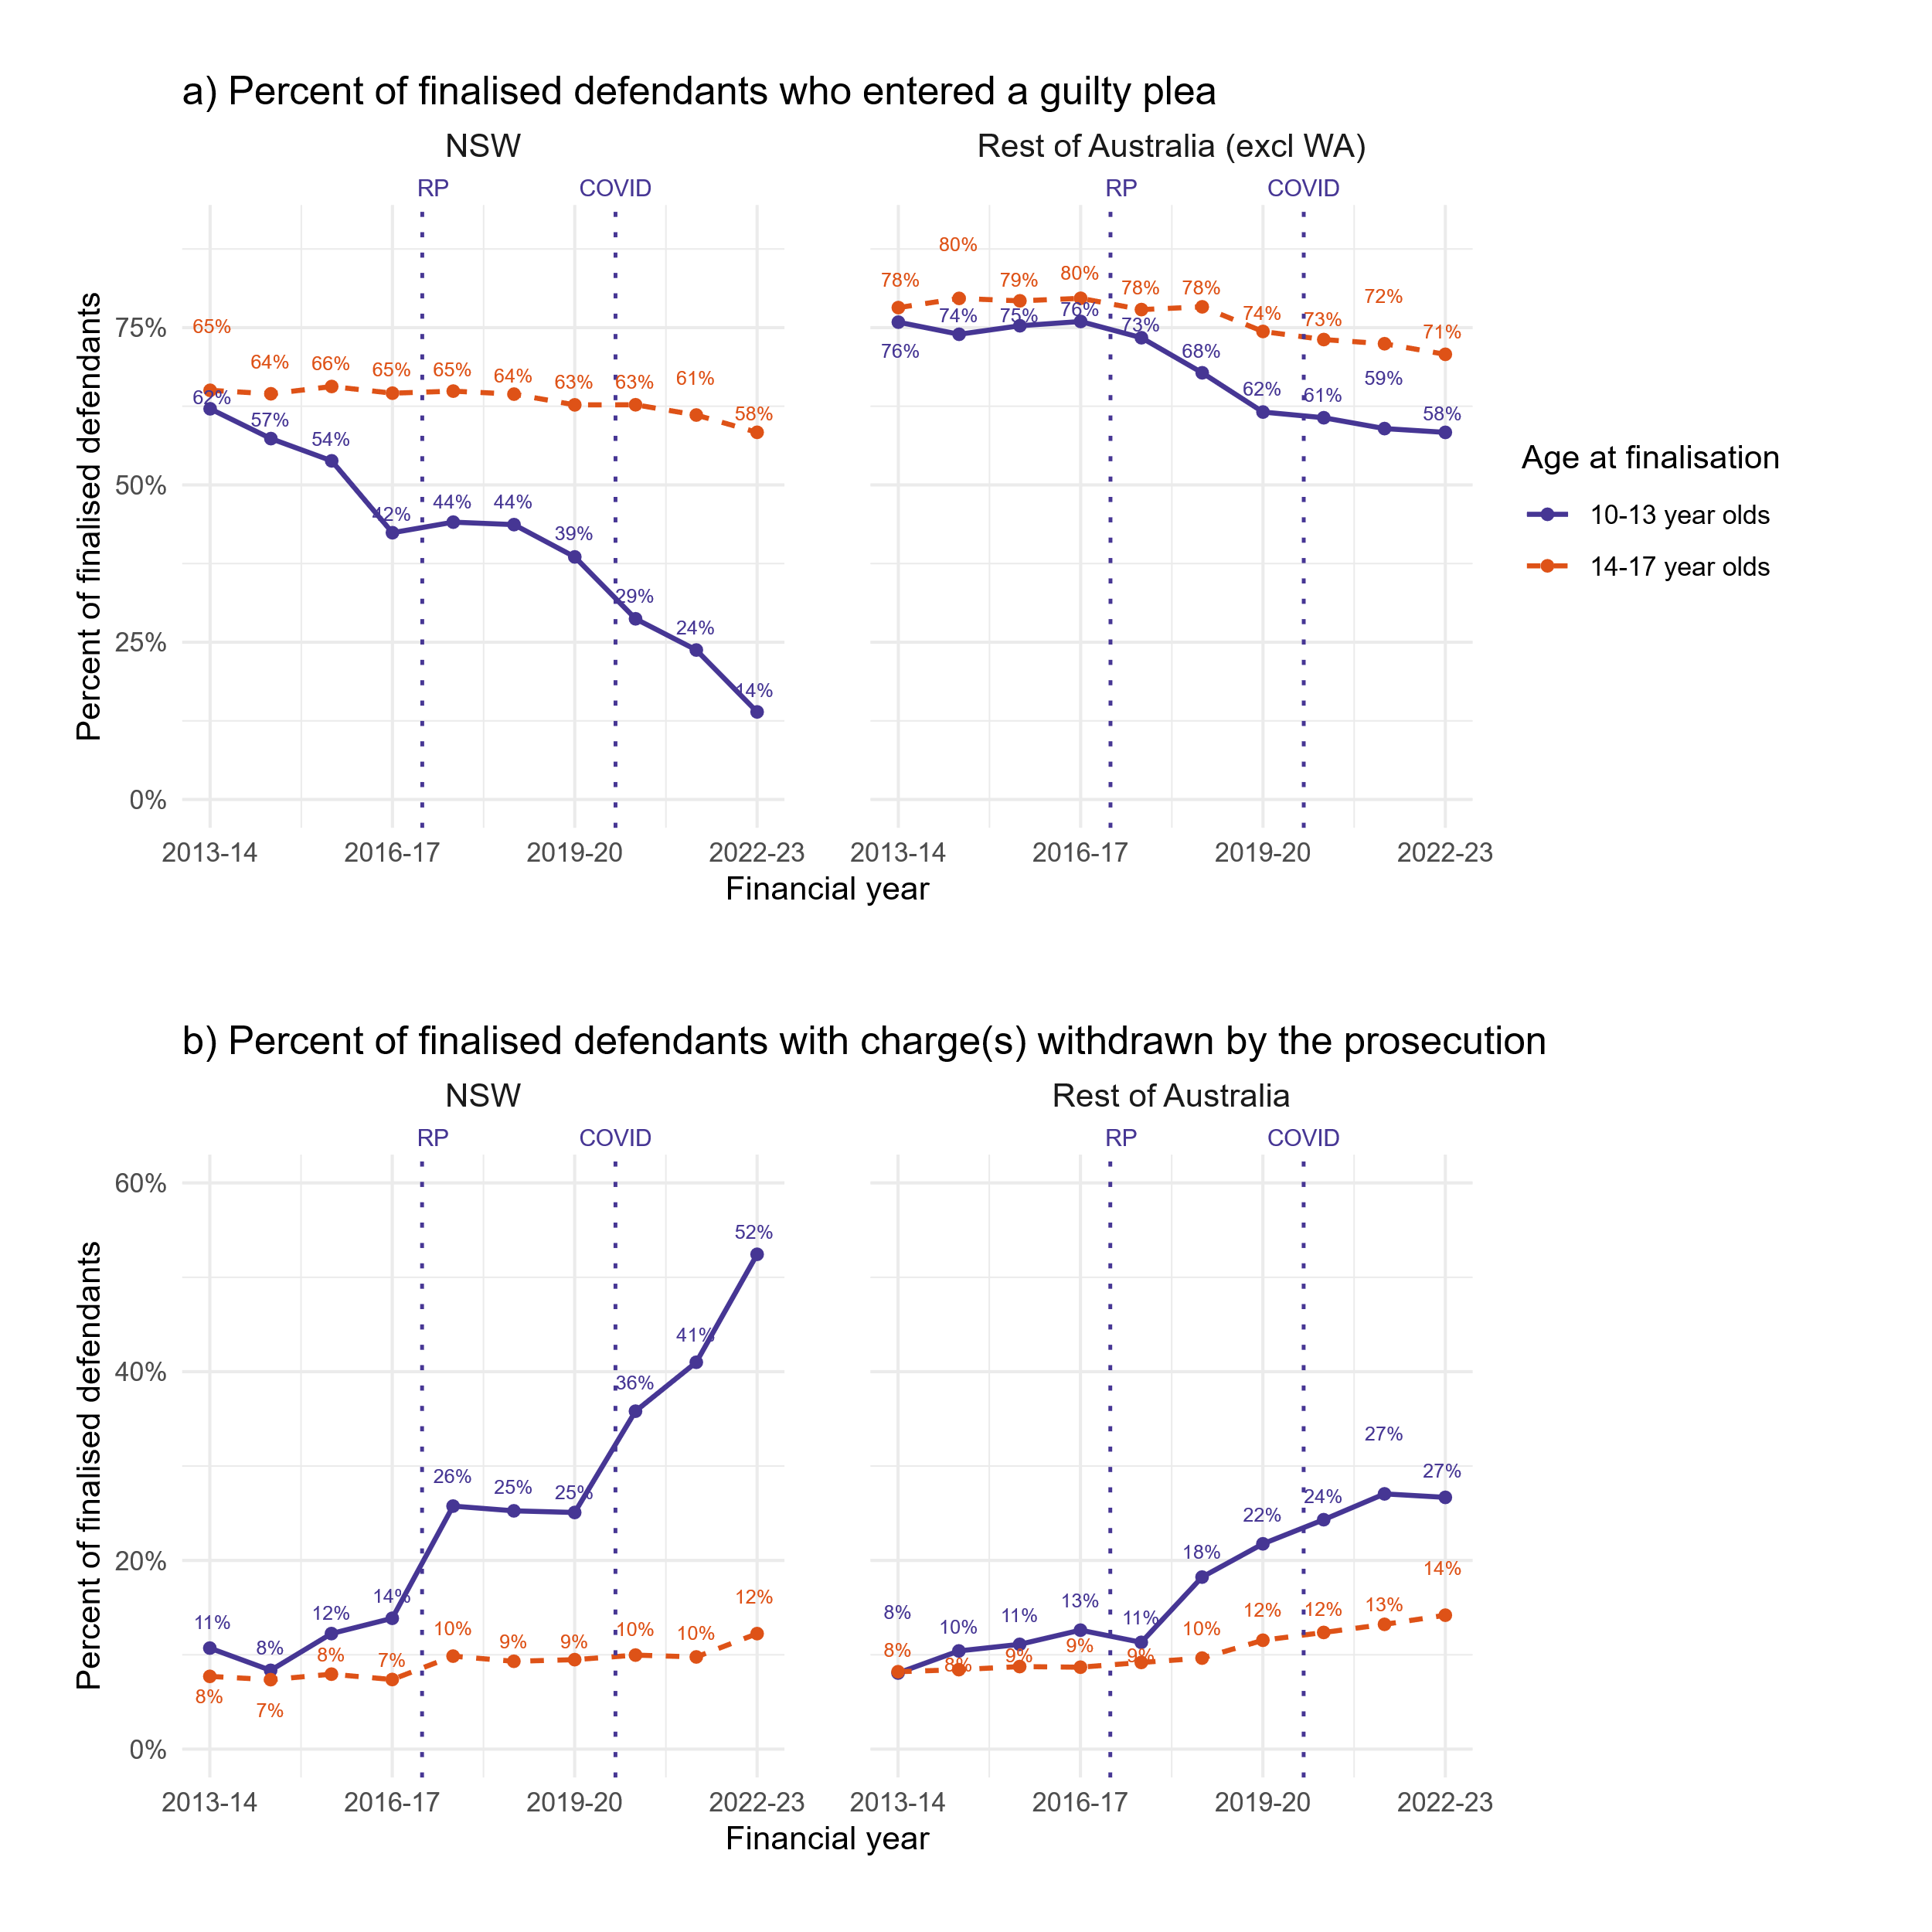
Defendants with withdrawn charges have also grown
Percent of finalised defendants with withdrawn charges , NSW vs. the rest of Australia
Percent of finalised defendants with withdrawn charges

Slide 24
RP is expected to have shifted trends in court outcomes in the rest of Australia
Expected change in outcomes since 2016 (from RP)
In Victoria and SA:
The impact of RP should be strongest in NSW, Victoria, and SA, which rely on common law for doli incapax (Moritz & Tuomi, 2023; see also Crofts, 2018)
↓ proven cases
↑ withdrawn charges

Slide 25
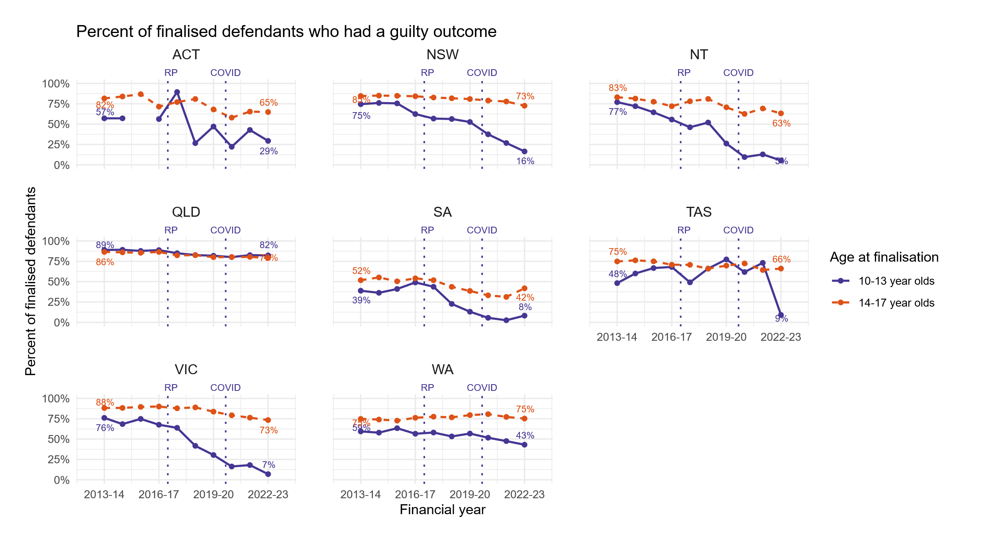
National trends are driven by NSW, SA and VIC
Percent of finalised defendants with a proven outcome
Percent of finalised defendants with a proven outcome

Slide 26
National trends are driven by NSW, SA and VIC
Percent of finalised defendants with a proven outcome
Percent of finalised defendants with a proven outcome

Slide 27
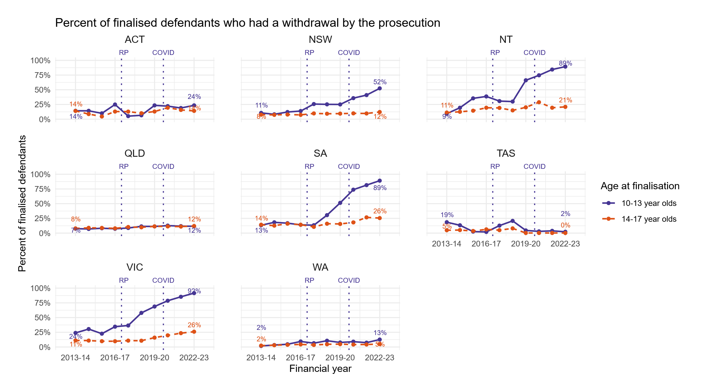
National trends are driven by NSW, SA and VIC
Percent of finalised defendants who had prosecutors withdraw charge(s)
Percent of finalised defendants with withdrawn charges

Slide 28
Trends in offence composition for defendants aged 10-13
3

Slide 29
Most offences have dropped or kept stable…
Volume of finalised court appearances for top 6 most serious offences with 10-13 y.o. defendants

Slide 30
…but provens have dropped for most offences
Volume of finalised court appearances for top 6 most serious offences with 10-13 y.o. defendants

Slide 31
Stark divide in outcome trends across age groups
Outcome trends for top 3 most serious offences
Trends are very different between the 10-13 and 14-17 age groups, across all the top 6 offences
Percent of finalised court appearances

Slide 32
Specialist magistrates in the Children’s Court
4

Slide 33
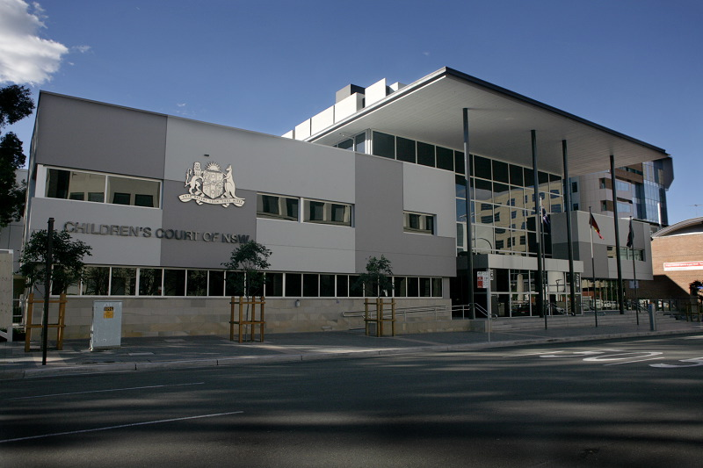


What are specialist magistrates?
Specialist magistrates only preside over cases in the Children’s Court, compared to generalist magistrates who oversee Local Court cases as well
Specialist magistrates have meetings and training sessions every 2 months with other specialist magistrates

Slide 34
Similar trends in specialist magistrates across both age groups
Percentage of court appearances overseen by specialist magistrates

Slide 35
Small differences in court outcomes between specialists and generalists
Trends in court outcomes for 10-13 year old defendants by magistrate type

Slide 36
Trends in penalties
5

Slide 37
Similar trends for defendants 10-13 and 14-17
Trends in principal penalties for cases with at least one charge proven

Slide 38
Similar trends for defendants 10-13 and 14-17
Trends in principal penalties for cases with at least one charge proven
Increase in juvenile dismissals unlikely to be connected to the RP decision, but could be connected to fallout from Australia’s Shame

Slide 39
Concluding remarks

Slide 40



Proven cases have declined after the RP decision
RP overruled a decision by the NSW Court of Criminal Appeals
Post-RP, the defence were less likely to plead guilty
By clarifying doli incapax, RP most likely made it harder to prosecute 10-13 year olds
The prosecution also increasingly withdrew all charges possibly due to insufficient evidence
The High Court has national jurisdiction, so RP has possibly impacted other jurisdictions, especially SA and Victoria
Post-RP trends accelerated during and after 2020, which could reflect the impact of the BC v R decision

Slide 41
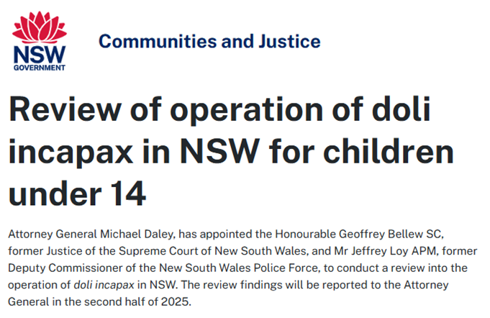
Doli incapax is currently under review
Terms of reference include:
The review should recommend a framework to enable the enactment of the presumption in New South Wales legislation and consider matters including, but not limited to:
  The form that the legislation should take, noting different approaches across Australian jurisdictions…

Slide 42

Thank you!
Email: Jonathan.Gu@dcj.nsw.gov.au
Report published at https://www.bocsar.nsw.gov.au/

Slide 43
Different legal thresholds for doli incapax
Legal thresholds for doli incapax in Australia, adapted from Moritz & Tuomi (2023)
# | Threshold | Authority | Jurisdictions | Key legislation/case
1 | Actual knowledge that the offending was ‘seriously wrong’ | Common law | NSW VIC (until 2024) SA | RP v The Queen [2016] HCA 53
2 | Actual knowledge that the offending conduct was ‘wrong’ | Statute | Cth ACT NT | Crimes Act 1914 (Cth), s 4N(1) Criminal Code Act 1995 (Cth), s 7.2(2) Criminal Code 2002 (ACT), s 26(1) Criminal Code 1983 (NT), ss 43AQ, 38A
3 | Capacity to know that the offending conduct should not occur | Statute | QLD TAS | Criminal Code 1899 (Qld), s 29(2) Criminal Code 1924 (Tas), s 18
4 | Capacity to know that the offending conduct was ‘seriously wrong’ | Statute (interpreted by WA case law) | WA | Criminal Code Compilation Act 1913 (WA), s 29 as interpreted in Rye v Western Australia [2021] WASCA 43, [51]

Slide 44
Court outcomes by the defendant’s Aboriginality

Slide 45
Court outcomes by remoteness area of the defendant’s residence

Slide 46
Court outcomes by the defendant’s gender

Slide 47
Percentage of finalised court appearances by pleas on principal offence

