Slide 1


Youth crime
Jackie Fitzgerald, Executive Director
NSW Bureau of Crime Statistics and Research
5 August 2025

Slide 2

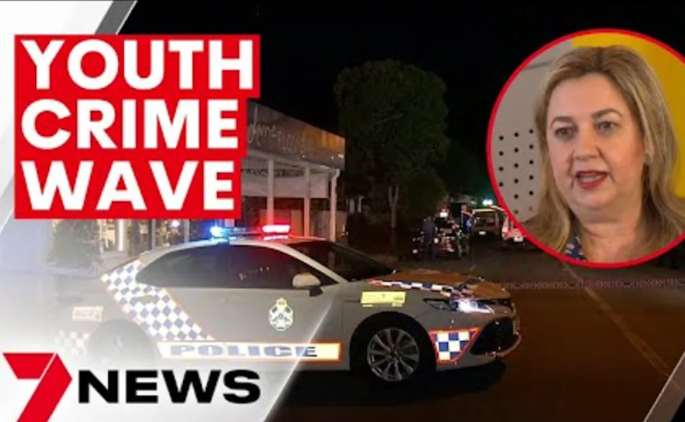
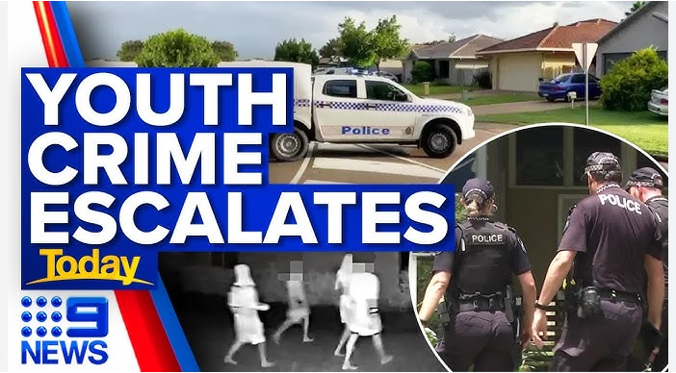



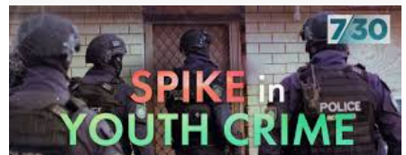
10 April 2023
Recent media framing of youth crime
23 April 2025
22 Mar 2024
19 Oct 2020

Slide 3

Crime trends across Australia
Self-reported experience of crime (ABS victim survey)
Violent crime
Property crime
Property crime
Long-term significant decline across all states/territories
Down 52% in Australia in 16 years
Violent crime
Long-term significant decline across all states/territories
Down 40% in Australia in 16 years
6,440
2,995
10,226
6.718
2,106
375
751

Slide 4

What about youth offending rates?

Slide 5
How does YOUTH offending compare across Australia?
Recorded Crime Offenders (ABS)
Youth offending rate vs adult offending rate
Youth offending rate by state
Youth offending
Long-term significant decline
Down 45% in Australia in 16 years
Adult offending
Steady decline
Down 25% in Australia in 16 years
6,440
2,995
10,226
6.718
2,106
375
751

Slide 6

Youth crime reduction evident from ‘Age crime curve’
Property crime
Violent crime
Rate per 100,000
Rate per 100,000
2
15
20
25
15
20
25

Slide 7

But has serious youth crime increased?

Slide 8
What about youth trends in serious offences?
6 Year Trend
Rate of young people appearing in court for selected serious offences, NSW
16 Year Trend
2008/09 to 2024/25
6 Year Trend
2018/19 to 2024/25
Serious assault
% Change – Down 43%
Serious assault
% Change – Up 29%
Car theft
% Change – Down 21%
Car theft
% Change – Up 120%
Aggravated break & enter
% Change – Down 50%
Aggravated break & enter
% Change – Up 70%
Robbery
% Change – Up 9%
Robbery
% Change – Down 72%

Slide 9

But have offenders got younger?

Slide 10
Youth crime accounts for 12% of all crime in NSW.
Down from a peak of 18% in 2010
Trends in youth offending by age
12%
Despite significant domestic violence policy and program development, trends in domestic violence victimisation have been stable for over a decade.
Rate of young people appearing in court by age, NSW
Trend
2008/09 to 2024/25
17 years – Down 38%
16 years – Down 45%
15 years – Down 44%
14 years – Down 28%
13 years – Down 25%
12 years – Down 30%
10 – 11 years – Down 48%
Proportion of 10–13 year old up from 14.4% in 08/9 to 16.4% in 24/25.

Slide 11

Trends in youth custody numbers

Slide 12
What about youth detention?
Number of young people aged 10-17 years in youth detention

Slide 13

Youth crime issues
1. High Crime Places

Slide 14

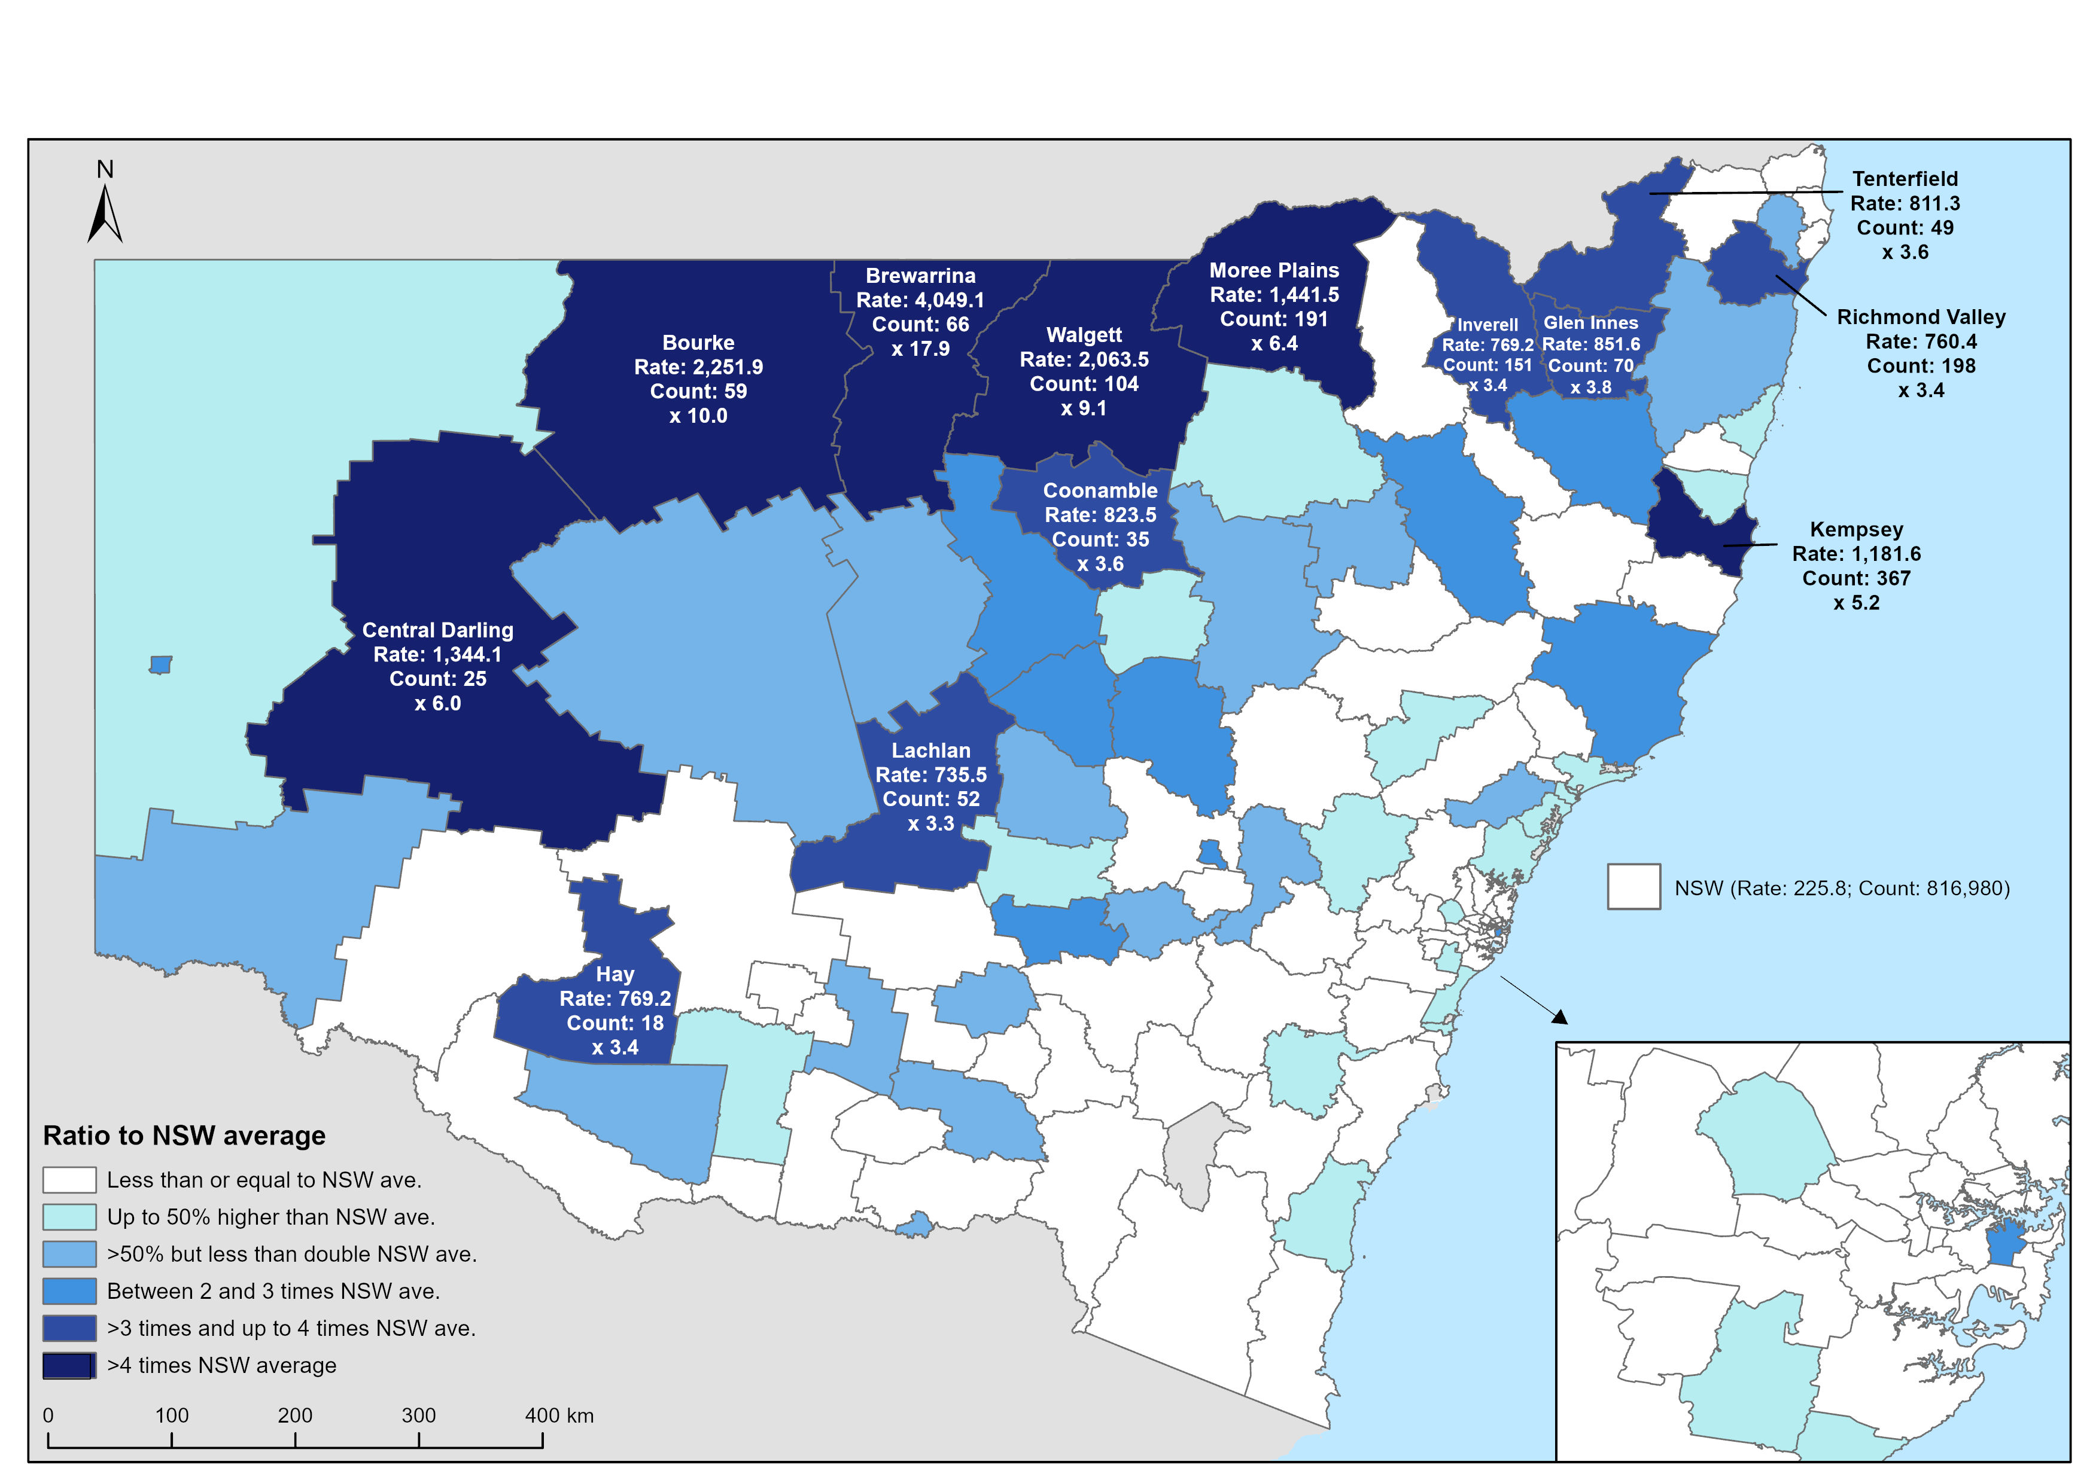
Locations with very high rates of youth offending
Rate of young people proceeded against per 10,000, April 2024 to March 25
Highest rates of youth crime in the state’s Northwest:
Brewarrina
18x NSW average
Bourke
10x NSW average
Walgett
9 x NSW average
Central Darling
6x NSW average
Moree
6x NSW average
Kempsey
5x NSW average

Slide 15

Youth crime issues
2. Aboriginal over-representation

Slide 16
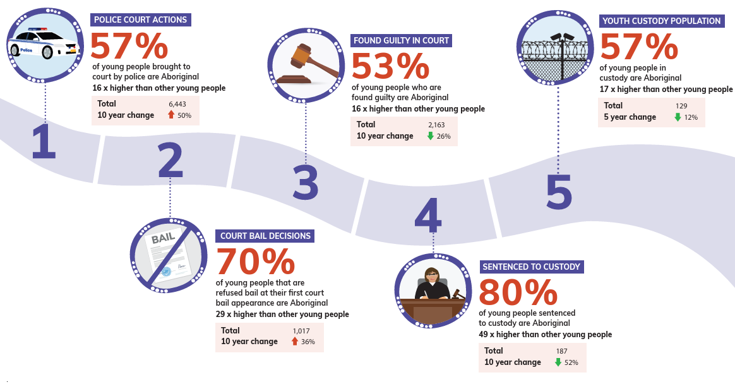
Aboriginal over-representation in the youth justice system

Slide 17

Thank you

Slide 18
Youth crime accounts for 12% of all crime in NSW.
Down from a peak of 18% in 2010
Trends in youth crime
12%
Rate of young people proceeded against by NSW Police – court/caution/conference
Down 38% in 17 years
Down 6% in 6 years
Number of young people in Youth Detention in NSW, at 30 June each year
Down 44% in 17 years
Down 14% in 6 years

Slide 19
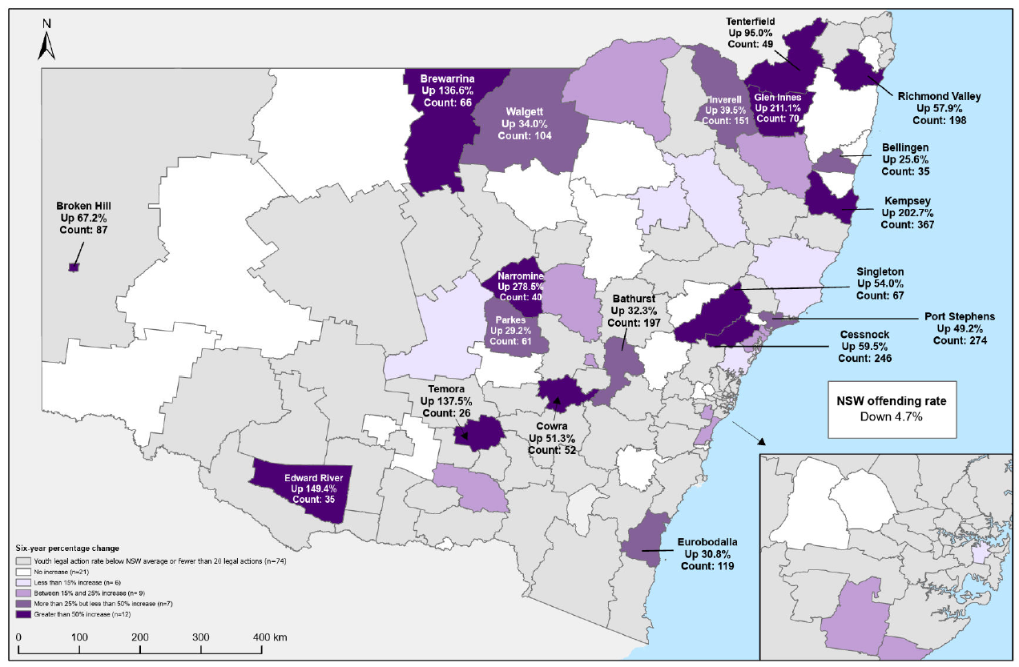
Locations with increased youth offending
LGAs with above average rates of youth crime & increased youth offending over the last 6 years to March 25
LGAs with largest increases in youth court proceedings over 6 years
Narromine
Up 279%
Glen Innes
Up 211%
Kempsey
Up 203%
Edward River
Up 149%
Temora
Up 138%
Brewarrina
Up 137%
2

Slide 20
Panel discussion on trends in youth crime and implications for practice and policy
Jackie Fitzgerald, Anne Hollonds, Peta MacGillivray, Garner Clancey,
Superintendent Greg Moore, Judge Nell Skinner

Slide 21
Therapeutic Pathways for Children
Background:
A Partnership initiative between the Aboriginal Legal Service (NSW/ACT) (ALS) and the NSW Department of Communities and Justice (DCJ) under the NSW Implementation Plan for Closing the Gap 2022–2024.
Jointly contributes expertise and knowledge to the development of alternative, therapeutic pathways and responses for all children and young people involved in, or at risk of involvement in, the criminal justice system in NSW.
Particular focus on children and young people aged under 14 (i.e. ages 10-13) and Aboriginal children and young people.
‘Therapeutic pathways’ can be understood as trauma-informed and culturally-safe responses which direct children and young people away from the formal criminal justice system and back into the community.
Peta MacGillivray
Social Determinants of Justice Research Hub UNSW

Slide 22
Reasons for Optimism
Working in partnership: NSW Government working differently with ACCOs to achieve positive outcomes from a shared co-design process. Informed by research and evidence.
Innovative methods: Double-Diamond enables creativity and inclusion of diverse stakeholders, while not trading off the depth of knowledge and experience of participants. UNSW team bringing practice and experience of evaluation of implementation, and systems understanding.
Successful co-design that holds integrity of method and participation values: Process itself produces options for immediate and staged delivery.
Outcomes from the Project:
Initiatives have come from the priorities and ideas of those working in the system /with lived experience of the system, from both Government and community sector.
ALS and DCJ practicing collaboration and holding interests of their shared goals for change. Important for short and long-term initiatives.
DCJ and ALS managed the process for making the ‘business case’ for Therapeutic Pathways for Children implementation.
Funds for implementation announced in June - $12 million
Peta MacGillivray
Social Determinants of Justice Research Hub UNSW
Notes:
Stage 1 focused on building partnership and practising
collaboration informed by research and evidence. This
collaborative work between the design partners – the
Department of Communities and Justice (DCJ) and the
Aboriginal Legal Service (NSW/ACT) Limited (ALS) – started
in March 2024 and involved partners meeting weekly with the
UNSW team to work through logistical and conceptual tasks and
actions for delivery of the project. Key outcomes of this process
were mapping the relevant systems and stakeholders, and
negotiation and finalisation of the government and community
sector representatives to participate in the co-design sessions.
A system review and summary of the research and evidence-
base was produced by the UNSW team as part of this stage of
the project and should be read together with this report.
Stage 2 involved the facilitation and delivery of four co-design
sessions using a methodology that enabled participants
engaged in different parts of the system to collaborate and
innovate. Participants explored definitions of Therapeutic
Pathways for Children, identified four primary priorities
for progressing ‘therapeutic pathways’, shared models for
delivery by government, non-government and community
sector partners to progress the conditions and capability, and
identified options and actions for immediate and staged delivery
of Therapeutic Pathways for Children.

Slide 23
But we still need to Think Big
There remains critical areas of work to achieve change that all of us must engage with meaningfully:
Structural reform and law reform is urgently needed, significantly accelerating the change we want. This doesn’t make service sector strengthening less of a priority, but we won’t have the impact without the reform piece.
A budget shift from government to community-based and community-led delivery of services and supports must be a system-wide approach and will take reform.
Supporting and enabling the self-determination of Aboriginal children and young people who are systems impacted in the short and long-term. Having children and young people join us in our efforts will see greater positive impact in short and long-term.
Peta MacGillivray
Social Determinants of Justice Research Hub UNSW
Notes:
Conditions for collaboration:
Therapeutic Pathways for Children is a unique, purposeful project enabled through the mandate of Closing the Gap and the deep support and commitment by key DCJ staff and the ALS NSW/ACT.
Stage 1 focused on building partnership and practising
collaboration informed by research and evidence. This
collaborative work between the design partners – the
Department of Communities and Justice (DCJ) and the
Aboriginal Legal Service (NSW/ACT) Limited (ALS) – started
in March 2024 and involved partners meeting weekly with the
UNSW team to work through logistical and conceptual tasks and
actions for delivery of the project. Key outcomes of this process
were mapping the relevant systems and stakeholders, and
negotiation and finalisation of the government and community
sector representatives to participate in the co-design sessions.
A system review and summary of the research and evidence-
base was produced by the UNSW team as part of this stage of
the project and should be read together with this report.
Stage 2 involved the facilitation and delivery of four co-design
sessions using a methodology that enabled participants
engaged in different parts of the system to collaborate and
innovate. Participants explored definitions of Therapeutic
Pathways for Children, identified four primary priorities
for progressing ‘therapeutic pathways’, shared models for
delivery by government, non-government and community
sector partners to progress the conditions and capability, and
identified options and actions for immediate and staged delivery
of Therapeutic Pathways for Children.

