Slide 1
REFRAMING RELATIONSHIPS
& REDUCING CRIME
The long-term evaluation of a Queensland Police Service (QPS) protective security project for First Nations communities.
August 2025
Notes:
My name is Deborah Kelso, and I am a Senior Research and Evaluation Officer with the Queensland Police Service Research and Evaluation Unit.
Joining me today is my colleague, Dr. Rebekah Chapman, Principal Research and Evaluation Officer.
Together, we will be presenting the long-term evaluation findings of a Protective Security Project conducted on Palm Island.

Slide 2
Acknowledgement of Country
We would like to respectfully acknowledge the Traditional Owners of the land on which this event is taking place; the Gadigal people of the Eora Nation, and the Elders past and present.
We would like to respectfully acknowledge the Traditional Owners of Palm Island, the Manbarra people, and the Indigenous Bwgcolman people and their descendants.
Notes:
I’d like to begin by respectfully acknowledging the Traditional Owners of the land on which we gather today — the Gadigal people of the Eora Nation — and pay my respects to Elders past and present.
I also wish to acknowledge the Traditional Owners of Palm Island, the Manbarra people, as well as the indigenous Bwgcolman people and their descendants.

Slide 3
Benefits of Community-Based
First Nations Employment
  A recent study found community-based employment to have significant benefits for Aboriginal and Torres Strait Islander wellbeing, aspirations and resilience (Doery et al., 2024).
  Employment is associated with a range of benefits for First Nations persons including financial security, enhanced social mobility and inclusion, improved standards of living, and better developmental outcomes (AIHW, 2024).
Notes:
Before outlining the Protective Security Project we’ll be discussing today, I’d like to briefly highlight recent research that reinforces the broader social and cultural value of community-based First Nations employment.
A 2024 Australian study by Doery and colleagues found that community-based employment strengthens:
Wellbeing
Cultural connection
Aspirations
And Resilience for Aboriginal and Torres Strait Islander peoples.
Participants in the study also reported:
Increased empowerment
Stronger goal-setting
Greater engagement with culture and community
Importantly, these outcomes extend well beyond economic participation.

Slide 4
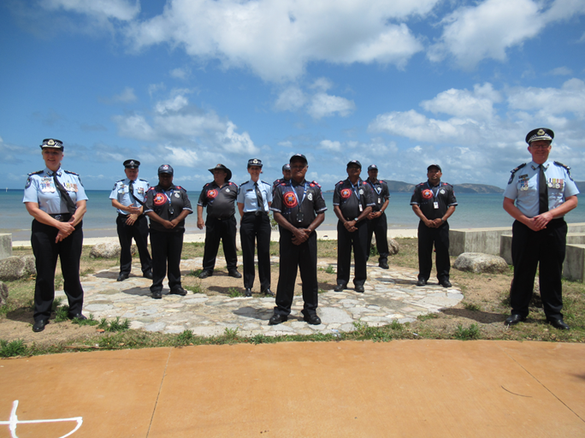
First Nations Senior Protective
Services Officer (FNSPSO) Project
The Protective Services Group First Nations Project is a service delivery initiative designed to recruit, train, and employ local First Nations community members.
After training, FNSPSOs are deployed in their own community, as Queensland Police Service employees.
Notes:
Protective Services Officers are members of the Queensland Police Service. They operate within the Protective Services Group of the Security and Counter-Terrorism Command.
These officers have legislated powers under the Police Powers and Responsibilities Act 2000 (Qld) to provide security to Queensland Government buildings and assets.
In 2020, the Protective Services Group launched its First Nations Project.
This project is designed to:
Recruit,
Train, and
Employ local First Nations people as Senior Protective Services Officers.
Successful candidates complete a four-and-a-half-week training course at the Townsville Police Academy.
Following training, First Nations Senior Protective Services Officers are:
Deployed within their own communities
And provide protective security to Queensland Government agencies on a fee-for-service basis
Historically, government security at these locations was provided by contracted private security guards, many of whom worked on a fly-in, fly-out basis.

Slide 5
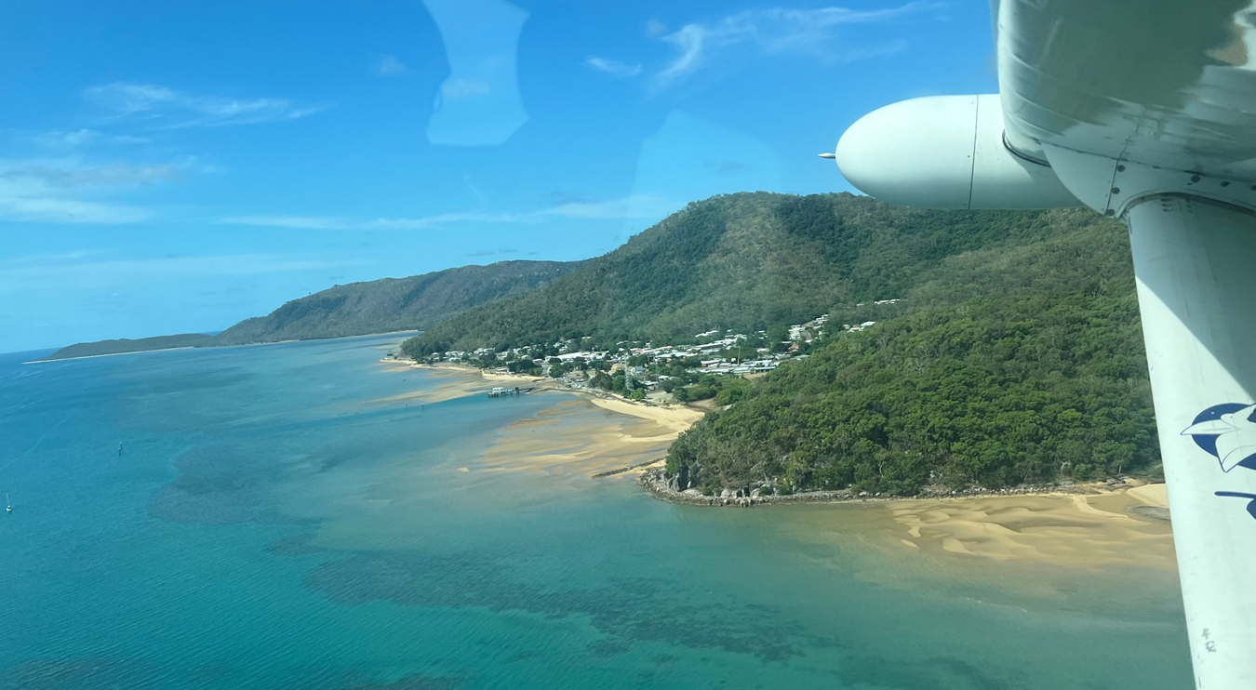
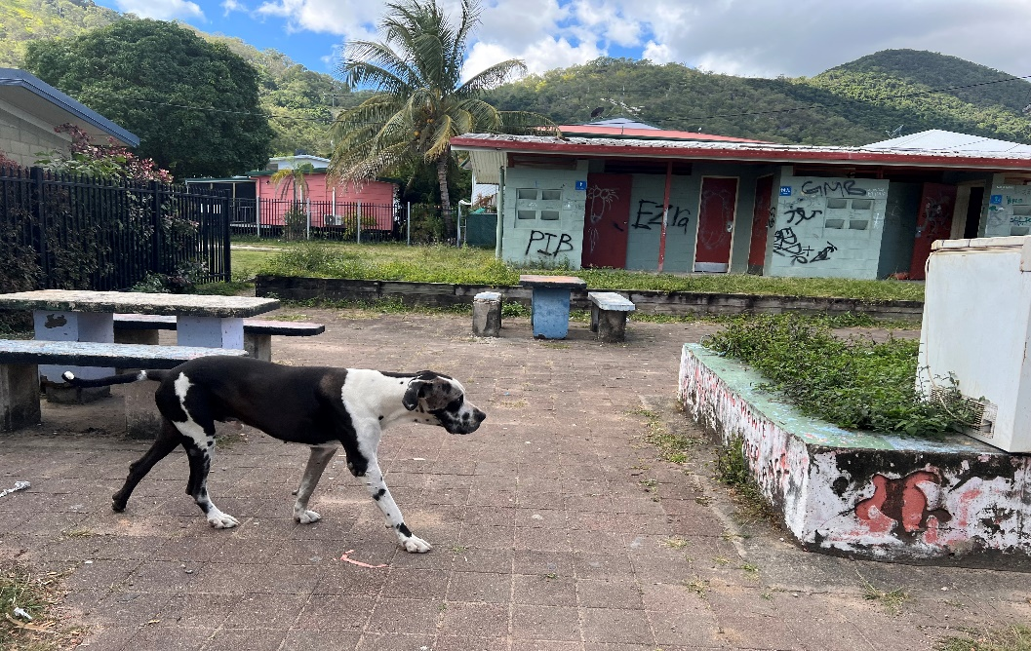
Palm Island
Palm Island is an Aboriginal community approximately 65 kilometres north of Townsville, Queensland.
It is known by the Aboriginal name Bwgcolman, meaning ‘many tribes, one people’.
Notes:
The pilot for this project began in October 2020 on Palm Island — a large, remote Aboriginal community located approximately 65 kilometres north of Townsville.
Palm Island is home to around 4,000 residents and the descendants of more than fifty different tribal groups. It is aptly known by its Aboriginal name, Bwgcolman, meaning “many tribes, one people”
The Protective Security Project was conceptualised in response to a series of incidents on Palm Island, where non-local security guards, contracted through Protective Services, were being targeted with crime — including rock throwing and damage to property.
These incidents highlighted that the existing, fly-in fly-out security model was not effective or well-received by the community. It hence became clear that a new, community-driven approach to security was needed.
Today, First Nations Senior Protective Services Officers are:
Deployed across multiple sites on Palm Island for client groups including:
The Department of Education
The Department of Justice and Attorney-General
Catholic Education

Slide 6
Palm Island Project Evaluation
  The Project trial was been supported by a two-phase evaluation:
  Phase 1 (Process Evaluation): Project delivery (implementation and communication), recruitment process & training (March 2021).
  Phase 2 (Medium-Term Outcomes): Assessed project delivery, stakeholder perceptions, relationships, crime rates and service costs (Nov 2021).
Notes:
The Palm Island pilot was supported by a two-phase evaluation, conducted by our unit in 2021.
Phase One was a process evaluation, which examined:
Project delivery
Implementation
Communication
Recruitment and training
Phase Two was a medium-term outcome evaluation, which focused on:
Project delivery
Stakeholder perceptions and relationships
Crime rates
Service delivery costs

Slide 7
Expansion
This evaluation forms a component of a broader evaluation of the FNSPSO Strategy, which has been expanded to other First Nations communities including Yarrabah, Bamaga, Lockhart River and Woorabinda.
The Phase 3 evaluation expands upon the initial evaluation findings through a long-term outcome evaluation of the FNSPSO Strategy on Palm Island.
Long term evaluations provide unique insight into “whether a program has had wider effects than the relatively narrow and well-defined outcomes usually measured in an outcomes evaluation” (Muir & Dean, 2017).
Notes:
In 2023, our unit was requested by the Protective Services Group to conduct an evaluation of the expansion of the First Nations Project.
The project had previously expanded to:
Yarrabah in 2022, and
Bamaga, Lockhart River, and Woorabinda in 2024.
Recognising the unique opportunity this presented—and with the agreement of our clients—we broadened the evaluation scope to include a long-term outcome assessment of Palm Island, four years post implementation.
Long-term evaluations like this are rare in government settings, but they can reveal critical insights often missed by short- and medium-term outcome assessments.
To explore long-term impacts more deeply, we conducted case studies with four First Nations Senior Protective Service Officers who were part of the first recruit group and remain employed in their role present day.
Their stories illustrate how a culturally grounded, community-first approach to security:
Delivers benefits well beyond crime reduction
Helps to reframe relationships between police and First Nations communities
Offers many beneficial outcomes for employees

Slide 8
Phase 3 – Long-Term Evaluation (Palm Island)
Recruitment & Training
Role Perceptions
Employment Opportunities
Safety & Prevention
Governance & Sustainability
Notes:
Our long-term evaluation, delivered in July 2025, assessed the sustained outcomes of the First Nations Project.
Key evaluation areas included:
Recruitment and training
Role perceptions
Employment opportunities
Safety and prevention
Governance and sustainability

Slide 9
Case Studies
Shared with the research team in 2024
Written in narrative format
Shared back with participants for their comment & consent for inclusion
De-identified (pseudonyms used)
Frank
(Original FNSPSO recruit)
Larry
(Original FNSPSO recruit)
Shaun
(Original FNSPSO recruit- Resigned & Re-applied in 2024)
Jamie
(Original FNSPSO recruit)
Notes:
As mentioned previously, as part of our evaluation, we developed a series of case studies featuring four First Nations Senior Protective Service Officers from the original 2020 Palm Island recruitment cohort.
Larry, Frank, Jamie, and Shaun generously shared their stories during research conversations held on Palm Island in late 2024.
Our team constructed these narratives to explore the long-term impacts of the project:
At the individual level, and
From a broader community perspective
Each officer was given the opportunity to:
Review their case study
Confirm its accuracy
Provide informed consent for inclusion in the evaluation
To respect and protect their privacy:
Pseudonyms were used
All case studies were presented in a de-identified format
These powerful personal accounts, alongside the wider evaluation findings, will now be explored in more detail by my colleague, Rebekah.

Slide 10
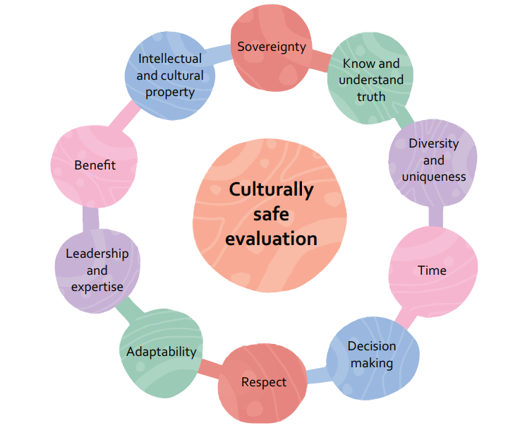
Preparation
  Guidelines for ethical conduct in research with Aboriginal and Torres Strait Islander peoples and communities (NHMRC)
    Core values: Spirit & Integrity, Cultural continuity, Equity, Reciprocity, Respect, Responsibility
  Australian Evaluation Society First Nations Cultural Safety Framework (AES)
    Principles of culturally safe evaluation:
  Code of Ethics for Aboriginal and Torres Strait Islander Research (AIATSIS)
    Principles: Indigenous self-determination, Indigenous leadership, Impact & value, Sustainability & accountability.
ENGAGEMENT; PARTNERSHIP; TIME; STRENGTH-FOCUS; TRANSPARENCY; ACCOUNTABILITY
Notes:
In evaluating the FN Protective Services Officer project on Palm Island and in the other communities it has since expanded to, we have ensured our research methodologies have been guided by not only the NHMRC National Statement on human research, but also the appropriate guidelines for research with Aboriginal and Torres Strait Islander peoples and communities, including the:
Relevant NHMRC guidelines
The principles of culturally safe evaluations outlined by the Australian Evaluation Society, and
The AIATSIS Code of Ethics for Aboriginal and Torres Strait Islander research.
I have outlined the various values and principles of these guidelines on this slide, and in bold down below I have highlighted the various values from across these guiding documents that we have really sought to embody in our research as we have gone through this process.
These have included:
Genuine collaborative engagement and partnership with the community and particularly with our First Nations Protective Services Officers as you’ll see through their case studies
Allowing time to develop these partnerships and to be flexible in our engagements, and ensuring that we have applied a strength focused lens throughout our research and evaluation processes, and
Making sure we have been transparent and accountable throughout this process, and that we are feeding back about the use and impact of this research and data in meaningful and appropriate ways through ongoing partnerships

Slide 11
Initial community (re)visit – June 2024
Community engagement
  Palm Island Aboriginal Shire Council
  Palm Island Community Company – Community Justice Group
  Rainbow Bridge Employment
  QPS officers
  FNSPSOs
  School leadership (State and Catholic school)
Notes:
As part of that collaborative engagement process, we initially revisited Palm Island to understand the community’s response to our plans for this long-term phase of the research, and to determine their support for us conducting research again in the community.
In June 2024 the research team, myself, Deborah and the Manager of R&E Sandra Smith travelled to Palm Island to engage with various community representatives, including…..
The team had previously built relationships with all of these stakeholder groups for the earlier phases of the evaluation in 2021, but of course some of the key people in these roles had changed over time and so we wanted to reconnect and rebuild those relationships.
Each of these stakeholders and community representatives we spoke to were supportive of our plans and provided us with letters of support that we were able to include as part of our application to the Townsville Hospital & Health Service Human Research Ethics Committee, and also to the Department of Education and Catholic Education Qld as per their research governance processes.
And following those pre-engagement and approval processes, we returned to Palm Island in October of 2024 to conduct the research.

Slide 12
Methodology
Qualitative:
  Discussions in community:
    FNSPSOs, Community representatives, Police officers, Education employees
  Case studies
    Telling FNSPSOs’ stories
Quantitative:
  Crime data:
    Palm Island; ‘key word’ locations
  Mapping of criminal offence occurrences at specific service delivery sites (coordinate mapping)
  Protective Services incident reporting
Notes:
The research itself was primarily qualitative, and involved:
in-depth discussions in the community, with particularly the Protective Services Officers to fully understand their stories associated with their employment in these roles since the beginning of the project in 2020, as well as
discussions with key community representatives,
police officers who are stationed on palm island and
school employees as the primary service clients.
We also accessed some quantitative data to enable insight into the long-term impact of the project on crime on Palm Island, and that was done in a few ways, which just in the interest of time I won’t go into great detail with, except to say that it involved analysis of offence data at the specific locations in the community that the protective service officers are actively patrolling, as well as analysis of protective services’ own incident reporting.

Slide 13
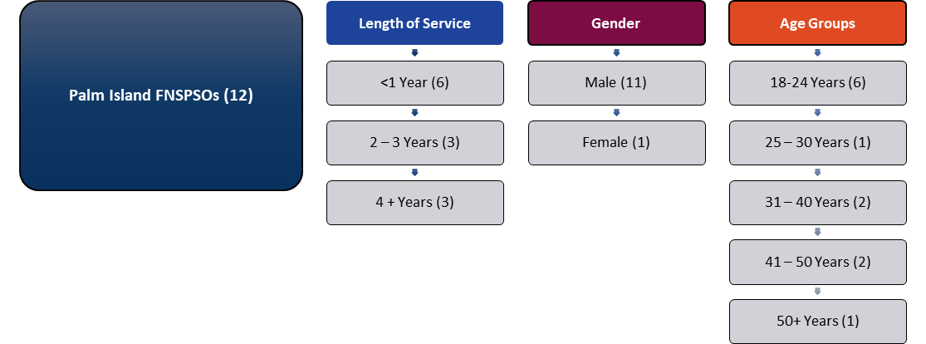
Employment
Source: QPS HR data, Feb 2025
Notes:
We also initially accessed QPS HR data to give a picture of the current status of employment into the FNSPSO role on Palm Island
And as you can see here, there are currently 12 locals employed as Protective Service officers on palm island – it has grown since the initial recruitment of 7 people in 2020.
Notably, three of the initial 7 recruits have retained their positions, with greater than 4 years of service in the role, while another of the initial recruits resigned in 2022 and then subsequently re-applied and was re-employed in 2024.
Recent recruitment rounds have resulted in a younger workforce on Palm Island, with the proportion aged 18 - 24 years currently at 50% (six of 12 employees).
Just one of the current officers on Palm Island is female, which isn’t actually reflective of the broader project as it has expanded into other communities. Across the whole project, the proportion of females employed in these roles actually currently sits at 48%.

Slide 14
FNSPSO stories
Larry originally applied for the SPSO role after being encouraged by a past supervisor, as he was unemployed at the time. Larry is a quiet and considered man, and suggests that: “I probably wasn’t the best candidate for the job, because that’s the way I am. I’m always in the background”. He describes how he has become more comfortable with himself and the role over time: “I am more at ease with myself, and what I do”. He has been continuously employed in the role for the past four years.
Jamie originally applied for the SPSO role as she was unemployed at the time and felt motivated to do something “different” to administration and cleaning. Jamie expresses how her commitment to her ongoing employment has evolved : “When I first started, I was kind of slackening off, like should I stay in the job, should I go in to work, or should I stay home? And then I forced myself to go in… I didn’t think I’d really stick it out hey, I didn’t think I was going to last this long. And this is the longest I’ve ever been in an actual job”.
Shaun originally applied for the position to experience “something new”. Shaun particularly liked the idea of joining the Police Service and aspired to a “better life; more money”. Shaun resigned from the role in 2022 due to personal reasons, however reapplied in 2024, undertaking recruit training for a second time. On describing his reasons for returning to the role, Shaun states “I like it hey, I like this job…You get some good respect around the island here, some good feedback from them, especially the kids”.
Frank had aspirational reasons for joining QPS: “goal was to look after the community…kids were burning bins on the road and everything…I would see these kids that were running amok, that’s why I put in for the job, to settle them down”. Frank has a great deal of pride in his role and encourages his team members to be proactive on duty: “That’s what I tell the other mob, when its lunchtime, go walk around, talk to the kids”. Frank has also become involved in encouraging young community members to apply for FNSPSO roles.
Notes:
At this point I’d really like to introduce you to our four continuing officers, who were recruited in 2020 and are still employed, or have been re-employed in one case, in the role.
As Deborah mentioned, these narratives were written based on conversations with the FNSPSOs through the data collection period, and have been endorsed by them as reflecting their stories. I am just sharing the intro here, but throughout the report for this evaluation, and also throughout the rest of the results in the presentation, you can see snapshots of their stories aligning with each of the main evaluation themes.
Larry…

Slide 15
Impact for FNSPSOs (and community)
Role modelling and community respect
  “I got a nephew; he’s leaving school - he asked me for a job here. So, the kids look up at you”. [FNSPSO]
  “Our people are keeping the order in the community, and our people look up to them…They’ve got that respect from our community”. [Education staff]
Self-confidence, employability, and skill development
  “They’ve come a long way from where they were (as individuals)”. [Community representative]
  “Like X, for instance, he was quiet when he first started here, but now he’s started to come out of his shell more”. [FNSPSO]
  “(We) don’t just give them a job, we give them a career”. [Protective Services Group member]
  “Gives them skills to orbit through other employment types when they get bored”. [Client]
Notes:
Initially in 2020, there was some apprehension among the new Protective services officers about how they would be perceived in the community, working with police, and there was also some initial scepticism among stakeholders about the sustainability of the project on Palm Island.
The results of this long term follow up however have indicated that the project has made substantial progress and gained trust within the community over the past 5 years.
The FNSPSOs in particular spoke of how they feel they are seen as positive role models in their community, and that perception also extended to other project stakeholders, including community representatives and clients.
We also observed a large positive change in the self confidence of the recruits, who are now all comfortable in their roles, and who are perceived as having come a long way in both themselves and how they are seen as particularly respected members of their community.
The employment skills and ongoing skill development of the FNSPSOs are also regarded positively, not just for the SPSO roles in QPS but also more broadly, for if and when they want to transition to other roles or even further within the police service itself.

Slide 16
Reframing relationships
“Before I applied for it, I heard people talking, (saying) ahhh, you’re not working for police”. [FNSPSO]
“It’s changed the way people think about police. My brother, he hated police. As soon as I come to this job, he’s got no beef with police hey. I tell you he’d throw rocks at them and everything. He don’t (sic) even bother them now”. [FNSPSO]
“Just that involvement (of FNSPSOs) with the (QPS) uniform and the badge, kind of like it's not all bad...that's what we are trying to do – there's ten positive things about policing, it's not just locking people up. Especially not here”. [QPS Officer]
Notes:
We also found some evidence of shifting relationships between the community and police, and comments relating to this were received from across the range of different stakeholder groups.
As I mentioned previously, there was initially some apprehension among the FNSPSOs in terms of how they would be perceived, in working with and for police, however both the protective services officers and police officers, as well as other community stakeholders, indicated that this project has gone some way to altering the perception of police in the community. I think that’s shown really well in this quote by one of our SPSOs….
And also, in this view expressed by a police officer on palm island…

Slide 17
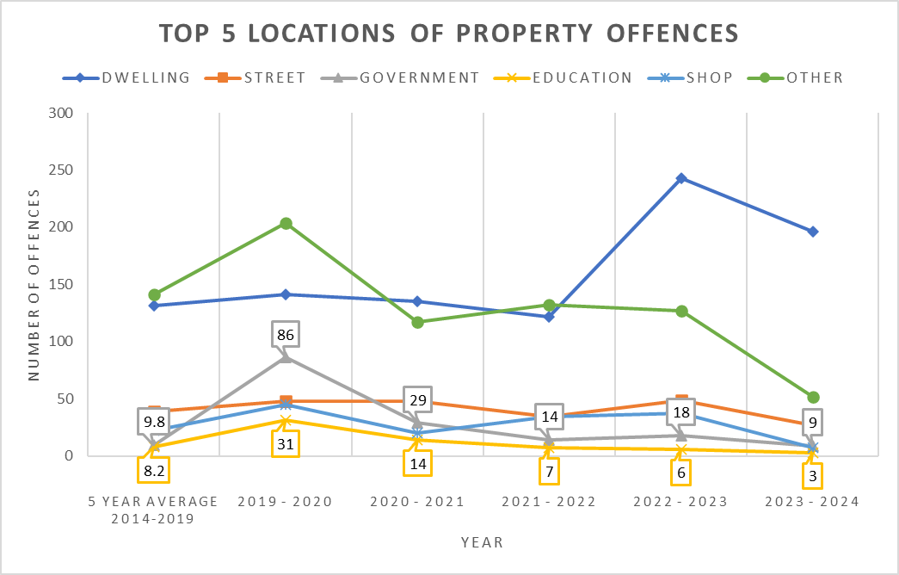
Crime and safety
FNSPSO views:
“My opinion is that we know where they live, and if the police were to ask us who they are, we’d know them straight away”.
“Because us and the community patrol, we communicate together. Like if we see them doing something outside our boundary, we tell them, and they come and deal with it. And if they see anything with the kids hanging around the school, they’ll come and tell us”.
“FNSPSOs in combination with the night patrol has really lowered the crime rate. Less break and enters”. [Community Representative]
Source: QPRIME, Feb 2025
Notes:
In regards to the long term impact on crime, I just want to caveat this slide by saying that of course there have been other initiatives that have operated targeting crime across this period, and so we aren’t able to attribute any change directly to the First Nations protective services officer project.
This graph here though does show the number of property offences; and I have singled out property offences as this is primarily what the project is targeting, in regards to protection of government buildings; so it shows the number of property offences by location from the year prior to project implementation in 2020, as well as the previous 5 year average, and across each year following project implementation, up to 2024. And you can see that when looking at both the grey line, and the yellow line, representing government and education properties, there has been a sustained decrease from that high of 86 offences at government sites and 31 offences at education sites in the year prior to the project, to just the most recent year, where we saw just 9 property offences committed at government sites and 3 at education sites on Palm Island.
And when you talk to the FNSPSOs themselves, they have a strong sense of their effectiveness in these roles, particularly in that they know the community, they know the kids, and they act particularly as a deterrent in that way. Teachers and staff at the schools also express that same view, and see the effectiveness of the FNSPSOs particularly in regard to their relationships with the kids and young people in the community and their families.

Slide 18
Next steps
Targeting identified issues:
  proactivity and engagement;
  skill development and capacity building;
  mentoring
Strategic integration into community policing
  “We had a missing person case here and it was a suicidal missing person. The FNSPSOs located the missing person, they knew the family, they had a bigger knowledge base than what we did. Better local knowledge”. [QPS officer]
  “(QPS) officers don’t really understand how they could incorporate FNSPSOs into policing in the community, they could be an extra set of eyes”. [QPS Officer]
Notes:
While there were a number of positive outcomes identified over the long term of the project, there were also a number of issues that arose throughout the evaluation process.
For example, some clients did express that service delivery had slipped somewhat over time, and indicated that there had recently been a lack of proactivity and active foot patrols observed, which seemed to align with a period of reduced on-site supervision of the FNSPSO team.
Several of the protective servicers officers also indicated that over their time with the QPS, they would have liked to have seen some expansion of their responsibilities and their reach in terms of their patrol locations, which have remained fairly consistent over the period of the project’s operation.
There are also opportunities to strengthen the pathways available to the FNSPSOs in regards to their progression and growth in their careers. We have seen one example of a SPSO on Palm Island moving to a protective services role in greater southeast Qld, and its hoped that such pathways are further identified and made easier to access moving forward.
There’s also been an identified need for increasing the formal and informal mentoring opportunities available to the FNSPSOs on palm island – particularly in initial stages of employment to really provide that scaffolding around new and younger employees, who may never have been in the workforce before, but also over the longer term.
And all of those identified issues are being fed back through our evaluation reporting to hopefully impact on changes in those areas moving forward.
Also, although we found some indication of shifting relationships between police and community, this evaluation found that there is opportunity for increased collaboration, integration and further embedding of the SPSO project into the local community policing model on Palm Island. Despite some challenges, there has been recent examples of FNSPSOs assisting police, particularly in this example highlighted where the FNSPSOs were able to locate a missing person due to their specific local knowledge.
It’s also been acknowledged by police that the officers don’t fully understand how they can incorporate these new staff members into their policing operations, and so that is something we have identified as important to focus on moving forward.

Slide 19
Benefits
Challenges/Limitations
Ongoing engagement
Remote methods not viable
Research team of 3 (two scribes).
Multiple community visits ($$$)
Community support
No audio recording
Telling the stories
Building capacity
Long-term focus, ongoing impact
Ongoing learnings for QPS
“Next steps” and strengthening for future
Ongoing engagement
Notes:
I just want to summarise by highlighting some of the challenges and benefits of doing long term evaluation research like this, from a crime and justice perspective, but also in regards to carrying out research in First Nations communities.
I’ll start with the challenges, including firstly ongoing engagement, which I have actually also noted as a benefit, however palm island is remote, and it costs a lot of money to fund researchers to be able to properly engage with First Nations communities for projects like this. We of course need to develop trusted collaborative relationships with communities before we can ask their support for our research to be conducted, and remote methods of engaging are just not viable in this instance.
As Qld Police Service staff, we also did not want to audio record discussions for this research, and so for ethics purposes and to ensure that we were accurately representing information, we needed to be a team of 3 for all travel, across multiple community visits.
Needless to say, this all involves a great investment of time and money, and we are grateful that QPS, and particularly the Protective Services Group, saw value in this work and enabled it to happen.
There are numerous benefits that greatly outweigh these costs, and the ability to engage in an ongoing way with the community is one of them. We are so privileged to have been able to revisit this community and its people, and to talk to them and tell their stories about the ongoing impact of this project on their lives and community, and to also work with them to identify issues for improvement and to build those “next steps” for them staying in these roles and shaping them into the future.
In showcasing the impact of this project we are actively building capacity for the FNSPSOs to continue successfully in their roles, and we are also identifying learnings for QPS, so that projects don’t just stagnate, but are allowed to continuously improve and strengthen their impact as they move into an ongoing, business as usual phase.

Slide 20
References
Australian Institute of Health and Welfare (2024). Socioeconomic indexes. [online] AIHW Indigenous HPF. Available at: https://www.indigenoushpf.gov.au/measures/2-09-socioeconomic-indexes.
Doery, E., Lata Satyen, Paradies, Y., Gee, G. and Toumbourou, J.W. (2024). Impact of community-based employment on Aboriginal and Torres Strait Islander wellbeing, aspirations, and resilience. BMC Public Health, 24(1). doi: https://doi.org/10.1186/s12889-024-17909-z.
Muir, S. and Dean, A. 2017. Evaluating the outcomes of programs for Indigenous families and communities. [online] Child Family Community Australia. Available at: https://aifs.gov.au/sites/default/files/publication-documents/evaluating-outcomes-porgrams-indigenous_0.pdf.

Slide 21
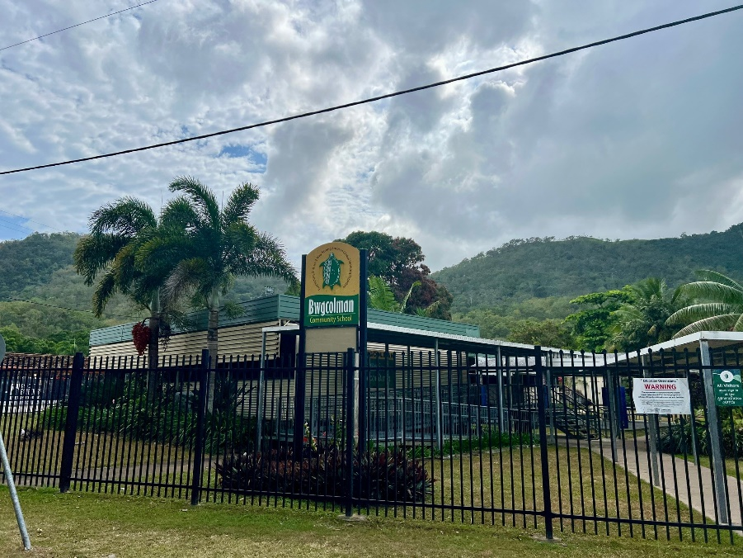

Thankyou
Sandra Smith:
Smith.SandraJ@police.qld.gov.au
Dr Rebekah Chapman: Chapman.Rebekah@police.qld.gov.au
Deborah Kelso:
Kelso.DeborahR@police.qld.gov.au

