Slide 1


Exploring the intersection between DFV and substance abuse and the policy responses that can be put into practice
Cathy Humphreys, Margaret Kertesz and Van Callaly
University of Melbourne
BOCSAR Conference 5ᵗʰ August 2025
1
Notes:
I need to acknowledge Margaret Kertesz and Van Callaly. We have worked as a research team for several years and so this presentation is a joint effort

Slide 2

Acknowledgement of Country
I acknowledge the Traditional Custodians of the unceded lands and waterways on which we meet today and pay respect to the Elders past and present.
I extend respect to Aboriginal or Torres Strait Islander people who are present today and note the importance of cultural safety for Aboriginal and Torres Strait Islander with whom we meet and work.
Diversity and Inclusion painting by artist, Chern'ee Sutton
Notes:
Acknowledgement
2

Slide 3


Overview
  Brief history of our involvement with AOD and DFV
  Evidence of the intersection of DFV and AOD
  Conceptualising substance use coercion (aspects of coercive control)
  KODY program findings
  Mystery of siloed sectors/fragmentation
  Implications for policy and practice development
3

Slide 4
Programs of applied research and evaluation
  The Stella Project, London 2003
  THE STACY Project: Safe & Together Addressing ComplexitY; ESTIE, ALFies, CHRISTIE Projects
  KODY Project (Kids First and Odyssey House addressing intersections of AOD and DFV); Policy Stakeholder Group
  The PIPSI Project (Prioritising Intersectorial Practice: Strategies and Innovations)
4

Slide 5
Evidence of the intersection of AOD and DFV
  Substance use increases the frequency, severity and intensity of family violence (Canfield, Radcliffe, D’Oliveira, & Gilchrist, 2019; Laslett et al., 2021; Ramsoomar, Gibbs, Chirwa, Dunkle, & Jewkes, 2021).
  Risk of severe physical injury twice as high when substances are involved (Mayshak et al, 2022).
  Victim-survivors may turn to using substances to cope with family violence (Phillips et al., 2020; Noonan et al, 2017).
  Exposure to these two issues reduces children’s sense of safety - increasing likelihood of child protection involvement (Victor et al., 2018) and forcible removal into out-of-home care (Canfield et al., 2017; Luu et al, 2024).
5

Slide 6
Homicide and Police Data
  Domestic homicide data – 240 women murdered by current or former male partner (2010-2018). 60% of offenders were substance affected at the time of the homicide (Australian DFV Death Review Network, 2022).
  Police offence data – between 24%-54% of DFV incidents alcohol related; 1%-9% illicit drug use related (Miller, 2016).
6

Slide 7

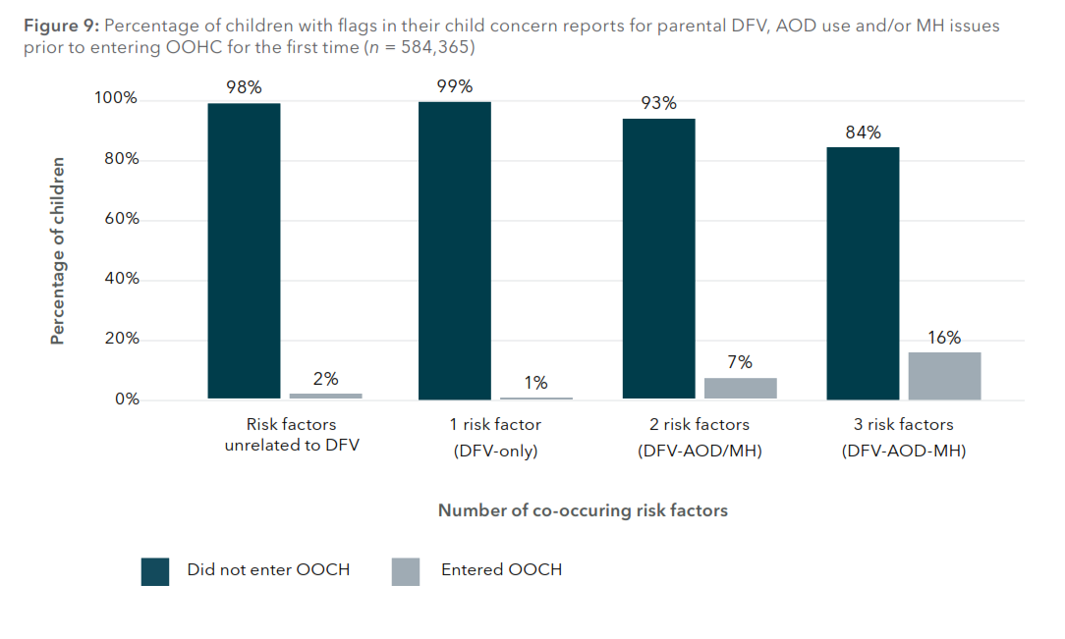
Risk factors increase the likelihood of entering OOHC (Luu et al., 2024)
7
Notes:
What is the evidence base?
The analysis of administrative helpline data from CP in NSW.
7

Slide 8
Adult survivor data: US DV Helpline Data (Warshaw et al., 2014)
  3,248 survivors surveyed about substance use.
  25% used substances to reduce physical pain caused by abuse.
  15% sought help for their substance use and 60% discouraged or sabotaged in accessing treatment.
  Substance use actively used to discredit help-seeking.
8

Slide 9
Substance Use Coercion
  Substance use coercion is an aspect of coercive control and refers to a pattern of behaviors in which one partner uses tactics of abuse and violence to control or manipulate the other partner's substance use, or alternatively to exacerbate or excuse their own violence, often as part of a broader pattern of power and control.
9
Notes:
We are interested in shifting the language – not causal; not co-occurring; but entwined
Recognising substance use as an aspect of coercive control. It is in fact the core business of the DFV sector
9

Slide 10


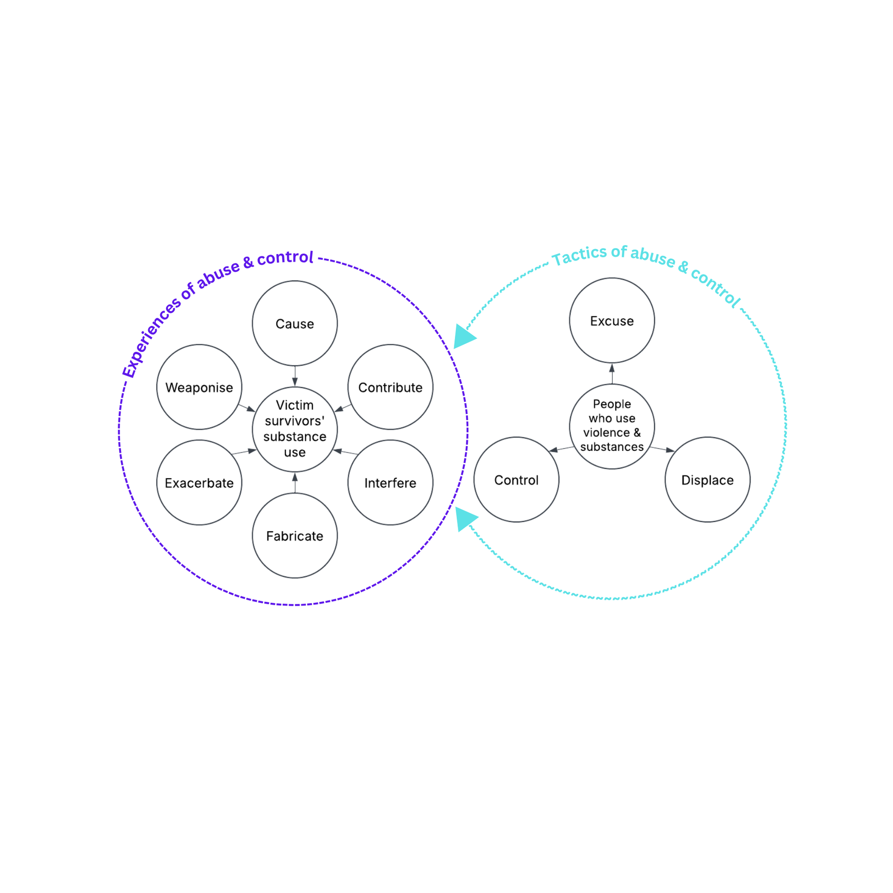
Substance use coercion
(tactics of abuse)
10
Notes:
Different responses from different sectors
Van Callaly, David Mandel and Margaret Kertesz all contributed to this diagram in different ways
Developed further by David Mandel – how does the person using violence weaponise the survivor’s substance use – the ‘gotcha moment’
How does the person using violence fabricate
Go through this slide
This is core business
Profound issues for the substance use sector on how they address the gendered issues. Is this nuance and understanding being addressed?
10

Slide 11











The KODY Program
Case Coordination
“All of family approach”
AOD Practitioner
KODY Caring Dads Facilitators
AOD Counselling
The KODY program innovates by:
  Bringing AOD content into Kids First’s Caring Dads program and providing case coordination for fathers through a collaborative effort by DV and AOD practitioners;
  AOD counsellor alongside Caring Dads group work program provided at Odyssey House;
  Taking an all-of-family approach that integrates Odyssey House Victoria’s Kids in Focus family-centred program to ensure the safety and wellbeing of children and providing parenting and family support through family case coordination.
Kids in Focus
KODY Caring Dads
Child & Family Wellbeing Practitioner
KiF Case Manager
Notes:
One of many projects around the country
BUT few projects survive. An international scoping review found that of 15 peer reviewed programs for men who use violence in the context of alcohol and other drugs that half were not longer in existence by the end of the scoping review.
11

Slide 12
Findings from the KODY project (Part A)
  Characteristics of the men – compared to the BAU Caring Dads program – men had much more substantial histories of violence – more convictions, more intervention orders, more breaches, double the number of violence charges (more violent outside the family).
  Referral from the AOD workers was difficult.
  Significant level of attrition.
  Collaboration needed to be funded and formal – goodwill between organisations and staff only lasts for about 18 months (burn out).
  Most women had moved on and therefore evaluation was difficult re triangulation with the men’s narratives.
12
Notes:
All these findings have policy implications
12

Slide 13
Findings from the KODY Policy Stakeholder Group (Part B)
  23 Senior Managers from Govt, CSOs, Peak Bodies – key interest in collaboration between AOD and DFV.
  Initial interviews.
  Meeting 9 times over a 3 year period.
  Input into Inquiries, submissions, discussions to progress collaboration.
  Metaphor analysis of the language of collaboration.
13
Notes:
A metaphor analysis of 6 workshop/sessions over a 2 year period explored the metaphors that were used that either facilitated or created barriers to collaboration.
Geo-political metaphors; business metaphors; fixing infrastructure; playing a game.
13

Slide 14
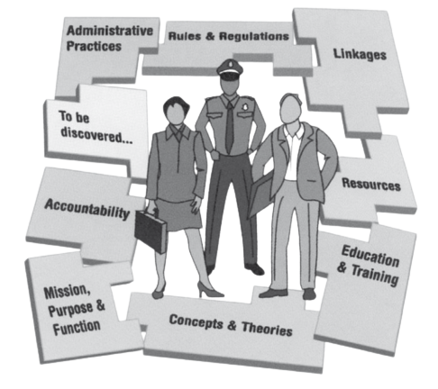
Organisational Ethnography:
The PIPSI project
Pence, E., Mitchell, S., & Aoina, A. (2007). Western Australia Safety and Accountability Audit of the Armadale Domestic Violence Intervention Project. Perth Western Australia: Western Australian Government.
14
Notes:
Go through this slide
In the Policy stakeholder group associated with the KODY project – a significant amount of time was spent on concepts and theories and language.
14

Slide 15
QNADA: DFV Capability Project (a further example)
  Workforce survey result: 92% of AOD staff encounter clients experiencing DFV weekly.
  Capability workforce assessment: Client centred practice – DFV aware but needs improvement in intake, assessment, documentation, consent processes
  Professional development – minimal training in DFV.
  Organisational policy and quality – basic awareness of DFV in policy but not linked to quality improvement system.
  System’s integration – 31% not engaged with local DFV networks; 7.5% active participation in cross-sector response; no specific funding.
15

Slide 16
Potential areas for advocacy
South Australian Context: Review of the Alcohol Liquor Licensing Act (1997)
The AOD sector has submitted three key recommendations, citing concerns that each additional hour of alcohol accessibility increases the risk of DFV related harm.
  Focus on harm reduction - expand the definition of alcohol-related harm to include DFV.
  Implement a Minimum 2-Hour Delay for Online Alcohol Deliveries.
  Restrict Hours for Alcohol Delivery.
16

Slide 17
A fragmented service system is a destructive service system
Men, women and children live with the intersecting issues of DFV with AOD.
Our service system response has been to fragment and silo these experiences.
Mystifying to those outside our sectors about why and how we do this.
Early PIPSI project interviews indicate the field is changing.
17
Notes:
The siloing of sectors – the practice and policy is falling behind the experiences of children, women and men.
Not only the AOD and DFV sectors – housing, justice, CP, MH
But its not an easy fix
International scoping review – only 9 programs evaluated that addressed the intersecting issues of substance use and DFV – in spite of promising findings from evaluations half had not been refunded
16

Slide 18
Typical Case Example
  The children of Jenny and Matt have come to the attention of child protection. The children are a 5 year old boy, Samual and a 7 year old girl, Simone. The children were referred to CP by police following a serious incident of domestic violence where Matt assaulted Simone resulting in injuries that involved attention at Accident and Emergency. Police recorded that Simone and Matt had been drinking and that Simone was drunk at the time of the incident. Simone returned home following treatment for her injuries. The children were staying with Simone’s parents.
  A case conference was called by CP and held with the professionals involved. A case plan was drawn up that recommended that Simone attends an alcohol treatment program and referral to DFV service; Matt attend a men’s behaviour change program; and that the children stay with the grandparents while the treatment programs are put in place for the parents.
  Matt and Simone have agreed to the plan.
18
Notes:
Will this plan address substance use coercion and its effects?
17

Slide 19
Implications for Policy and Practice: Assessing a functional system for responding to substance use coercion (SUC)
  Efficacy (does it produce its intended outcome? Providing a service to men, women and children where there is SUC)
  Efficiency (does it do this with the best use of resources?)
  Effectiveness (does it achieve a higher-level or longer term aim? The safety of women and children; accountability for the person using violence; and desistance from AOD and DFV)
  Ethicality (are the purposes of the system met in ways which are congruent with principles and values which promote respect and justice for children and others affected by domestic violence and substance use coercion (usually women)
19
Notes:
Peter Checkland – soft system methodology
Moral injury
"For every complex problem there is an answer that is clear, simple, and wrong,"
18

Slide 20
Policy/Practice issues to be addressed
  Attention to intersection of AOD and DFV written into national plans in the Drug Sector; Alcohol Sector; National Family Violence Plans (Aboriginal; Woman and Children).
  Control of the density of alcohol outlets.
  Earlier intervention – adolescent to parent violence prioritised
  How to resource a funding stream that could address substance use coercion – Currently, AOD services and DFV services (services for women; services for children; services for men) have siloed funding streams?
  Bringing together key leaders across the sectors to strategically plan the intersection of DFV and AOD (peak bodies are siloed but sometimes develop work together).
20
Notes:
Creates authorisation
PIPSI Strategic Policy Group
19

Slide 21
Policy/Practice Issues
  DFV Risk assessment and risk management implemented in AOD organisations.
  Learning from holistic family response models in the Aboriginal Sector where they are addressing intersection of AOD and Family Violence.
  Police training on mis-identification of the primary perpetrator of violence and abuse (who is in fear?)
  Chairs of high risk panels (SAMS; RAMPs etc) trained to respond to substance use coercion.
  Safe & Together model (or the principles of S&T) implemented across sectors working with children – attention to complexity.
21

Slide 22
Policy/Practice issues continued
Agreeing a plan for addressing substance use coercion:
  a) Workers trained to address substance use coercion – joint training?
  b) Strategic advisors for secondary consultations with each sector?
  c) Alcohol counsellors based in a MBC program or specialist FV sector organisations for adult and child survivors?
  d) Joint case management is funded and information sharing is legislated?
  e) Development of programs that address substance use coercion (Uturn; Advance; KODY Caring Dads; All of family programs)?
  f) Generic family services workers trained to respond to substance use coercion
22

Slide 23

Where to from here?
  The evidence is clear
  The practice is not…
  The policy settings are not…
  There is an appetite for change…
  Where are the avenues for change?
23

Slide 24
References
Healey, L., Heward-Belle, S., Humphreys, C., Isobe, J., Tsantefski, M. & Young, A. (2020). Working at the intersections of domestic and family violence, parental substance misuse and/or mental health issues. Research report of the STACY Project: Safe & Together Addressing ComplexitY. Melbourne, University of Melbourne. https://violenceagainstwomenandchildren.com/wp-content/uploads/2020/10/STACY-working-with-complexity-Final-Report.pdf
Heward-Belle, S., Kertesz, M., Humphreys, C., Tsantefeski, M. & Isobe, J. (2022). Participatory practice guideline development at the intersections of domestic and family violence, mental distress and/or parental substance use. Advances in Dual Diagnosis, 15, 51-65 https://www.emerald.com/insight/content/doi/10.1108/ADD-12-2021-0017/full/html
Humphreys, C., Kertesz, M., Parolini, A., Isobe, J. (2020). Safe & Together Addressing ComplexitY for Children (STACY for Children): Key findings and future directions (Research to policy and practice, 22/2020). Sydney: ANROWS https://20ian81kynqg38bl3l3eh8bf-wpengine.netdna-ssl.com/wp-content/uploads/2020/10/ANROWS-RtPP-Humphreys-STACY_children.pdf
Warshaw, C. and Tinnon, E. (2018), “Coercion related to mental health and substance use in the context of intimate partner violence: a toolkit for screening, assessment, and brief counseling in primary care and behavioral health settings”, US National Center on Domestic Violence, Trauma and Mental Health and the National Domestic Violence Hotline

Slide 26

Contemporary metaphor analysis
        Metaphor analysis used as a data analysis tool to illuminate different ways of understanding cross-sector collaboration.
        Metaphors are "understanding and experiencing one kind of thing in terms of another” (Lakoff & Johnson 1980, pp.5).
        People use metaphorical concepts to understand, talk and reason with others (Ibanez & Hernandez 2011).
        Provided a structured way to explore situation before identifying opportunities for change (McClintock et al. 2004)
Notes:
1.7.2013
What’s this got to do with policy – nothing so practical as a good theory
Goes beyond the idea of barriers and facilitators
‹#›

Slide 27
1. Engaging with Geopolitics
Substance use and family violence sectors are different planets with unique cultures, histories and populations. Collaboration involved protecting each sector's territory and resources.
Ways to conceptualize collaboration
2. Fixing Infrastructure
Cross-sector collaboration required long-term plans to redesign and rebuild broken infrastructure.
3. Running a business
Cross-sector collaboration supports the provision of efficient services. Every sector must fulfil their core business while collaborating to maintain a competitive advantage.
4. Playing a game
Cross-sector collaboration entailed different players to come together, adhere to shared rules in order to reach their goals. Fair rules of play required players to demonstrate trust, respect and commitment to the game.
Notes:
1.7.2013
My findings found four dominant ways in which participants conceptualised and enacted cross-sector collaboration.
list these...
i will now go into further detail of each of these metaphorical concepts and how they influence particpants' colloborative capacity
‹#›

Slide 28



Perception of Threats
“Mental health is a massive system, and drug and alcohol is very tiny in comparison to that. I think with the family violence sector, we felt a little bit more equal, or perhaps even parts of the family violence sector seemed smaller. So, we are in a very… different power, power position as compared to mental health.” (P07, substance use)
“There’s that whole idea that if you talk about alcohol in the context of family violence, you’re blaming it on the alcohol… there is a particular form of feminist theory that really pushes back on that.” (P21, research)
Substance Use
Sector
Mental Health Sector
Family Violence
Sector
Notes:
1.7.2013
Participants from the substance use sector deemed the mental health sector to be a threat to their sovereignty, however, a comparison between the substance use and DFV sectors revealed a different power dynamic. Despite the significant investment of resources into the Victorian DFV sector, professionals in the substance use sector did not identify domestic violence as a threat to their authority and influence.
QUOTE
In contrast, the issue of substance use by perpetrators of violence emerged as a potential threat to the DFV sector. Participants from the family violence sector raised concerns that in addressing perpetrators’ use of substances, their violence becomes a secondary issue or a means to excuse violence. Consequently, DFV professionals have been found to adopt defense strategies to safeguard their field from the substance use sector.
‹#›

Slide 29

Running a business
Maximizing work
Streamline, increase client satisfaction, improve efficiency
Competitive advantage
Risk, cost, benefits
Motivation
Incentivise, reward, sell, buy in
Time as a commodity
Resources, spend time, waste time, use time
Notes:
1.7.2013
The third metaphorical concept:
Collaboration between substance use and DFV sectors was understood as running a business where participants worked together to provide more efficient services. Throughout participant interviews, different sectors came together to maximize their work output - “improve efficiency, streamline, increase client satisfaction.” Each organization had designated “core business” to fulfil, but concurrently collaborated to maintain a competitive edge – “risk, reward, cost, benefits.” Participants, therefore, had to “sell, incentivize” others to engage with collaborative practices. Central to most business practices, there was the desire to innovate, which requires an investment of resources including energy, financial capital, and time. In this context, time was conceptualized as a scarce commodity– “spend time, waste time.” Underpinning this metaphorical concept were neoliberal tendencies shaping the way participants related to other collaborators.
‹#›

Slide 30
Core Business
“Everything is trying to narrow you down to your core business in a very capitalist, market-driven world. So, for an AOD service where their core business is AOD work, what's going to motivate them to spend time on collaboration practices?” (P12, DFV)
Notes:
1.7.2013
As part of this metaphorical concept, participants made active boundary judgements concerning their core business. Collaborative work deemed outside of participants’ core business practices used up time, which was perceived as a precious and finite commodity.
Participants' perception of their core business was intrinsically linked to governments' performance measures. The government's implementation of market-oriented policies to increase service efficiency and cost-effectiveness was deemed detrimental to collaborative practice. Narrow performance standards set by governments hindered participants' attempts to "sell" collaboration to others.
‹#›

Slide 31


Playing a Game
Participants
Players, champions
The game
Rules, timeout, boundaries, goals
Play
Flexibility, trust, communication, two-way conversation
Notes:
1.7.2013
Cross-sector collaboration between substance use and family sectors was conceived as playing a game. This arose in participants' descriptions of different “players” or “champions” coming together to “adhere" to "shared rules, understanding, principles” and reach predetermined “goals.” In this study, two significant and interlinked elements of collaboration as playing a game are explored. Firstly, an agreement about the “game”, which referred to the established structure of collaboration - “timeout, goals, boundaries.” Secondly, an intrinsic part of collaboration as playing a game was the process of “play”, which has its own implicit rule set – “flexibility, trust, communication, open dialogue, two-way conversation.” Participants found that collaboration ceases to function when there was an insufficient shared understanding of the rules associated with the game structure and play process. Ineffectual collaboration may appear as a clash of rule sets, as though one team is playing football and the opposing team basketball.
‹#›

Slide 32

The Game
“Often people don’t understand what another sector’s world is like, what the constraints are, what the rules are, what they can do, what they can’t do.” (P05, Substance use)
“Where collaboration works best is where they, they regard themselves as an entity… it’s like taking that next step beyond an individual organization’s needs to what’s the collective… the common goals… forgetting… your own vested interests.” (P23, Family welfare)
Notes:
1.7.2013
One cornerstone of collaboration as playing a game was the importance of adhering to the rules and boundaries. Participants discussed a need for a shared understanding of rules, which needed to be defined and negotiated to determine one’s position on the field.
QUOTE
Participants discussed that working together to reach overall goals increased their motivation to collaborate. Tensions arose when participants attempted to meet conflicting goals such as those established by their work organization and those of the collaborative group.
QUOTE
‹#›

Slide 33

Collaborative Bottlenecks
    Topics that a particular sector persistently raised, but it elicited limited engagement from others.
    In some cases, one sector remained silent on the topic. Silence can serve as a way to avoid engagement or deal with uncomfortable emotions (Fairclough, 1992, pp. 152–153).
    These conversations typically led to shifts in focus to other areas, resulting in limited commitment to action.
Notes:
1.7.2013
‹#›

Slide 34
Areas of collaborative bottlenecks
Metaphor | Topic
'Political machinery' | Short-term funding cycles hinders long-term collaboration and creates dependency on political agendas - decisions outside of participants’ control.
'Unknown territory' | (De)gendering DFV: Efforts to use gender-neutral language in DFV discussions often revert to gendered terms, illustrating challenges in change.
‘Feeling lost’ | Accountability for people who use violence: Agreement on accountability for perpetrators, but hesitation in how to address substance use without compromising accountability.
Notes:
1.7.2013
Firstly, short-term funding cycles were consistently raised as a barrier to long-term collaboration. Participants described this as being 'under political machinery,' emphasizing how funding decisions were perceived as being entirely outside their control.
Two other areas were seen as ‘unknown territory’ leading to participants feeling lost:
The issue of (de)gendering DFV was a collaborative bottleneck
The AOD sector advocating for gender-neutral language. However, participants often defaulted back to gendered terms, reflecting the ‘unknown territory’ of changing deeply embedded gendered perspectives in the DFV sector.
It's important to note that stats - women and child are the disproportionally the victims. While there is interest in being inclusive for sexual and gender diversity – limited debate about whether gender-netural language was the way to proceed.
= Accountability for people who use violence was another stagnant topic. While there was agreement that individuals who use violence should be held accountable, there was little commitment to action. Participants expressed uncertainty about how to address people who use violence and substances without colluding or diluting accountability within their programs.
These bottlenecks illustrate persistent tensions that continue to hinder collaboration, even when there is some level of agreement.
‹#›

