Slide 1

Alternative justice for DFSV: What we can learn from the ACT experience Hayley Boxall

Slide 2
“Trying to balance what will never be equal”
Auntie Yvonne Weldon

Slide 3
Restorative justice in the ACT
1995–2000:
ACT-based Reintegrative Shaming Experiments (RISE) focused on youth, property crime, drink driving
Domestic and family violence deliberately excluded due to concerns at the time
2004
Youth diversion for minor offences.
2018
2016
Expanded to include adult offenders and serious offences.
Further expansion to include domestic and family violence (DFV) and sexual violence (SV)
Crimes (Restorative Justice) Act
Notes:
Desistance is broadly focused on the processes by which offenders…
Seen as fairly revolutionary to explore why people stop, as opposed to start or persist
Originally defined as an ‘event’ where an offender stops
However, has evolved over time – dual taxonomy
Instead of an event, it is a process of maintenance

Slide 4
Evaluation
Period: Nov 2018 – Aug 2022
Context: COVID-19 disruptions to conferencing and recruitment
Data sources:
Stakeholder interviews (n = 47)
RJ participant interviews (n = 16) (PH/PR/supporters)
Post-conference surveys (n = 28)
Analysis of linked administrative data extracted for RJU participants and a control group (ACT Policing + ACT Corrective Services data)
Notes:
Desistance is broadly focused on the processes by which offenders…
Seen as fairly revolutionary to explore why people stop, as opposed to start or persist
Originally defined as an ‘event’ where an offender stops
However, has evolved over time – dual taxonomy
Instead of an event, it is a process of maintenance

Slide 5
PROCESS

Slide 6
Key features of the RJS
Risk or need | Phase Three design response
Power imbalances | Co-convenor model with gender-based violence training
Coercion or manipulation by PR | Participation is voluntary; PR must accept some responsibility; apologies not required
Patterned nature of abuse | Full relationship history reviewed—not focused on single incidents
Victim-survivor safety and control | Continuous risk assessment; person harmed can withdraw at any time
Notes:
Desistance is broadly focused on the processes by which offenders…
Seen as fairly revolutionary to explore why people stop, as opposed to start or persist
Originally defined as an ‘event’ where an offender stops
However, has evolved over time – dual taxonomy
Instead of an event, it is a process of maintenance

Slide 7
Snapshot of referrals (n = 162)
Persons Harmed (n = 208)
Persons Responsible (n = 165)
76% male
Main referrers
Magistrates Court (42%)
Type (non-mutually exclusive categories)
Family violence (60%)
19% Indigenous
15% under 18 years
69% female
23% Indigenous
33% under 18 years
ACT Policing (38%)
Children’s Court (11%)
IPV (36%)
sexual violence (10%)
Notes:
Desistance is broadly focused on the processes by which offenders…
Seen as fairly revolutionary to explore why people stop, as opposed to start or persist
Originally defined as an ‘event’ where an offender stops
However, has evolved over time – dual taxonomy
Instead of an event, it is a process of maintenance

Slide 8
Referral type (%)
Notes:
Desistance is broadly focused on the processes by which offenders…
Seen as fairly revolutionary to explore why people stop, as opposed to start or persist
Originally defined as an ‘event’ where an offender stops
However, has evolved over time – dual taxonomy
Instead of an event, it is a process of maintenance

Slide 9
Taking responsibility: eligibility criteria vs outcome
“I’ve seen that happen through defence work, where the person has said, ‘Yeah, we just sort of signed up because I thought that would look good, but in fact it was actually quite good to meet with the person and I got something out of it’ … I would say that it would be foolish to refuse someone just because they’re trying to get a benefit. Every person who’s before a court and is about to be sentenced is trying to do everything that will look good for them”. (Legal professional)
“I’m not here to judge people … my job is to work with you to get you to a place where you can acknowledge and also hear the impact you’ve caused and be able to respond to that” (RJ practitioner)
Notes:
Desistance is broadly focused on the processes by which offenders…
Seen as fairly revolutionary to explore why people stop, as opposed to start or persist
Originally defined as an ‘event’ where an offender stops
However, has evolved over time – dual taxonomy
Instead of an event, it is a process of maintenance

Slide 10
Taking responsibility: eligibility criteria vs outcome
“I knew that he wouldn’t be able to answer my questions with any depth or I wouldn’t get any clarity. I knew that. It was more about me having a platform to say what I wanted to say. And whether he understood and comprehended that, I didn’t care. I just needed to say those things, air my grievances and get my money and walk away. And that’s exactly what it provided me, a safe space to do that”. (Person harmed, sexual violence)
Notes:
Desistance is broadly focused on the processes by which offenders…
Seen as fairly revolutionary to explore why people stop, as opposed to start or persist
Originally defined as an ‘event’ where an offender stops
However, has evolved over time – dual taxonomy
Instead of an event, it is a process of maintenance

Slide 11
Snapshot of conferences (n = 24)
Type (non-mutually exclusive categories)
CPV (50%)
IPV (current partner) (25%)
Sibling-to-sibling violence (10%)
Agreements
Made in 63% of matters
100% of PR said agreement was fair
78% of PH said agreement was fair
Delivery mode
92% in-person
8% remote/video-link
Satisfaction with outcomes
PH: 100% at end of conference, reduced to 80% at time of survey
PR: 100% at end of conference and at time of survey
Notes:
Desistance is broadly focused on the processes by which offenders…
Seen as fairly revolutionary to explore why people stop, as opposed to start or persist
Originally defined as an ‘event’ where an offender stops
However, has evolved over time – dual taxonomy
Instead of an event, it is a process of maintenance

Slide 12
Catharsis and truth telling
Post-conference survey results (n = 28):
89% felt they were able to say what they wanted to say
86% felt the conference gave them the chance to explain how they were affected
82% felt they were treated with respect throughout the process
“It gave me an opportunity to say how it made me feel in a way that he wasn’t going to interrupt me and he had to listen. Whereas, in the home setting if he didn’t want to hear it, he would just walk away or distract himself or me with something else”. (Person harmed, family violence)
Notes:
Desistance is broadly focused on the processes by which offenders…
Seen as fairly revolutionary to explore why people stop, as opposed to start or persist
Originally defined as an ‘event’ where an offender stops
However, has evolved over time – dual taxonomy
Instead of an event, it is a process of maintenance

Slide 13
outcomes

Slide 14
Victim-survivor recovery
Greater emotional clarity and closure
A sense of validation that helped shift blame and shame
Feeling less fearful or trapped after the process
Enhanced capacity to move on with life, regardless of PR’s remorse
Notes:
Desistance is broadly focused on the processes by which offenders…
Seen as fairly revolutionary to explore why people stop, as opposed to start or persist
Originally defined as an ‘event’ where an offender stops
However, has evolved over time – dual taxonomy
Instead of an event, it is a process of maintenance

Slide 15
Victim-survivor recovery
“I did get the answers, although they weren’t answers I was looking for, I did get answers to why … I got the answers that I needed, even if they weren’t the answers that I wanted.” (Person harmed, sexual violence)
“I felt heard, even though I didn’t need my perpetrator to understand what I was saying. I just needed a space to say it. And I don’t think I realised how helpful that was going to be to me”. (Person harmed, family violence, 2021)
“I felt great. It actually felt like a weight had been lifted off me. I just didn’t have to deal with that anymore. It was finally done … Our meeting went for about an hour or two and I got to say everything I wanted to say, and it was like a line under that part of my life.” (Person harmed, sexual violence, 2021)
Notes:
Desistance is broadly focused on the processes by which offenders…
Seen as fairly revolutionary to explore why people stop, as opposed to start or persist
Originally defined as an ‘event’ where an offender stops
However, has evolved over time – dual taxonomy
Instead of an event, it is a process of maintenance

Slide 16
Relationship repair
“Since then things have been better, we are communicating … Everyone is aware they don’t want to have a similar situation … I felt for our family it was important but I also wanted to make sure that our son wouldn’t be becoming a violent person. That was important to me”. (Supporter, family violence)
“It had a positive impact on the trajectory of our relationships. It put us in a place where we could keep growing in our relationships, rather than being stalled and estranged from one another”. (Person harmed, family violence)
Notes:
Desistance is broadly focused on the processes by which offenders…
Seen as fairly revolutionary to explore why people stop, as opposed to start or persist
Originally defined as an ‘event’ where an offender stops
However, has evolved over time – dual taxonomy
Instead of an event, it is a process of maintenance

Slide 17
Impact on reoffending – Identity work and redemption scripts
“I wanted to forgive him. I live in a world where forgiveness is a really powerful thing … I think it was more for his benefit that he apologised so that then, when I said I accepted his apology, he could feel forgiven. When I had probably already forgiven him, he needed to accept that I’d forgiven him. But by apologising and me accepting his apology publicly in that meeting, in the conference, that then gives him freedom”. (Person harmed, family violence)
Notes:
Desistance is broadly focused on the processes by which offenders…
Seen as fairly revolutionary to explore why people stop, as opposed to start or persist
Originally defined as an ‘event’ where an offender stops
However, has evolved over time – dual taxonomy
Instead of an event, it is a process of maintenance

Slide 18
Reoffending
 | Adults | Young people
Prevalence of reoffending | No diff | No diff
Frequency of reoffending | Fewer offences (59% diff) | No diff
Time to first reoffence | No diff | No diff
Notes:
Desistance is broadly focused on the processes by which offenders…
Seen as fairly revolutionary to explore why people stop, as opposed to start or persist
Originally defined as an ‘event’ where an offender stops
However, has evolved over time – dual taxonomy
Instead of an event, it is a process of maintenance

Slide 19
Key messages
Restorative justice can be a powerful and safe response when victim-survivor voice, choice, and preparation are prioritised
The ACT model has addressed common concerns through purpose-built safeguards: risk screening, trauma-informed facilitation, co-convenor model
For many victim-survivors, the process provided validation, catharsis, and emotional relief—even without PR remorse
Positive outcomes observed for adult PR reoffending, but youth require stronger post-conference supports
Conferences were most effective when embedded within a broader ecosystem of accountability and care
Notes:
Desistance is broadly focused on the processes by which offenders…
Seen as fairly revolutionary to explore why people stop, as opposed to start or persist
Originally defined as an ‘event’ where an offender stops
However, has evolved over time – dual taxonomy
Instead of an event, it is a process of maintenance

Slide 20
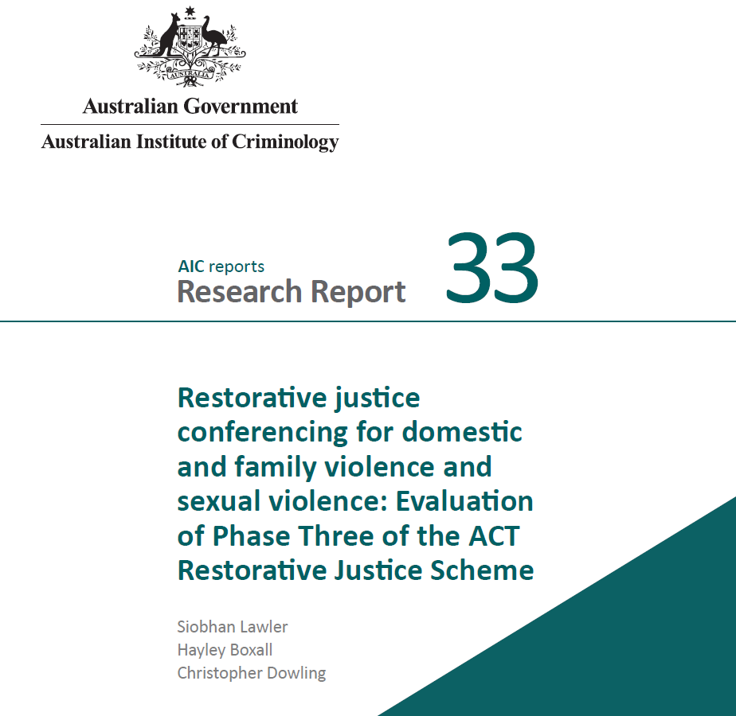
Thank you
Hayley.boxall@anu.edu.au
https://www.aic.gov.au/publications/rr/rr33

