Slide 1
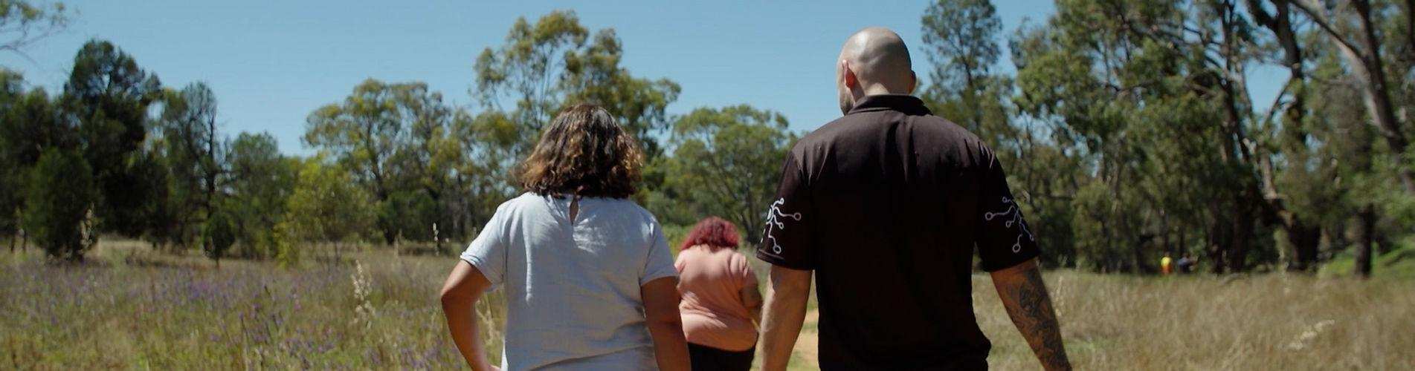
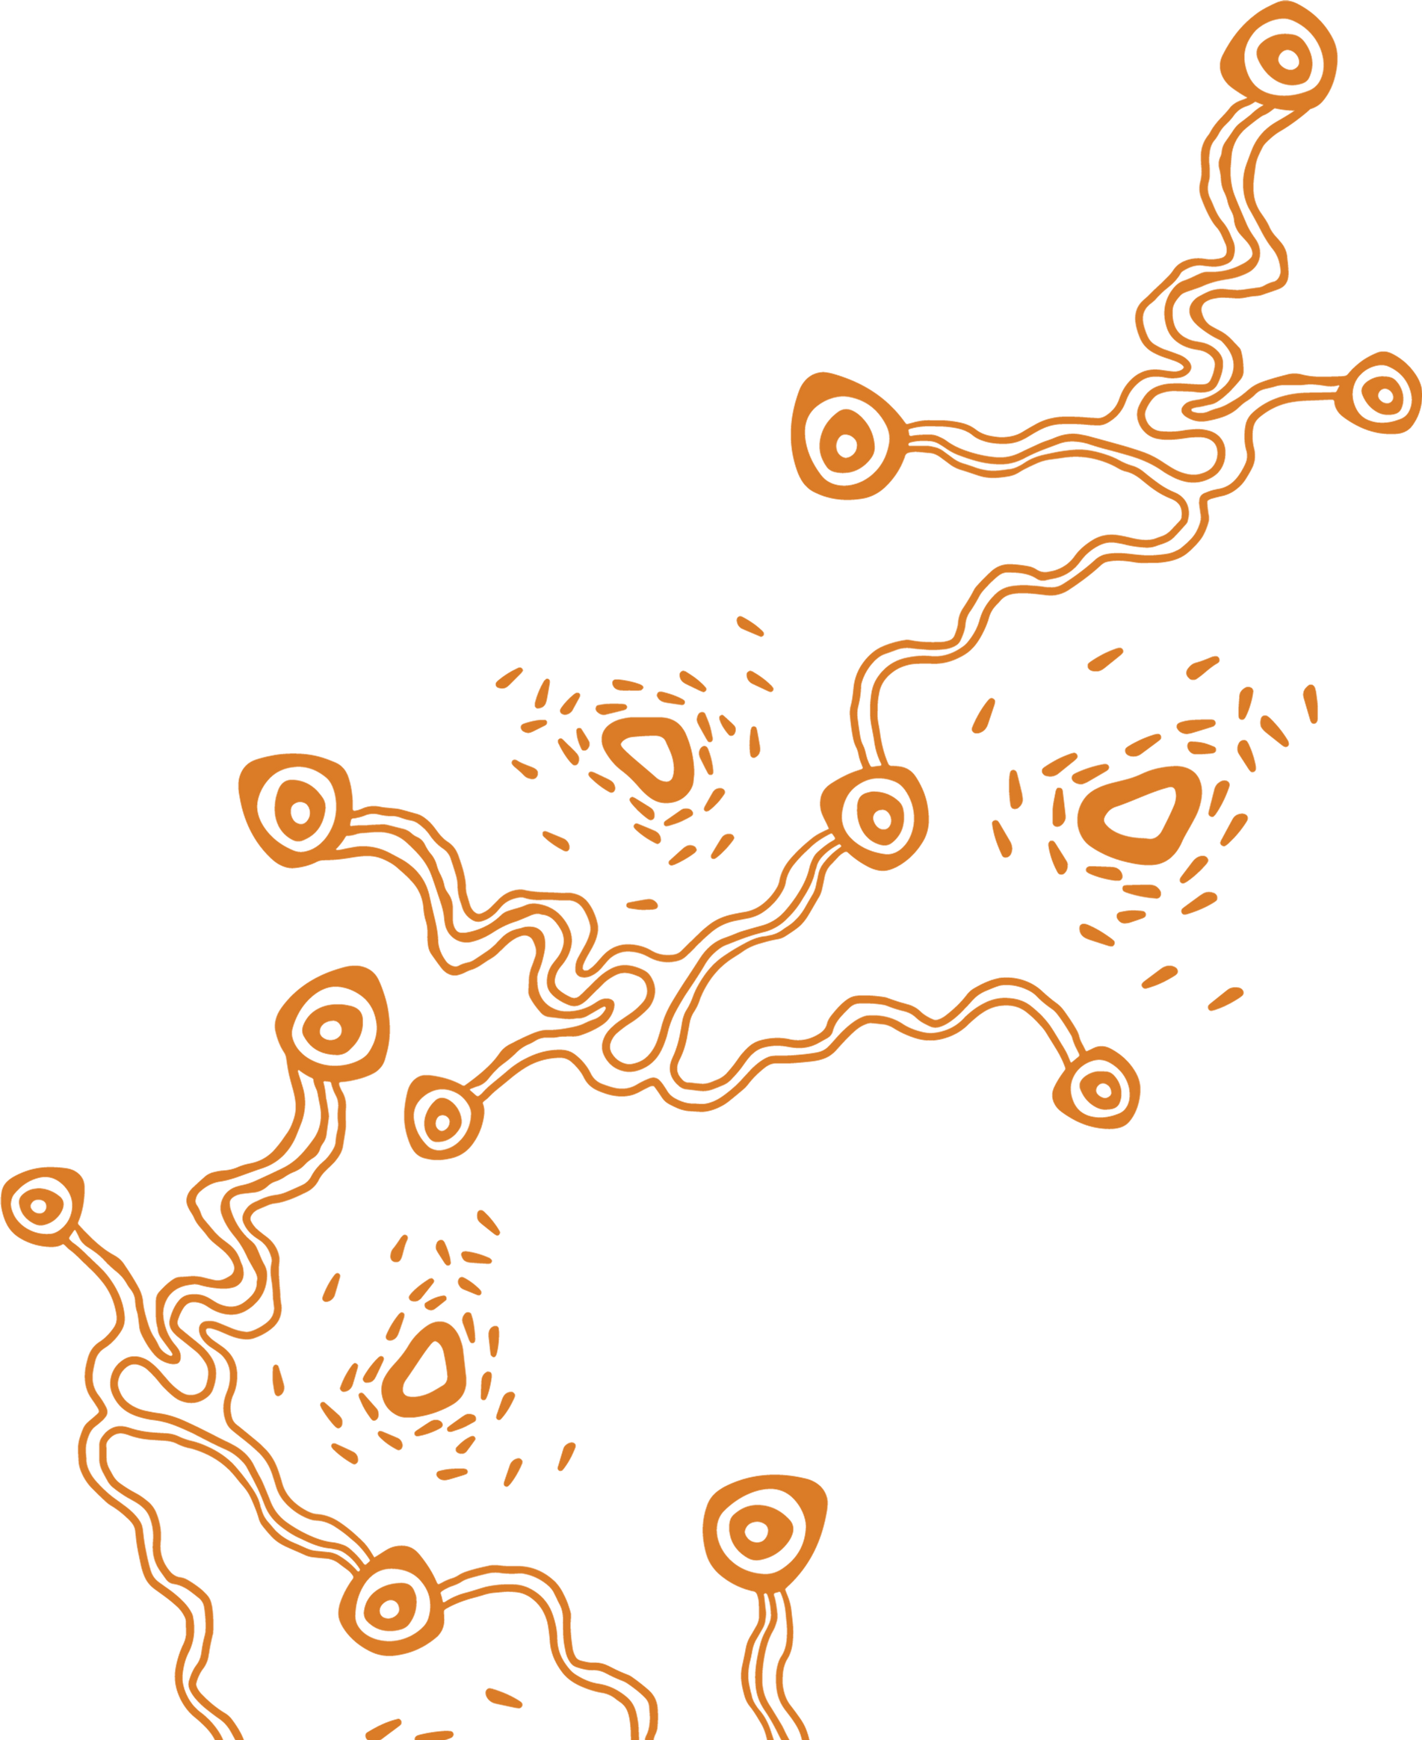

CoDesign in Practice: Embedding Aboriginal Voices in Justice Research
June 2025

Slide 2
”You never step into the same river twice, because both you and the river are in a constant state of change”
Want a copy of our CoDesign River Framework specific for research design?
Email sam.johnson@impactpolicyau.com
CoDesign as River System
Notes:
“Instead of you asking me questions, I’d like you to answer one:
What is one shift you could make in your work to embed lived experience in design, not just as data?”

Slide 3
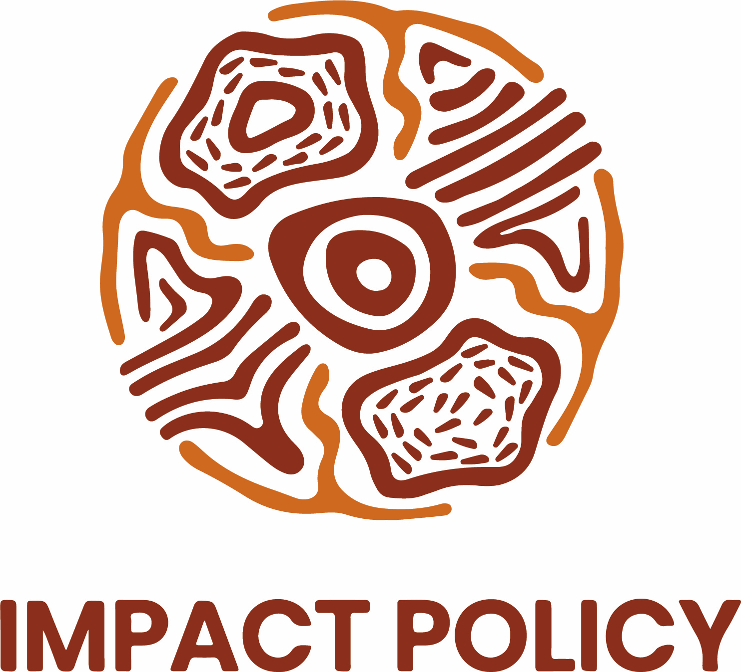
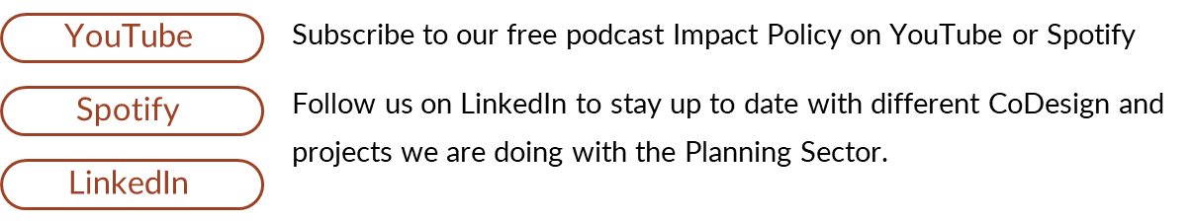
Who is Impact Policy?
Impact Policy is an Aboriginal owned and led consulting firm that specialises in Co-design, Strategy, Research and Communications.
We work largely with the public sector across a range of social policy portfolios and prior to Impact many of our staff come as experienced senior public servants.

Slide 4
Part 1: The Problem
"From Extraction to Empowerment: Why Traditional Research Fails"

Slide 5
Part 1: The Problem
Colonial Legacy in Research and Evaluation
Disconnection from Lived Experience
The friction of ‘Evidence-Based’
Lack of Cultural Safety in Evaluation Practice
Evaluation without Accountability
Notes:
Colonial legacy
Research has often been a tool of colonial control, not community benefit.
Aboriginal communities have historically been researched on, not with. We get treated as data sources rather than knowledge holders.
Evaluation frameworks have rarely been designed by or for Aboriginal communities they are external, imposed, and misaligned with community priorities.
“Too often, Aboriginal people have been the subject of research, not the leaders of it.”
Lived experience
Evaluation often measures what matters to institutions, not what matters to communities.
Lived experience is sidelined or tokenistic, used as input but not influence.
Critical Indigenous standpoint in theory and practice by many is described as secondary often too western research analysis.
This results in research or evaluations that are well-meaning but poorly designed, missing the mark on understanding what real impact looks like in context for our people.
Friction of evidence based
The term “evidence-based” often defaults to Western academic standards, dismissing Indigenous ways of knowing, storytelling, and cultural authority.
This leads to the devaluation of community knowledge, which is often more insightful, place-based, and sustainable than clinical or academic research measures.
“When we say something 'works', we need to ask: for who? And by whose definition?”
Lack of cultural safety
. Many research and evaluation processes are not culturally safe, lacking relational accountability.
There’s often no space for truth-telling, recognition of intergenerational trauma, or sovereignty, and data is extracted without proper Cultural governance.
Communities are tired of being consulted without being heard, engaged without power.
Evaluation without accountability
Many evaluations don’t result in change they sit on shelves. Or behind academic paywalls
Communities don’t see themselves in the findings, and worse, don’t see improvements in the systems evaluating them, or papers exist in language and communication that doesn’t translate locally and isn’t accessible.
This builds deep distrust in research and evaluation institutions.

Slide 6
Part 2: The Opportunity of CODESIGN
“Rethinking Research Design: CoDesign as a Tool for Systems Change”

Slide 7
Part 2: The Opportunity
1. Reframing Research as Relationship
Research can be a process of trust-building, not data extraction and transaction.
When we centre relationships first, community and stakeholder priorities guide the design not the other way around.
This is about a shift from "what do we want to know, do or get out of this project?" to "what do communities and stakeholders want to change?”
Notes:
Slide Visual Idea
A side-by-side comparison:
🔴 Traditional model (researcher-led, extractive, outcome-focused)
🟢 Rethought model (community-led, relational, process-focused)

Slide 8
But what is CoDesign??
Co-design means working together with others to create something new, like a product, a service, or an experience. It's about making sure everyone, no matter their background or abilities, has a voice in the creation process.
In traditional design, one person (like a designer or in your case a researcher) makes the decisions. In co-design, many people work together from the start.
Co-design involves everyone, including people who will use the product, service, or idea. It’s a team effort.

Slide 9

CoDesign & Collaborative Development of a Method
Respectful
Engagement and design is achieved through meaningful engagement with all stakeholders.
Inclusive
Participative
Prioritising engagement for participants in custody.
Ensuring as best possible everyone has an opportunity to have their voice heard
Outcomes Focused
Iterative
Understanding that together we are developing a method.
That the development is ongoing and that that is communicated back to priority groups
Ref: WA Council of Social Services
Notes:
Co-design processes are generally characterised by five core principles (WA Council of Social Services 2017). These are that the process is: Inclusive, Respectful, Participative, Iterative and Outcomes focused. Perhaps the most critical principle for this project is the equitable participation of all stakeholder groups. This principle underpinned the focus of the co-design engagement with a focus on participation and voices of the Walama List participants as a priority.

Slide 10
Part 2: The Opportunity
2. Centre Lived Experience and Cultural Authority
Lived experience is not anecdotal always. If we ask the right questions and create the right conditions it’s expertise.
Aboriginal community members, especially Elders and those with cultural authority, must shape the design, conduct, and methods for interpretation of research.
This also means valuing Indigenous knowledge systems and critical Indigenous research methods including yarning as method, story telling, country based understanding, and Cultural practice is critical.
Notes:
Slide Visual Idea
Circle diagram showing lived experience, cultural knowledge, and academic rigour in balance (not hierarchy).

Slide 11
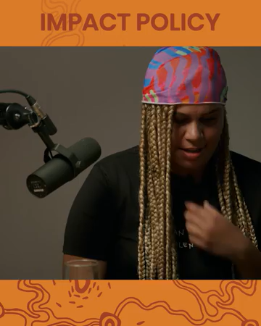
Part 2: The Opportunity
Notes:
Slide Visual Idea
Circle diagram showing lived experience, cultural knowledge, and academic rigour in balance (not hierarchy).

Slide 12
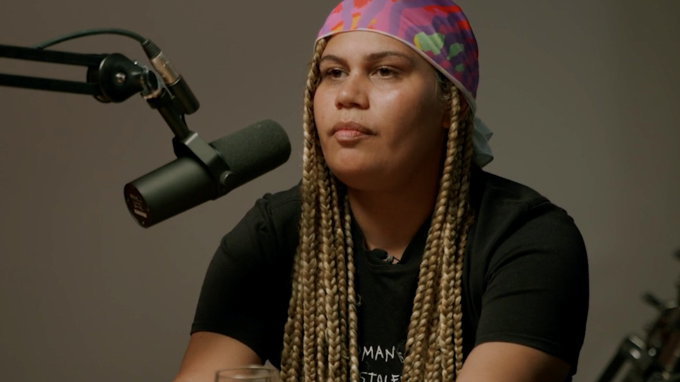

“He humanised my
brother, that judge in
that moment”.
Story is a qualitative First Peoples methodology that can capture insights, detail and analysis that often text cannot (Williams, Tait, Crabtree & Meher, 2018).
Story as a method can thus allow for a more comprehensive and clear understanding of the impact of Walama through stories of lived experience that structured and direct interview questions may not capture.
Chloe Quayle – Family member of Walama Participant

Slide 13
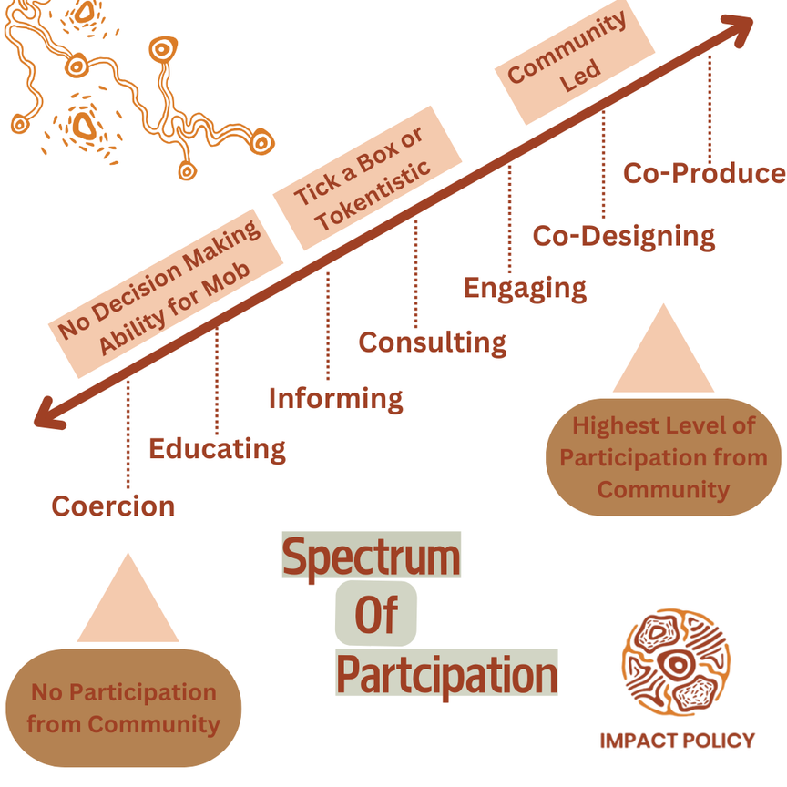

Slide 14
Part 2: The Opportunity
3. But how do you Co-design Research? What does this mean?
We Co-Design the questions, the indicators, the measures of success, who, where, how, which way
That means slowing down to:
  Understand community definitions of wellbeing, safety, success, etc beyond just statistics and and rates of reoffending.
  And then building evaluation tools that reflect these definitions.
Notes:
Slide Visual Idea
Example from Impact Policy work: show how a co-designed framework looked different from a standard logic model.

Slide 15
Part 2: The Opportunity
Agency and Participation
“I wanna be recorded and tell my story that way... I feel that I’ve got to tell my story.”
“Having a podcast or something like that’d be good, ask us questions, it’s confidential but it’s about sharing our past traumas and experiences. It would get out to community to show them what this program's doing for us…and how to break the cycle.”
Shared Benefits
I reckon it'd help a lot of young brothers struggling, hearing what people been through, what they’re going through and how they come out and been on top… hopefully catch them before they end up like us."

Slide 16
🎤 Part 2: The Opportunity
4. Creating Impact Beyond Reporting
Evaluation should drive learning, not just accountability.
If we do it right:
  Communities can use evaluation findings to advocate, grow programs, secure funding. Shared benefits should be clearly visible, understood and accessible for our communities.
  Policymakers receive context-rich insight, not just numbers.
When co-designed, research can create policy influence and community empowerment.

Slide 17
Part 3: The Impact
“Changing the System by Changing the Way We Listen”

Slide 18
Part 3: The Impact
1. Designing for Impact with Communities, Not Just On Behalf of Them
When we reframe research and evaluation as a co-led, culturally grounded practice, the impact is deeper, more sustainable, and more aligned with what communities value.
It also builds local capacity and community confidence and research becomes a tool for advocacy, action, and healing.
This is what we’ve been embedding in our work at Impact Policy.

Slide 19
Part 3: The Impact
2. The Ripple Effects
These approaches don’t just improve programs they rebuild trust.
We’re seeing increased community participation, stronger partnerships, and better policy alignment.
Organisations and departments are rethinking how they define outcomes and accountability.

Slide 20
Part 3: The Impact
3. What It Takes to Do This Work Well
This is complex work. It requires:
  Time - for trust, translation, and testing.
  Resources - paying lived experience experts, not just consulting them.
  Cultural governance - not just ethics approvals.
  Commitment to discomfort - for systems and staff to reflect and change.
At Impact Policy, we’ve developed a research design and co-design methodology that supports all of this from planning to policy influence.

Slide 21
🎤 Part 3: The Impact
4. Final Reflections & Call to Action
The opportunity is now: to rethink what research is for, and who it is for.
When lived experience, cultural authority, and co-design lead the way, we don't just evaluate impact, we create it.
Ask yourself:
  Are you always holding the pen?
  Who is getting to decide what matters?
  And what could be possible if we gave that power back?

Slide 22
Thank You!
GET IN TOUCH
Sam Alderton-Johnson
Founder and Managing
Director at Impact Policy
Sam.johnson@impactpolicyau.com
0466 036 006
www.impactpolicyau.com

