Slide 1

Closing the Gap
Information Repository
July 2025 Dashboard update
2025 Annual Data Compilation Report
BOSCAR ARCJC Conference 2025
Selwyn Button, Commissioner
Notes:
Selwyn

Slide 2

Acknowledgement of Country
Notes:
Selwyn
For over 65,000 years, Aboriginal and Torres Strait Islander people have sustained thriving, diverse, and interconnected systems of economies made up of systems and knowledge grounded in deep relationships with Country, kin, communities, trade, and innovation.
We recognise Aboriginal and Torres Strait Islander people as Australia’s first researchers, innovators, and knowledge holders, and honour their expertise and experience, built through an enduring connection to, and custodianship of, Country.
We acknowledge the Traditional Custodians of the lands, sea, and waters where we live, work and gather. We pay our respects to Aboriginal and Torres Strait Islander cultures, and to Elders past and present.

Slide 3
Presentation outline
Our role
2025 ADCR & July dashboard updates
Overview of progress
Considering context
Future considerations
Notes:
Selwyn
Here’s an overview of what we’ll cover today. Questions are welcome - please use the chat function and we’ll get to those at the end of the presentation.
For today, we’ll cover off:
Our role in the National Agreement
2025 ADCR & July dashboard updates – we’ll talk through some of the things that are new or have changed since last year
Overview of progress – we’ll provide a fairly quick look of the national picture of progress
Considering context – this is a look under the hood at the factors which contribute to the outcome areas
Dashboard demonstration – Amanda and Andrew will take you on a tour of the dashboard and look more closely at some of the targets and supporting indicators
Future considerations – we’ll finish up with some information about connected pieces of work and things coming up.

Slide 4
Our role

Slide 5
The Commission has important accountability roles under the National Agreement
PUBLIC ACCOUNTABILITY FRAMEWORK (SECTION 9)
Dashboard
Jurisdictions Annual Report
Productivity Commission Review
Annual Data Compilation Report
Response by
Joint Council
Coalition of Peaks Report
Aboriginal and Torres Strait Islander led Review
Notes:
Selwyn
For those of you who have been to a few of these presentations, you’ll have seen this slide before - we like to open with a reminder of the role of the Productivity Commission under the National Agreement.
Section 9 of the National Agreement explains what all parties have agreed to do to make sure progress towards Closing the Gap is properly monitored and held accountable.
[Note: the arrows show the main direction – not necessarily the only direction – of input across the elements.]
The Productivity Commission has two important roles:
One is in monitoring progress against the targets and indicators
This is via the Dashboard and Annual Data Compilation Report (underpinned by an Information Repository)
The other is in respect of assessing progress under the Agreement more broadly (though three-yearly reviews), noting we completed our first three-yearly Review in February 2024 and will commence planning for the second review shortly.
The Dashboard and Annual Data Compilation Report are key tools to keep governments accountable in achieving progress under the National Agreement.
the Dashboard provides up to date data (as per the Agreement is updated at a minimum annually, however we’ve provided at least two updates per year since reporting commenced),
while the Annual Data Compilation Report provides a point in time snapshot of the Dashboard every year.
Pass to Sarah who will provide an overview of the key elements of the release next week.

Slide 6
2025 ADCR and July dashboard updates
Notes:
Thank you Sel
I’ll run you through some of the things that you’ll see in our latest updates.

Slide 7

2025 ADCR
Fifth report in the series
Thematic and strengths-based reporting
Analysis that looks beyond the headlines
More on the data landscape
State and territory progress
Snapshots of themes
Update on Closing the Gap Reviews
Priority Reform milestone
Notes:
Sarah
Understanding the diverse experiences of Aboriginal and Torres Strait Islander people across Australia requires more than just data, and our approach to monitoring progress is evolving. We’d like to thank everyone who has guided this journey (either via feedback or engagement with the Commission and our products).
This is the second year of combining the mid-year data update with the ADCR release.
We have continued the themes that were introduced in 2024 and transitioned our artwork to the second piece in that series
(created by artist: Lani Balzan).
We have also taken care to present accurate and strengths-based reporting.
You will see that as well as reporting on progress toward the targets, there is analysis and information for over 40 supporting indicators this year. The expanded contextual information helps to present a picture that is more that just the target headlines. The nine theme summaries ( or snapshots of themes) in section 2 of the report bring together some of the key insights or analysis within each theme.
You will find more details throughout the report on state and territory progress – we note that while formal targets have not been agreed for each state and territory, we’ve included a summary of state and territory progress for each outcome area in the body of the report (section 2), along with a summary table in the appendix. We’ve also added a glossary to explain some of the concepts discussed in our reporting.
The update on Closing the Gap Reviews includes a summary of key findings and core themes from the inaugural independent Aboriginal and Torres Strait Islander led review of the National Agreement on Closing the Gap.
Priority Reform milestone
The report also notes that the Tamworth Aboriginal Community Controlled Organisations (TACCO) and Tamworth Regional Council have formalised a Mara Ngali Partnership Agreement on 9 May 2025 - the first time in Australia that a local council and an Aboriginal community-controlled organisation have signed a formal agreement to work together on Closing the Gap.

Slide 8

Indigenous story-telling through the data
  When it comes to the histories of Aboriginal and Torres Strait Islander people, it is data that tells our stories on a grand scale. Each statistic or number in a data report can be traced back to a person – an individual star – who happened to be asked or chose to share their story with others.
  Dr Scott Avery
Notes:
Sarah
The ADCR does present some detail on the data landscape and acknowledges that it is Important to hear from Aboriginal and Torres Strait Islander people about data. This year, Dr Scott Avery has shared his expert perspective on population statistics reported on the Closing the Gap dashboard and in the ADCR.
Dr Avery is a descendant of the Worimi people, of the Port Stephens and Great Lakes region of New South Wales, and professor of Indigenous disability health and wellbeing in the School of Public Health, University of Technology Sydney.
The article emphasizes how the stories of Aboriginal and Torres Strait Islander people can be told with the respectful use of data. It:
Explores Aboriginal and Torres Strait Islander perspectives of their representation in datasets over time and changing social constructs
Provides a greater understanding of factors that influence Aboriginal and Torres Strait Islander population data over time.
Connects Aboriginal and Torres Strait Islander culture, histories and storytelling to the data.
We're very grateful to Dr Avery for his contribution. In the spirit of Dr Avery’s article, we would also like to acknowledge all people that have contributed to the stories shared through the Information Repository, as well as those who have chosen not to identify but whose stories remain important.

Slide 9
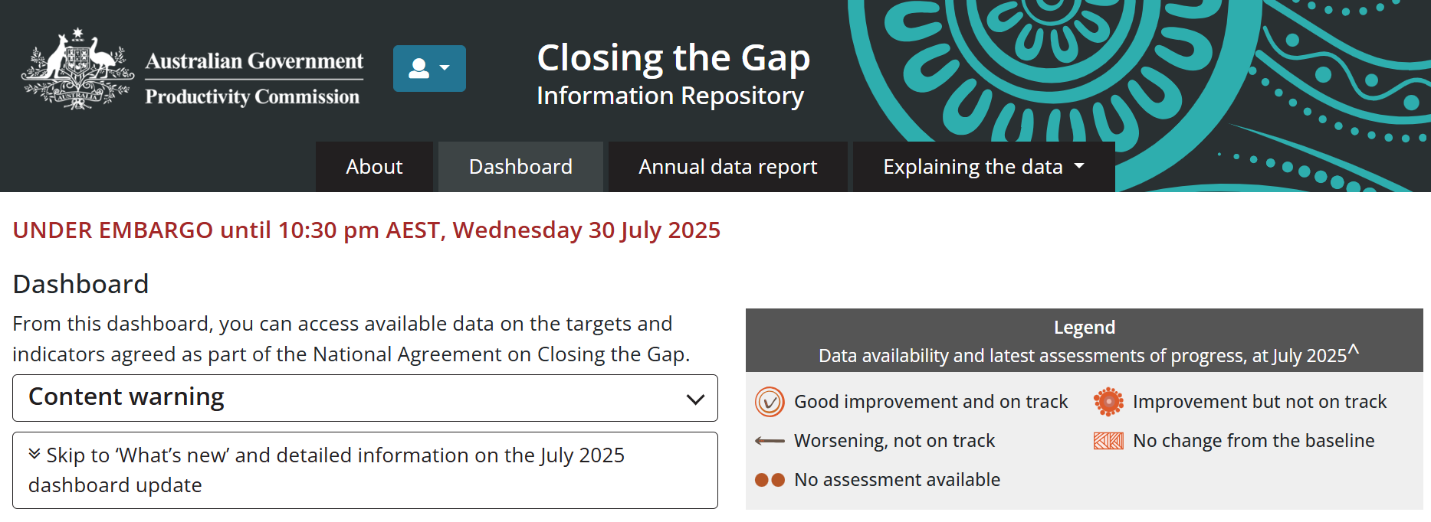
The July 2025 dashboard includes new updates
Historical and ongoing context
target 8: economic participation
Revised population rates:
target 3: preschool enrolment
A new year of data:
target 3: preschool enrolment
target 4: early child development
New disaggregations for:
target 17: digital inclusion
New material:
12 new supporting indicators
Notes:
Sarah
It’s been a busy year.
With the July 2025 dashboard update, we have added another historical and ongoing context piece which we’ll cover later in the presentation.
Population-based rates
Some of you may remember that at the start of the agreement, all of the population-based targets (& indicators) were calculated using the ABS 2016 population estimates. In March of this year, we commenced the transition from those 2016-based population rates to 2021-based rates.
This transition has now been completed in the July update, with revised population rates for Target 3: preschool enrolment
A new year of data
The July update also includes a new year of data for two targets - target 3: early childhood education and target 4: children developmentally on track.
This means there is a new assessment of progress for both targets – which we will talk about a little later - however we note this is only the second time since the start of the National Agreement that we’ve been able to update the assessment of progress for target 4.
We’ve also added 12 new supporting indicators to the dashboard in July, taking the total to 16 new indicators for this year’s ADCR (four were added in November).
We’ve also added disaggregated data for target 17: digital inclusion.
(this target now includes data about access to the internet by sex, age, remoteness, socio-economic status and disability status).
As I said, it’s been a busy year!
Pass to Selwyn to provide an overview of progress

Slide 10
Overview of progress

Slide 11



The information repository continues to report mixed progress
Fifteen socio-economic targets with data available to assess progress
  4 targets show good improvement and are on track
  6 targets show improvement but are not on track
  1 target has no change from the baseline
  4 targets are worsening
  4 targets cannot be assessed
Notes:
Selwyn
In 2025, we have assessed 15 of 19 socio-economic targets.
Unfortunately, four targets are continuing to worsen, including incarceration rates for adults; children assessed as developmentally on track; children in out-of-home care; and, alarmingly, suicide rates.
We have seen improvements in pre-school enrolment rates; economic participation; and land and water rights for traditional owners, which are all assessed as on track to be met.
Outcome areas that are showing improvement, but not at a sufficient rate to meet the relevant target by 2031, include: life expectancy rates, healthy birthweights; school completion rates; post school education, youth engagement; and overcrowded housing.
We are still unable to assess progress against access to essential services; family violence; languages being spoken; and internet access at home.
We’ll go into a bit more detail on the next couple of slides

Slide 12
Outcomes vary by theme
Health, Wellbeing and development
CtG1:
71.9 years for males | 75.6 years for females
is the life expectancy of people born in 2020–2022
CtG2:
89.2%
of babies were born with a healthy birthweight in 2022
CtG14:
30.8 per 100,000
deaths due to
suicide in 2023
CtG4:
33.9%
of children commencing school were developmentally on track in 2024
Families and kin
CtG12:
50.3 per 1,000
children were in
out-of-home care in 2024
CtG13:
8.4%
of females experienced harm
No new data since baseline
Education and training
CtG3:
94.2%
Of children were enrolled in preschool in 2024
CtG5:
68.1%
of 20–24 year olds with year 12 or equivalent in 2021
CtG6:
47.0%
of 25–34 year olds with certificate III or above in 2021
CtG7:
58.0%
of 15–24 year olds
fully engaged in employment, education or training in 2021
Notes:
Selwyn
We’ll step through what’s happening by each of the ADCR themes, focussing on data that’s been updated since last year.
Health, Wellbeing and Development
Some mixed news here, with target 2 (babies of a healthy birthweight) shifting to ‘improving, but not on track” to be met by 2031.
- What we’re seeing in this report is that in 2022, 89.2% of Aboriginal and Torres Strait Islander babies were born with a healthy birthweight (2022 is the latest year for which data is available).
From the supporting indicators, we can see some positive data in the drivers for target 2, with latest data showing :
A fall in Smoking rates during pregnancy (Indicator 2a).
A rise in Early prenatal care rates (Indicator 2d).
Still in the Health, Wellbeing and development domain, the new year of data for target 4: children thriving in their early years, shows that more needs to be done to achieve the agreed target (by 2031). Sadly, we’re are not seeing the change needed in the proportion of children who are developmentally on track, which we’ll cover in more detail later in our presentation.
Tragically, the rate of suicide among Aboriginal and Torres Strait Islander people continues to increase. In 2023, 265 Aboriginal and Torres Strait Islander people in Australia lost their lives from suicide. The most recent data shows that suicide was the leading cause of death for Aboriginal and Torres Strait Islander people aged 15–39 in 2023. Again, the supporting indicators provide some important context:
While suicide rates have increased, hospitalization rates for self harm have shown recent declines (14a)
There remains high levels of Psychological distress among Aboriginal and Torres Strait Islander people.(Indicator 14d).
Aboriginal and Torres Strait Islander people report experiencing racial prejudice is increasing (Indicator 14e)
Families and Kin
Children in out-of-home care is another of the targets where we are seeing worsening outcomes; where we continue to see the persistent overrepresentation of Aboriginal and Torres Strait Islander children in the child protection system. Nationally in 2023, the rate of Aboriginal and Torres Strait Islander children aged 0–17 years in out‑of‑home care was 50.3 per 1,000 children in the Aboriginal and Torres Strait Islander population. This rate remains over 10 times the rate experienced by non-Indigenous children
Education and training
This is one area where we are seeing some positive signs across the board.
The only target that we have updated in this ADCR is target 3, enrolment in the Year Before Full-time Schooling (YBFS) early childhood education (or preschool enrolment).
Nationally in 2024, 94.2% of Aboriginal and Torres Strait Islander children in the Year Before Fulltime Schooling age cohort were enrolled in a preschool program. This rate exceeds the rate of non-Indigenous children enrolled and the target is on track to be met.

Slide 13
Outcomes vary by theme (2)
Economic participation
Housing
CtG9A:
81.4%
lived in appropriately sized housing in 2021
CtG9B:
No data available
CtG8:
55.7%
of 25–64 year olds were employed in 2021
Digital
Inclusion
Justice
CtG11:
26.1 per 10,000
young people were in detention in 2023-24
CtG17:
88.3%
accessed the internet in 2022-23
No assessment of progress
CtG10:
2304.4 per 100,000
adults in prison in 2024
Culture and Language
Country
were subject to Aboriginal and Torres Strait Islander peoples rights or interests in 2024
CtG16:
123
languages spoken
No new data since baseline
CtG15A:
4 314 744 km²
of land
CtG15B:
113 517 km² of
sea country
Notes:
Selwyn
The remaining themes are presented here. I will draw your attention to the three areas that we’ve updated since last year.
The Justice theme includes adult incarceration and youth justice (Target 10 & 11). Here we are seeing setbacks.
for target 10: The number of adults in prison continues to grow, rather than decline. Nationally at 30 June 2024, the age-standardised rate of Aboriginal and Torres Strait Islander prisoners was 2304.4 per 100,000 adult population. While adult imprisonment rates have decreased for the youngest age group (18-24 years), imprisonment rates are increasing in older age groups (with the highest increase among adults aged 40-44 years)
We note this rate differs from the ABS published rate (due to the change to the population denominator), which we believe they’ll remedy in their next update.
for target 11: After an initial decline in youth detention rates, more recent increases in the number of young people in detention means that the trend of the national target shows no change from the baseline (2018-19).
Supporting indicators also indicate areas of concern, with the most recent data showing (for the jurisdictions with data available) :
That the number of Aboriginal and Torres Strait Islander people were charged by police has increased (Indicator 10a).
The proportion of unsentenced prisoners has increased (Indicator 10d)
The majority of young people in detention were unsentenced (indicator 11a)
And finally, we are seeing highly positive outcomes in targets 15A and 15B, which is the relationship to land and waters.
Both the sea country and land area subject to Aboriginal and Torres Strait Islander rights or interests are on track to be met. We’d also like to acknowledge that the sea country native title determinations already exceed the agreed target of a 15% increase by 2030.
[Note there was a recent Native title determination in Victoria (Millewa-Mallee native title), but this will not enter the dashboard data at this point.

Slide 14
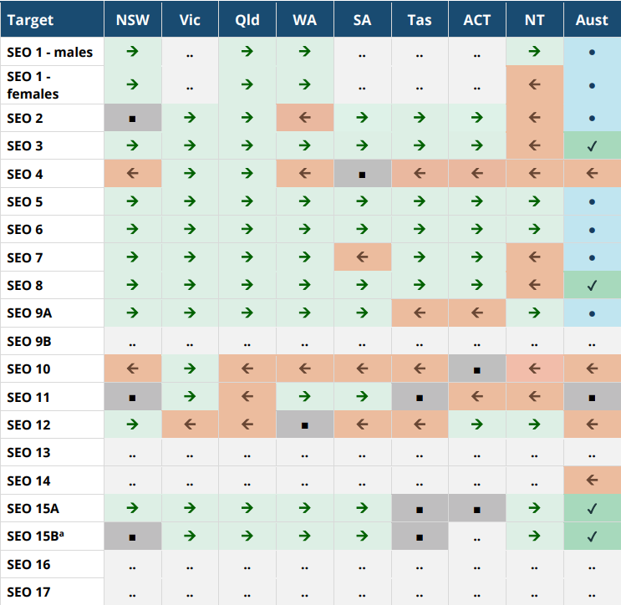



Improvement for many States and Territories for most targets*
* There are no State and Territory targets established in the National Agreement
The table highlights areas where jurisdictions have shown:
improvement
worsening
no change
Notes:
Selwyn
To this point, we’ve talked about national assessments.
It is worth noting that only national targets have been set under the Agreement and at the moment there is no agreed process to determine the contributions required from each jurisdiction towards those targets.
The assessments of state and territory progress are currently limited to whether outcomes have improved, worsened or remain unchanged compared with the baseline year.
It’s important to note that an assessment of “improvement” for a state or territory does not indicate whether that progress is enough to achieve the national target. The PC is currently working with PWG members on methods to better reflect state progress in future reporting.
Across most states and territories we are seeing improvements in outcomes for most targets, however there are a couple of exceptions to this:
The Northern Territory shows improvement in about only half of the targets areas.
All states and territories are showing worsening outcomes in the justice and/or out-of-home sectors
The state and territory summary is available in the ADCR, Attachment 4 and we also include an overview of state and territory progress in each of the themes in the ADCR.
[Optional to cover:]
NSW – improvement for most targets. Worsening against target 4 (child development, and 10 (adult imprisonment)
Vic – improvement for most targets. Worsening against target 12 (out-of-home care)
Qld – improvement for most targets. Worsening against targets 10 (imprisonment), 11 (youth detention) and 12 (out-of-home care)
WA – improvement for most targets. Worsening against targets 4 (child development) and 10 (adult imprisonment)
SA – improvement for most targets. Worsening against targets 7 (youth engagement), 10 (adult imprisonment) and 12 (out-of-home care)
Tas – improvement for most targets. Worsening against targets 9A (housing),10 (imprisonment) and 12 (out-of-home care)
ACT – improvement for most targets. Worsening against targets 9A (housing) and 11 (youth detention)
NT – improvement against half the targets. Worsening against targets 1 (female life expectancy), 2 (birthweight), 3 (early childhood education), 4 (child development), 7 (youth engagement), 8 (employment) and 11 (youth detention).
The different contexts in different jurisdictions are also factors in outcomes, such as data comparability (variability of data due to small populations), and remoteness, which can make access to services difficult.
Pass to Sarah to discuss state analysis

Slide 15

Although outcomes against the adult imprisonment, youth justice and out-of-home care are of concern
Notes:
Sarah
We are aware that the following information may be sensitive for those of us who have had family or community members impacted by Australia's justice system. Please take a moment if you need.
We’d like to talk about what we’re seeing in incarceration and out-of-home care, nationally and across all jurisdictions.
All of the states and territories continue to show worsening outcomes for Aboriginal and Torres Strait Islander people in Youth Justice, Adult Imprisonment or Out-of-home care.
This is an alarming trend that we have seen for successive years. Recent changes to the minimum age of criminal responsibility in some jurisdictions will likely perpetuate this trend.
The outcomes show that far more effort is needed from all levels of government to support improved outcomes for Aboriginal and Torres Strait Islander people.

Slide 16
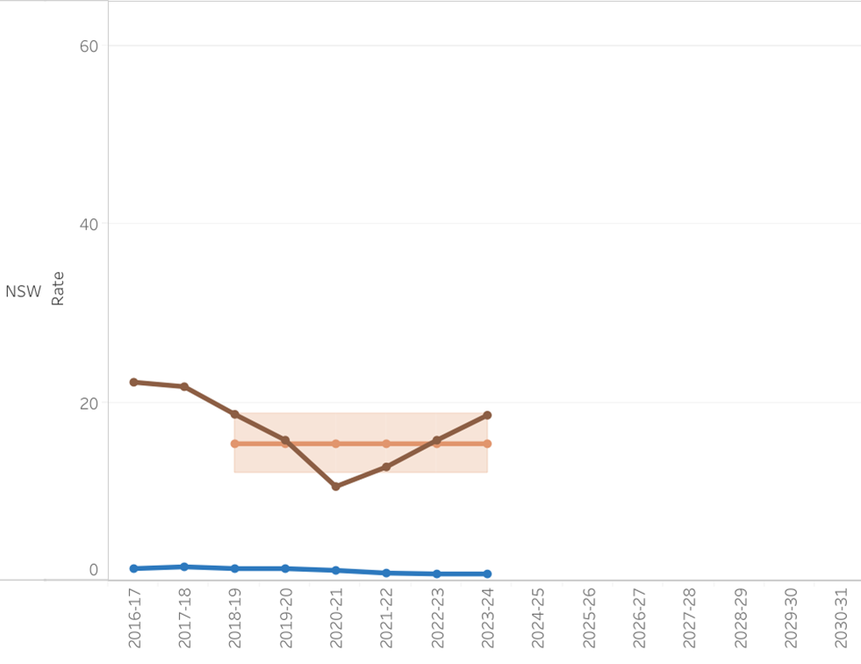
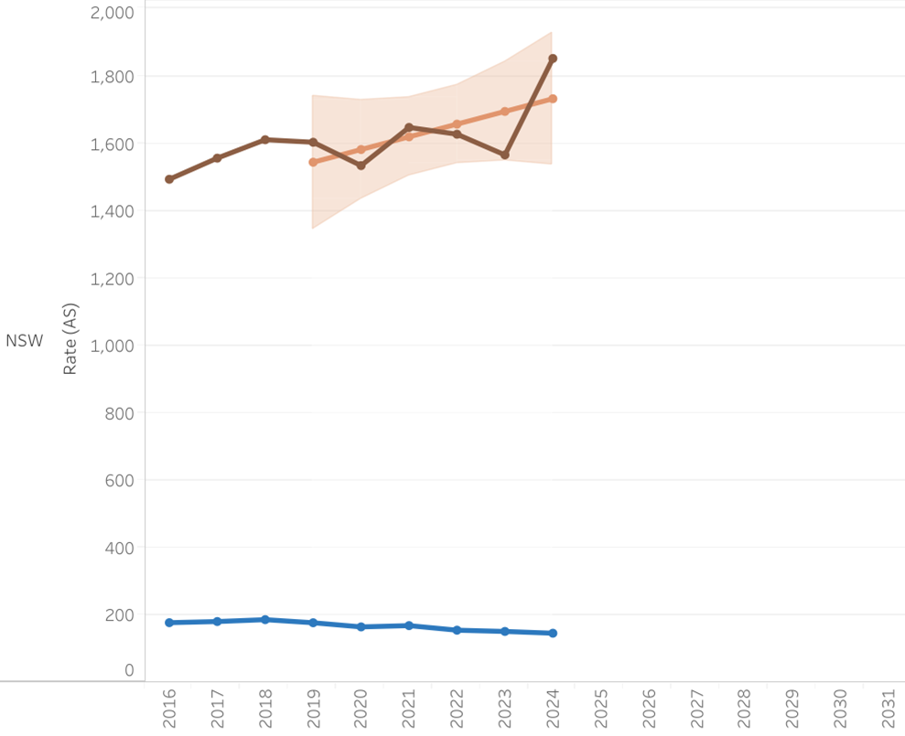
Imprisonment (target 10) continues to worsen, while the recent trend for youth justice (target 11) is a cause for concern
Target 10 (Imprisonment)
Target 11 (Youth Detention)
Figure CtG10.1 Age-standardised imprisonment rate per 100,000 adults at 30 June, Australia
Figure CtG11.1 Young people in detention on an average day, Rate per 10,000 young people
National assessment: Worsening
National assessment: No change
NSW assessment: Worsening
NSW assessment: No change
Notes:
I will now run through some of the relevant data for justice.
We have new years of data for both Target 10 (adult imprisonment) and 11 (youth detention).
For Target 10: Adult Imprisonment, the rate is worsening.
The target is for a reduction in the rate of Aboriginal and Torres Strait Islander imprisonment by at least 15%.
The March update shows an increase in the rate of Aboriginal and Torres Strait Islander adults held in incarceration. As of 30 June 2024, the national age-standardised rate of Aboriginal and Torres Strait Islander prisoners was 2,304.4 per 100,000 adult population, representing 15,871 people.
For NSW, the age-standardised rate was 1,852.6 per 100,000, or 4,188 people.
For NSW, this is an increase from the previous year – in 2023, the rate was 1,566.2 per 100,000. And it is also an increase from the baseline year (2019) where it was 1,603.8 per 100,000.
Based on progress from the baseline year, the assessment shows the target is worsening for both national and NSW. This assessment is also provided with a high level of confidence.
It is also important to note that the rates reported in this update differ from the ABS publication ‘Prisoners in Australia 2024’. For our update, the rates are calculated using the 2021 Census-based population. The ABS publication rates are calculated using the 2016 Census-based population.
For Target 11: Youth detention, the data shows No change from the baseline
This target aims to reduce the rate of Aboriginal and Torres Strait Islander young people (10-17 years) in detention by 30%.
While previously, the target has been reported as improvement and on track for the national results. This update shows no change in the rate of young people aged 10–⁠17 in detention for both the national and the NSW assessment.
Nationally in 2023-24, the rate of Aboriginal and Torres Strait Islander young people in detention on an average day was 26.1 per 10,000 young people in the population; representing 460.4 young people. For NSW, this rate was 18.6 per 100,000 and the number was 114.9.
For NSW, the 2023‑24 rate is above the previous four years. There was a low in 2020-21 where the rate was 10.6 per 10,000 young people. The March update is a similar rate to that in the baseline year (2018‑19, 18.7 per 100,000).
Also, it is important to note that these rates reported differ from the rates reported in the RoGS (section 17 ) for the ACT, the NT, and Australian total. The scope for CtG and RoGS differ for this area. For RoGS, the scope of youth is from jurisdiction’s legislated minimum age of criminal responsibility, to people aged 17 years. For CtG, the scope for ‘young people’ is defined consistently across the jurisdictions as people aged 10–17 years.

Slide 17
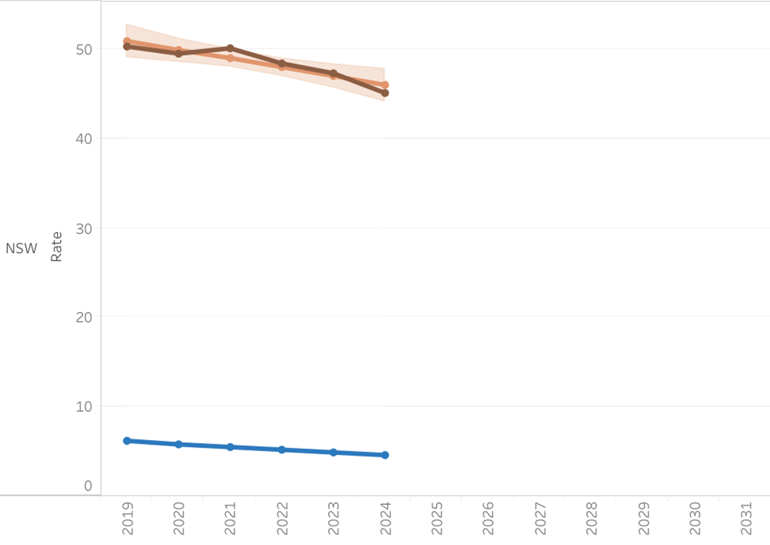

Children in Out of Home Care continues to be an area of concern (Target 12)
Figure CtG12.2 Children aged 0-17 in out-of-home care at 30 June, Rate per 1,000 children
Target: By 2031, reduce the rate of overrepresentation of Aboriginal and Torres Strait Islander children (0–17 years old) in out-of-home care by 45%.
National assessment: Worsening
NSW assessment: Improvement
Notes:
Another relevant area is Target 12 – children in out-of-home care
Unfortunately for Target 12 the national rate is worsening.
The target is for a reduction in the rate of Aboriginal and Torres Strait Islander children (0–17 years old) in out-of-home care by 45%
The baseline year, 2019, was 47.3 per 1,000 children in the Aboriginal and Torres Strait Islander population – it is now 50.3 per 1,000 children , meaning that the target is not on track. This assessment of progress is provided with a high level of confidence.
However, the assessment of progress for NSW, the NT and the ACT all show improvement in this target. WA shows no change, and the remaining states show worsening progress.

Slide 18
Considering context

Slide 19
Outcomes are not the same for all Aboriginal and Torres Strait Islander people
Poorer outcomes for people living in more remote areas
Some improvement across all socio-economic areas of disadvantage
Mixed outcomes for young people
Different outcomes for men and women
Some improvement for people living with a disability
Notes:
Sarah
As we’ve mentioned earlier, the headline results for the targets are only part of the story.
Some of you may have heard about the ‘tyranny of the aggregate’.
This is because progress toward the targets under the Agreement is reported at a national level, which obscures the different experiences of Aboriginal and Torres Strait Islander people in different regions and within specific communities.
The local experience can look diametrically different to progress or priorities at the national level.
The dashboard and ADCR provide breakdowns of the data – or disaggregations – which can provide more insights into the outcomes and experiences in different regions and population groups, highlighting areas of progress and where greater effort is needed.

Slide 20
Analysis of the supporting indicators in the ADCR help to understand the drivers for change and context to the outcomes
Introduced to reporting in 2025
Supporting indicators (drivers)
  Potentially avoidable mortality
  School attendance
  Caring responsibilities
  Prisoner legal status
  Unsentenced detention
  Self-harm hospitalisations
  Aboriginal and Torres Strait Islander language speakers
  Employed in media
Supporting indicators (contextual)
  VET graduate outcomes
  Prisoner legal status
  OOHC Cultural support plans
  SHS assistance (with children)
  Connection to homelands
Notes:
Sarah
Beyond the headline targets, we also update supporting indicators.
The data outlined in this presentation is a portion of the indicators available on the dashboard and analysed in the ADCR. The Commission works with the parties to the Agreement to specify and develop the supporting indicators named in the Agreement, expanding the range of indicators reported each year.
We currently have 54 of 164 indicators outlined in the Agreement on the dashboard (of which 48 have data reported).
We have introduced 16 supporting indicators to the dashboard in 2025 and the 2025 ADCR.
As the mix of drivers and contextual information expands, greater information is available for you to understand the factors that underpin each of the targets.
I'll now pass to Andrew and Amanda who will demonstrate how to access some of the data and stories within the Information Repository

Slide 21
Beyond the headline - considering context
Historical and ongoing context
Cultural and historical context included for socio-economic outcome area 8 (economic participation)
  Economic activity can be in many forms
  Has existed for tens of thousands of years
  Provides independence and autonomy
Notes:
Sarah
Beyond the numbers reported in information repository, some of you will recall our work to improve the understanding of historical and ongoing context for each of the socioeconomic outcome areas – these context pieces inform the way people interpret and interact with the data on the dashboard and is one of the ways we can improve the cultural safety of the dashboard.
For this update, we have included historical and ongoing context for Target 8, economic participation.
The piece explores the economic activity of Aboriginal and Torres Strait Islander peoples for tens of thousands of years, the effect of colonisation and the progress of the Aboriginal and Torres Strait Islander economy, despite historical and ongoing challenges.
It also outlines key factors that would support improved economic participation and development and the reinforcement of independence and autonomy.
The contexts presented both on the dashboard and the ADCR, aim to acknowledge the strength of Aboriginal and Torres Strait Islander people and promote a richer understanding of their cultures, lore and histories. We note the impact of systems and structures as well as ways to drive positive change.
Reporting on the targets and supporting indicators within the context of Aboriginal and Torres Strait Islander people experiences is extended throughout the 2025 ADCR. By doing this, the report helps build a richer, and more representative story on outcomes being achieved.

Slide 22
Future considerations

Slide 23
The work is ongoing to report all the data specified in the Agreement for the CtG information repository
There is no data to assess progress on the Priority Reforms
We do not have an assessment of progress for four socio-economic targets
Many targets have only been assessed once
The dashboard reports on 54 of the 164 supporting indicators
150 data development items
2026 reporting - targets and supporting indicators
with annual data
Notes:
Selwyn
The data outlined in this report and on the dashboard is a portion of the indicators outlined in the Agreement. Given the Agreement outlines 23 targets and 164 supporting indicators across the Priority Reforms and socio-economic outcomes, the scope of outstanding material to be reported remains extensive.
There is no data to assess progress on the Priority Reforms – While there is agreement that progress against the Priority Reforms should be measured in a consistent and coherent way, conceptual and data development work is required before baseline data and progress is reported. In June 2023, NIAA commissioned the Australian and New Zealand School of Government (ANZSOG) to develop a coherent and consistent framework for measuring progress in achieving the Priority Reforms. The Partnership Working Group (PWG) are considering recommendations from the ANZSOG report.
We do not have an assessment of progress for four socio-economic targets. Targets 13 (family violence) and 16 (languages) have no new data since the baseline. An assessment of progress is not possible for target 17 (digital inclusion). For target 9B (essential services meeting standards), there is no baseline data, because the Parties have not agreed to a suitable data source.
Many targets have only been assessed once since the commencement of the agreement.
The dashboard reports on 54 of the 164 supporting indicators – The PC works with the parties to the Agreement to specify and develop the targets and supporting indicators named in the Agreement, expanding the range of indicators reported each year.
There is also additional work underway within governments and the community to progress the Agreement’s approximately 150 data development items outlined in the Closing the Gap Data Development Plan and we look forward to the recommendations of the Data Development Partnership.
Due to available data, it is likely that the 2026 dashboard updates will comprise those targets and supporting indicators with annual data, and new indicators introduced to the dashboard.

Slide 24
The outcomes reported highlight the ongoing need for the implementation of the National Agreement
Independent Aboriginal and Torres Strait Islander-led review
  12 Key Findings
  9 Recommendations
The PC will release case studies of transformative action aligned with Priority Reform 3 starting in September
Terms of reference for the second
PC review are expected by early 2026
Notes:
Selwyn
The Coalition of the Peaks recently conducted the inaugural independent Aboriginal and Torres Strait Islander led review of the National Agreement on Closing the Gap, putting the perspectives, experiences and solutions of Aboriginal and Torres Strait Islander people front and centre.
The review made nine recommendations, urging governments to share power more genuinely with Aboriginal and Torres Strait Islander people, invest directly in communities and ACCOs, improve transparency and accountability through better communication and reporting, and support systemic change rather than relying on individual efforts.
The PC’s first comprehensive three-yearly Review of the National Agreement on Closing the Gap (the PC Review) was well over a year ago. It found that despite some pockets of good practice, progress against the Priority Reforms has for the most part been weak, and reflects tweaks to, or actions overlaid onto business-as-usual.
In consultation with the Coalition of Peaks, the PC is developing case studies of transformative action aligned with Priority Reform 3. This will be an ongoing research project to support implementation of PC recommendations. The first set of case studies will be released in September, followed by a second release in early 2026.
Joint Council will take some time to take in the findings of the Aboriginal and Torres Strait Islander led review over the coming months. Terms of reference for the PC's second review of the National Agreement are expected by early 2026.

Slide 25
Thank you
Thanks to our participants for their support in reviewing and engaging in the drafting of the dashboard and population rates transition.
Further queries?
Please contact us ctg.data@pc.gov.au
pc.gov.au/closing-the-gap-data
Notes:
SEL
We would like to thank all of you for attending today and also to everyone who has supported the drafting of our products.
We appreciate the engagement and feedback.
So now we’d like to open it up for questions, please feel free to raise your hand, or pop your questions in the chat.

