Slide 1
the role of offending propensity and social and ecological risks in the growth of high frequency youth offending
Dr Molly McCarthy
ARC DECRA Senior Research Fellow
Justice, Young People and Community Network
Alfred Deakin Institute, Deakin University
Acknowledgements: Supported by an Australian Research Council Discovery Early Career Research Fellowship
Gratefully acknowledge Queensland Youth Justice for providing data for this project
Notes:
I would like to acknowledge the traditional owners of the lands on which we are meeting, the Gadigal people, and their elders, past and present

Slide 2
overview
Youth offending trends in Australia
Project aims and theoretical framework
Study 1: Have offending trajectories of justice-involved young people changed in recent birth cohorts?
Study 2: What is the role of offending propensity and social and ecological risks in reoffending among justice-involved adolescents?
Study 3: What factors are associated with growth in high-frequency offending in recent cohorts?

Slide 3
Youth offending trends in Australia
Many international jurisdictions have experienced a youth crime decline over the past 20 to 30 years, including the U.S., U.K., Northern European countries, New Zealand and Australia
Youth offending reductions in Australia have been primarily reductions in offending participation, rather than in offending frequency/reoffending, and mostly comprised of reductions in the volume of low-level or adolescent limited offending¹
At the same time, there has been small increases in the number of young people offending at very high levels of frequency, which has had disproportionate effects on total youth crime rates¹
Has led to polarization of justice-involvement risk across different groups of adolescents – for many the risk of justice-involvement has decreased, for a small number it has increased
¹ McCarthy, 2021; Payne et al., 2019

Slide 4
Drivers of youth crime decline
A number of factors proposed for youth crime decline including increases in property security technology, demographic changes, policing and criminal justice policy changes, and long-term civilizing processes making antisocial behaviour less acceptable
U.S. and Northern European research suggests that changes in the routine activities of adolescence in recent years has been significant drivers of reductions in youth delinquency
Brought on by proliferation of high-speed internet access and smartphone technology, and development of social media and gaming technology, the social landscape of adolescence has transformed
In recent cohorts, adolescents spend significantly less time in unstructured, unsupervised activities with peers, lower rates of binge drinking, reductions in ‘going out’ with peers (without adults), display greater engagement with school and reduced preferences for risk taking activities²
² Baumer et al., 2021; Keyes et al., 2018; Nasi et al., 2024; Svensson & Oberwittler, 2021; Van der Laan et al., 2021
³ Twenge & Park, 2019

Slide 5
What is Driving growth in high frequency youth offending?
Why is offending increasing among a small group of young people while it declines among the majority of young people? Little research on this (c.f. McCarthy, 2021; Nilsson et al., 2017; Sivertsson et al., 2021)
What characterizes the contemporary social context for young people engaging in high frequency offending?
Aim of project: To identify social and environmental risks for high frequency and high harm youth offending (note: this presentation focused on high frequency offending)
Data source: Queensland Youth Justice data (2003 – 2023); youth justice orders, related proven offences and YLS-CMI risk assessment data
Collaborators: Professor Stephane Shepherd, Associate Professor Troy Allard, Dr Michael Bryden; Dr Mohammed Ali; Research Fellow: Ms Mariel Matteo
Theoretical framework : Wikstrom’s (2020) Developmental Ecological Action Model of Situational Action Theory - a causal model of offending which predicts changes in offending behaviour over times at macro (societal) and micro (individual) level

Slide 6
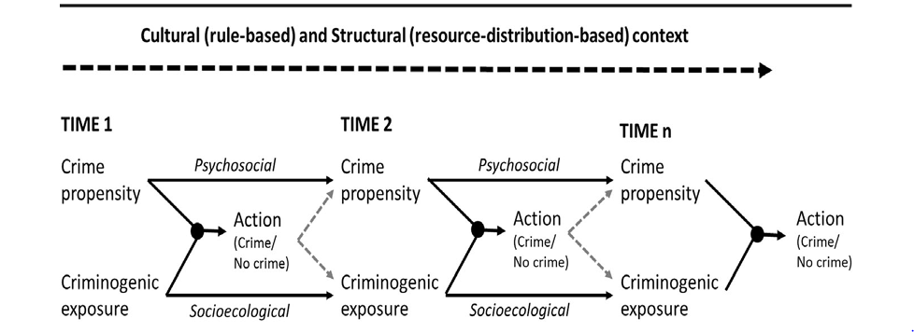
Wikstrom’s developmental ecological action model of situational action theory
Crime propensity – defined as a combination of self-control and personal morality (i.e. law relevant attitudes towards rule-breaking and moral emotions, e.g. guilt and shame)
Criminogenic exposure - a person's activity field, social and ecological contexts to which they are exposed; criminogenic settings reflects the presence of a moral context that may support antisocial or offending behaviour and the absence of restraining factors (e.g. guardians)

Slide 7
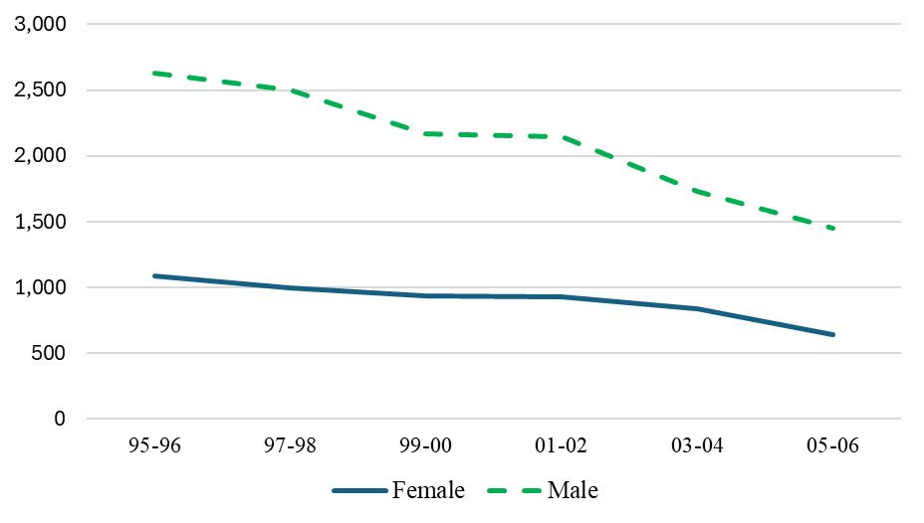
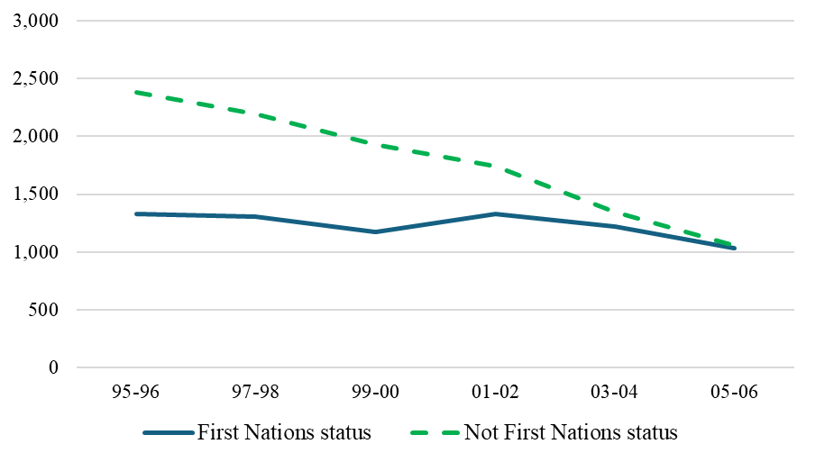
Study 1: changes in offending trajectories for justice-involved young people
Data: Queensland Youth Justice data
Sample frame: All Queensland adolescents aged 10 – 16 years who had a youth justice order (including court diversion) and were born between 1995 and 2006; orders and proven offences (only orders which represent distinct court sanctions included) (N=18,044)
Analysis: Descriptive trend analysis and latent class growth modelling (trajectory modelling)
Figure 1
Figure 2
Figure 1: Trends in sex of justice-involved adolescents by birth cohort. Figure 2: Trends in First Nations status of justice-involved young people by birth cohort.

Slide 8
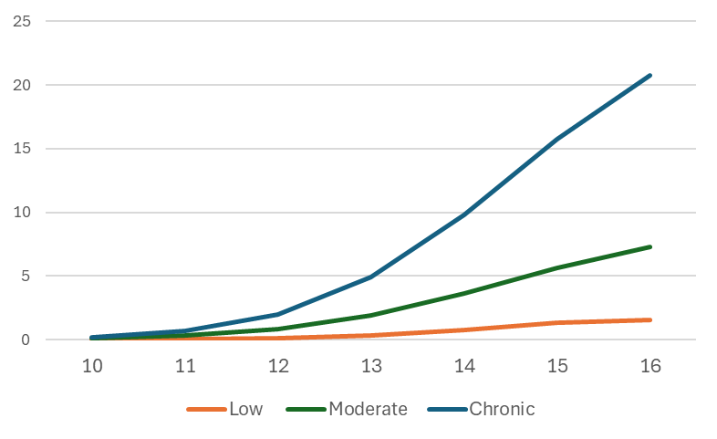
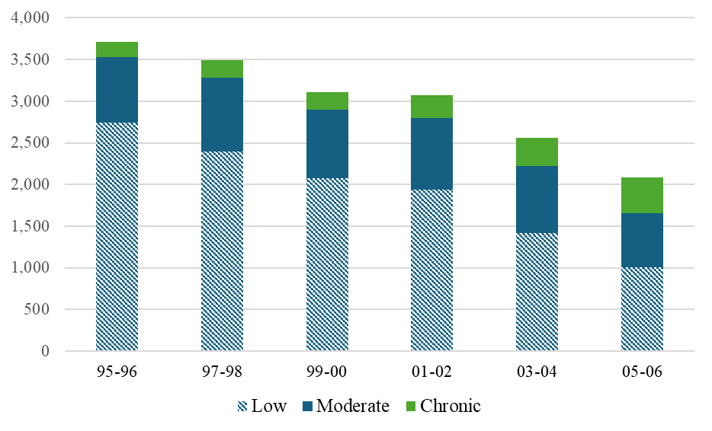
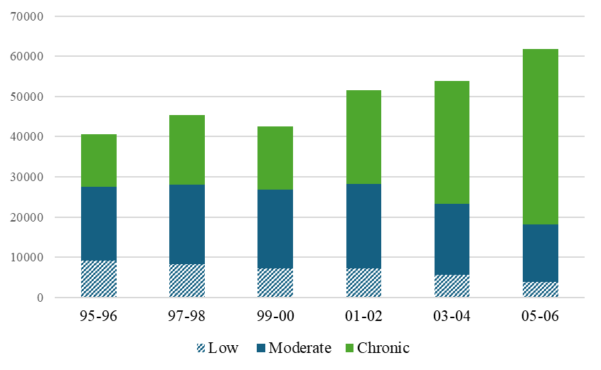
Study 1: changes in offending trajectories for justice-involved young people
Figure 5
Figure 5: Latent class growth modelling on total sample (3 class best fit solution from 2 to 6 classes; quadratic function);
Figure 6 : Total number of young people classified in each offending trajectory by birth cohort;
Figure 7: Total number of proven offences by young people according to offending trajectory in each birth cohort
9.3%
26.7%
64.0%
Figure 6
Figure 7

Slide 9
Study 2: What is the role of offending propensity and social and ecological risk in reoffending among justice-involved adolescents?
Data: Queensland Youth Justice data; proven offences and YLS-CMI Risk Assessment tool (conducted within 6 months of order commencement)
Sample frame: All Queensland adolescents aged 10 – 16 years born between 2001 and before July 2007 (reflects adolescent period in which 17-year-olds were in the QLD Youth Justice system) who had at least one supervised order (N=3295); index event is first supervised order
Analysis: Association between offending propensity and social and ecological risk (drawn from YLS-CMI within first 6 months of order commencement) and number proven offences 12 months following first supervised order
Table 1: Bivariate and adjusted relationships between offending propensity factors and social and ecological risks and reoffending within 12 months of first supervised orders (Negative binomial regression models)
 | Bivariate models |  | Full model (adjusted coefficients)
Independent variables | Coefficients | S.E. | Coefficients | S.E
Sex | 0.141*** | 0.027 | 0.135*** | 0.027
Age | -0.167*** | 0.018 | -0.179*** | 0.019
Offending propensity indicators
Self control
Short attention span | 0.318*** | 0.050 | 0.047 | 0.052
Poor frustration tolerance | 0.138** | 0.050 | -0.108* | 0.053
Personality morality
Antisocial attitudes | 0.562*** | 0.048 | 0.287*** | 0.057
Inadequate guilt feelings | 0.322*** | 0.052 | 0.070 | 0.055
Social and ecological risk factors
Inadequate parental supervision | 0.535*** | 0.050 | 0.140* | 0.056
(Parents) difficulty controlling behaviour | 0.698*** | 0.053 | 0.310*** | 0.062
Some delinquent friends | 0.849*** | 0.069 | 0.435*** | 0.076
No or few positive acquaintances | 0.504*** | 0.048 | 0.241*** | 0.052
History of truancy | 0.577*** | 0.054 | 0.216*** | 0.059
Occasional/chronic alcohol or drug use | 0.333*** | 0.056 | 0.134* | 0.061
Constant | -- | - | 3.378*** | 0.282
Notes:
Bradford Hill criteria – dose response effects in place of causation

Slide 10
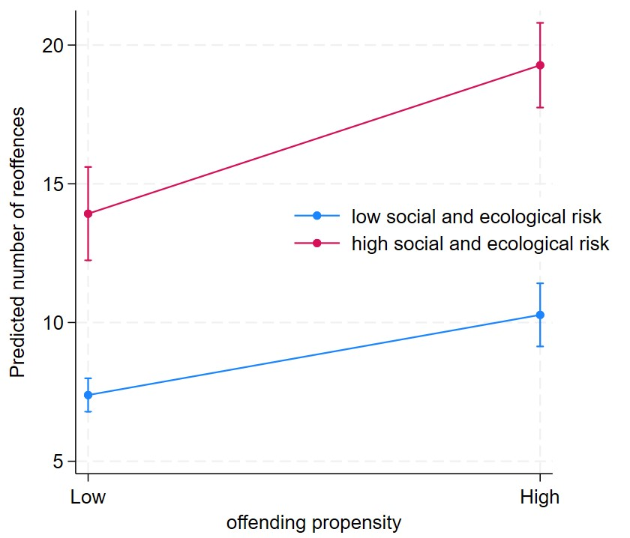
Study 2: What is the role of offending propensity and social and ecological risk in reoffending among justice-involved adolescents?
Table 2: Predicting moderate and high reoffending in 12 months after first supervised order (negative binomial regression models)
 | Model 1 -Main effects | SE | Model 2 – interaction term | SE | Model 3 – full model | SE
Male | 0.179*** | 0.026 | 0.179*** | 0.026 | 0.179*** | 0.026
Age | -0.172*** | 0.018 | -0.172*** | 0.018 | -0.172*** | 0.018
Propensity (high) | 0.328*** | 0.050 |  |  | 0.330*** | 0.070
Social and ecological risks (high) | 0.631*** | 0.050 |  |  | 0.634*** | 0.074
Interaction: Propensity by social and ecological risks |  |  |  |  | -0.005 | 0.101
Low propensity*high social and ecological risk |  |  | 0.634*** | 0.074
High propensity * low social and ecological risk |  |  | 0.330*** | 0.070
High propensity *high social and ecological risk |  |  | 0.959*** | 0.057
Constant | 3.986*** | 0.265 | 3.986*** | 0.265 | 3.986*** | 0.265
Item response theory (2 parameter logistic model) used to establish latent factors for propensity and social and ecological risk
Social and ecological risks more strongly predict reoffending (increase log count of expected reoffences by 63%) compared to propensity indicators
Notes:
Item response theory (2 parameter logistic model) used to establish latent variables for propensity and social and ecological risks
High propensity predicts approximate increase in 3 to 4 offences, while high social and ecological risks predicts 7 to 8 offences; interaction is not significant when main effects included in the model. Main effects explain most of the variance

Slide 11
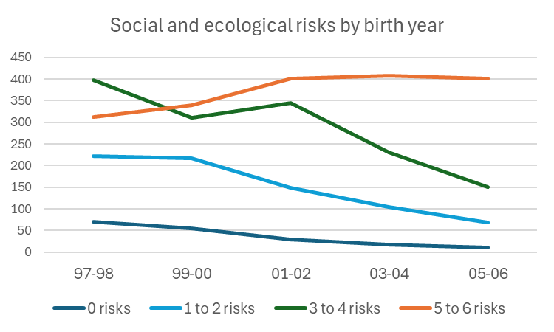
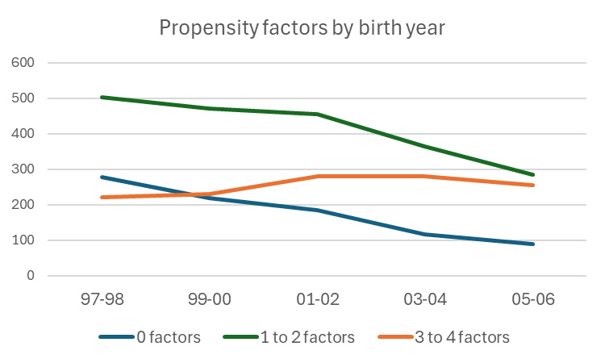
Study 3: What role do offending propensity and social and ecological risks have in growth of high frequency youth offending
Data: Queensland Youth Justice data; proven offences and YLS-CMI Risk Assessment tool (conducted within 6 months of order commencement)
Sample frame: All Queensland adolescents aged 10 – 15 years born between 1997 and 2006 who had at least one supervised order (N=4238) (16-year-olds excluded as their 12 month follow up period censored in this period, as 17-year-olds were dealt with by adult corrections until 2018)
Analysis: Trend analysis of offending propensity and social and ecological risk (drawn from YLS-CMI); predicting number of proven offences 12 months following first supervised order
Figure 8: Number of social and ecological risks for justice-involved adolescents (10 to 15 years) at first supervised order
Figure 9: Number of offending propensity factors for justice-involved adolescents (10 to 15 years) at first supervised order

Slide 12
Study 3: What role do offending propensity and social and ecological risk have in growth in high frequency youth offending
Table 4: Predicting moderate and high reoffending from birth year, offending propensity and social and ecological risks
 | Model 1 – Birth year | Model 2 – Offending propensity | Model 3 – Social and ecological risks
No reoffending (base) | Risk ratios | Risk ratios | Risk ratios
Moderate reoffending ( 1 to 14 reoffences)
Sex | 1.099* | 1.113* | 1.190***
Age | 0.841*** | 0.836*** | 0.830***
Birth year | 1.062* | 1.024 | 0.964
Offending propensity |  | 1.574*** | 1.137*
Social and ecological risks |  |  | 2.000***
Constant | 19.664*** | 24.576*** | 30.380***
High reoffending (15 or more reoffences)
Sex | 1.341*** | 1.370*** | 1.534***
Age | 0.693*** | 0.682*** | 0.669***
Birth year | 1.352*** | 1.255*** | 1.135**
Offending propensity |  | 2.414*** | 1.445***
Social and ecological risks |  |  | 3.319***
Constant | 46.558*** | 69.745*** | 94.930***
Significant increase in risks of being classified as a high reoffender by birth year (35% increased risk for each birth year group)
Offending propensity and social and ecological risks both predict risk of being a high frequency reoffender, but effect size is larger for social and ecological risks
Risk ratio associated with birth year diminishes notably when social and ecological risks are included in the model, indicating these factors may explain a reasonable amount of the variation in high reoffending by birth year

Slide 13
Summary of findings​
Decline by approximately 43% in number of adolescents 10 to 16 years in contact with youth justice in Queensland from birth years 1995/96 to 2005/06
But significant growth in chronic youth offending in this period – and over 53% growth in total proven offences
Offending propensity and social and ecological risks significantly predict reoffending, but exposure to social and ecological risks are more important and explain more of the growth in reoffending across birth cohorts
Likely to be a somewhat reciprocal relationship between propensity and social and ecological risks, particularly between antisocial attitudes /personal morality and antisocial peer networks (Wikstrom et al., 2024)
Findings suggest growth in high levels of reoffending appears to be mostly predicted by increased presence of social and ecological risks – high reoffending young people in recent birth cohorts are presenting with nearly all of the following risks:
  History of truancy from school
  Parents having difficulty controlling their behaviour
  Inadequate parental supervision
  Delinquent friends
  No or few positive/pro-social acquaintances
  Occasional or chronic drug or alcohol use

Slide 14
Implications – theory, policy and programs​
Risks of offending have reduced among a large majority of recent cohorts of young people, at least in part as a result of changes in adolescent routine activities and behavioural norms
BUT transformation of routine activities involves spending more time at home, in structured activities and/or under adult supervision - requires that young people live in households which are safe, comfortable, financially stable, and have access to key amenities
Chronic youth offenders tend to come from backgrounds of socio-economic disadvantage and social adversity; more likely to have experienced family violence, child maltreatment and neglect, exposure to child protection and out of home care, learning or cognitive disabilities, and low educational achievement and/or school disengagement
If prevalence of social adversity has not changed, the risks of young people engaging in chronic offending behaviour would remain stable across birth cohorts
However GROWTH in chronic offending suggests risks for chronic offending have increased
Increased exposure to social and ecological risks might in part explain this

Slide 15
Implications – theory, policy and programs ​cont.​
Why would exposure to criminogenic social and environmental risks have grown for some young people?
Social media
  Increased social learning opportunities for antisocial attitudes and behaviour, facilitating contact with antisocial peers;
  May act as a snare which potentially embeds an offending identity earlier through “performative offending”, experimenting with antisocial identities, and secondary labelling effects -> increased social exclusion by pro-social peers and from conventional opportunities
  May increase feelings of strain or stigmatization– social comparison may foster perceptions of disparity/deprivation and social alienation
Greater social sorting (segregation of interpersonal networks) and concentration of risk
  Young people who disengage from school may now be increasingly exposed to more high-risk antisocial peer groups, with fewer off-ramps via prosocial relationships;
  Greater majority of young people engaged in education and in structured activities - adolescents excluded from these settings have access to less varied groups of peers, and to a greater concentration of peers experiencing significant social adversity and exclusion

Slide 16
Implications – theory, policy and programs ​cont.​
Implications for prevention, early intervention and desistance strategies:
Prevention focused on high-risk communities:
  Justice reinvestment in First Nations communities
  Fostering educational engagement among at-risk adolescents, e.g. free tutoring programs, access to early assessment and support for learning disabilities
  Community-based recreational activities and sporting groups - providing access for socio-economically disadvantaged adolescents to structured activities, positive peer networks and mentoring
  Parenting support and strategies/training targeted to families experiencing high levels of conflict/stress
Early intervention for adolescents within first year of contact with criminal justice system:
  Diversion and/or community-based programs which link young people with community-based mentors, family support, facilitate pathway back to education, and activities which enable building of prosocial peer networks
Desistance/ rehabilitation strategies for adolescents engaged in high frequency offending:
  family-focused wrap-around support which focused on re-engagement of young person in education, vocational training or employment, e.g. multi-systemic therapy
  Lived experience mentoring – assistance with navigating path to pro-social identity/future
Some programs will require cultural shaping to effectively engage adolescents and their families from specific cultural or ethnic backgrounds who are over-represented in Australian youth justice systems, including First Nations, African Australian and Pasifika young people

Slide 17
Questions?
Contact: molly.mccarthy@deakin.edu.au

