Slide 1
The relationship between diagnoses of mental illness and substance use disorders, and reincarceration among Aboriginal and Torres Strait Islander adults.
Darcy J. Coulter
Justice Health Group, Curtin University
Alexander Campbell, Jesse Young, David Preen, Ed Heffernan, Louise Southalan, Jocelyn Jones, Stuart Kinner
Supported by AIC Indigenous Justice Research Program

Slide 2

Notes:
Garambi Baan

Slide 3
Health After Release From Prison
HARP4

Slide 4
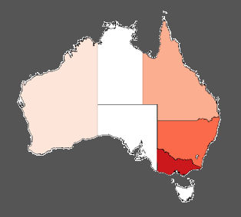
HARP4 Cohorts
Combined Cohort
N = 4,135
21% Female
36% Indigenous
Median age (IQR) 31 (25-38)
QLD Cohort
N = 1,325
21% Female
24% Indigenous
Median age (IQR) 30 (24-39)
Cohort lead: Kinner²
VIC Cohort
N = 400
0% Female
17% Indigenous
Median age (IQR) 36 (30-42)
Cohort lead: Stoové¹
WA Cohort
N = 1,376
18% Female
48% Indigenous
Median age (IQR) 28 (23-34)
Cohort lead: Preen
NSW Cohort
N = 1,034
33% Female
43% Indigenous
Median age (IQR) 33 (26-42)
Cohort lead: Dean³
Kirwan et al (2019). The Prison and Transition Health (PATH) Cohort Study: Study Protocol and Baseline Characteristics of a Cohort of Men with a History of Injecting Drug Use Leaving Prison in Australia
Kinner et al (2013). Randomised controlled trial of a service brokerage intervention for ex-prisoners in Australia
Justice Health and Forensic Mental Health Network (2017). 2015 Network Patient Health Survey Report
Notes:
Baseline recruitment
Qld 2008-2010
WA 2013-2016
NSW 2015
Vic 2014-2016
Qld, WA, NSW all representative, (Qld/WA women oversampled though)
Vic just men with history of drug injection use

Slide 5
HARP4
Pre-index incarceration
Post-index incarceration
Index incarceration
Administrative data
Hospital
ED
MBS
PBS
Administrative data
Hospital
ED
MBS
PBS
Baseline surveys
Prison medical records*
Bloods†
Administrative data
* Not in Victoria
† NSW and Victoria only

Slide 6
What is the relationship between dual diagnosis and reincarceration for Aboriginal and Torres Strait Islander adults?

Slide 7
What do we currently know?
Aboriginal and Torres Strait Islander adults
  Significant overrepresentation in prisons
  High health needs (Abbott et al, 2015)
  Differences in substance-related mortality (Forsyth et al., 2014)
Dual diagnosis
  High rates within prison (Coulter et al., 2025)
  Growing cohort (Bukten et al., 2024; Butler et al., 2022)
  Unique health needs
Notes:
I think we all know about the shameful overrepresentation of First Nations people in Australia’s prisons. 14 times higher than that of non-Indigenous age/sex matched peers.
Like non-Indigenous people, health needs of Aboriginal people in prison are particularly high, and these include mental health and substance use needs.
Forsyth: In the year following release, Indigenous people more likely to die from alcohol-related causes, but less likely to die of other drug-related causes.
Coulter et al. MI only 7.0% (95%CI 4.3–11.5), SUD only 26.8% (95%CI 18.9–33.5), and DD 40.9% (95%CI 30.1–48.2).
Evidence from Canada and Scandinavia has demonstrated a consistent increase throughout the 2010s in people admitted to prison with dual diagnosis both in raw numbers and as a proportion of the entire prison population (Bukten et al., 2024; Butler et al., 2022).
Unique health needs:
“Often these multiple co-occurring health problems interact, increasing complexity and making management of the individual’s health more difficult; this can result in poor health and justice outcomes.”
Integrated treatment may be of benefit. So the combination of treatments and services from both the mental health and addiction fields
“mental health and AOD services in Australia continue to operate in a siloed fashion, creating avoidable and often insurmountable barriers to care for those most in need”
- people who leave prison are at a greatly increased risk of death in the period after release compared to the general population” and “Mental illness and drug use are prominent factors in the risk of post-release death”
Despite DD often being talked about as a prominent risk factor for further CJS, there’s not actually that much high-quality evidence, and it doesn’t all align

Slide 8
What do we currently know?
Evidence on dual diagnosis’ relationship with recidivism:
  Equivocal
    DD greater risk of recidivism than MI only and SUD only
      Balyakina et al. (2014) – US
      Rezanoff (2012) – Canada
    DD greater risk of recidivism than MI only (but not SUD only)
      Hartwell (2004) – US (did not assess DD vs SUD-only)
      Dalbir et al. (2024) - US
    DD no greater risk of recidivism than MI only and SUD only
      Zgoba et al. (2020) – US
  Small evidence-base in Australia
    Smith & Trimboli (2010)
    O’Driscoll et al. (2012)
Notes:
Hartwell (2004) is an early one from the US which demonstrates that higher likelihood of return to correctional facility for those with DD than with MI-only
And then in the US, Dalbir et al (2024) showed significant associations between MI only, and DD, with return to jail, but not for SUD only.
Ogilvie (2022/2023). So there’s some recent evidence from Queensland that shows evidence between different MI (including SUDs) and offending/re-offending. No analysis of dual diagnosis though
In NSW Smith & Trimboli (2010) found the weighted rate of re-offending was higher for DD than for SUD-only, MI-only, and no diagnosis.
Using the same dataset though (and a greater follow-up), O’Driscoll et al. (2012) didn’t find that DD had a sig greater association with re-offending than SUDs only (but Indigenous status and also personality disorders and SUDs were significant risk factors for re-offending)
Ogloff – Forensic mental health service sample. More frequent and serious offending than those with MI-only. Didn’t analyse SUD-only, and the offending was past history, not recidivism

Slide 9
Aims/Overview
In a sample of Aboriginal and Torres Strait Islander adults (n=967) released from prisons, we aimed to:
  Determine the strength of association between mental illness, SUDs, or dual diagnosis and reincarceration, and
  Quantify the concentration of reincarceration among people with these diagnoses.
Data sources:
  Survey responses
  Prison medical records
  Inpatient and emergency department hospital data

Slide 10
Diagnoses
Diagnosis
- Mental illness
-Substance use disorder
-Dual diagnosis
Baseline survey
Prison medical records
Hospital & emergency department
Notes:
Survey: anxiety, depression, SUD, schizophrenia, other (specify)
ICD-10-AM codes: MI = F01-09 and F20-99. SUD = F10-19
International Classification of Primary Care: MI = P70–76, P79–82, P86–98. SUD = P15, P18, or P19.

Slide 11
Diagnoses
Diagnosis
- Mental illness
-Substance use disorder
-Dual diagnosis
Baseline survey
Prison medical records
Hospital & emergency department
“Have you ever been told by a doctor, psychologist or psychiatrist that you have a mental illness?”
Notes:
Survey: anxiety, depression, SUD, schizophrenia, other (specify)
ICD-10-AM codes: MI = F01-09 and F20-99. SUD = F10-19
International Classification of Primary Care: MI = P70–76, P79–82, P86–98. SUD = P15, P18, or P19.

Slide 12
Diagnoses
Index incarceration records.
Coded using ICPC-2.
Diagnosis
- Mental illness
-Substance use disorder
-Dual diagnosis
Baseline survey
Prison medical records
Hospital & emergency department
“Have you ever been told by a doctor, psychologist or psychiatrist that you have a mental illness?”
Notes:
Survey: anxiety, depression, SUD, schizophrenia, other (specify)
ICD-10-AM codes: MI = F01-09 and F20-99. SUD = F10-19
International Classification of Primary Care: MI = P70–76, P79–82, P86–98. SUD = P15, P18, or P19.

Slide 13
Diagnoses
Index incarceration records.
Coded using ICPC-2.
Diagnosis
- Mental illness
-Substance use disorder
-Dual diagnosis
Baseline survey
Prison medical records
Hospital & emergency department
“Have you ever been told by a doctor, psychologist or psychiatrist that you have a mental illness?”
Before, during, and after index incarceration. ICD-10 F codes.
Notes:
Survey: anxiety, depression, SUD, schizophrenia, other (specify)
ICD-10-AM codes: MI = F01-09 and F20-99. SUD = F10-19
International Classification of Primary Care: MI = P70–76, P79–82, P86–98. SUD = P15, P18, or P19.

Slide 14
12-month vs lifetime diagnoses
Index release
12-month period
12-month period
End of follow-up
6 months
9 months
18 months
30 months
36 months
48 months
MI
SUD
MI
MI
No dx
MI + SUD
SUD
MI
DD
DD
MI
No diagnosis
DD
SUD
MI
DD

Slide 15
12-month vs lifetime diagnoses
Index release
12-month period
12-month period
End of follow-up
6 months
9 months
18 months
30 months
36 months
48 months
MI
SUD
MI
MI
No dx
MI + SUD
SUD
MI
DD
DD
MI
No diagnosis
DD
SUD
MI
DD
12-month

Slide 16
12-month vs lifetime diagnoses
Index release
12-month period
12-month period
End of follow-up
6 months
9 months
18 months
30 months
36 months
48 months
MI
SUD
MI
MI
No dx
MI + SUD
SUD
MI
DD
DD
MI
No diagnosis
DD
SUD
MI
DD
Lifetime

Slide 17
Sample
Sample
Baseline characteristics of cohort (n=967)
 | n | %
Sex
Male | 722 | 74.7
Female | 245 | 25.3
State
Qld. | 331 | 34.2
WA | 636 | 65.8
Index offence
Violent | 269 | 27.8
Property | 309 | 32.0
Sex | 31 | 3.2
Drug-related | 28 | 2.9
Dangerous/negligent acts endangering persons | 36 | 3.7
Other | 291 | 30.1
Lifetime diagnoses (at release)
Mental illness only | 64 | 6.6
Substance use disorder only | 280 | 29.0
Dual diagnosis | 458 | 47.4
 | M | SD
Age | 29.1 | 7.9
Times in custody | Median | IQR
Juvenile | 1 | 0–4
Adult | 4 | 2–7

Slide 18
Analyses
Piecewise reincarceration incidence rates
Univariable/multivariable Andersen-Gill Cox regressions
Notes:
Talk about how we ran everything multiple times with difference reference groups

Slide 19
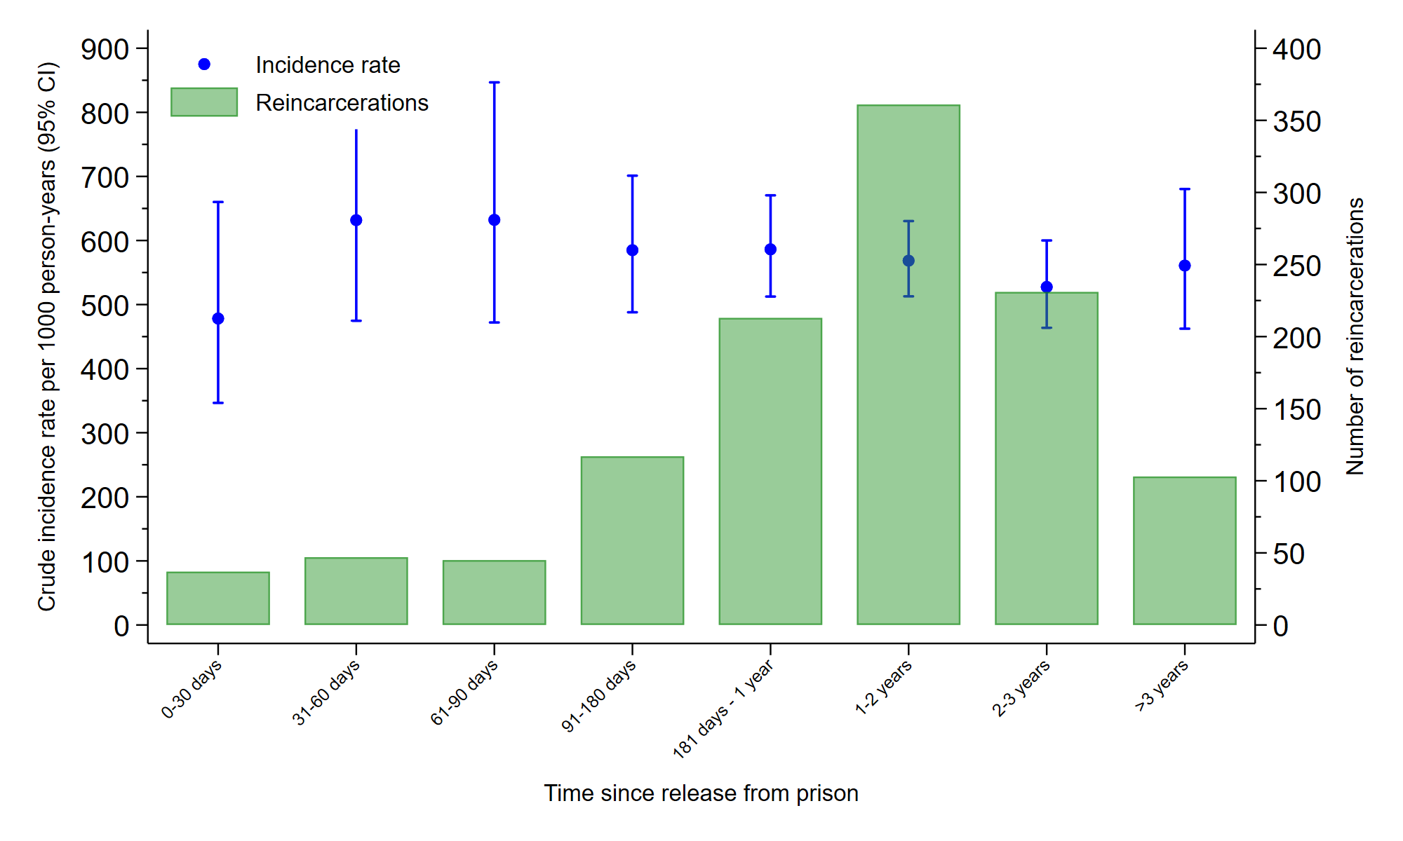
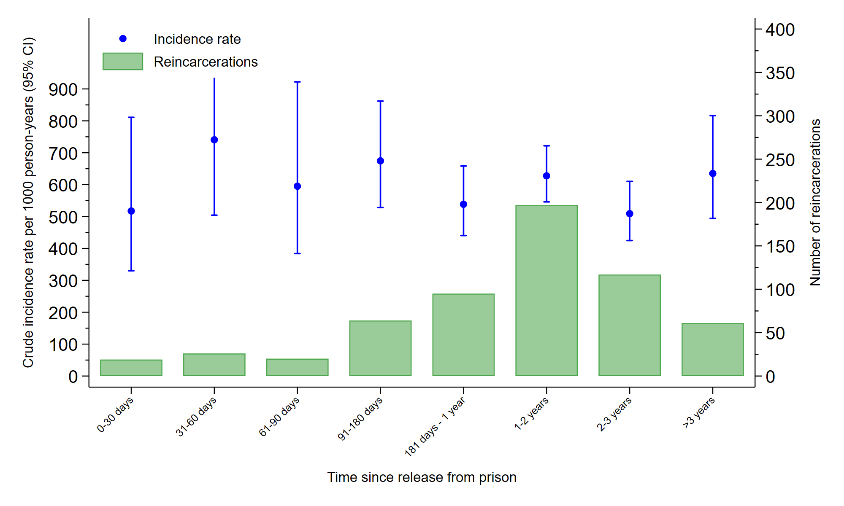
Incidence rates
Full sample
Dual diagnosis only

Slide 20
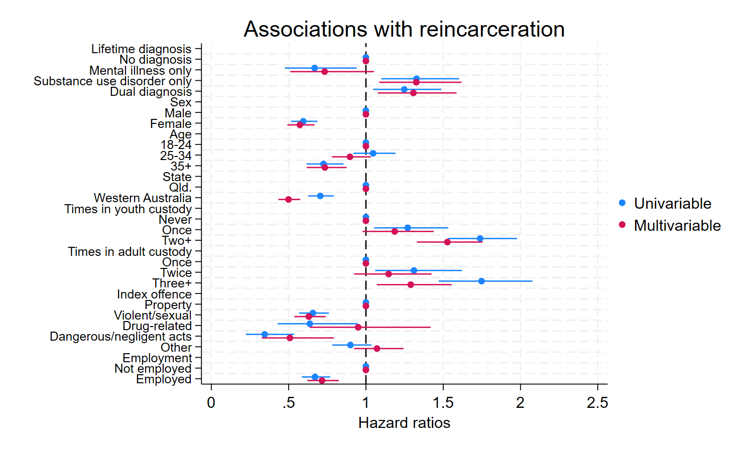
Results – Lifetime diagnoses
Notes:
Left of 1 = lower risk of reincarcerations
Right of 1 = Greater risk of reincarcerations
And all our statistically significant covariates here don’t cross 1

Slide 21
Results – Lifetime diagnoses
Notes:
Left of 1 = lower risk of reincarcerations
Right of 1 = Greater risk of reincarcerations
And all our statistically significant covariates here don’t cross 1

Slide 22
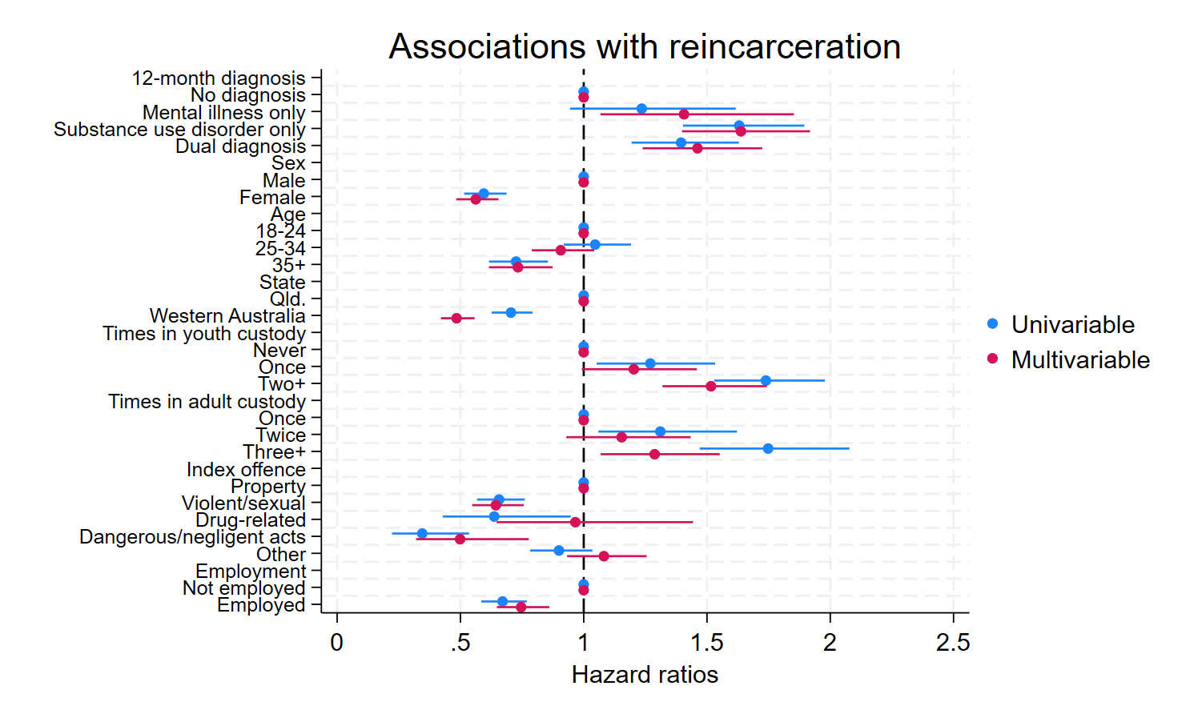
Results – 12-month diagnoses
Notes:
Left of 1 = lower risk of reincarcerations
Right of 1 = Greater risk of reincarcerations
And all our statistically significant covariates here don’t cross 1

Slide 23
Results – 12-month diagnoses
Notes:
Left of 1 = lower risk of reincarcerations
Right of 1 = Greater risk of reincarcerations
And all our statistically significant covariates here don’t cross 1

Slide 24
Results – 12-month diagnoses
Notes:
Left of 1 = lower risk of reincarcerations
Right of 1 = Greater risk of reincarcerations
And all our statistically significant covariates here don’t cross 1

Slide 25
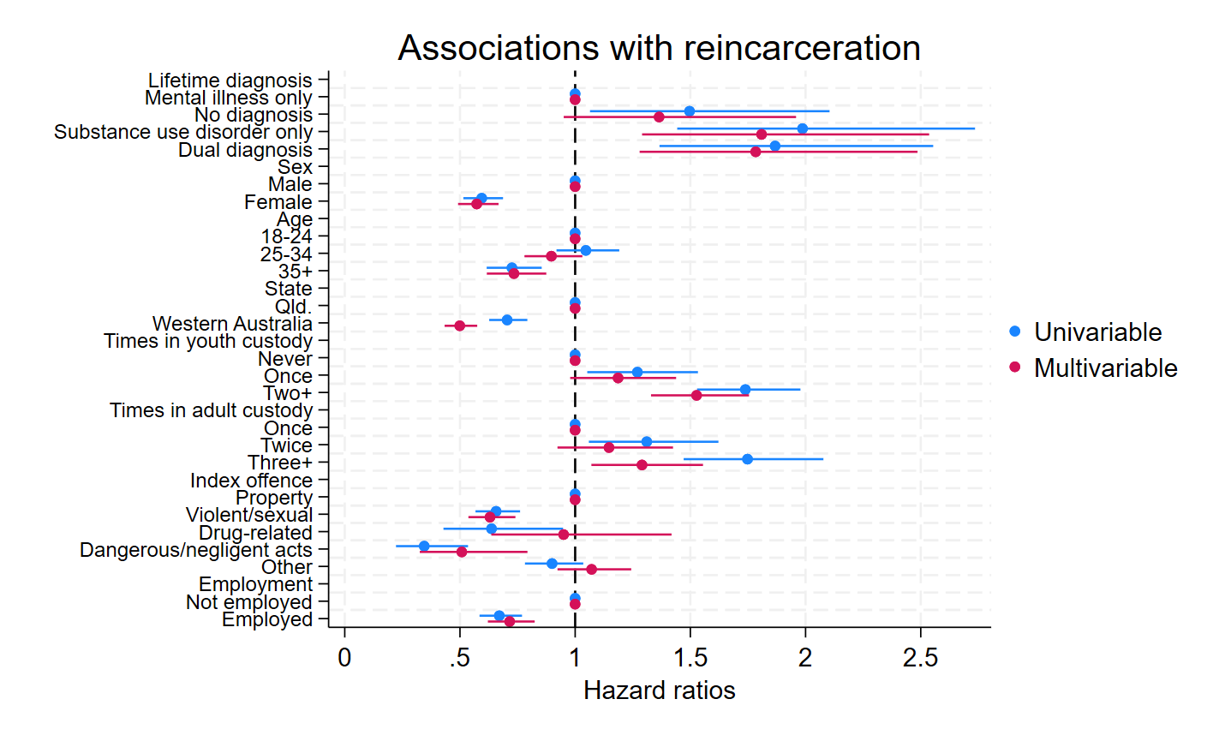
Results – Lifetime diagnoses
Notes:
Lifetime – MI as ref group

Slide 26
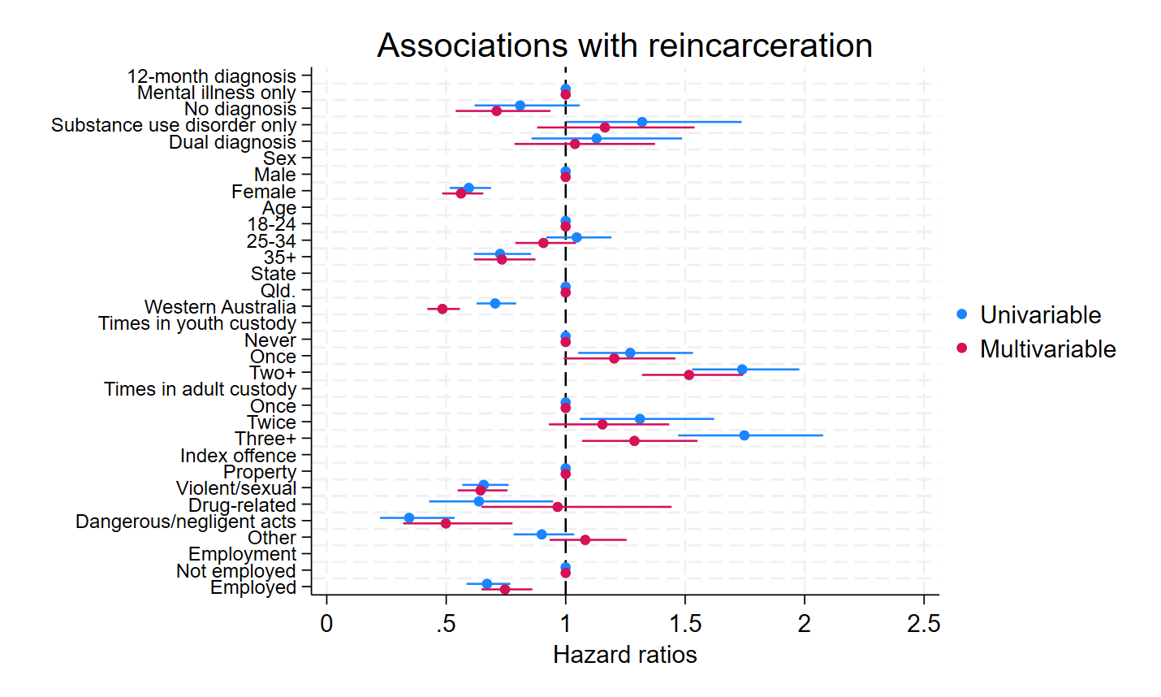
Results – 12-month diagnoses
Notes:
12-month MI reference
And all our statistically significant covariates here don’t cross 1

Slide 27
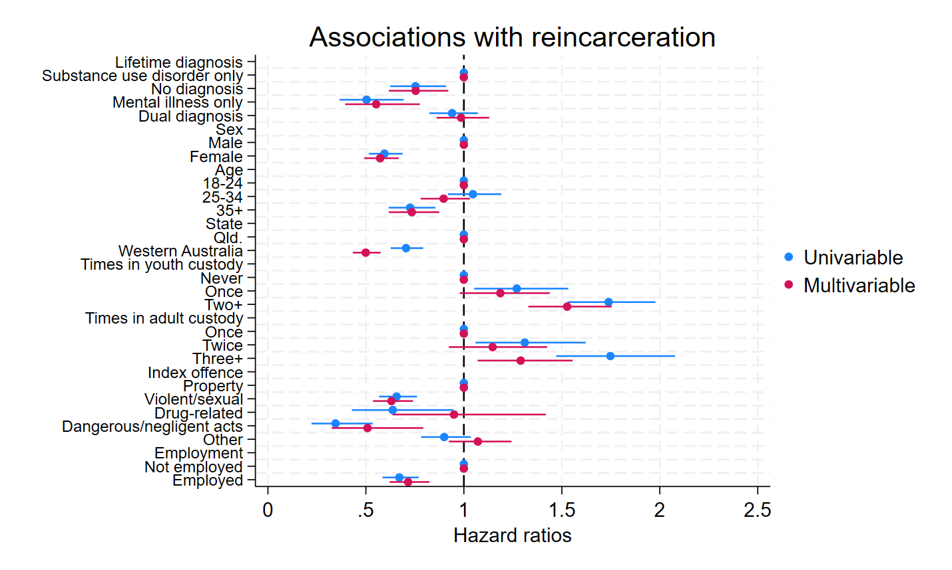
Results – Lifetime diagnoses
Notes:
Lifetime SUD as reference

Slide 28
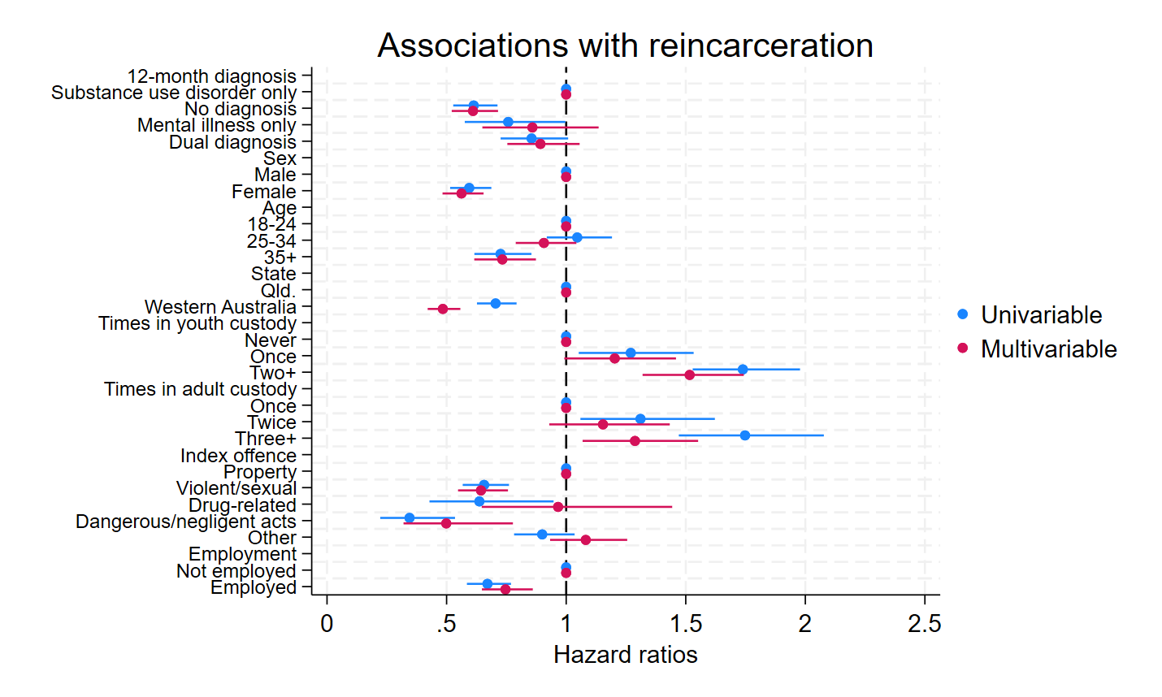
Results – 12-month diagnoses
Notes:
12- month sud refs
And all our statistically significant covariates here don’t cross 1

Slide 29
Summary of results
Substance use disorder-only and dual diagnosis = greater risk of reincarceration than no diagnosis
Mental illness only = greater risk of reincarceration than no diagnosis using 12-month definition only
Reference category | Dual diagnosis relationship to reincarceration
 | Lifetime | 12-month
No diagnosis
Mental illness only
Substance use disorder only
Notes:
That non-sig difference for 12-month mental illness really only exists because of that flip we see from MI almost being protective in the lifetime diagnoses, but a risk factor in the 12-month.
We think that is most likely because the only data that can update our analyses post-release are our administrative data, so we may be capturing more severe instances here than our lifetime data sources
In terms of no difference from SUD –only, two possible reasons:
1. Maybe the effect just doesn’t exist. And that would back up some of the research from the US (Dalibir) and Aus (O’Driscoll)
2. Maybe has to do with our definitions of MI. Important to remember we’re not looking at severe mental illness only. And diagnoses of mental health, especially less acute conditions may actually just be capturing people who are taking a more proactive approach to managing their mental health

Slide 30
Implications
Transitional health services must be appropriately funded and accessible
Barriers to care
Dual diagnosis is still a large cost to government
Notes:
Really our results showed that substance use disorders with and without co-occurring mental illness are a risk factor for reincarceration. Appropriately resourced and accessible substance use services upon release may help to mitigate this.
For this cohort in particular we know that these services should be provided by ACCHOs. And even when this does occur, we know the continuity of care is not great because only one prison in Australia has healthcare run by an ACCHO
Pettit and colleagues interviewed ACCHO staff about providing care to people leaving prison and found that the organisations found it difficult to access prisoners, limited funding available for appropriate services, and
Barriers to community healthcare:
And this is talked about in one of Jane Lloyd’s (2015) papers on primary health care in and out of prison for Aboriginal and Torres Strait Islander people. There’s no one agency that is responsible for the coordination of health care after release for Aboriginal people
From Lloyd et al’s discussion. “include managing competing priorities such as meeting parole requirements; finding accommodation; reconnecting with family; and securing employment…no money to get prescriptions filled.”
Although we didn’t find that DD was associated with greater risk of re-offending than SUD-only, previous studies have still shown that their cost to the government in terms of health spending is much greater than that of MI only and SUD only

Slide 31
Contact
darcy.coulter@curtin.edu.au
Notes:
Next steps:
Focus groups
Expansion to two more states.
HARP trial
Other mental health outcomes

Slide 32
The HARP Trial: Improving (mental) health and wellbeing after release from prison
CHIEF INVESTIGATORS: Prof Stuart Kinner, Prof Ed Heffernan, Prof Kimberlie Dean, Prof Rohan Borschmann, A/Prof Michael Doyle, Prof Penny Abbott, Prof David Preen, Prof Mark Stoové, Dr Jesse Young, Dr Craig Cumming, Dr Lucas Calais-Ferreira, Dr Michael Curtis, Dr Darcy Coulter, Prof Dennis Petrie, Prof Emily Wang
Funding: MRFF $5 million 2025-2030
OUTCOME: an evidence-based, culturally safe, gender responsive, scalable model of transitional health care
1. National consultation and co-design
2. RCT (N=1000) in south-east Queensland
3. Adaptation and national scaling
ASSOCIATE INVESTIGATORS: Dr Marshall Watson, Ms Margaret Doherty, Prof Megan Williams, A/Prof Balaji Motamarri, Dr Sophie Davison, Mr Andrew Wiley, Prof Shira Shavit, Dr Lisa Puglisi, Dr Ashleigh Stewart, A/Prof James Foulds, Prof Julia Crilly, Dr Fiona Kouyoumdjian, Dr Thomas Cheung, Dr Abby Lane

Slide 33




The intervention (v1.0)
GP
[MBS item*]
Peer worker
Nurse or
AHW
* RACGP (2017). RACGP submission access to Medicare in prison.

Slide 34
Contact
darcy.coulter@curtin.edu.au
Notes:
Next steps:
Focus groups
Expansion to two more states.
HARP trial
Other mental health outcomes

Slide 35
Table S1. Piecewise incidence rate of reincarcerations after release from prison
Time since release from prison |  | Number of reincarcerations | Person years | Incidence rate [95% CI]
0-30 days |  | 37 | 77 | 478.3 [346.5, 660.1]
31-60 days |  | 47 | 74 | 631.8 [474.7, 840.8]
61-90 days |  | 45 | 71 | 632.2 [472.0, 846.7]
91-180 days |  | 117 | 200 | 584.9 [488.0, 701.1]
181 days - 1 year |  | 213 | 363 | 586.2 [512.5, 670.5]
1-2 years |  | 361 | 635 | 568.6 [512.8, 630.3]
2-3 years |  | 231 | 438 | 527.5 [463.7, 600.1]
>3 years |  | 103 | 184 | 560.9 [462.4, 680.3]
Total |  | 1154 | 2043 | 564.9 [533.2, 598.5]
Note. Maximum time since release = 5.06 years

Slide 36
Current study
Health After Release from Prison (HARP)
  Face-to-face interviews with people within 6 weeks of release from Qld and WA prisons
  >2,700 participants
  Survey data linked with prison medical records and corrections and health administrative datasets
Sample period
  Queensland: August 2008 – July 2010
  Western Australia: May 2013 – August 2016

Slide 37
Data source coverage
QLD: → July 2012
QLD: Inpatient 1999 →
QLD: ED 2002 →
Birth to end of follow-up
Birth →
Index incarceration
WA: → June 2018
WA: 5 years ←
Baseline survey
Emergency department and inpatient admission data
Data source coverage
Prison medical records
Reincarceration data

Slide 38
Notes:
MI 7.0% (95% CI 4.3–11.5),
SUD 26.8% (95% CI 18.9–33.5), and
DD 40.9% (95% CI 30.1–48.2)
Self-report SUD and DD = 10% combined, but about 68% in the combined

Slide 39
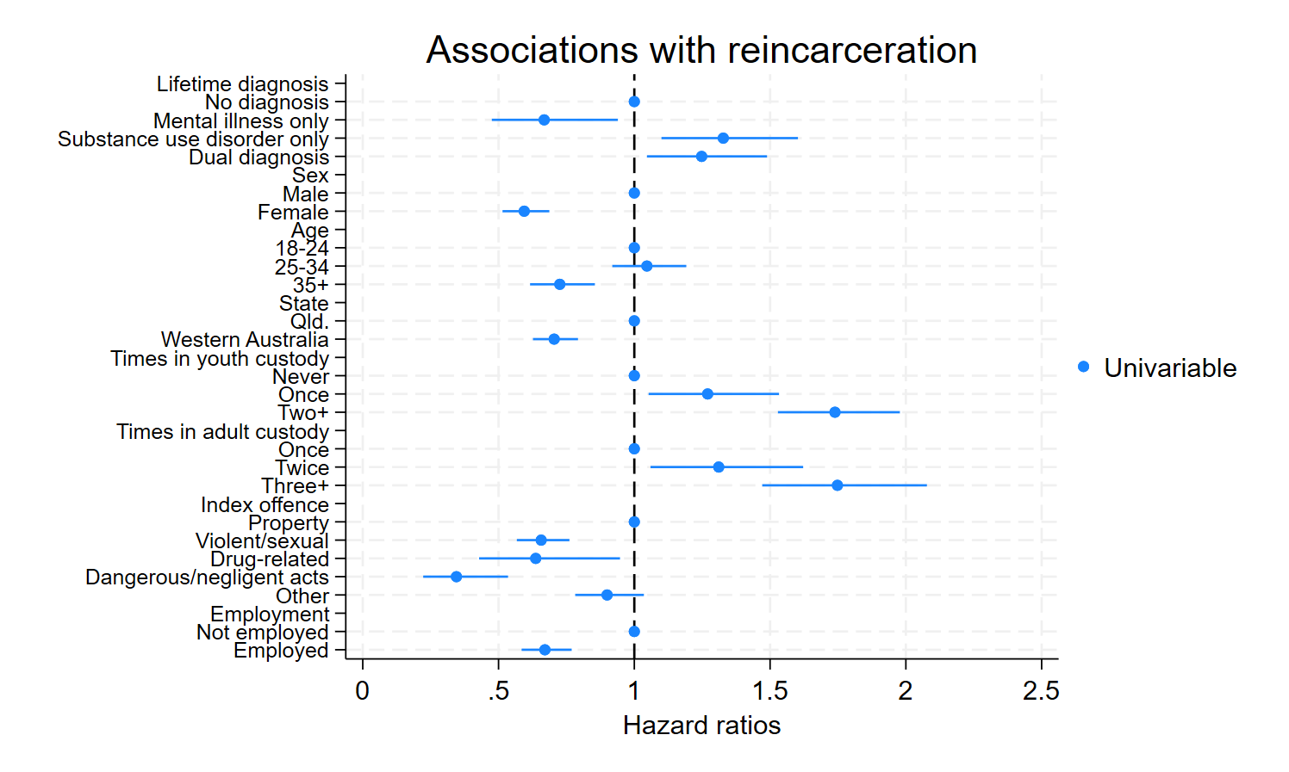
Results – Lifetime diagnoses
Notes:
Left of 1 = lower risk of reincarcerations
Right of 1 = Greater risk of reincarcerations
And all our statistically significant covariates here don’t cross 1

Slide 40
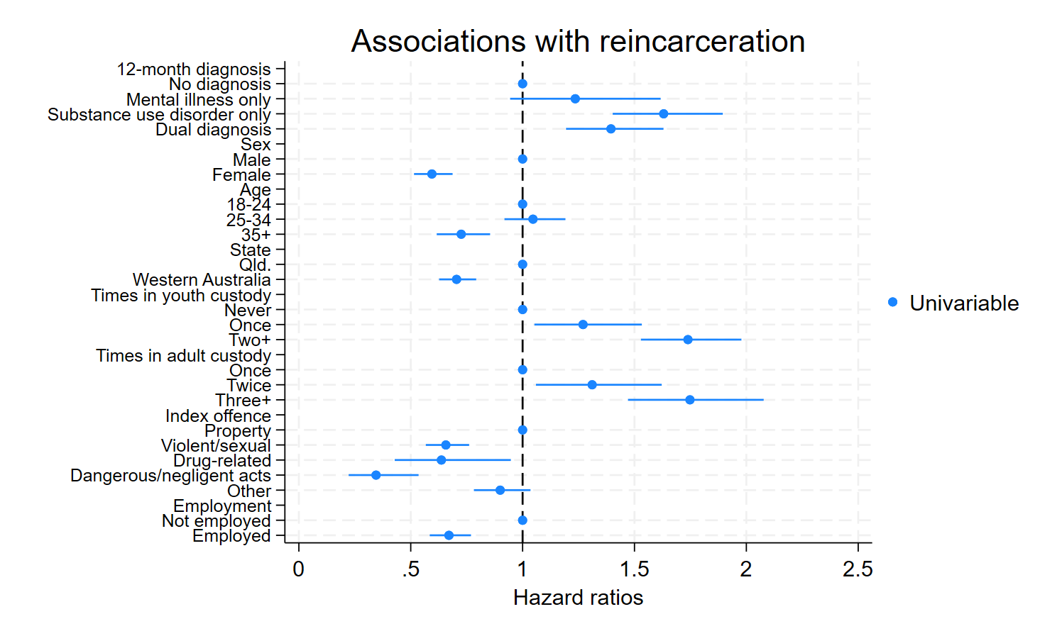
Results – 12-month diagnoses
Notes:
Left of 1 = lower risk of reincarcerations
Right of 1 = Greater risk of reincarcerations
And all our statistically significant covariates here don’t cross 1

