Slide 1



Consorting & Children in nsw
Justine Simpkins
Manager, Prevention and Education
Law Enforcement Conduct Commission

Slide 2

Acknowledgement of Country

Slide 3

Agenda
LECC’s legislative review function
What is consorting?
How we did the review
Results of our analysis - children
Recommendations and responses

Slide 4

Use of consorting law – capturing and criminalising associations that may not relate to serious organised crime?
Potential to increase young people’s interactions with the criminal justice system

Slide 5

Detect, investigate, prevent misconduct and maladministration within law enforcement in NSW
Oversight and monitor the investigation of critical incidents
Systemic misconduct and maladministration
Legislative reviews

Slide 6

What is consorting?
Legislation introduced in 2012 ...
made consorting an indictable offence
increased the maximum penalty from a maximum of six months imprisonment and/or a fine of $400 to three years imprisonment and/or a $16,500 fine
extended the meaning of consorting to include communication by electronic means
provided guidance on the meaning of ‘habitually consorting’
included six possible defences where the former offence had none.

Slide 7


Amendments
Amendments to the consorting law - 2019:
‘indicatable offence’ includes an indictable offence committed in another jurisdiction
excluding children under the age of 14 years
Time caps for duration of official consorting warnings:
  6 months for persons <18
  2 years for persons 18+
clarified elements of the consorting warning
extra defences e.g., complying with directions for the State Parole Authority and Corrective Services officers, engaging in welfare services or transitory accommodation arrangements
‘family members’ includes First Nations kinship systems.
These amendments were the basis of the Commission’s review.

Slide 8




Types of consorting warnings
Pre-emptive
(12,430)
On the spot​
(3568)
Subsequent or retrospective
(72)
booking​
(284)

Slide 9
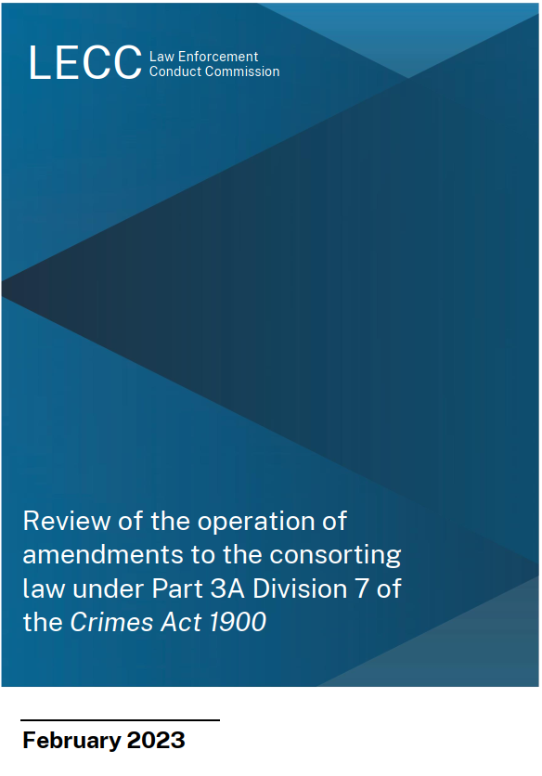
Our Review
Review period:
1 February 2019 - 28 February 2022

Slide 10
What we found
No young people under the age of 14 were warned for consorting.
No children were charged with consorting offences during the review period.
Notes:
This slide can be deleted and ‘spoken’ about instead as the following two slides show the data supporting this statement.

Slide 11
2012-15 vs 2019-21
CHILDREN Issued consorting warning
ombudsman review
CHILDREN issued consorting warning
lecc review
CHILDREN named in WARNING
Ombudsman review
CHILDREN NAMED IN WARNING
LECC REVIEW
Age | Total
13-15 | 46
16-17 | 205
Total | 251
Age | Total
14 | 6
15 | 11
16 | 10
17 | 21
Total | 48
Age | Total
13-15 | 55
16-17 | 270
Total | 325
Age | Total
14 | 0
15 | 1
16 | 2
17 | 8
Total | 11

Slide 12

WHY FEWER CHILDREN?
Legislative change
Changes to Standard Operating Procedures in 2019:
Do not to give an official warning ‘in relation to’ a person aged under 18 unless they have been convicted of a serious children’s indictable offence.
SOPs emphasised the law is aimed at addressing organised crime.

Slide 13



CONVICTION HISTORIES
Of the 11 people < 18 who were named in a consorting warning:
8 did not have a conviction for an indictable offence
1 was convicted of reckless grievous bodily harm
1 was convicted of supplying a commercial quantity of a prohibited drug
1 was convicted of robbery armed with an offensive weapon.

Slide 14
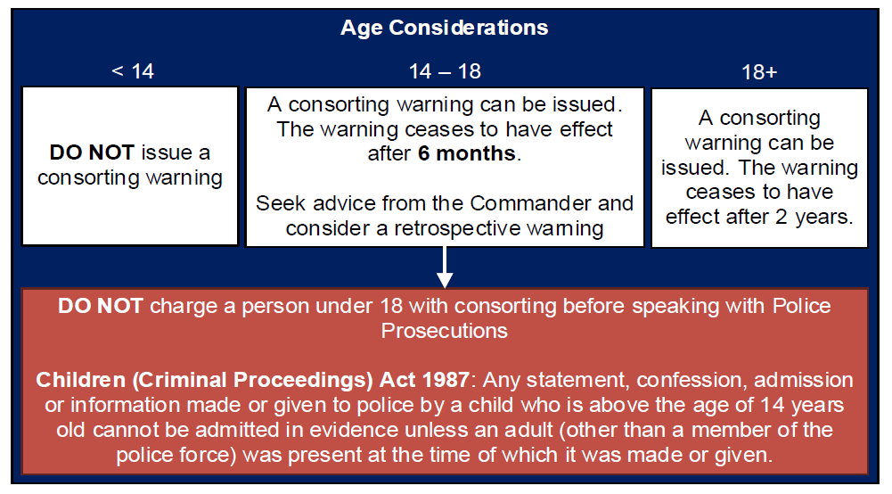
2022 – Additional Quality Assurance Checks

Slide 15

VERBAL WARNINGS
Warnings issued by general duties police are typically verbal
BWV that we reviewed showed:
  many recipients did not know what consorting was
  inaccurate information about duration of warnings
RECOMMENDATION
If captured by the consorting laws at all, children should always receive written warnings

Slide 16


SERIOUS ORGANISED CRIME?
Majority of general duties uses on children did not appear to relate to serious criminal activity or organized crime.

Slide 17

What we have recommended
RECOMMENDATIONS
13 Recommendations in total.
Amend the law to state its purpose is to prevent serious criminal offending.
Require warnings to be recorded on Body Worn Video.
In relation to children:
Exclude children from the consorting law
Anyone under the age of 18 - written warnings
Establish the child understands warning, duration, meaning

Slide 18
READ OUR Full report
Available on the LECC website:
www.lecc.nsw.gov.au

