Slide 1

Presented by Lorelei Hine and Charlotte Bell
Notes:
My name is Lorelei Hine and I’m the acting Research Manager overseeing the Evidence Portal project. I have been at ANROWS for almost a year now and have research expertise in the methodologies we use for the Portal. I’ll be talking you through the first half of the presentation today to speak to our methodology and how we have built the Portal. I’ll then hand over to my lovely colleague Charlotte Bell who will talk about how you can use the Portal to support your work.
We expect to release the website to the public on 8th September 2023. Please sign up to the ANROWS mailing list to receive information about the launch event being held in Queensland.

Slide 2
Presentation objectives
Background and methodology of the Evidence Portal
How the Evidence Portal works
Ways that the Evidence Portal could support your work
PRELIMINARY FINDINGS on criminal justice interventions
Notes:
Today, our presentation will:
Provide the Background and Methodology of the Evidence Portal
Demonstrate how the Evidence Portal works
Identify ways that the Evidence Portal could support your work
Explore a case study on Australia’s National Research Agenda to end violence against women and children (ANRA) 2023-2028
The Evidence Portal is a large and complex project, so our aim of today’s presentation is to provide you with an understanding of the methodology underpinning the project and the scope of the project. It’s also a chance for us to share with you some key elements of the Evidence Portal. Our plan for disseminating the portal and getting the word out there is ongoing, so we won’t cover all elements in detail today. However, these will be the subject of future presentations/events.
This forum is a way for us to educate you about the Evidence Portal before its official launch on the 18th August 2023.

Slide 3

Acknowledgements
The Evidence Portal is overseen by two important committees
  Advisory Group
  Policy Reference Group
We also thank the staff involved in similar projects in the UK for their expertise, insights and advice
Thank you to our ANROWS staff
Notes:
Our advisory group is largely made up of subject matter experts across the VAW sector but also expert methodologists. In particular, we have partnered with Associate Professor Angela Higginson from Queensland University of Technology and Dr Liz Eggins from Griffith University. These academics provided specialist systematic review and critical appraisal support.
Our policy reference group has policy representatives from around Australia.
I would like to gratefully acknowledge the support provided by both groups during our consultations.
We also held consultations with other organisations and groups internationally (majority from the UK) who have implemented similar evidence portal or ‘what works’ projects in order to gain insights/learnings from them to improve our own project.
Lastly, I would like to acknowledge the hard work of our Evidence Portal research team, including Charlotte who is with me today, but also our current staff Dr Lizzy Watt, Dr Rebecca Pollard, Rhiannon Smith, and our group of casual research assistants.

Slide 4
A note on “evidence”
While we use the term “evidence” to refer to our project, we do not capture all forms of evidence, and we are not able to answer all research questions
We stress the importance of drawing from other resources and forms of knowledge to complement the knowledge base
The ANROWS Evidence Portal is one tool in your ‘toolkit’
Notes:
Evaluations of interventions are one tool to determine what may work for your community or population. While there is much merit in bringing the evaluations together into one place, other forms of evidence should also be used to complement what the Evidence Portal can tell us about ‘what works’. For example, practice knowledge and lived experienced may be captured in the Evidence Portal, but only when situated within an evaluation, so our picture of this knowledge may be incomplete.
We don’t include process evaluations or implementation evaluations because our portal is more concerned with the “what works” to reduce and end VAW research question

Slide 5
What are evidence portals?
Broadly, they seek to consolidate information about interventions so that policy, practice, and/or research stakeholders can get a sense of:
  What intervention evaluation research exists, and are there gaps?
  Do evaluations show whether an intervention works?
  What should be considered during local implementation of interventions?
Evidence portals are normally concerned with:
Evaluation - using social research methods to systematically investigate the effectiveness of social intervention programs
Interventions - any program, policy, strategy, tool, campaign, directive, or other activity designed to produce change or address a problem
Notes:
Firstly, what do we mean when we say evidence portal? It isn’t a new concept, and we aren’t the first evidence portal or ‘what works’ centre. The UK is about 10 years ahead of us in terms of funding and creating evidence portals.
Broadly, evidence portals are a place to consolidate information about interventions to help people understand the evaluation literature on a particular topic. They have been used to help stakeholders get a sense of:
What intervention evaluation research exists, and are there gaps?
Do evaluations show whether an intervention works?
What should be considered during local implementation of interventions?
By evaluation, we are referring to social research methods that investigate the effectiveness (or “what works”) of interventions.
By intervention, we mean any program, policy, strategy, tool, campaign, or directive that aims to produce change or address a problem. This is a wide definition that captures all sorts of approaches. It includes systems level policies, and also smaller-scale programs implemented in local settings. It includes programs as you might typically think of them (e.g., a set X-week long group therapy program) but it also includes things like policy change.
Evidence portals, toolkits and “what works” centres have largely developed out of what White (2019, p. 4) calls the “fourth wave of the evidence revolution”, where “activities … seek to institutionalise the use of evidence in policy and practice”. Indeed, as Gough (2021) states, there is a need for research evidence to be accessible to policymakers, practitioners and decision-makers if it is to inform decision-making. Evidence portals fill this need by providing web-based information that summarises what is known about interventions from research on a given topic (Gough & White, 2018). By providing a curated picture of the available evidence, evidence portals can offer a solution to a variety of potential barriers that decision-makers may face in accessing high-quality evaluation evidence. These may include factors such as an overwhelming number of research papers on a topic, technical language, or limited time to assess the full body of evidence (Gough, 2021). Evidence portals can also offer a solution to a tendency towards cherry-picking evidence based on availability, accessibility or other biases (Hoces de la Guardia et al., 2020; Schuller-Martínez et al., 2021).

Slide 6
Why do we need an Evidence Portal?
We’re the first Evidence Portal specifically within the violence against women sector
We need a tool that…
Consolidates information into one place
Provides an interactive way to visualise the evidence and gaps
Provides a framework to understand/explore interventions and their outcomes
Is written in plain and accessible language, plus takes into account potential biases in the research
Can be a component in understanding what interventions are effective, or might be worth funding, implementing, and researching
Notes:
The Evidence Portal consolidates information into one place and synthesises it so that you don’t need to trawl through many individual papers
Evaluation evidence is an important component to knowing ‘what works’ or what interventions might be worth funding, implementing, and researching

Slide 7
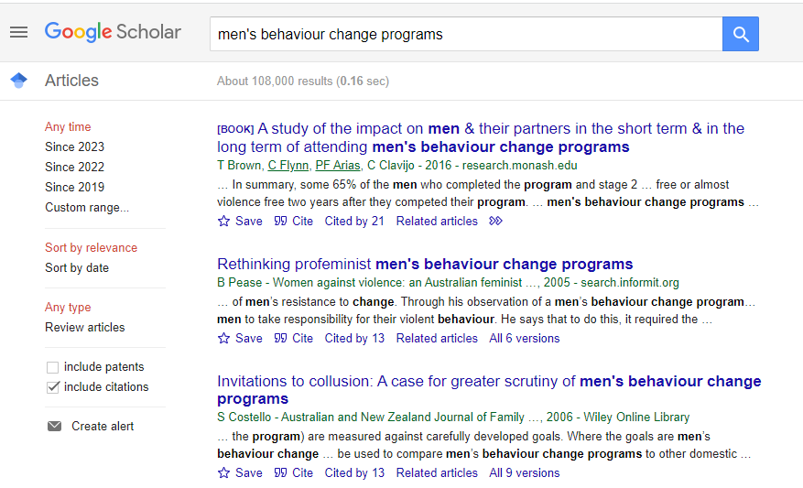
Why do we need an Evidence Portal?
Notes:
Huge amount of evaluation evidence out there
This is just on one program. Imagine repeating this if you were searching across multiple initiatives!
Also note that because we read the papers, we can group them together and tell the end user about the nature of them quicker than reading the full article (e.g., tagging all MBCPs that include modules on parenting, or all MBCPs that require mandated attendance from courts versus voluntary attendance). Some people may also use different terms of MBCPs, such as “domestic abuse program”
This is a good example of how we might bring together evaluations into one portal that provides quicker/streamlined evidence of evaluations of interventions on a particular topic, such as MBCPs.

Slide 8
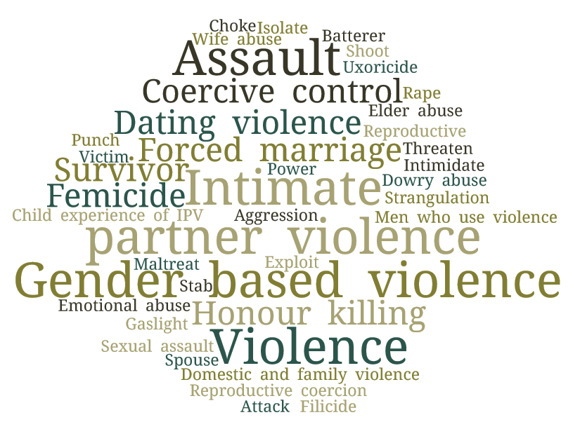
Why do we need an Evidence Portal?
Some papers are written in technical language or jargon
Many different words and terms are used to describe violence against women concepts
Notes:
Terms have also shifted over time.
Different countries may use slightly different words for the same concepts.
Not every paper actually uses the words “intervention to address VAW” in their title or abstract – some are much more obscure
**Talk about the terms and doing different searches e.g on GBV and VAW etc.
All this to say that bringing together such a vast evidence base into one place will save time and resources for end users!

Slide 9
What is the ANROWS Evidence Portal?
The ANROWS Evidence Portal is a website that hosts:
Evidence and gap maps, which provide a big-picture, visual overview of interventions using a pre-specified framework
an Intervention Finder to search and filter for available interventions in the VAW area
Intervention Reviews, which follow a comprehensive, pre-determined format to provide a standardised assessment of available interventions in accessible language
bespoke tools, which are designed to assess the risk of bias in the quantitative evidence base and estimate the effectiveness of interventions
Notes:
The Evidence Portal is a publicly accessible website. It is designed to be a living resource that will be continuously updated with new knowledge.
On the website, we host our outputs. These are:
Evidence and gap maps which provide a visual overview of the evidence
A search tool to find interventions that we have catalogued
Intervention reviews (i.e. the search results) that provide a summary about each intervention topic that we catalogue
Two research tools. The first enables us to assess the methodological rigour (or risk of bias) of studies. The second allows us to estimate the effectiveness of interventions using quantitative results.
Today, we’ll be talking you through the evidence and gap maps. We’ll briefly touch on the intervention finder and intervention reviews as well. First, however, I’ll start with the methodology that underpins all three of these outputs.
Future Evidence Portal dissemination activities will take a deeper dive into the intervention reviews, and our research tools.

Slide 10
Overview of the Evidence Portal
AIM
Determine what is known about evaluations of interventions that aim to address and end violence against women
METHOD
Evidence search and synthesis is underpinned by gold standard systematic review methodology
RESULT
Transparent way of measuring effectiveness of existing interventions and identifying gaps in knowledge
OUTCOME
Aids policymakers, practitioners, researchers and funders to develop a collective understanding of “what works”
Notes:
So broadly, what is the objective of the Evidence Portal, what does it seek to achieve?
This flowchart briefly captures our aim, which is to determine what’s known about evaluations of interventions for VAW; we use a systematic review method to help us to transparently and rigorously identify what we know about interventions, how effective they are, and where there are gaps in knowledge. The outcome of this work is to aid policy, practice and research to develop a collective understanding of the effectiveness, or “what works”, knowledge base.
So now you know the overarching aims and desired outcomes of the Evidence Portal, what exactly does it look like?

Slide 11

What is a systematic review?
Scientifically rigorous and replicable
Minimises bias and increases transparency
Provides explicit guidance to manage and synthesise large and complex bodies of research
Allows us to easily group ‘like’ interventions together
Notes:
A systematic review follows a series of planned steps + takes into account all possible literature that might be relevant for the research question. In this way, it’s able to be scientifically rigorous and transparent. It gives us researchers a framework to ensure that we’re not producing a biased product and can more confidently/accurately paint a picture of the large evidence base for VAW.
By applying definitions and reducing ambiguity in our concepts, we make the job of consolidating such a vast research base easier
Makes our job as the research team easier to sort through and categorise such a large evidence base
Results in a comprehensive database and understanding of all interventions and outcomes in the violence against women area
Interventions - any program, strategy, tool, campaign, directive, or other activity designed to produce change or address a problem

Slide 12
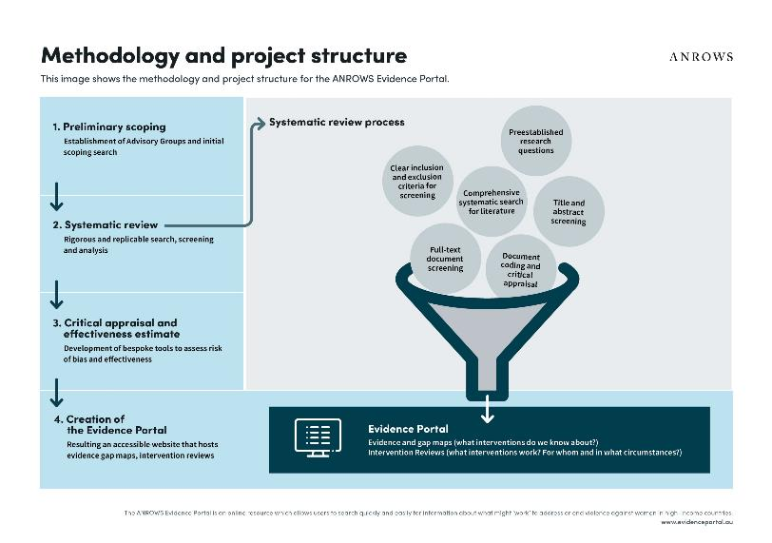
Evidence Portal methodology
Notes:
You can think of a systematic review as a funnel, as shown in this diagram.
You start with your research questions and then search for studies.
The systematic search uses a large number of search terms to capture our topic, and covers academic databases and unpublished sources. In other words, while we capture traditional research outputs such as journal articles, we also capture technical reports and other outputs from peak bodies such as governments or research organisations (this is referred to as grey literature).
As you work down the funnel, you apply your inclusion criteria to each paper, and exclude those that don’t meet the criteria. What is left are your studies that meet all requirements to be eligible for inclusion in the project.
We have to put “rules” around how we determine which evidence is ‘in’ or ‘out’ – we built a process to reduce some ambiguity in our product. However, that means that studies not meeting our “rules” aren’t indexed in the EP, and you need to access those elsewhere
These “rules” aren’t meant to tell you what evidence is ‘good’ or ‘bad’, but they just help us make sense of a complex body of literature/knowledge by putting replicable and unambiguous parameters on it
You extract key data and information from these studies (e.g., the target population or setting of the intervention, what outcomes were studied). This information is also captured using standardised forms so that you can collate it.
The final output on this image is a systematic review. This last part here for us is essentially our Evidence Portal and the evidence and gap maps, intervention reviews, that we will talk about in more detail soon. Where an academic team might publish their systematic review in an academic journal article, we have produced the Evidence Portal.

Slide 13
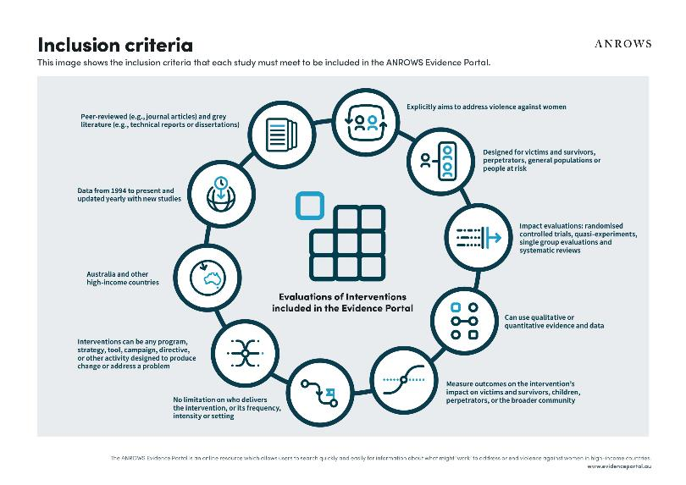
What is included in the Evidence Portal?
Notes:
Violence against women is “any act of gender-based violence that results in, or is likely to result in, physical, sexual or psychological harm or suffering to women, including threats of such acts, coercion or arbitrary deprivation of liberty, whether occurring in public or in private life” (United Nations, 1994).
Type of violence
Intimate partner violence is Physical violence or sexual violence and emotionally abusive, harassing and controlling behaviour that occurs between current or former established intimate partners. Children’s experience of intimate partner violence between parents is included in this category
Non-partner sexual violence is Sexual harassment, threats, trafficking, or assault from a someone who is not an established intimate partner, such as a stranger, friend, acquaintance, or romantic interest
Child-to-parent violence is Physical violence, sexual violence or emotionally abusive, harassing and controlling behaviour perpetrated by an individual against their parent or carer. This includes forms of adolescent family violence and elder abuse against parents
Extended family violence is Physical violence or emotionally abusive, harassing and controlling behaviour perpetrated by extended family members against someone in current, past, or proposed intimate partner relationship. This includes dowry abuse, “honour” killings, forced marriages and extended family and in-law abuse
Qual + quant + reviews – expands beyond traditional systematic review methods that prioritise quantitative data
Interventions - any program, strategy, tool, campaign, directive, or other activity designed to produce change or address a problem

Slide 14
How have we organised the interventions?
Domain | Intervention aims
Prevention | To prevent the likelihood of violence against women happening by changing attitudes, knowledge, and behaviours
Early intervention | To identify violence against women as early as possible and connect individuals to services
Response | To improve the safety of victims and survivors of violence against women and address their immediate needs
 | To respond appropriately to perpetrators of violence against women and prevent them from offending
Recovery and healing | To improve the long-term mental health and wellbeing of victims and survivors of violence against women, and children who have experienced violence between parents
Notes:
3x sources
Adapted from National Plan
Stakeholder consultations
Scoping review
Ongoing process of categorisation and can change with the state of the literature
All eligible studies are categorised into the 4 domains and then these are used to feed into our EGM and intervention review outputs.
Living resource: To date, we include 1500+ studies across these 4 domains

Slide 15
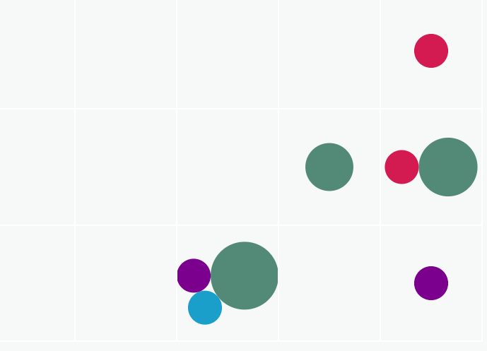
Evidence and gap maps
What is an EGM?
visual overview of available evidence
use a pre-specified framework
overview of interventions and outcomes on each axis
Case study:
Preliminary findings from the “Response” EGM

Slide 16
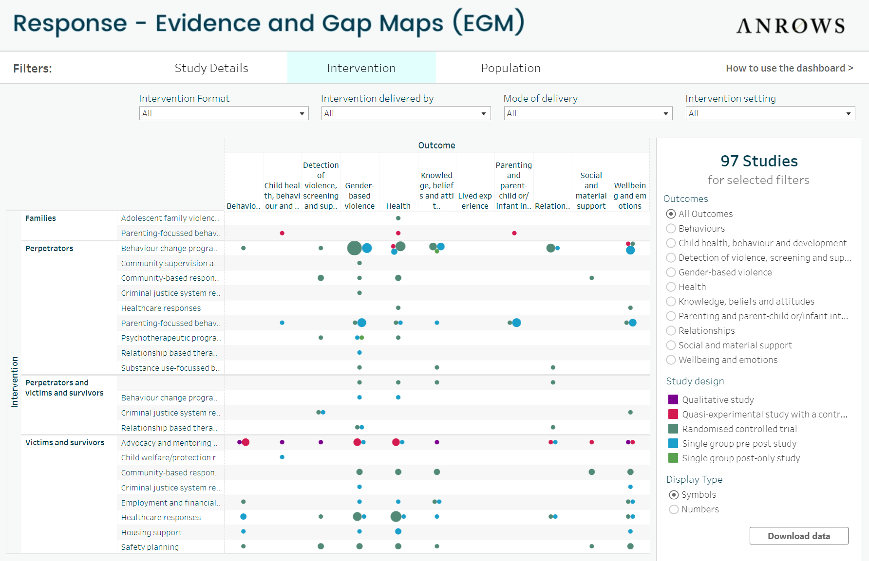

Slide 17
How can you use the EGMs?
Access a consolidated knowledge base
Identify evidence gaps within relevant sectors
Determine the nature of available evidence
Guide future knowledge production, research priorities, funding
Support a strategic approach to decision-making

Slide 18
Criminal justice interventions: Where is the evidence?
Criminal justice interventions are captured across the continuum of prevention, early intervention, response, and recovery and healing
Most commonly shown in the Response domain
Currently catalogued over 90 studies on a range of criminal justice interventions
Interventions cover behavioural change programs, electronic monitoring for perpetrators, policing, legal responses, risk assessment and restorative justice
Violence types include IPV, sexual violence, stalking, adolescent family violence
Outcomes cover gender-based violence, health, relationships, wellbeing and systems
Wide range of research designs included

Slide 19

The next part of the puzzle – “what works?”
Intervention Reviews are plain language summaries that:
follow a comprehensive, pre-determined format
provide a standardised assessment of available interventions
are based on high-quality evidence that has been assessed by ANROWS risk of bias tool
use accessible language, designed specifically for policy and practice use

Slide 20
How can you use the Intervention Reviews?
assess the overall quality and effectiveness of a body of evidence
consider intervention applicability to different populations, settings
understand who might the intervention work for, under which circumstances, and why

Slide 21


Questions
You can email any questions to:
evidenceportal@anrows.org.au
or
lorelei.hine@anrows.org.au
Notes:
We expect to release the website to the public on 8th September 2023. Please sign up to the ANROWS mailing list to receive information about the launch event being held in Queensland.

