Slide 1


Intergenerational Incarceration - a Public Health Problem
Evidence from NSW Correctional Settings
Marc Remond¹, Reem Zeki², Erica Breur¹, Julia Bowman ², Jennifer Galouzis³, Kelly-Anne Stewart³, Elizabeth Sullivan^{1, 2}
1.University of Newcastle 2. Justice Health and Forensic Mental Health Network 3. Corrective Services NSW, Sydney, Australia
Notes:
Good afternoon everyone. My name is Liz Sullivan and I would like to thank BOCSAR for the opportunity to present our research on intergenerational incarceration in NSW.
I would first like to acknowledge the Gadigal people as traditional custodians of the land where we are gathering today and pay my respect to Elders past, present and emerging.
I would also like to acknowledge my co-authors some of who are in the room today

Slide 2

Background
Criminalisation of poverty is a major public health problem.
Key indicator “intergenerational offending”
Factors associated with “intergenerational incarceration”
Individuals whose parent(s) have been in prison are at increased risk of incarceration themselves.
Australian context
Giordano PC & Copp JE 2015. ‘Packages’ of risk: Implications for determining the effect of maternal incarceration on child wellbeing. Criminology & Public Policy 14(1): 157–168)
Farrington DP, Coid JW & Murray J 2009. Family factors in the intergenerational transmission of offending. Criminal Behaviour &Mental Health 19:109–24
Stinson JD, Quinn MA & Levenson JS 2016. The impact of trauma on the onset of mental health symptoms, aggression, &criminal behavior in an inpatient psychiatric sample. Child Abuse & Neglect 61: 13–22
Tzoumakis S, Burton M, Carr V, Dean K, Laurens K, Green M. The intergenerational transmission of criminal offending behaviours (Report to the Criminology Research Council - Grant: CRG 19/14-15). Australia: Criminology Research Council, 2019
Whitten T, Burton M, Tzoumakis S, Dean K. Parental Offending &Child Physical Health, Mental Health, &Drug Use Outcomes: A Systematic Literature Review. J Child Fam Stud 2019; 28(5): 1155-68.
Notes:
The criminalisation of poverty is not new public health problem but one that reflects persistent systemic disadvantage and marginalisation that is sustained across generations in Australia and globally. One way of viewing this is through the lens of “intergenerational offending”?
Intergenerational offending refers to the idea that criminal behaviour may be “transmitted” from one generation to another… in other words, individuals whose parents have been involved in criminal activity are more likely to follow in their footsteps with almost normalisation of this pathway. This is associated with the phenomenon of “intergenerational incarceration”, where individuals whose parent or parents have been in prison are at increased risk of imprisonment themselves.
As Giordano & Copp published in the 2015 article Packages’ of risk: Implications for determining the effect of maternal incarceration on child wellbeing - These intergenerational linkages are likely to be a result of complex processes and are associated with a multitude of factors – research shows these range from : family factors including exposure to socio-economic disadvantage such as unemployment, systemic racism and financial stress; and to pro-criminal thinking and behaviour; housing instability, lack of education, family instability, as well as interpersonal violence and trauma; problematic gambling and drug and/or alcohol abuse; gender of the parent and child; parental characteristics such as younger maternal age and marital status at birth.
Research led by Tzoumakis and Whitten and colleagues in the intergenerational transmission of criminal offending behaviours found that the imprisonment of parents can detrimentally impact on the development of their dependent.
Context is essential when discussing Intergenerational incarceration – and I am going to provide some context over the next three slides –

Slide 3
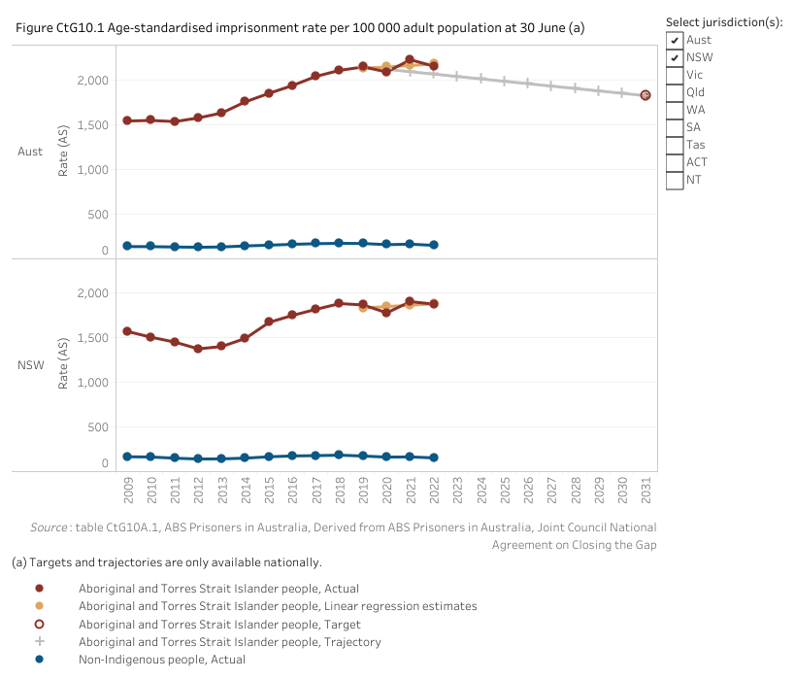
Over-incarceration of Aboriginal People
“growing public awareness of the mass incarceration "crisis" and its economic failings, but a deeper discussion must be had about the "fundamental immorality" and "systemic racism" underpinning criminal justice systems across the globe”
Dr Baz Dreisinger, Incarceration Nations: A Journey to Justice in Prisons Around the World
Source: Hayley Gleeson (2019). Australia must 'radically rethink' its prisons to avoid becoming like America, US activist says. Retrieved from https://www.abc.net.au/news/2019-04-30/australian-prisons-need-radical-rethink-baz-dreisinger-says/11059478?pfmredir=sm
Productivity Commission, Closing the Gap Information Repository, Canberra https://pc.gov.au/closing-the-gap-data accessed 12082023. Reporting against agreed Priority Reform and socioeconomic outcome targets and indicators.
Notes:
The first issue I wanted to contextualise is the over incarceration of Aboriginal people in Australia. Dr Baz Dreisinger, a US activist and author of - Incarceration Nations: A Journey to Justice in Prisons Around the World noted in her pre COVID 2019 visit to Australia that …..
This growing awareness is evident in the Australian Government’s agreed priority reform - to reduce the rate of Aboriginal and Torres Strait Islander adults held in incarceration by at least 15 per cent by 2031. After adjusting for differences in population age structures, the national age-standardised imprisonment rate per100 000 Aboriginal and Torres Strait Islander population in 2021-22 was 1897.1, compared with a corresponding rate of 156.1 for the non-Indigenous population after taking into account the effect of differences in the age profiles between the two populations, the national imprisonment rate for the Aboriginal and Torres Strait Islander population is 12.2 times greater than for the non-Indigenous population. Rates that do not take age profile differences into account are16.4 times greater.

Slide 4
Intergenerational trauma
“…..my brothers and that are still in juvenile and been locked up—yeah, I’ve been getting locked up since I was thirteen. This is my sixth birthday, sixth Christmas. When I was in foster care I loved going to juvie, DoCS had no control over me then, you know, [unclear] where I have to live, what I had to do, [unclear] it was all fun and games so juvie was my holiday away”. p133
SL. Lighton, Mothering and trauma: Lived experiences of Aboriginal mums in NSW prisons,electronic thesis, May 2021. Accessed 13082023 at: https://opus.lib.uts.edu.au/bitstream/10453/150777/2/02whole.pdf
Notes:
The second contextual factor as a public health physician is the need to privilege the voices of those impacted – which is not possible in the data being presented today - Intergenerational incarceration is an outcome of the criminalisation of social disadvantage, poverty, and trauma and its sequelae. The voices of the women from earlier work from our study on the social emotional and physical wellbeing of Aboriginal mothers in prison in NSW – known as SCREAM documents the lived experience and impact of intergenerational trauma as a pipeline for contact with the criminal justice system and our failure as a society of care of children. As Stacey Lighton states in her PhD Mothering and trauma: Lived experiences of Aboriginal mums in NSW prisons, based on SCREAM, The women’s narratives include ‘a meta-narrative of society’s failure of care of these women as children in NSW’ – I quote from Stacey’s PhD “Such failures of care are embedded in our social histories and are systemic. These failures have led to the enduring family hardships and pain that the women spoke of and the high unmet needs in communities. Pain from child removals, institutionalisation, discrimination and impoverishment, exacerbated by the provision of poor schooling experiences, few life and employment opportunities, lack of housing, poor access to healthcare and no parenting support.
In response many of the families of the women developed patterns of coping, such as self-medicating alcohol use, that exacerbated stress on the children. As presented on the slide - the state replied with removal, piling systemic failure upon systemic failure, until the woman was incarcerated in adult prison’

Slide 5
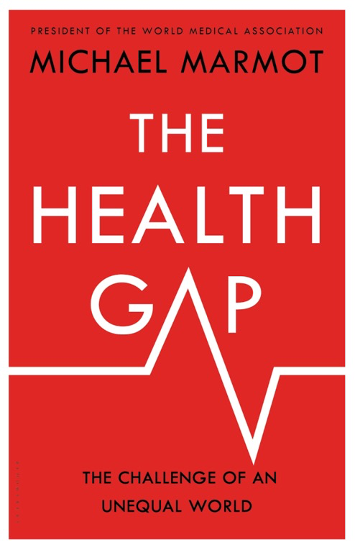
“the pollutant is not only poverty, but also social disadvantage.”
“causal thread runs through these stages of the life course from early childhood …., & to inequalities in health.
The best time to start addressing
inequalities in health is with equity from the start.”
“Health
inequalities are perhaps the most damning indictments
of social and economic inequalities.”
Source: Lancet 2015; 386: 2442–44 Published Online September 10, 2015 http://dx.doi.org/10.1016/S0140-6736(15)00150-6
Notes:
And lastly the Intersection of crimonogenic and health factors – and the inability of us collectively to provide at a system level – integrated social, educational and health services in the community to disrupt – this pipeline.
The research of Michael Marmot notes – the pollutant is not only poverty, but also social disadvantage and for us here today this is often mediated by intergenerational offending and incarceration – however this results in intergenerational “Health inequalities – which are perhaps the most damning indictments of social and economic inequalities” - causal thread runs through these stages of the life course from early childhood with the best time to start addressing inequalities in health is with equity from the start.”

Slide 6
Method
Data was analysed from two state-wide surveys conducted in 2015:
NSW Network Patient Health Survey - 1132 adults in prison
Young People in Custody Health Survey - 213 young people in youth justice centres
Statistical testing for significance was not undertaken. Findings of differences between sub-groups of participants must be treated with caution
Responses in these surveys were primarily based on self-report by participants and therefore are subject to potential recall issues
Small number of participants included in the YPICHS, particularly female participants… generalisation of results from this survey to a broader context should be avoided
Notes:
We were engaged and funded by Corrective Services NSW to provide an in-depth snapshot of intergenerational incarceration in NSW to provide an evidence-base around the extent of parental incarceration in NSW and how this impacts upon children.
To do this, we accessed secondary data from two state-wide surveys - the NSW Network Patient Health Survey conducted in adult prisons and the Young People in Custody Health Survey conducted in juvenile justice centres. Both surveys were undertaken in 2015 by Justice Health and the Forensic Mental Health Network and Youth Justice NSW (previously Juvenile Justice).
I’d like to quickly mention a few limitations relating to the study before I present the results
We were not able to undertake any statistical testing for significance as we were only given access to secondary, amalgamated data.
Importantly, this means that findings of differences between sub-groups of participants must be treated with caution.
Responses in these surveys were primarily based on self-report by participants and therefore are subject to potential recall issues.
Analyses were limited to data collected as part of the surveys and did not consider the impact of unreported external factors including environmental variables, peer influence, and family structure.
It is also important to note the small number of participants included in the YPICHS, particularly female participants. This means that we should be very careful when attempting to generalise results from this survey to a broader context.
I will now present the key results of this report.

Slide 7
Results
Prevalence of Intergenerational Incarceration
Notes:
The key finding was that just over one-in-six, 17% of the 1132 adults in prison who took part in the NPHS survey reported that at least one of their parents had previously been imprisoned. Participants who had experienced parental incarceration were more likely to report that their father had been imprisoned rather than their mother (76.8% reported that only their father had been imprisoned, 12.1% reported that only their mother had been imprisoned, and 11.1% that both their parents had been imprisoned). The over representation of males is not surprising given that just over 90% of adults in prison in Australia are males.
Of the 213 young people in youth justice centres who participated in the YPICHS, just over one-half, 52.6%, reported that at least one of their parents had previously been imprisoned. Of those with a previously imprisoned parent, the majority, 72.3%, reported that their father had been imprisoned while 13.4% reported that their mother had been imprisoned and one in seven - 14.3% that both their parents had been imprisoned.

Slide 8
Intergenerational Incarceration by
Aboriginal status
Notes:
Our findings show that Aboriginal participants were more likely to report that a parent had been imprisoned than non-Aboriginal participants reflecting the earlier contextual data presented of the over incarceration of Aboriginal people in Australia.
From this figure you can see that Aboriginal adults in prison were over 2 ½ times more likely to report that at least one of their parents had been imprisoned than non-Aboriginal adults in prison (32% vs 12.2%).
Similarly, young Aboriginal people in youth justice centres were almost twice as likely to report that a parent had been imprisoned than non-Aboriginal youth in youth justice centres (66.4% vs 35.1%).
These results are a clear demonstration of the intergenerational impact of the over-representation of First Nations peoples in the Australian criminal justice system. First Nations Australians are currently being imprisoned at 10 times the Australian national rate and this burden of incarceration is one of the critical factors that must be structurally addressed to disrupt the current pipeline of intergenerational imprisonment.

Slide 9
Intergenerational
Incarceration
by sex
Notes:
Compared to men - women in prison were more likely to report that at least one of their parents had been imprisoned (21.0% vs. 16.6%).
Similarly, a greater percentage of female young people in youth justice centres reported that at least one of their parents had been imprisoned compared to young male people in youth justice centres (73.7% vs. 50.5%)
This may suggest that parental incarceration potentially has a greater impact on the future risk of incarceration for their daughters than their sons.

Slide 10
Sex of previously
incarcerated
parent
Notes:
In the previous slide we saw some evidence that female adults and youth in correctional centres were more likely to report an incarcerated parent. We also wanted to see whether the sex of the incarcerated parent was influential on the risk of intergenerational incarceration.
To produce this chart, we only included adult participants who had reported a previously incarcerated parent. What we found was that of the adults in prison who reported a previously incarcerated parent, 29.0% reported that their mother had been incarcerated while 84.3% reported that their father had been incarcerated (This adds up to greater that 100% because for some participants had had both parents incarcerated)… What is of concern here is that we know that over the recent years approximately 8% of the NSW prison population are women while approximately 92% are men. So, we’d expect to see a similar ratio in the sex of the previously incarcerated parents for our sample if the impact of maternal and paternal imprisonment were similar with respect to the risk of intergenerational incarceration. The over-representation of mothers as the imprisoned parent we see would suggest mother–child transmission of incarceration may be stronger than father–child transmission.
Next, we stratified our subgroup of adults who reported a previously incarcerated parent - by sex and what we found was that women reported almost twice the proportion (41%) of their mother having been incarcerated as men (21.5%). This suggests that mother-daughter transmission of incarceration may be the strongest of all impacts. This finding is of considerable concern given the rapid rise in the number of women (and therefore mothers) incarcerated in New South Wales over recent years (Ooi 2018).
Note that we saw similar results for the young people in youth detention centres. Of those that reported a previously incarcerated parent, 27.7% reported that their mother had been incarcerated and 86.6% that their father had been incarcerated.

Slide 11
Factors Associated with increased “risk” of Intergenerational Incarceration
Age and schooling
Adults in prison and young people in juvenile detention centres who were younger and who completed fewer years of schooling…
Notes:
We next looked at whether there were any associations between socio-economic indicators and risk of intergenerational incarceration. I’ll talk about a few of the associations we found.
Firstly, we found that younger participants in these surveys, and those who completed fewer years of schooling, were more likely to report that a parent had been in prison.
As can be seen in these two graphs, younger age appeared to be correlated with a greater risk of previous parental incarceration. We saw this both in the adult prison population on the left and the young people in youth justice centres on the right.
In relation to schooling, adults in prison who didn’t complete year 10 schooling were over twice as likely to report that a parent had been imprisoned than those who completed year 10 or above (26.5% vs. 11.0%).
A similar trend was observed for youth in custody with almost 60% of participants who had not completed year 10 reporting that a parent had been in prison compared to 45% of those who had completed year 10 or above.

Slide 12
Previous incarceration in youth justice centres
Adults in prison who had previously been in youth detention were more than twice as likely to report a previously incarcerated parent compared to those who had never been in youth detention (27.0% vs. 12.1%)
again, younger age at first detention was associated with higher rates of intergenerational incarceration
Notes:
We also looked at whether adults in prison were previously incarcerated in youth justice centres.
Adults who had previously been in youth detention were more than twice as likely to report a previously incarcerated parent compared to those who had never been in youth detention (27.0% vs. 12.1%)
Again, younger age at first detention was associated with higher rates of intergenerational incarceration. This graph only presents data for adults in prison who had a previously been in youth detention - 43% of those who had first been incarcerated at the age of 10 years or younger reported that a parent had been in prison, while only 14% of those first incarcerated at 16 years or older reported that a parent had been in prison.
Note this data allows us to examine very young people in custody i.e. less than 10 years old (for the Young People in Custody Health Survey we only had data for those aged 14 years and above)

Slide 13
Age of first incarceration in youth justice centres
We saw a similar age association for youth in youth justice centres
Notes:
This next graph shows a similar relationship for young people in youth justice centres. That is, young people in youth justice centres who were first detained at a younger age were more likely to report that a parent had been imprisoned.
Thus 59% of participants first detained at the age of 14 years or younger reported that a parent had been imprisoned compared to 45% of participants first detained at an age of 15 years or older.
It’s worth noting that while both age groups reported similar proportions of incarcerated fathers (38.3% for those first detained at <14 years, 37.8% for those first detained at >15 years), those participants first detained at a younger age (<14 years) reported a higher percentage of imprisoned mothers (9.6% vs. 4.1%) and a higher percentage of both parents being imprisoned (11.3% vs. 3.1%) than those first detained at an older age (>15 years).

Slide 14
Number of times in juvenile detention
Young people in detention centres who had been incarcerated on numerous occasions…
Notes:
This slide presents data showing that for young people in youth justice centres, those who had been incarcerated on numerous occasions were more likely to report that at least one of their parents had been in prison.
You can see that for those youth in detention for the first time, only 31% reported that a parent had been in prison while 84% of those youth who had been in custody more than 10 times reported that a parent had been in prison.

Slide 15
Out-of-family care
Adults who had experienced OOHC before the age of 16 years
Notes:
We also found an association between out-of-home-care and intergenerational incarceration.
Adults in prison who had been placed in out-of-home-care before the age of 16 years were twice as likely to report that at least one of their parents had been in prison compared to those who had not been placed in care (30.2% vs 14.7%).
When we looked at different kinds of out-of-home-care, we found that participants who had been placed in adopted families reported one of the lowest percentages of previously incarcerated parents (8.7%).

Slide 16

Summary
High prevalence among those incarcerated of intergenerational incarceration
Particularly for young people in juvenile detention centres and Aboriginal people in custody.
Incarceration of mothers may have a greater impact on their children, particularly for their daughters.
Socio-economic disadvantage associated with intergenerational incarceration in NSW.
Notes:
The sobering finding of this study is that there is a high prevalence of intergenerational incarceration in NSW correctional settings, particularly for young people in juvenile detention centres and Aboriginal people in custody.
Younger people in the criminal justice system appear more likely to have a parent who has been in prison.
The rise in female incarceration has had a significant downstream negative impact on families and children with the children of imprisoned mothers more likely to be made homeless, have to move schools, and be separated from siblings; since the majority will not remain in the care of their father (Carlen, 1998; Dodge and Pogrebin, 2001) which is different to the children of male prisoners. Our findings suggest additionally– that incarceration of mothers may have a greater impact on the trajectory into custody of their children, particularly their daughters.
Our findings are consistent with the literature of an association between socio-economic disadvantage, previous experiences of out-of-home care and intergenerational incarceration. There is a need to disrupt this transmission of intergenerational incarceration through a whole of government approach to developing and implementing policies and programmes to address socio-economic disadvantage in our communities and support young people at risk.

Slide 17

What kind of Australia do we want to live in?
“fundamental issues such as the high levels of suicide and incarceration rates seemed to be an ingrained part of what Australians accepted as normal practice”
CCA CEO David Crosbie
Source: Community Council for Australia. The Australia we want. Second report Canberra, March 2019
Notes:
The findings of our report align with questions raised in The Australia We Want. The Community Council for Australia’s –
2019 report highlighting Australia progress and lack thereof in certain domains. The Australia We Want national roundtable was focused at moving the national policy debate beyond economic units and towards a values driven discussion on the type of society we aspire to and raise the question about What kind of Australia do we want to live in

Slide 18
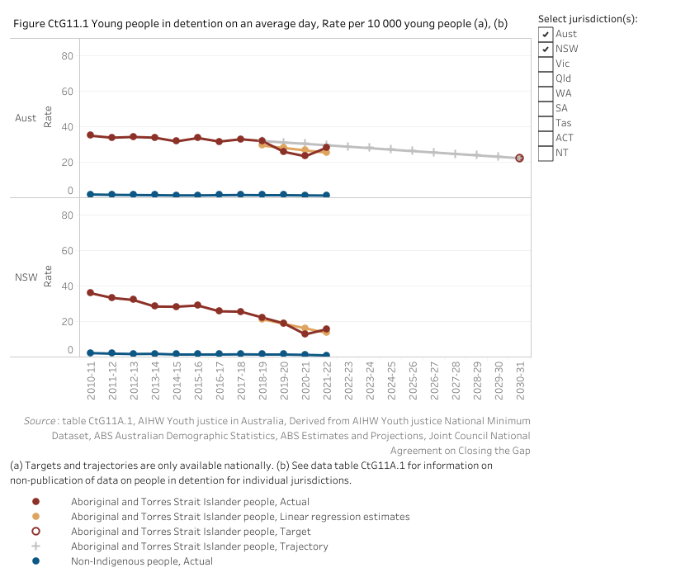
Breaking the cycle
Source: Hayley Gleeson (2019). Australia must 'radically rethink' its prisons to avoid becoming like America, US activist says. Retrieved from https://www.abc.net.au/news/2019-04-30/australian-prisons-need-radical-rethink-baz-dreisinger-says/11059478?pfmredir=sm
Notes:
A first step is in addressing intergenerational incarceration in NSW is to acknowledge as Roxanne Moore, former Principal Adviser Change The Record Coalition stated in 2019 the "systemic racism" within the justice system and the over-representation of First Nations Australians in prison and particularly juvenile detention centres. The pipeline needs to be disrupted reducing the rate of young people entering the system. A key step to this is measuring and reporting on this with targets in Closing the Gap to reduce the rate of Aboriginal and Torres Strait Islander young people (10‑17 years) in detention by at least 30 per cent by 2031
Nationally, progress has been made from the baseline of 32.0 per 10 000 young Aboriginal and Torres Strait Islander people aged 10-17 years in detention in 2018-19 to 28.3 per 10 000 young people in 2021-22.
This rise in female incarceration has had a significant downstream negative impact on families and children with the children of imprisoned mothers more likely to be made homeless, have to move schools, and be separated from siblings; since the majority will not remain in the care of their father (Carlen, 1998; Dodge and Pogrebin, 2001) which is different to the children of male prisoners
First Nations Executive Director at The Foundation of Young Australians

Slide 19
Breaking the cycle…
Prevention of Intergenerational Involvement in the Criminal Justice System Strategy
Increased use of diversionary programs and home detention to maintain family units
Targeted policies, programmes and monitoring of children impacted by parental incarceration.
Increasing the age of criminal responsibility
SHINE for Kids Submission to the Parliament of Victoria Inquiry into Children Affected by Parental Incarceration. Accessed 12082023 file:///C:/Users/eas250/OneDrive%20-%20The%20University%20of%20Newcastle/Research%20JHFMHN%202022/VIC-Parliamentary-Inquiry-SHINE-For-Kids-Submission-1-1.pdf
Notes:
To break the cycle - there is a need for national leadership – and the development of Prevention of Intergenerational Involvement in the Criminal Justice System Strategy at the national level would ensure quality programs and policies are developed to support children of prisoners. SHINE for Kids Submission to the Parliament of Victoria Inquiry into Children Affected by Parental Incarceration noted that State and National policy guidelines for children with a parent in prison is needed which both identifies children of prisoners as a specific group and designates accountability for supporting them across government departments. There exists a need for greater cohesion and coordination by government with an integrated approach to wrap around social, educational and health services that addresses the policy void and departmental drift that these children currently experience and provides policy status to them as a group from a policy and strategy perspective.
Policies need to be targeted at both the parents on remand and in prison and their children. This includes increased use of diversionary programs and home detention to particularly for women. Concurrently, other areas of focus range from increasing the age of criminal responsibility to prevent very young, at-risk children, particularly those who may have a parent in prison, from becoming part of the pipeline into custody, to designing and implementing interventions for children whose parents are incarcerated or at risk of incarceration.
There remains enormous untapped opportunity for us as a community to disrupt the cycle of intergenerational incarceration for the next generation of young people at risk.

Slide 20

Children’s rights & the ‘best interest principle’
Best interests of children must be the primary concern in making decisions that may affect them. All adults should do what is best for children.
Bangkok Rules
2019 Global Study on Children Deprived of their Liberty recommends a ‘presumption against a custodial measure or sentence for primary caregivers’. …. ‘review all judicial and administrative arrangements to prevent imprisonment by providing support services to families at risk and use diversion and other alternative measures
Walker JR, Baldry E, Sullivan EA. Residential programmes for mothers and children in prison: Key themes and concepts. Criminology & Criminal Justice, ﻿1–19, 2019. DOI: 10.1177/1748895819848814
Lucy Halton and Laurel Townhead (2020), Children of Incarcerated Parents: International Standards and Guidelines (Quaker United Nations Office, Geneva.).
https://quno.org/sites/default/files/resources/QUNO%20-%20Children%20of%20Incarcerated%20Parents%20-%20Intl%20Standards%20and%20Guidelines_02032020.pdfneva).
Notes:
To date the Best interests of children must be the primary concern in making decisions that may affect them. The ‘best interest principle’ is reflected in the United Nations Rules for the treatment of women prisoners and offenders (the ‘Bangkok Rules’), All adults should do what is best for children. When adults make decisions, they should think about how their decisions will affect children. This particularly applies to budget, policy and law makers. The 2019 Global Study on Children Deprived of their Liberty recommends a ‘presumption against a custodial measure or sentence for primary caregivers’.51 To facilitate this State actors should “review all judicial and administrative arrangements to prevent imprisonment by providing support services to families at risk and use diversion and other alternative measures”.52
Take into account the rights of children and prioritize the best interests of the child at all stages. This should be done by all actors involved in the process including law enforcement, prison service professionals, and the judiciary.43
It also recommends that essential components of best interests assessments include, …the emotional and physical wellbeing, the possibility of developing strong and early attachment to the mother and breastfeeding. The factors to be considered by decision-makers… include the potential caregiving capacity, the nature of the offence, sentence length and carer’s behaviour in prison insofar as they affect the child’s welfare and best interests. 26

Slide 21

Incarceration in Australia
National expenditure on corrective services in 2021-22 was $5.77 billion
Operate 116 custodial facilities nationally = $4.44 billion
Operate community corrections = $0.80 billion
40,591 Australian prisoners (30 June 2022)
Average daily cost ~$295/prisoner per day of keeping an adult prisoner/offender in jail in Australia
Number of children of Australian prisoners unknown
Source: Productivity Commission, Report on Government Services 2022
https://www.abs.gov.au/statistics/people/crime-and-justice/prisoners-australia/latest-release#:~:text=Media%20releases-,Key%20statistics,prisoners%20per%20100%2C000%20adult%20population.&text=Bar%20chart%20with%207%20bars.
Notes:
Productivity Commission reports that the prison and community corrections system costs taxpayers $5.77 billion a year to put about 41K people in prison, impacting many children and families when a parent is incarcerated. These families and children experience trauma, stigma, financial and housing instability, disruption to education and health and a loss of social, emotional, cultural and physical wellbeing. The number of children who have experienced parental incarceration is unknown in Australia
This report has demonstrated there is a high prevalence of intergenerational incarceration in NSW correctional settings, particularly for young people in juvenile detention centres and Aboriginal people in custody. There remains an absence of targeted policy, services and investment in meeting the unique needs of children with incarcerated parents. This is in contrast to the $5.77 billion spent on corrective services in 2021-22 and an average cost of 107K per adult inmate in jail for a year. The lack of prioritisation of this group or national leadership / policy to take responsibility for their well-being unintentionally places them at risk of intergenerational cycles of harm, ill health and incarceration. .
Source: based on Steering Committee for the Review of Government Service Provision data, Report on Government Services 2023.

Slide 22
Conclusions
Intergenerational Incarceration is a major Public Health Problem
Socio-economic disadvantage is an important driver
Prison is a traumatic space for parents; it disrupts the parent-child relationship. Link between imprisonment of mothers and poorer outcomes for their children.
Prevention of Intergenerational Involvement in the Criminal Justice System Strategy
Investment in all of government approach & funding
Preserve the best interests of the child and empower them
Increased use of diversionary programs & alternatives to custodial sentences for mothers & young people
Delay age of criminal responsibility to disrupt the pipeline
Use a child rights-based framework to support women to negotiate good quality care arrangements that meet the needs of their children
A BILL OF RIGHTS
I have the right TO BE KEPT SAFE AND INFORMED AT THE TIME OF MY PARENT’S ARREST.
I have the right TO BE HEARD WHEN DECISIONS ARE MADE ABOUT ME.
I have the right TO BE CONSIDERED WHEN DECISIONS ARE MADE ABOUT MY PARENT.
I have the right TO BE WELL CARED FOR IN MY PARENT’S ABSENCE.
I have the right TO SPEAK WITH, SEE AND TOUCH MY PARENT.
I have the right TO SUPPORT AS I FACE MY PARENT’S INCARCERATION.
I have the right NOT TO BE JUDGED, BLAMED OR LABELED because my parent is incarcerated.
I have the right TO A LIFELONG RELATIONSHIP WITH MY PARENT.
Source: https://sfonline.barnard.edu/children/SFCIPP_Bill_of_Rights.pdf. Accessed 13082023.
Notes:
they provide strong evidence of the link between imprisonment of mothers and the risk of their children becoming involved in the criminal justice system. Socio-economic disadvantage is an important driver of this.
We noted that prison is a traumatic space for mothers and it disrupts the mother-child relationship… this has significant impact on mothers and their children leading to stigmatisation, insecurity of the parental bond and possibly increased out-of-home-care.
How can we begin to break the cycle of intergenerational incarceration associated with imprisonment of mothers?
To start with, we need alternatives to custodial sentences, where possible, for both mothers and young people. Diversion programs for mothers should be strongly encouraged where possible.
We must also increase the age of criminal responsibility to keep very young children out of custodial settings, especially as we saw an association between lower age and increased risk of intergenerational incarceration.
A child rights based framework be used to support women in prison to negotiate good quality care arrangements that meet the needs and rights of their children. If a women who is a parent does go to jail, then it is critical that her mothering role be supported.
There is a need to support comprehensive parenting services that go beyond ‘parenting skills’ and communication to ensure women have equivalence of access to services in prison that they would have as parents in the community.
To preserve the best interests of the child and to empower them – a must be the primary concern in making decisions that may affect them
A holistic approach requires the involvement of corrections, health, education, housing and social welfare services, among others.

Slide 23

Acknowledgements
CSNSW for funding the report.
Collaborators at CSNSW, Youth Justice, and the Justice Health & Forensic Mental Health Network.

Slide 24
Publications
Report - An Epidemiological Analysis of Intergenerational Incarceration in NSW Prisons and Youth Justice Centres
Remond M, Zeki R, Austin K, Bowman J, Galouzis J, Stewart K-A, Sullivan E. 2023. Intergenerational incarceration in New South Wales: Characteristics of people in prison experiencing parental imprisonment. Trends & issues in crime and criminal justice no. 663. Canberra: Australian Institute of Criminology. https://doi.org/10.52922/ti78863

