Slide 1
What’s changing in what’s being stolen?
Examining 11-years of residential burglaries in Western Australia
Applied Research in Crime and Justice Conference
13-14 February 2019
Sydney, NSW
Dr Joe Clare
UWA School of Law

Slide 2

Acknowledgements
I would like to thank the Western Australian Police Force for making their data available for this analysis
2

Slide 3
What I want to cover
What we already know
Other things that matter
Data/hypotheses
Findings
Who cares?
3

Slide 4
1. What we already know

Slide 5
10 principles of opportunity and crime
    Opportunities play a role in causing all crime
    Crime opportunities are highly specific
    Crime opportunities are concentrated in time and space
    Crime opportunities depend on every day movements
    One crime produces another
    Some products offer more tempting crime opportunities
    Social and technological changes produce new crime opportunities
    Opportunities for crime can be reduced
    Reducing opportunities does not usually displace crime
    Focused opportunity reduction can produce wider declines in crime
Source: Felson, M., & Clarke, R.V. (1998). Opportunity makes the thief: practical theory for crime prevention
5
Notes:
Felson, M., & Clarke, R.V. (1998). Opportunity makes the thief: practical theory for crime prevention (Police Research Series Paper 98). Home Office: Policing and Reducing Crime Unit, Research, Development Statistics Directorate.

Slide 6
10 principles of opportunity and crime
    Opportunities play a role in causing all crime
    Crime opportunities are highly specific
    Crime opportunities are concentrated in time and space
    Crime opportunities depend on every day movements
    One crime produces another
    Some products offer more tempting crime opportunities
    Social and technological changes produce new crime opportunities
    Opportunities for crime can be reduced
    Reducing opportunities does not usually displace crime
    Focused opportunity reduction can produce wider declines in crime
Source: Felson, M., & Clarke, R.V. (1998). Opportunity makes the thief: practical theory for crime prevention
6
Notes:
Felson, M., & Clarke, R.V. (1998). Opportunity makes the thief: practical theory for crime prevention (Police Research Series Paper 98). Home Office: Policing and Reducing Crime Unit, Research, Development Statistics Directorate.

Slide 7
6. Some products offer more tempting crime opportunities
    Not all products are equally at risk for theft
    Products are more attractive to thieves when they are
C
oncealable
–
easier to remove, transport,
and dispose
R
emovable
–
you have to take it to steal it
A
vailable
–
macro
-
,
meso
-
, and micro
-
level availability
V
aluable
–
without value, it is not worth stealing
E
njoyable
–
relates to disposability
of items
–
greater demand
D
isposable
–
stolen goods
are generally converted into cash/drugs
7
Notes:
Felson, M., & Clarke, R.V. (1998). Opportunity makes the thief: practical theory for crime prevention (Police Research Series Paper 98). Home Office: Policing and Reducing Crime Unit, Research, Development Statistics Directorate.

Slide 8
6. Some products offer more tempting crime opportunities
    Not all products are equally at risk for theft
    Products are more attractive to thieves when they are
    CRAVED items can change over time as a function of market forces
    (the life-cycle theory, Wellsmith and Burrell, 2005, Brit.J.Crim)
      Stable CRAVED – jewellery, gold, cash
      Variable CRAVED – small electronic goods, clothes
C
oncealable
–
easier to remove, transport,
and dispose
R
emovable
–
you have to take it to steal it
A
vailable
–
macro
-
,
meso
-
, and micro
-
level availability
V
aluable
–
without value, it is not worth stealing
E
njoyable
–
relates to disposability
of items
–
greater demand
D
isposable
–
stolen goods
are generally converted into cash/drugs
8
Notes:
Felson, M., & Clarke, R.V. (1998). Opportunity makes the thief: practical theory for crime prevention (Police Research Series Paper 98). Home Office: Policing and Reducing Crime Unit, Research, Development Statistics Directorate.

Slide 9
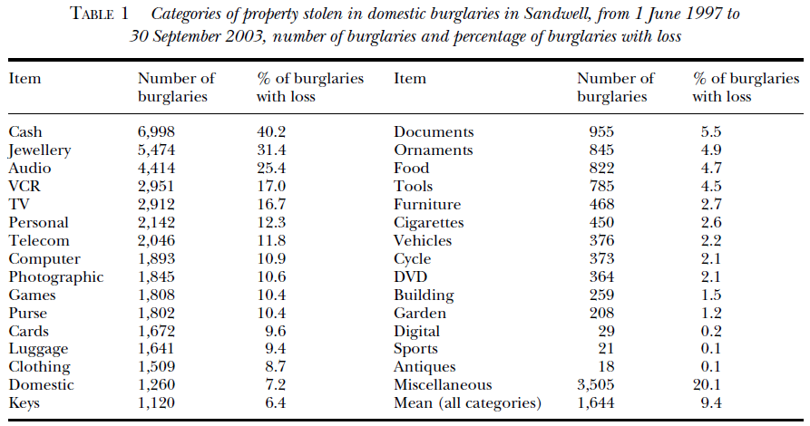
6. Some products offer more tempting crime opportunities
Source: Wellsmith, M., & Burrell, A. (2005). The influence of purchase price and ownership levels on theft targets. British Journal of Criminology, 45(5), 741-764.
9

Slide 10
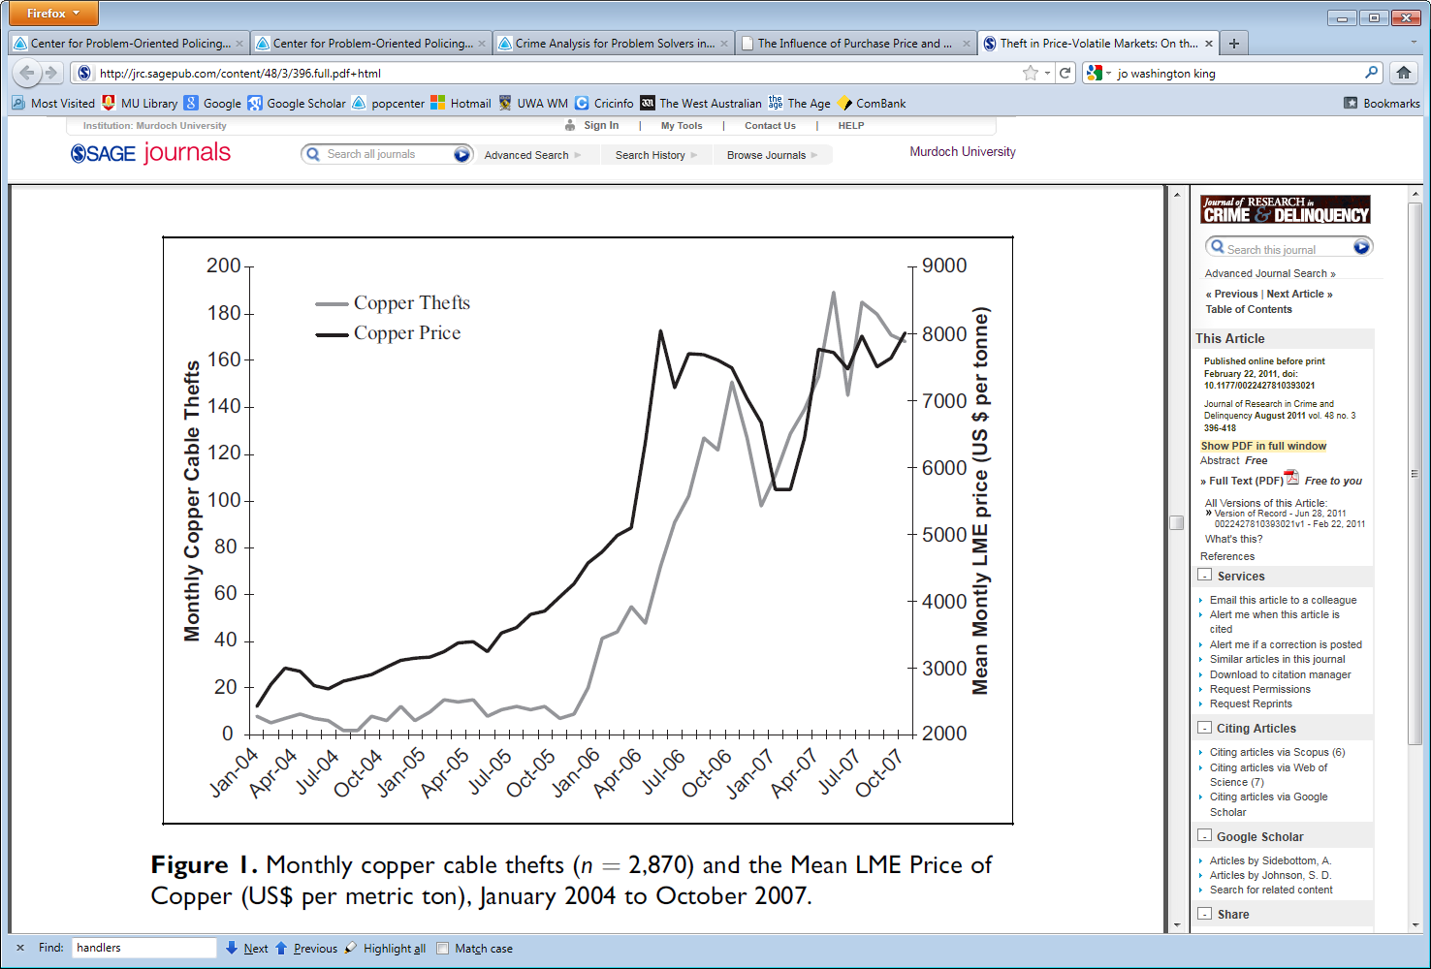
6. Some products offer more tempting crime opportunities
Source: Sidebottom, A. et al. (2011). Theft in price-volatile markets: on the relationship between copper price and copper theft. Journal of Research in Crime and Delinquency, 48(3), 396-418.
10

Slide 11
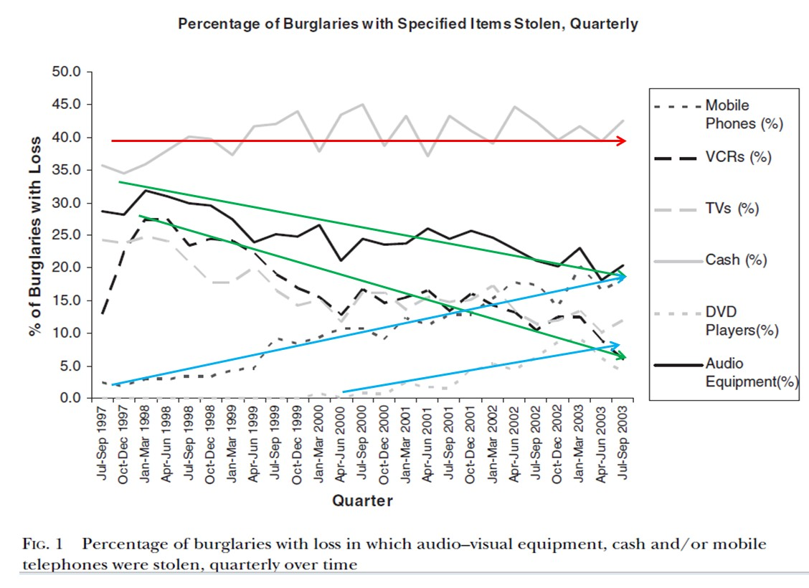
7. Social and technological changes produce new crime opportunities
    Mass-produced consumer goods pass through a life-cycle
      Innovation – restricted, special small group of consumers
      Growth – products cheaper, easier to use, more common, desired
      Mass market – product becomes endemic
      Saturation – most people who want one, already have one
Source: Wellsmith, M., & Burrell, A. (2005). The influence of purchase price and ownership levels on theft targets. British Journal of Criminology, 45(5), 741-764.
11

Slide 12
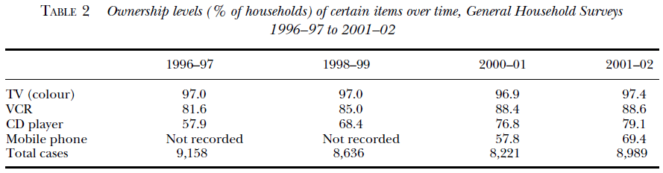
7. Social and technological changes produce new crime opportunities
The variations observed matched the market saturation of these products in the domestic market and were consistent with the normal product life-cycle
Products are most vulnerable in their 'growth' and ‘mass market' stages, as demand for them is at its highest
Most products will reach a 'saturation' stage where most people have them and they then are unlikely to be stolen
12

Slide 13
8. Opportunities for crime can be reduced
    If this wasn’t true, no one would bother
      Locking cars/houses
      Keeping money in a safe place
      Telling young children to avoid strangers
      Watching the neighbour’s house when they’re away
    The opportunity reducing methods of situational crime prevention can be applied to all aspects of everyday life, but they must be tailored to specific situations
    The Security Hypothesis as an explanation for the Global Crime Drop
      Parsimonious to local changes and global trends
      See work by Farrell and colleagues (2010 onwards) for more detail
      Works very well for vehicle theft and electronic immobilisers
13
Notes:
Felson, M., & Clarke, R.V. (1998). Opportunity makes the thief: practical theory for crime prevention (Police Research Series Paper 98). Home Office: Policing and Reducing Crime Unit, Research, Development Statistics Directorate.

Slide 14
8. Opportunities for crime can be reduced
6.5% in 1993
1.7% in 2018
Source: CSEW domestic burglary in a dwelling
14

Slide 15
CSEW Domestic burglary in a dwelling
0.8 percentage point decline
Security?
Source: CSEW domestic burglary in a dwelling
15

Slide 16
CSEW Domestic burglary in a dwelling
Tseloni et al. (2017) Security Journal
Used CSEW (2008-12) to estimate security protection influence of target hardening strategies
Most effective individual devices:
external lights and door dead locks
Door/window locks + external lights + security chains 20 times greater protection
(relative to no devices)
Source: CSEW domestic burglary in a dwelling
16

Slide 17
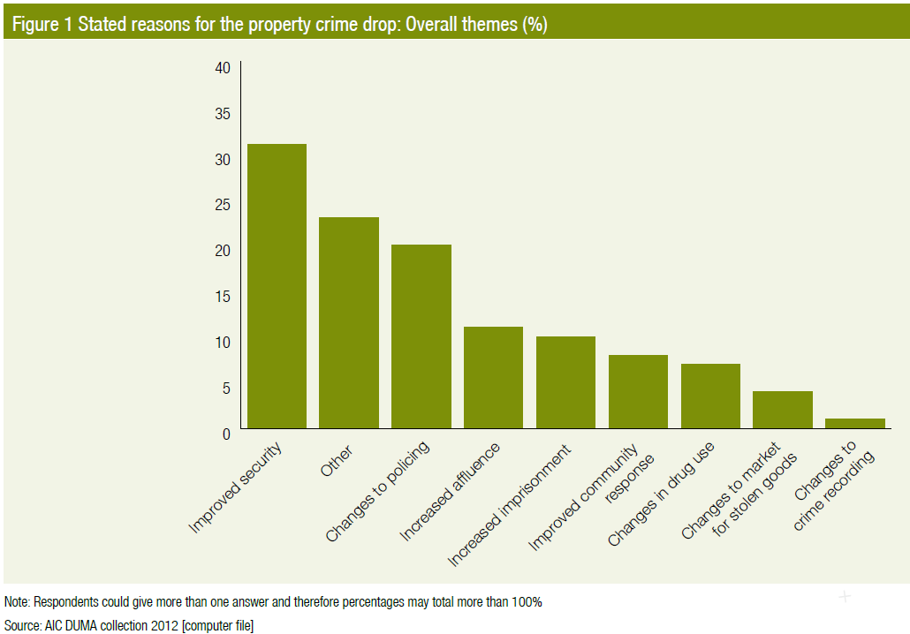
8. Opportunities for crime can be reduced
Source: Brown, 2015, Trends and Issues 495, Australian Institute of Criminology
17
Notes:
Brown, 2015, Trends and Issues 495, Australian Institute of Criminology
What did the UK stolen goods survey paper show?

Slide 18
2. Other things that matter

Slide 19
CSEW Domestic burglary in a dwelling
7.9 percentage point decline
Less stuff worth taking?
The equivalent time window I’m looking at for WA
Source: CSEW domestic burglary in a dwelling
19

Slide 20
Evidence there is less stuff of value
Source: Brown, 2015, Trends and Issues 495, Australian Institute of Criminology
20
Notes:
Brown, 2015, Trends and Issues 495, Australian Institute of Criminology

Slide 21
Evidence there is less stuff of value
Shaw et al. (2015) Crime and the Value of Stolen Goods (Home Office Report)
Used responses to the CSEW over a 20 year period
Found the average value of a single theft declined by 35%
Concluded value, availability, and disposability were key drivers in what gets stolen
Source: Brown, 2015, Trends and Issues 495, Australian Institute of Criminology
21
Notes:
Brown, 2015, Trends and Issues 495, Australian Institute of Criminology
Up to page 32 of the HORR – read the rest on the plane.

Slide 22
Australian trends – victim surveys
10% decline in absolute number
6% decline in absolute number
Source: Extracts from Table 20 and 21 of Crime Victimisation Australia (ABS 4530), various years
22
Notes:
Arguably we’d expect to see an increase in attempted burglary, if security was the only reason for the decline in success?

Slide 23
Australian trends – victim surveys
10% decline in absolute number
Arguably, we’d expect to see an increase in attempted burglary, if security was the only reason for the decline in success?
6% decline in absolute number
Source: Extracts from Table 20 and 21 of Crime Victimisation Australia (ABS 4530), various years
23
Notes:
Arguably we’d expect to see an increase in attempted burglary, if security was the only reason for the decline in success?

Slide 24
Australian trends – police recorded crime
15% decline in absolute number
4 percentage point decline
Source: Extracts from Table 1 Recorded Crime Victims – Australia (ABS 4510), 2018
24

Slide 25
Why are people getting in and not taking things and/or less people are bothering?
    Idea 1: cash is sooooooo 2007…
    Implications for the availability-side of CRAVED
25
Notes:
Doyle, M-A, Fisher, C, Tellez, E., & Yadav, A. (2017). How Australians pay: evidence from the 2016 Consumer Payments Survey. Research Discussion Paper RDP 2017-04, Reserve Bank of Australia.

Slide 26
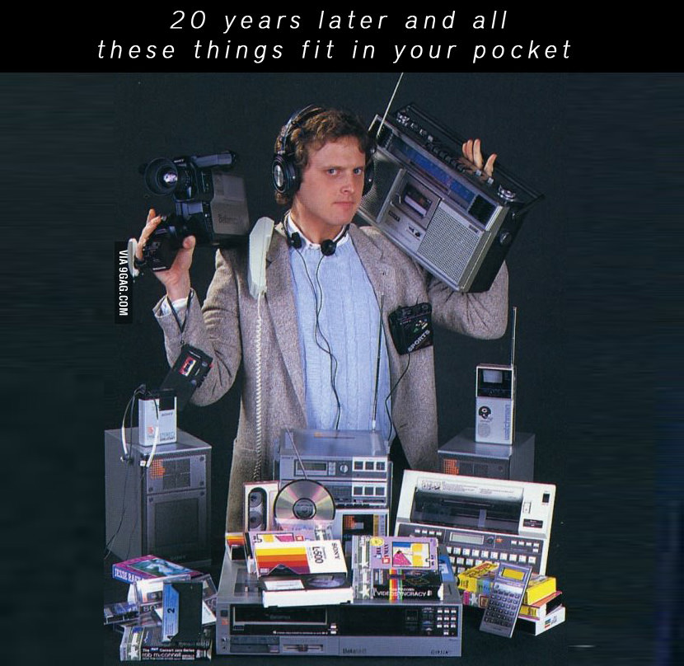
Why are people getting in and not taking things and/or less people are bothering?
    Idea 2: phones have replaced a lot of other stuff we used to have/need
26
Source: https://www.geckoandfly.com/13143/50-things-smartphone-replaced-will-replace-future/
Notes:
https://www.geckoandfly.com/13143/50-things-smartphone-replaced-will-replace-future/

Slide 27
Why are people getting in and not taking things and/or less people are bothering?
    Idea 3: stuff people want gets older, quicker…
    “Technology based commodities such as mobile phones and computers have shorter innovation cycle so that the previous generation becomes obsolete faster, either functionally or psychologically.”
    Lebreton & Tuma (2006) A quantitative approach to assessing the profitability of car and truck tire remanufacturing. Int J Production Economics
    “Product life cycle in electronic industry is shorter than before due to technology advances, and as a result, an outdated product could reach its end-of-use even if it is still in a good condition.”
    Hsueh (2011) An inventory control model with consideration of remanufacturing and product life cycle.
    Int J Production Economics
    Implications for the market-side (value/disposability) of CRAVED
27
Notes:
Quotes taken from Pricing decision model for new and remanufactured short-life cycle products with time-dependent demand
https://doi.org/10.1016/j.orp.2014.11.001

Slide 28
3. Data/hypotheses

Slide 29
Hypotheses
I don’t have data for security changes, and it doesn’t look like that’s the only thing going on, so…
Looking within the properties and using CRAVED as a starting point
Availability-related:
More burglaries with no loss reported because
  Reduced cash reported stolen due to declining use of cash generally
  Fewer suitable targets because phones have replaced other suitable targets (e.g., cameras, tablets, stereos, e-readers)
Valuable/Disposable-related:
Very short periods of attractiveness for specific high-value electronic products that are rapidly replaced on legitimate market
29

Slide 30
Data
All residential burglaries in WA between 2007 and 2017 (inclusive)
  284,426 events (187,747 with loss recorded – 66%)
  1.29 million records of stolen items
Repeat victimisation present
  1,546 properties experienced 4 or more burglaries with loss since 2007 (0.7% of victims experienced 3.8% of burglaries)
Cash and jewellery still king
  Cash stolen in 31% of burglaries with loss
  Jewellery stolen in 22% of burglaries with loss
30

Slide 31
4. Findings

Slide 32
Availability: burglary with no loss (H1)
0.5 percentage point decline
1 percentage point decline
32
Notes:
This could be an artefact of under-reporting burglaries with nothing taken.

Slide 33
Availability: trends for cash (H1a)
Transactions more than $22 done by card
Cash theft:Cash Use
r = 0.83
33
Notes:
Correlate this with the values in the Reserve Bank table.
From 2012 to 2017 cash z-test = 15.17

Slide 34
Availability: the impact of phones (H1b)
Biometric security on smartphones became mainstream
Higher resolution smart phones commenced
r = 0.97
34
Notes:
https://www.geckoandfly.com/13143/50-things-smartphone-replaced-will-replace-future/
r = 0.97099, meaning R2=0.94.
Z-score (phones 2013 onwards) = 9.77
https://en.wikipedia.org/wiki/Camera_phone
https://www.businessinsider.com.au/smartphone-biometrics-are-no-longer-the-stuff-of-science-fiction-2017-12?r=US&IR=T

Slide 35
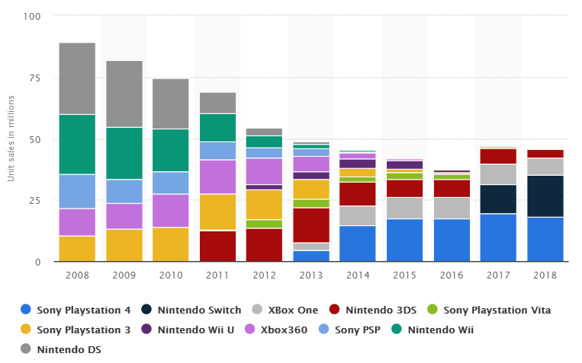
Value/Disposability: gaming consoles (H2)
Source: https://www.statista.com/statistics/276768/global-unit-sales-of-video-game-consoles/
35
Notes:
https://www.statista.com/statistics/276768/global-unit-sales-of-video-game-consoles/
r = 0.918612, meaning R2=0.84.

Slide 36
Value/Disposability: gaming consoles (H2)
r = 0.45
r = 0.74
r = 0.54
36
Notes:
https://www.statista.com/statistics/276768/global-unit-sales-of-video-game-consoles/
Computer items made up about 9.6% of all items stolen and these 6 items made up 6.5% of all computer items.

Slide 37
Value/Disposability: gaming consoles (H2)
r = 0.75
r = 0.92
r = 0.92
37
Notes:
https://www.statista.com/statistics/276768/global-unit-sales-of-video-game-consoles/
r = 0.918612, meaning R2=0.84.

Slide 38
Value/Disposability: gaming consoles (H2)
r = 0.86
38
Notes:
https://www.statista.com/statistics/276768/global-unit-sales-of-video-game-consoles/
r = 0.918612, meaning R2=0.84.

Slide 39
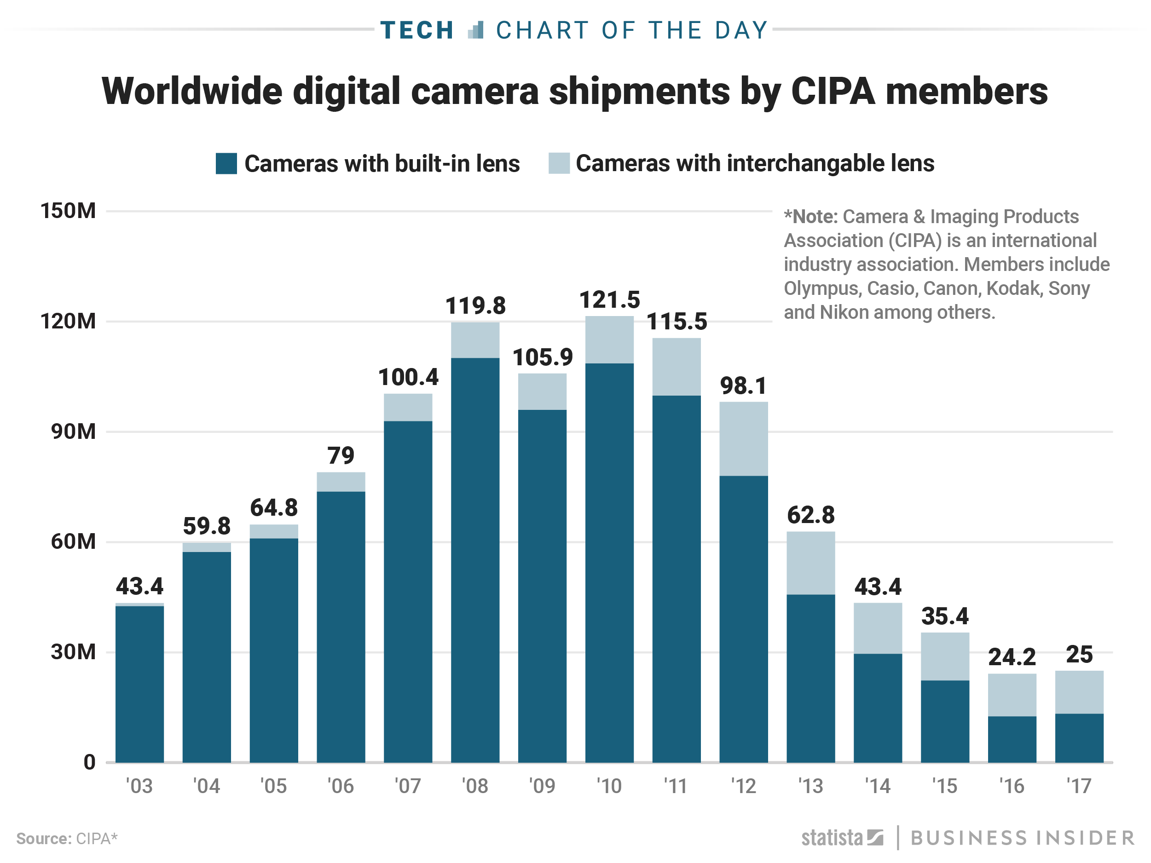
Value/Disposability: digital cameras (H2)
39
Notes:
https://www.businessinsider.com.au/digital-camera-shipments-15-years-decline-and-rise-2018-2?r=US&IR=T

Slide 40
Value/Disposability: digital cameras (H2)
Instagram commenced Oct 2010
Camera thefts:Camera shipments
r = 0.96
40
Notes:
So less available, because of cameras, and less valuable/disposable because there is no legitimate market for them

Slide 41
Value/Disposability: digital cameras (H2)
41

Slide 42
5. Who cares?

Slide 43
Summing it up
  Decline in burglary with loss
  Less cash being taken, in a pattern that matches cash usage decline (jewellery stolen at the same rate)
  Fewer cameras stolen (aligned with improved smart phone cameras) and fewer phones stolen (aligned with biometric introduction)
  Shorter product life-cycle influencing demand and value for specific stolen goods
  Value determined by location in the life-cycle relative to other similar products
  Looking within-product categories is important to see trends
43
Notes:
Miles 2007
d’Este 2014 – the effects of stolen goods markets on crime: evidence from a quasi=natural experiment.
Harbaugh et al., 2013
From Draca, Koutmerdis, and Machin, 2015 paper, which covers modelling of metal theft, jewellery, etc., looking at the price they attract on resale. It doesn’t look at the CRAVED framework though, and looks only at the external value of something (ignoring the product lifecycle speed and the reduction in cash in homes).

Slide 44
Implications for theory
  Making things less available (within properties) and less disposable/valuable is likely having an impact on reducing offender motivation to commit burglaries
  This idea is compatible with the security hypothesis and can operate in parallel
  Also compatible with explanations of offending that draw on cognitive psychology (domain-specific expertise) and economics
  Offenders have reduced opportunity to ‘learn’ how to be an effective burglar – fewer available targets (macro- and meso-level) and less chance to gain financial reward
  A no-result burglary and/or failed attempts to sell items that are stolen may well influence the perceived utility of burglary
  Reducing the attractiveness of engaging in this crime in the future
44
Notes:
Miles 2007
d’Este 2014 – the effects of stolen goods markets on crime: evidence from a quasi=natural experiment.
Harbaugh et al., 2013
From Draca, Koutmerdis, and Machin, 2015 paper, which covers modelling of metal theft, jewellery, etc., looking at the price they attract on resale. It doesn’t look at the CRAVED framework though, and looks only at the external value of something (ignoring the product lifecycle speed and the reduction in cash in homes).

Slide 45
Practical implications
  Clear implications for targeted prevention interventions
  Continue to design-in/create techniques to reduce disposability of stolen goods
  e.g., phone kill switches, immobilizers, preferred purchasers of second hand metal, bike registers
  Continue to disrupt stolen goods markets (traditional and emerging e-markets), using current trends in burglary and stolen goods data to prioritise focus
  The market reduction approach (see Sutton)
  Potential for long-term sustainable crime prevention without arrest or conviction (much like car immobilisers)
45

Slide 46
Where to next?
  Use available data to monitor trends
  Find out more about the stolen goods market in Australia
  The more we know, the more we can do to disrupt it
  Explore what is increasing
  Compare these signatures with other jurisdictions
  Consider displacement (e.g., burglary with vehicle theft)
  Consider links with repeat victimisation
  What is being taken at these separate events, timing, value, etc.
46

Slide 47

Thank you
Dr Joe Clare
UWA School of Law
+61 8 6488 7956
joe.clare@uwa.edu.au
47

Slide 49
6. Some products offer more tempting
crime opportunities
49
Notes:
Doyle, M-A, Fisher, C, Tellez, E., & Yadav, A. (2017). How Australians pay: evidence from the 2016 Consumer Payments Survey. Research Discussion Paper RDP 2017-04, Reserve Bank of Australia.

Slide 50
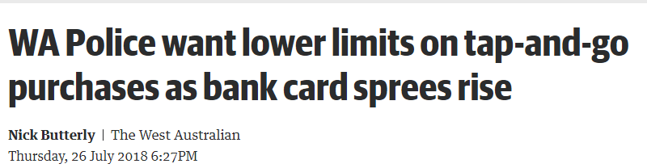
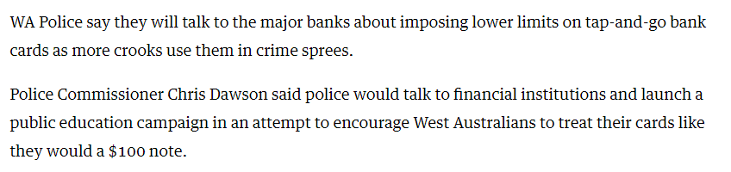
7. Social and technological changes produce new crime opportunities
50

Slide 51
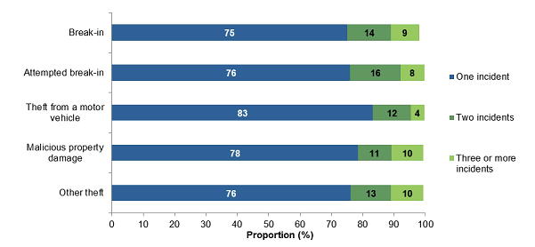
Repeat victimisation is to be expected
ABS survey data shows that each year only about 2.2% of households experience a break-in
Source. ABS 4530.0 Crime Victimisation Australia 2016-17
51
Notes:
http://www.abs.gov.au/ausstats/abs@.nsf/Lookup/by%20Subject/4530.0~2016-17~Main%20Features~Multiple%20victimisation%20~8

Slide 52
WA burglary with loss repeat victimisation
1,546 properties experienced 4 or more burglaries with loss since 2007 (0.7% of victims experienced 3.8% of burglaries)
52
Notes:
Include in this slide the ABS percentage of households that experience a burg on any given year

Slide 53
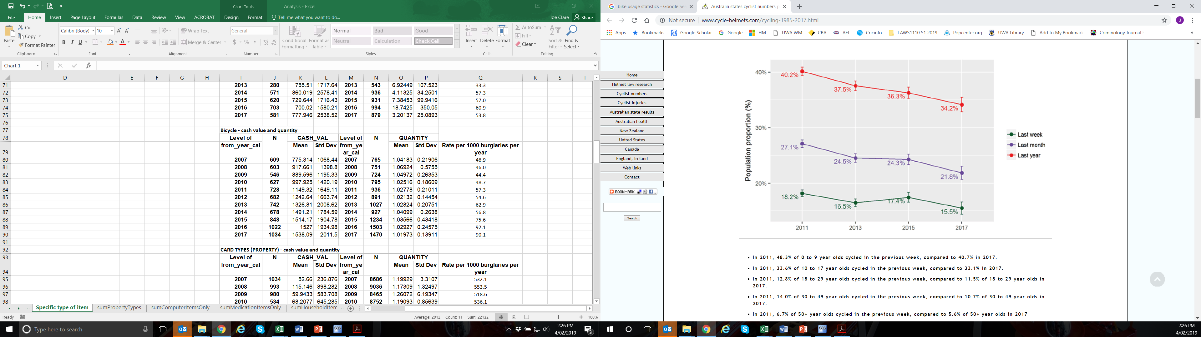
Trends in bike usage – Australia
53
Notes:
http://www.cycle-helmets.com/cycling-1985-2017.html
2017 National Cycling Participation Survey shows reductions in the percentage of the population who are regular cyclers since 2011. However, it needs to be considered how population growth corrects this decline to an extent (in absolute number terms).
http://www.cycle-helmets.com/cycling-1985-2017.html

Slide 54
Value/Disposability: Xbox (H3)
X-box discontinued
54
Notes:
https://en.wikipedia.org/wiki/Xbox

Slide 55
Value/Disposability: Xbox (H3)
X-box 360 sold 72million units world wide – 3 times more than X-box
Lower resale demand
X-box 360 discontinued
X-box 360 released June 2006
55
Notes:
https://en.wikipedia.org/wiki/Xbox
https://www.statista.com/statistics/276768/global-unit-sales-of-video-game-consoles/

Slide 56
Value/Disposability: Xbox (H3)
X-box One released Nov 2013
56
Notes:
https://en.wikipedia.org/wiki/Xbox

Slide 57
Value/Disposability: Playstation (H3)
Playstation 1 released 1995 selling 105 million units
57
Notes:
https://en.wikipedia.org/wiki/PlayStation

Slide 58
Value/Disposability: Playstation (H3)
Playstation 2 released 2000 selling 155 million units
58
Notes:
https://en.wikipedia.org/wiki/PlayStation

Slide 59
Value/Disposability: Playstation (H3)
Playstation 3 released Nov 2006 selling 84 million units
59
Notes:
https://en.wikipedia.org/wiki/PlayStation

Slide 60
Value/Disposability: Playstation (H3)
Playstation 4 released Nov 2013 selling 81 million units
60
Notes:
https://en.wikipedia.org/wiki/PlayStation

Slide 61
More to find out: what is being stolen?
61
Notes:
Quantity non-significant
Cash value – significant increase F(10, 118865) = 61.25, p < .0001
SO what’s increasing in value and quantity over time? Leave this as a think-piece question?

