Slide 1
Can electronic monitoring + home detention reduce re-offending?
Jenny Williams
University of Melbourne
Don Weatherburn
NSW Bureau of Crime Statistics and Research

Slide 2
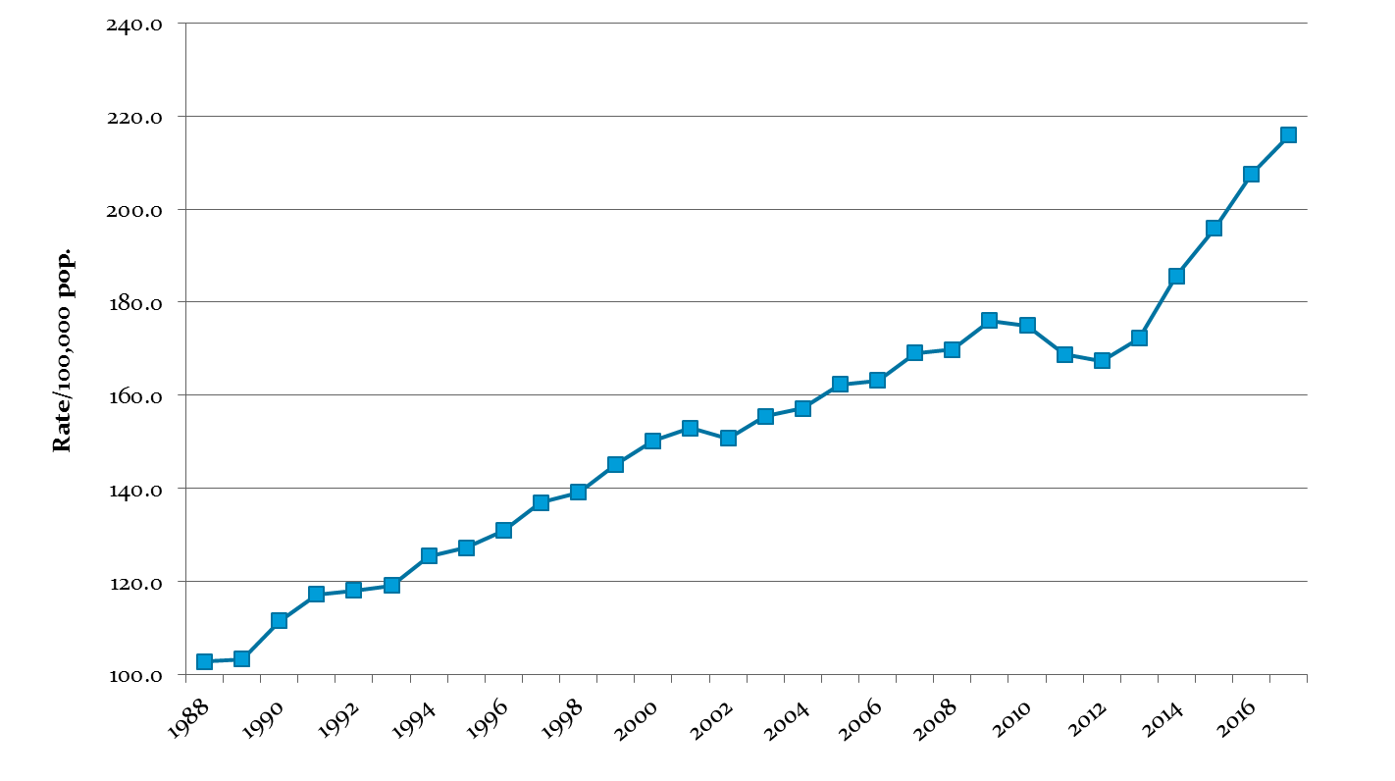
Australia’s imprisonment rate has more than doubled since 1988

Slide 3
The NSW prison population has risen by a third since 2013

Slide 4
EM seems to be a promising alternative
Di Tella & Schargrodsky (2013)
  Examined Argentina’s pre-trial use of EM
  Available for all crimes
  EM reduced recidivism by 11-23 pp. relative to prison
Henneguelle, Mommery & Kensey (2016)
  Evaluated France’s pilot of EM as front-end alternative
  EM reduces recidivism by 6-7 pp. after five years
Marie (2009)
  Evaluates UK’s use of EM as back-end alternative
  Available for violent crimes
  EM reduces recidivism by 6 pp. after one year

Slide 5
EM in NSW
Linked to home detention (HD)
Available in NSW since 1997
Had a strong rehabilitation focus until late 2007
Shifted focus to deterrence in late 2007 (CCMG)
Likelihood of a positive recommendation fell
Judges became less likely to request EM assessment

Slide 7
CCMG disbanded in 2013
A free pass to paroled crooks
“NSW criminals on parole will be given new-found freedom after the state government dumped its specialist monitoring group.”
Barclay Crawford, State Political Reporter, Sydney Daily Telegraph, January 13th, 2013

Slide 8
Current policy
Expand the use of EM
  New offender electronic monitoring equipment introduced
  Now applied to high-risk DV offenders
  Can also be applied to offenders serving intensive correction orders

Slide 9
Eligibility for EM in NSW
Step 1:
  Court must first decide if prison is appropriate and, if so, select a sentence length
Step 2
  If the sentence length is <= 18mths
  Offences are not violent or threatening
  Past offences not violent or threatening
Step 3
  Then the offender can be referred for EM suitability assessment

Slide 10
Suitability for EM
Suitability assessment conducted by:
  NSW Community Corrections Service
If the offender:
  Poses no substantial threat to family or community
  Can be managed successfully on home detention
  And family/co-residents consent to home detention
Then the probation and parole service can recommend HD/EM to the court but…
Final decision is up to the court

Slide 11
EM in practice
Can’t leave home without approval
Can get approval for work, medical appointments etc.
Movement outside home based on agreed schedule
Real time compliance with schedule checked using EM
Breach of schedule results in issue of arrest warrant
Participation in rehab programs mandatory

Slide 12
Aim of the current study
Find out whether EM reduces re-offending more effectively than prison

Slide 13
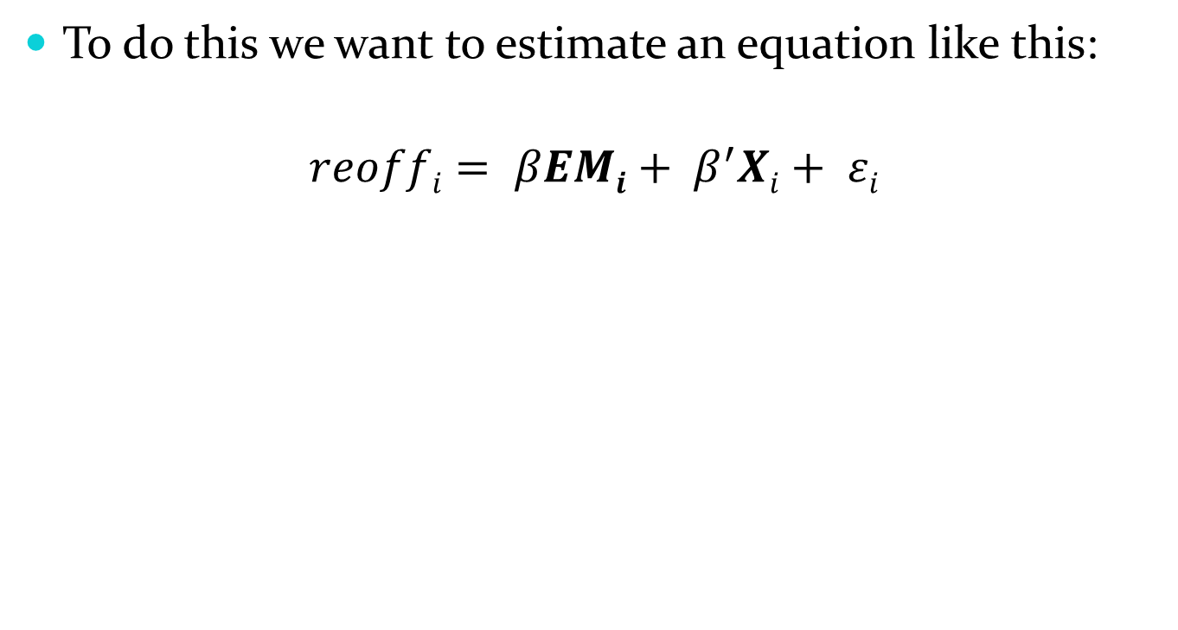
Empirical set-up
Probability of re-offending by offender i

Slide 14
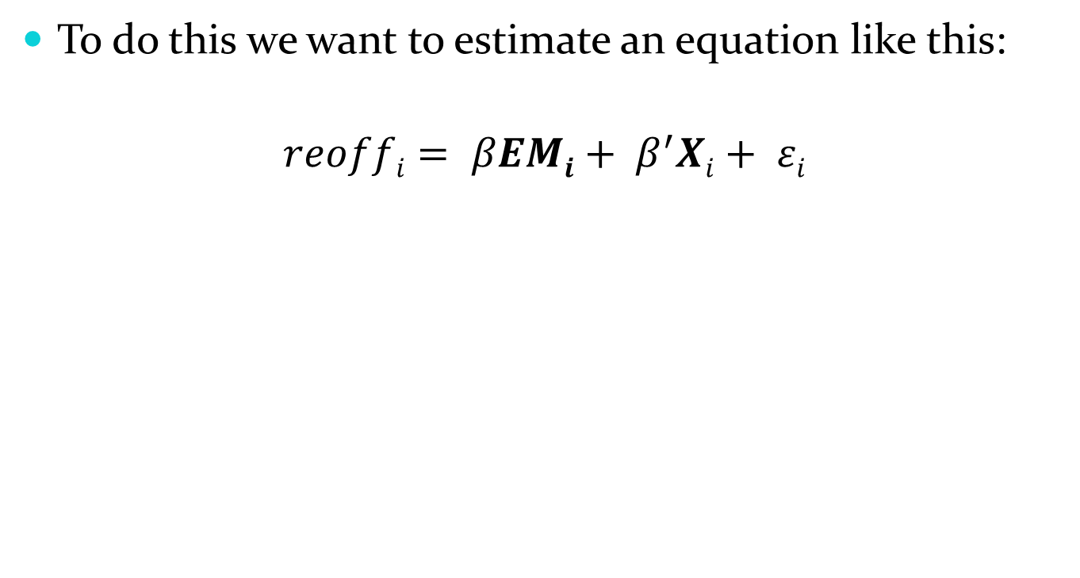
Empirical set up
β measures the effect of EM on reoffending
EMi measures whether offender i got EM

Slide 15

Empirical set-up
Β΄ measures the effect of the X_{i} on reoffending
Xi measures other factors that might affect re-offending

Slide 16
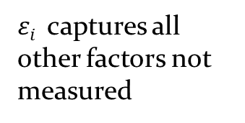
Empirical set-up

Slide 17
But the problem is….
Recidivism
Penalty
Unmeasured factors
Remorse
Family ties
Employment
Etc.
  If we don’t do something about this our estimate of the effect of EM (β) will be biased and inconsistent

Slide 18
The solution…..2SLS
Find a factor (called an instrument) that influences penalty choice but has no effect on re-offending except through the penalty chosen

Slide 19
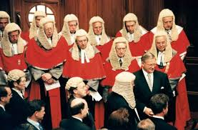
What might such a factor be?
JUDICIAL DISPARITY IN SENTENCING OF COURSE !!!!!

Slide 20
Why?
Judicial officers differ in proclivity to use EM
They don’t get to choose the cases they hear
They are effectively randomly assigned
And all this means………………………

Slide 21



EM vs. Prison
Recidivism
Proclivity to recommend EM

Slide 22
Data
Data Sources:
  ROD
  OIMS
The analysis sample (N = 7,366)
  All those who first became eligible for EM between 2000 and 2007 regardless of whether they got EM or prison
The full sample (N = 16,066)
  All EM eligible offences in ROD receiving prison or EM
  Used to calculate judge proclivity for EM
Re-offending (following index) measured till Sept 2016

Slide 23
Exclusions
Cases before 2000 or after 2007
Cases where judge has dealt with < 10 EM eligible cases
Cases with non-eligible EM offences or sentences
Cases heard in courts with less than 2 judges
  Randomisation is at the court level
Cases where the offender does not live in Sydney
  EM confined mainly to urban areas
Cases where the offender is identified as Aboriginal
  Very different relationship with the CJS

Slide 24
Variables
Primary dependent variable:
  Re-appearance in court within 24 months ‘free’ time
Secondary dependent variables:
  Re-appearance within 12,24,36, 60….120 months
Controls
  Age
  Gender
  # court appearances in last five years
  Legal representation
  Offence type

Slide 25
Constructing the IV
Compute the leave out mean for judge i and case j
  Leave out mean = proportion of all cases (except case j ) where judge i imposed EM
Regress the leave out mean on a set of fully interacted court and year of finalisation fixed effects
  (This controls for differences across time and courts in the types of cases heard or the culture of strictness)
The residual from this regression becomes the instrument (IV)

Slide 26
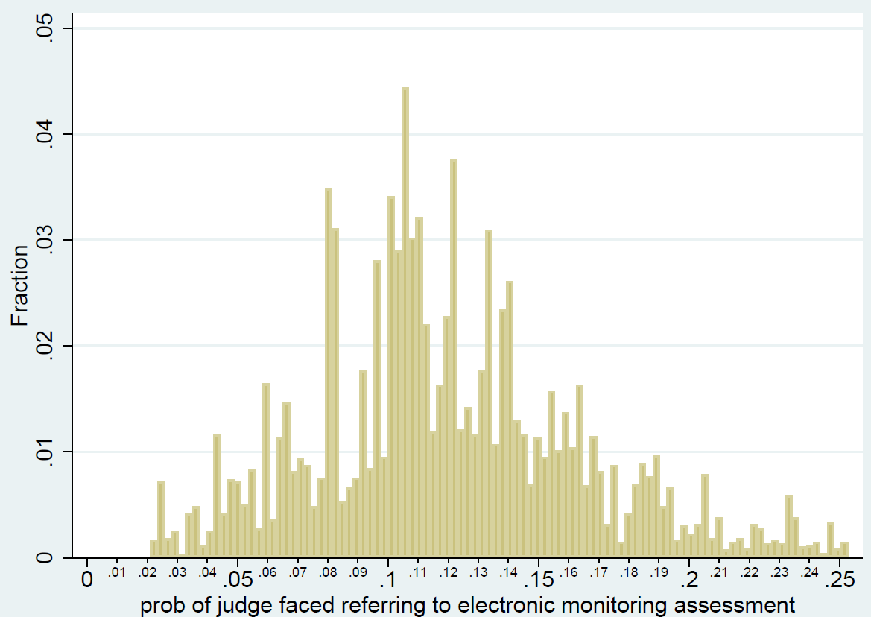
What does the IV distribution look like?

Slide 27

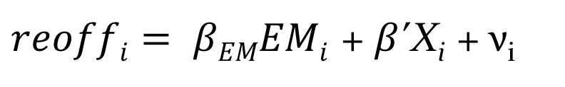
2SLS analysis
First stage:
Instrument
Other controls
Second stage:

Slide 28
Assumptions
Exclusion
  Judge’s tendency to refer for assessment impacts re-offending only through the choice of sentence
Random assignment
  Judge’s tendency to refer for assessment is random, conditional on court x year fixed effects
Relevance
  Judge’s tendency (IV) must be a strong predictor of sanction choice
Monotonicity
  Judge’s tendency to refer must affect all subgroups of offenders in the same direction (or not have any significant effect)

Slide 29
First stage estimates and tests
 | Court x Year of finalisation interacted fixed effects | Adds demographics and crime type | Adds criminal history and legal representation
Judge proclivity | 0.61*** (0.08) | 0.59*** (0.08) | 0.59*** (0.08)
F test of excluded instruments F(1,63) | 57.53 (0.00) | 60.57 (0.00) | 54.88 (0.00)
SW under-identification test χ² (1) | 60.92 (0.00) | 64.23 (0.00) | 58.66 (0.00)
Observations | 7,366 | 7,366 | 7,366
***p<0.01, **p<0.05,*p<0.1
Conclusion 1: IV is strong; model is not under-identified
Conclusion 2: Adding controls doesn’t change proclivity estimates

Slide 30
Further random assignment test
Variables | Received EM | Judge proclivity | Mean | SD
Age | -0.0081*** | 0.0001 | 31.38 | 9.65
Age Squared | 0.0001*** | 0.0000 | 1077.75 | 705.36
Gender is male | -0.1048*** | 0.0002 | 0.88 | 0.32
No. court apps last 5 yrs | -0077*** | -0.0006 | 3.24 | 2.65
No legal representative | 0.1247*** | 0.0004 | 0.08 | 0.28
Injury offence | -0.402*** | -0.0006 | 0.07 | 0.26
Negligent driving | 0.0603** | -0.0070 | 0.04 | 0.20
Break and enter | 0.0016 | 0.0020 | 0.10 | 0.30
Theft | -0.0026 | 0.0017 | 0.21 | 0.41
Fraud | 0.1084*** | 0.0071 | 0.11 | 0.31
Public order | -0.0081 | 0.0002 | 0.06 | 0.23
Traffic | 0.1373*** | -0.0003 | 0.24 | 0.43
F-stat | 31.29 | 1.4
P-value | 0.00 | 0.20
Observations | 7,366 | 7,366
R-squared | 0.2678 | 0.0358

Slide 31
Baseline IV Results:
Re-offending in 24 months free time
 | Controls for court x year interacted fixed effects | Add demographic and crime type | Add criminal history and legal representation
OLS Sentence is EM | -0.25*** (0.02) | -0.16*** (0.02) | -0.14*** (0.02)
Reduced form Judge proclivity for EM | -0.17*** (0.06) | -0.12*** (0.05) | -.09*** (0.04)
IV Sentence is EM | -.27*** (0.08) | -.21*** (0.07) | -.16*** (0.07)
Mean | 0.58 | 0.58 | 0.58
***p<0.01, **p<0.05,*p<0.1

Slide 32
Robustness tests
 | Adjust EM freetime | No prison in last 5 yrs. | No prison in last 5 yrs. and no remand
Sentence is EM | -0.19** (0.06) | -0.20** (0.07) | -0.13** (0.07)
Observations | 7,328 | 5,263 | 2,933
***p<0.01, **p<0.05,*p<0.1
Slightly different results for offenders not previously imprisoned or remanded in custody

Slide 33
IV estimates: long-term results
 | 12 | 24 | 36 | 48 | 60 | 72 | 84 | 96 | 108 | 120
All ages | -0.2* (0.10) | -0.16** (0.07) | -0.14 (0.09) | -0.14* (0.09) | -0.15* (0.09) | -0.12 (0.08) | -0.11 (0.08) | -0.10 (0.07 | -0.06 (0.07) | -0.03 (0.07)
N | 7,459 | 7,366 | 7,327 | 7,309 | 7,288 | 7,271 | 7,253 | 7,221 | 7,013 | 6,769
Less than 30 | -0.41* | -0.43** | -0.39 | -0.32 | -0.35 | -0.33 | -0.37* | -0.31* | -0.22 | -0.22
N | 3,683 | 3,644 | 3,624 | 3,618 | 3,615 | 3,609 | 3,602 | 3,589 | 3,511 | 3,443
At least 30 | -0.09 (0.14) | 0.02 (0.14) | 0.03 (0.15) | 0.02 (0.16) | -0.01 (0.15) | 0.05 (0.14) | 0.07 (0.14) | 0.07 (0.12) | 0.09 (0.13) | 0.12 (0.14)
N | 3,776 | 3,722 | 3,703 | 3,691 | 3,673 | 3,662 | 3,651 | 3,632 | 3,502 | 3,326
***p<0.01, **p<0.05,*p<0.1

Slide 34
Savings from EM
Assumptions
Average prison sentence = 260 days (from our sample)
Average time on Home Detention = 180 days (from our sample)
Probability of re-offending = 0.14 (from our sample)
Probability of prison/given reoffending = 0.44 (from our sample)
Reduction in court appearances (from our sample) = -1.10
$182 per day for prison (from Auditor General’s report)
$47 per day for HD (from Auditor General’s report)

Slide 35
Savings from EM
Savings from EM per person per year
Savings from reduced cost of sentence for current offence | $25,200
Savings from court cases averted | $449
Savings from custodial sentences averted | $3,603
Total savings per annum per offender | $29,252
Total savings for study cohort per annum | $5,800,000

Slide 36
Summary
EM reduces re-offending within 24 months free time by 16 percentage points (by 28% relative to those imprisoned)
The effects are limited to those under 30 but persist for at least five years
The savings are substantial and could be re-invested in EM/HD or other programs
Savings would be much greater if EM/HD is expanded but only if EM is used as an alternative to prison
Don’t know for sure whether it’s EM, HD or both that produce the reduction in reoffending

Slide 37
Acknowledgment
Sincere thanks to Corrective Services Corporate Research and Evaluation Unit for supplying the data and to Community Corrections for advice and feedback
Copies of our paper:
https://www.iza.org/publications/dp/12122/can-electronic-monitoring-reduce-reoffending

