Slide 1
Does CCTV help police solve crime?
Presentation to the Applied Research in Crime and Justice Conference
Anthony Morgan, Christopher Dowling, Alexandra Gannoni & Penny Jorna
Australian Institute of Criminology
14 February 2019

Slide 2
Perceived impact of local council CCTV
Mean scores for impact (1=no impact & 10=significant impact)

Slide 3
How does CCTV help in police investigations?
Based on UK research on public transport:
Footage available in half of all cases
Footage useful in two-thirds of cases where it was available (Ashby 2017)
Based on Swedish research in city centres:
Police sought access for one in eight incidents
Footage useful in one in four cases (Kindgren & Marklund 2014)

Slide 4
Our research questions
How often do police request CCTV footage from cameras located in public areas?
What factors influence the likelihood that police will request CCTV footage?
Why do police request CCTV footage and how do they use the footage provided to them?
What impact does CCTV footage have on clearance outcomes?

Slide 5
Study 1
Study 2
Study 3
Analysis of 10,000 police requests for CCTV footage from the rail network in 2014 (+ security incident data)
Interviews with investigators from 146 randomly selected incidents where footage had been requested
Compares matched cases with and without CCTV footage requests using linked data on crime clearance outcomes
By Hugh Llewelyn from Keynsham, UK;cropped and adjusted by uploader EurovisionNim - H22, CC BY-SA 2.0, https://commons.wikimedia.org/w/index.php?curid=54970057

Slide 6
Police requests for NSW rail network CCTV footage
59
percent of all requests were received from police
6,324
requests for footage were made by police in 2014
78
percent related to crime, criminal justice and ASB
14
requests per day from police for criminal investigations

Slide 7
Requests for CCTV footage by police, by incident type, 2014
 | n | %
Police inquiry/search | 953 | 19
Assault | 934 | 19
Robbery | 477 | 10
Graffiti | 431 | 9
Malicious damage | 428 | 9
Theft | 400 | 8
Antisocial behaviour | 362 | 7
Steal from person | 298 | 6
Sexual offences | 158 | 3
Other | 508 | 10

Slide 8






What factors are associated with a higher number of requests?
Incidents
Footfall
Cameras
Interchange
Accessibility
Elevation

Slide 9
What factors are associated with a higher number of requests?
Zero-inflated negative binomial regression model predicting number of requests per station (Incident rate ratios; n=303)
↑ 100%
↑ 11%
↑ 5%
↓ 2%
χ²(4)=223.59, p<0.001; McFadden’s Adjusted R² 0.234

Slide 10
Is there a relationship between station characteristics and the number of requests?
Zero-inflated negative binomial regression model predicting number of requests per station, metropolitan stations only (incident rate ratios; n=172)
↑ 39%
↑ 32%
↑ 8%
χ²(6)=154.93, p<0.001; McFadden’s Adjusted R² 0.213

Slide 11
Why do police request CCTV footage? (n=136)

Slide 12
How do police use CCTV footage? (n=136)
87%
of investigators used the footage in some way
62%
of investigators used the footage for its intended purpose
46%
of investigators used the footage to identify (or confirm identity) a suspect
71%
of investigators rated the footage as ‘useful’ or ‘very useful’

Slide 13








What impact does CCTV footage have on clearance rates?
Footage
Time of day
Day of week
Peak period
Location
Severity
Offence type
Time window

Slide 14
What impact does CCTV footage have on clearance rates?
 | Coefficient of difference | Standard Error | z | p | 95% CI lower | 95% CI upper
Footage requested vs not requested | 0.044 | 0.008 | 5.440 | <0.001 | 0.028 | 0.060
Footage requested and provided vs not requested | 0.055 | 0.009 | 6.260 | <0.001 | 0.038 | 0.072

Slide 15
What impact does CCTV footage have on clearance rates?
Predicted clearance rates for treatment and control groups

Slide 16
What impact does CCTV footage have on clearance rates?
Predicted clearance rates for treatment and control groups, by principal offence type (footage requested vs not requested)

Slide 17
Summary of findings
Rail network CCTV footage is frequently requested by police for the purpose of criminal investigations
Number of security incidents, number of cameras and passenger footfall predictors of the number of requests
Station design and presence of other forms of surveillance may be important

Slide 18
Summary of findings
Footage is used by police for its intended purpose in around two-thirds of cases where it’s available
Availability of footage associated with increased likelihood of offender being proceeded against
Access to footage is not equally beneficial for all offence types

Slide 19
What does this mean?
CCTV systems should be targeted at locations where there is a higher concentration of incidents
But, focus on those incidents more likely to result in requests from police, or where police are more likely to benefit
Particularly in those locations where other forms of surveillance are less likely
Need to find ways to ensure police have timely access to footage of criminal incidents
Access to footage for investigative purposes requires resources, cooperation and systems

Slide 20
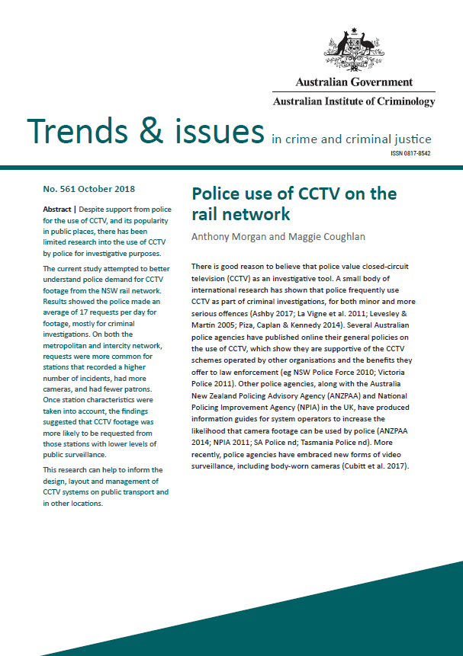
www.aic.gov.au

Slide 21
Anthony Morgan
anthony.morgan@aic.gov.au
(02) 6268 7472

