Slide 1
The role of mental health treatment in preventing offending behaviour
Armita Adily PhD, Tony Butler PhD
Justice Health Research Program

Slide 2
Investigators
Dr Stephen Allnutt – UNSW Australia
A/Professor Peter Schofield – Hunter New England Health
A/Professor Handan Wand - Kirby Institute
Dr Azar Kariminia – Kirby Institute
Dr Grant Sara-NSW Health
Mr Luke Grant- Corrective Services NSW
A/Professor Don Weatherburn - NSW Bureau of Crime Statistics and Research
Mr Olayan Albalawi – PhD Candidate - Kirby Institute
Ms Nabila Zohora Chowdhury – PhD Candidate, Kirby Institute
Funder: NSW Mental Health Commission

Slide 3
Presentation
Introducing the NSW data linkage study to investigate the association between psychosis and offending
Two sub-studies
To examine the effectiveness of the NSW Court Diversion Programme on re-offending
To examine the effect of contact with health services for mental health treatment on re-offending.

Slide 4
Psychosis
A syndrome found in mental disorders such as schizophrenia, delusional disorders, bipolar mood disorder, and some forms of severe depression.
The syndrome comprises symptoms reflecting profound disturbances of thought, perception and behaviour.¹
12-month treated prevalence in Australia - 4.5 per 1000 people.²
Average annual cost to the Australian health sector - $21,658 per person.³
¹Douglass et al. Psychol Bull 2009, ^{2.} Morgan et al. ANZJP 2012, ³ Neil et al. ANZJP 2014

Slide 5
Background
Psychosis is considered to be a risk factor for criminal offending, particularly violent offending.
A meta-analysis of 204 studies showed that psychosis was associated with a 49% to 68% increase in the odds of a conviction for violence, compared with the odds of violence in the absence of psychosis.¹
Victorian register data for 2,861 selected patients with schizophrenia showed that 21% of those with schizophrenia had been convicted of a criminal offence (vs. 8% of controls)²
Swedish linkage study (1988-2000) estimated that individuals with a hospital admission for psychotic disorders committed 5.2% of all violent crimes.³
1. Douglass et al. Psychol Bull. 2009, 2. Wallace. Am J Psychiatry.2004, 3. Fazel & Grann. Am J Psychiatry 2006

Slide 6
The Relationship between psychosis and offending – Data linkage Study

Slide 7
The relationship between psychosis and offending in NSW
Aim
Determine the association between psychosis and offending behaviour in New South Wales

Slide 8
The relationship between psychosis and offending in NSW
Study population
A cohort of all individuals who have been diagnosed with psychosis (on admission to a hospital or presentation to an emergency department) in NSW between 1 July 2001 and 31 December 2012.
Psychosis types (based on ICD codes):
    Schizophrenia and related psychosis
    Affective psychosis
    Substance related psychosis

Slide 9
The relationship between psychosis and offending in NSW
Controls
For each case, two controls without any record of a diagnosis of psychosis during the study period matched by birth year and sex from NSW Health administrative data collections:
  NSW Admitted Patient Data Collection
  NSW Emergency Department Data Collection
  NSW Registry of Birth, Death and Marriages
  NSW Mental Health Ambulatory Data Collection
  NSW Perinatal Data Collection
  NSW Central Cancer Registry
  NSW Pap Test Registry
  NSW Notifiable Conditions Information Management System
.

Slide 10
The relationship between psychosis and offending in NSW
Primary Outcome
At least one offence recorded in the NSW Bureau of Crime Statistic and Research Reoffending Database (ROD)¹ from 1 July 2001 to 31 December 2012.
¹ Excluding traffic offences

Slide 11
The relationship between psychosis and offending in NSW
Study Plan
A retrospective cohort involving a population level data-linkage using eight administrative data collections in NSW: ¹
NSW Admitted Patient Data Collection
NSW Emergency Department Data Collection
NSW Mental Health Ambulatory Data Collection
Mental Health Outcomes and Assessment Tool Collection
Pharmaceutical Drugs of Addiction System
NSW Bureau of Crime Statistics and Research Reoffending Database
NSW Offender Integrated Management System
The NSW Registry of Births, Deaths and Marriages
^{1.} Linked at the Centre for Health Record Linkage (CHeReL).

Slide 12
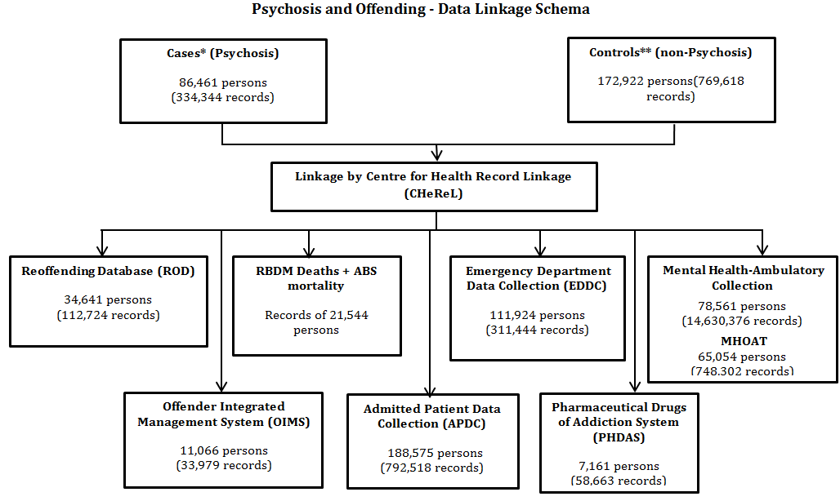




* Psychosis Cases selected from the APDC & EDDC data collections - 2001-2012 (EDDC – 2005 onwards).
** Controls selected from CHeReL’s master linkage key (2 controls for each psychosis case matched by sex and age).

Slide 13
Court Diversion and
Re-offending

Slide 14
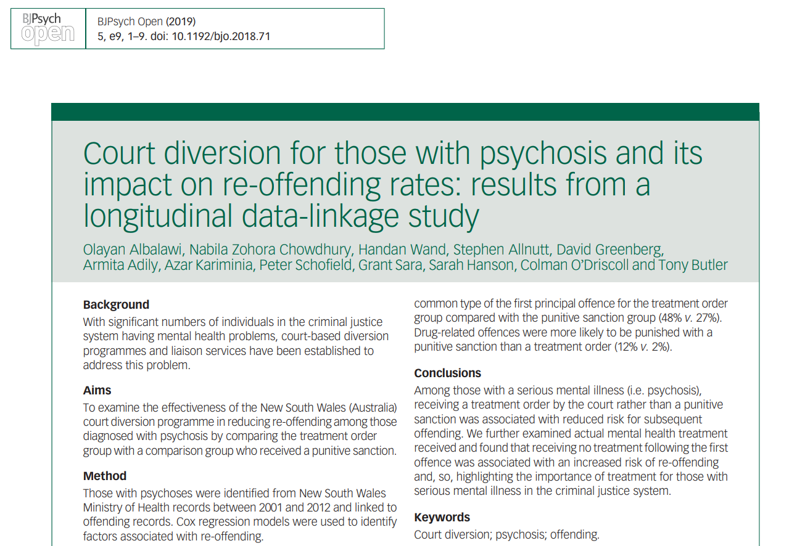

Slide 15
Court liaison/diversion services
Court liaison/diversion services developed to intervene with those charged with minor or summary offences with mental illness or cognitive impairment to improve health and justice outcomes
All jurisdictions in Australia have some form of court diversion/liaison service*
NSW Mental Health [Forensic Provisions] Act 1990 – Section 32/Section 33 Treatment order by magistrate:
  Section 32 treatment orders recommends the person receives community-based treatment and management
  Section 33 requires the person to be transferred to an inpatient hospital setting.
  Choice of treatment order based on the perceived risk to the community with the latter considered to pose a greater risk.
Studies (mostly US) have found positive outcomes e.g. reduced re-offending, improved living skills, reduced substance use
Little evaluation of the NSW Community and Court Liaison Service (SCCLS)
* Davidson, F., et al. (2016). A critical review of mental health court liaison services in Australia: A first national survey. Psychiatry, Psychology & Law, 1-14, doi: 10.1080/13218719.2016.1155509.

Slide 16
Section 32 & Section 33 Treatment orders 2001-2012
SCCLS: currently operates in 22 courts across NSW

Slide 17
Study design
Retrospective study using diagnostic and treatment data from the NSW Health and court and re-offending data from the NSW Bureau of Crime Statistics and Research Reoffending Database (2001-2012)

Slide 18
Treatment order group
Individuals with diagnosis of psychosis prior to their court finalisation date who were diverted from the courts into treatment for their first principal offence.
Comparison group
Individuals with diagnosis of psychosis prior to their court finalisations date who received punitive sanction (bond, community order, fine, probation, suspended sentence) for their first principal offence.

Slide 19
Outcomes of interest SCCLS sub-study
Incidence of the second offence following the first principal offence by sanction type (treatment order vs. punitive sanction)
Time to the second offence following the first principal offence by sanction type
Predictors of the second offence

Slide 20
Analysis
Descriptive analysis to examine the characteristics of the treatment and comparison group
Survival analysis and Cox regression models to examine time to re-offend and predictors of re-offending

Slide 21
Treatment and comparison groups
7,743 were identified with psychosis prior to their court finalisation for their first principle offence.
1,996 (26%) received treatment order
5,747 (74%) received punitive sanction

Slide 22
Characteristics of the treatment order vs comparison (punitive) groups
Men: 73% vs 73%
Indigenous status: 7% vs 11%
Schizophrenia and related psychoses: 81% vs 65%
Substance related psychosis: 7% vs 25%
First offence (violent): 56% vs 38%

Slide 23
Incidence of re-offending
(treatment order group vs comparison group)
Re-offending in treatment order group: 38%
Re-offending in comparison group: 50%
Incidence of re-offending by sex:
Men in the treatment order group: 6.8 per 100 person-years (95% CI 6.3 – 7.4)
Men in the comparison group: 11.1 per 100 person - years (95% CI 10.6 – 11.6)
Women in the treatment order group: 6.9 per 100 person - years (95% CI 6.0 – 8.0)
Women in the comparison group : 9.6 per 100 person – years (95% CI 8.9 – 10.4)

Slide 24
Incidence in treatment and comparison groups by diagnosis
Diagnosed with Affective psychosis:
  Treatment order group: 5.3 per 100 person – years
  (95% CI 4.2 – 6.6)
  Comparison group: 7.8 per 100 person – years (95% CI 6.9 – 8.9)
Diagnosed with Schizophrenia and related psychoses
  Treatment order group: 7.0 per 100 person – years
  (95% CI 6.5 – 7.6)
  Comparison group: 10.6 per 100 person – years
  (95% CI 10.1 – 11.1)
Diagnosed with substance related psychosis
  Treatment order group: 8.1 per 100 person – years
  (95% CI 6.4 – 10.4)
  Comparison group: 12.3 per person-years (95% CI 11.4 – 13.2)

Slide 25
Incidence in treatment order and comparison groups by type of first offence
Non-violent offence
  Treatment order group: 7.4 per 100 person – years
  (95% CI 6.7 – 8.2)
  Comparison group: 11.6 per 100 person – years
  (95% CI 11.1 – 12.1)
Violent offence
  Treatment order group: 6.4 per 100 person – years
  (95% CI 5.8 – 7.1)
  Comparison group: 9.3 per 100 person – years
  (95% CI 8.7 – 9.9)

Slide 26
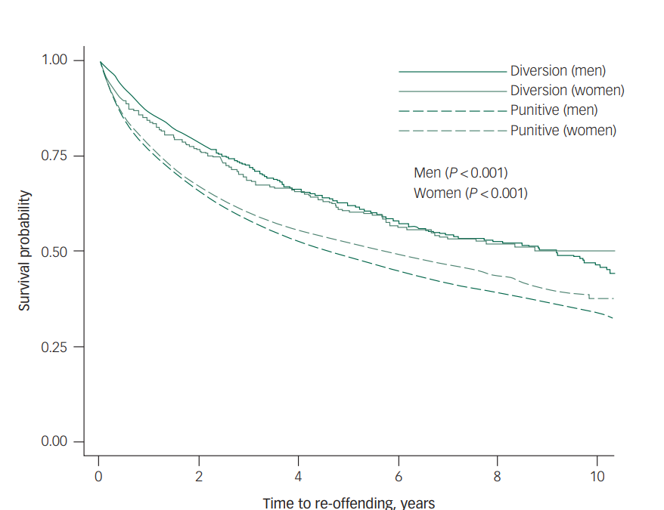

Slide 27
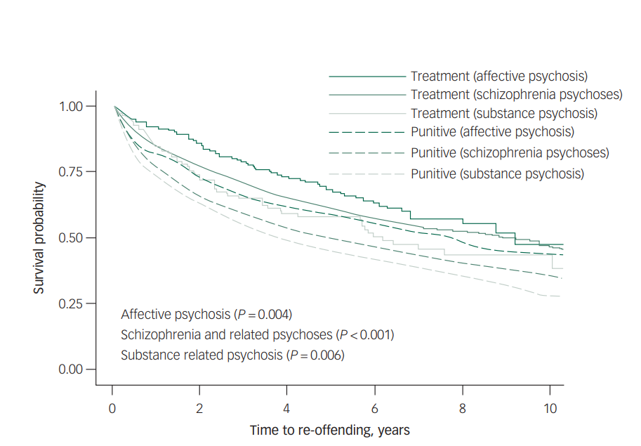

Slide 28
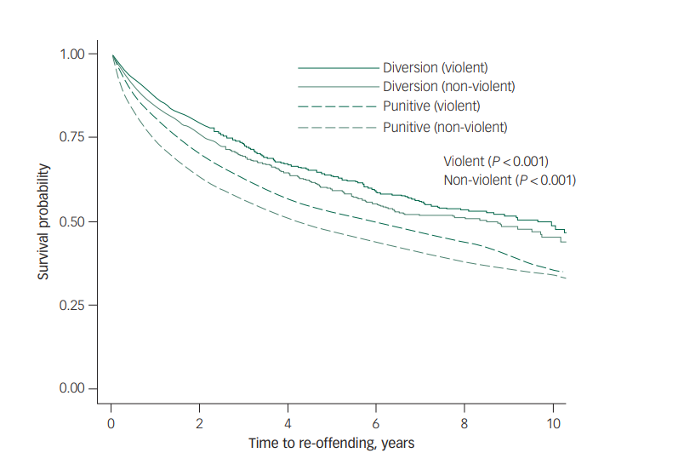

Slide 29
Factors associated with re-offending: offenders with psychosis, 2001 – 2012 (7,743)
 | Overall (N=7,743)
 | N (%) | aHR* (95% CI) | P-value
Group
Punitive sanction group | 5,747 (74) | 1
Treatment order group | 1,996 (26) | 0.68 (0.62 – 0.74) | <0.001
Psychosis type
Affective psychosis | 796 (10) | 1
Schizophrenia and related psychoses | 5,351 (69) | 1.19 (1.05 – 1.34) | 0.005
Substance related psychosis | 1,596 (21) | 1.46 (1.27 – 1.67) | <0.001
Age at the first offence
<18 years | 69 (1) | 2.26 (1.65 – 3.09) | <0.001
18 – 25 years | 1,586 (20) | 1.57 (1.40 – 1.77) | <0.001
26 – 35 years | 2,635 (34) | 1.64 (1.47 – 1.83) | <0.001
36 – 45 years | 2,095 (27) | 1.34 (1.19 – 1.50) | <0.001
46 + years | 1,358 (18) | 1
Aboriginal
No | 6,176 (80) | 1
Yes | 773 (10) | 1.85 (1.68 – 2.03) | <0.001
Unknown | 794 (10) | 0.08 (0.06 – 0.11) | <0.001
Marital status
Married | 959 (12) | 1
Other | 6,784 (88) | 1.21 (1.09 – 1.35) | <0.001
Country of birth
Other | 1,339 (17) | 1
Australia | 5,343 (69) | 1.18 (1.08 – 1.30) | <0.001
Unknown | 1,061 (14) | 1.27 (1.12 – 1.45) | <0.001
First principal offence type
Violent | 3,288 (43) | 1
Non-violent | 4,455 (57) | 1.20 (1.12 – 1.28) | <0.001
*Adjusted by age, marital status, country of birth and psychosis type.

Slide 30
Conclusion
Diversion into treatment is associated with significant lower rates of subsequent re-offending in men and women regardless of type of offence (violent vs non-violent) of type of psychosis.
Less people from Indigenous background were in the treatment order group.
This study provides insights into Magistrates’ sentencing patters.

Slide 31
Clinical contact with health services associate with treatment of mental illness and
Re-offending

Slide 32
Clinical contact with health services associated with treatment and re-offending
Cohort
All individuals in New South Wales who were admitted to a hospital or presented to an emergency department with a diagnosis of psychosis before their first offence between July 2001 and December 2005 and received a non-custodial sentence or no penalty for their first offence
.

Slide 33
Study plan
Treatment group
Individuals with a diagnosis of psychosis prior to their court finalisation date between July 2001 and December 2005 who had one or more clinical contact with health services (i.e., hospital admission, community mental health service, emergency department) for mental health treatment between July 2001 and December 2008 (follow- up period)
Comparison group
Individuals with diagnosis of psychosis prior to their court finalisation date between July 2001 and December 2005 who had no clinical contact with health services for mental health treatment during the follow – up period

Slide 34
Analysis
Descriptive analysis to examine the characteristics of the treatment and comparison group
Survival analysis and Cox regression models to examine time to re-offend and predictors of re-offending

Slide 35
Outcomes of interest (treatment vs comparison group) during the follow up period (2001 – 2008)
Incidence of re-offending
Time to re-offending
Predictors of re-offending

Slide 36
Characteristics of clinical contact vs no clinical contact groups
N = 2,724
Men: 74% vs 75%
Indigenous status: 8% vs 8%
Schizophrenia and related psychosis: 77% vs 62%
Substance related psychosis: 14% vs 28%
First offence (violent): 36% vs 28%

Slide 37
Court outcome for first offence
18.8% dismissed for mental illness
  Dismissed by the lower courts due to mental illness/health (8.9%)
  Section 32 dismissal – persons suffering mental illness or condition (8.4%)
  Section 33 dismissal – mentally ill persons (1.5%)

Slide 38
Contact with health services for mental health treatment during follow-up (July 2001 – December 2008)
70% had clinical contact with health services for mental health treatment during the follow up.
The median time of first contact with health services for mental health treatment following the first offence was 50 days (IQR: 4 – 199.5 days).
First contact with health services
  Community mental health service (52%)
  Hospital admission (47%)
  Emergency Department (1%)

Slide 39
Number of contact with health services for mental health treatment during the follow –up (July 2001 – December 2008)
Median number of clinical contacts with health services during the follow – up: 22 times (IQR 4 – 99)
Number of contacts
  0 (30%)
  1-14 (31%)
  15 – 30 (8%)
  31 – 40 (4%)
  41+ (28%)

Slide 40
Type of health services contacted during the follow – up for treatment of mental health problem (July 2001 – December 2008)
Community mental health services (96.1%)
Hospital admission (3.5%)
Emergency Departments (0.4%)

Slide 41
Factors associated with clinical contact with health services for treatment of mental health problem during the follow up
Characteristics | Total N=2,724 (%) | One or more clinical contacts N =1,895 (70%) | No clinical contact N=829 (30%) | p-value
Age at the first offence Mean (years), (SD, range) | 33 (10, 12-82) | 33 (10,12-82) | 32(11,12-74) | 0.024
Type of psychosis |  |  |  | <0.001
Affective psychoses | 253 (9) | 169 (9) | 84 (10)
Schizophrenia and related psychoses | 1,976 (73) | 1,466 (77) | 510 (62)
Substance related psychoses | 495 (18) | 260 (14) | 235 (28)
Type of first offence (2001-2005) |  |  |  | <0.001
Non-violent | 1,819 (67) | 1,219 (64) | 600 (72)
Violent | 905 (33) | 676 (36) | 229 (28)

Slide 42
Incidence of re-offending during the follow up period
Incidence of re-offending in no clinical contact group:
32.0 per 100 person-years (95% CI 29.5 – 34.8)
Incidence of re-offending in those with one or more clinical contacts:
12.7 per 100 person-years (95% CI 11.9 – 13.9)
Re-offending was 44% less for those with clinical contact for mental health treatment than those with no contact (aHR 0.44; 95% CI 0.40-0.49)

Slide 43
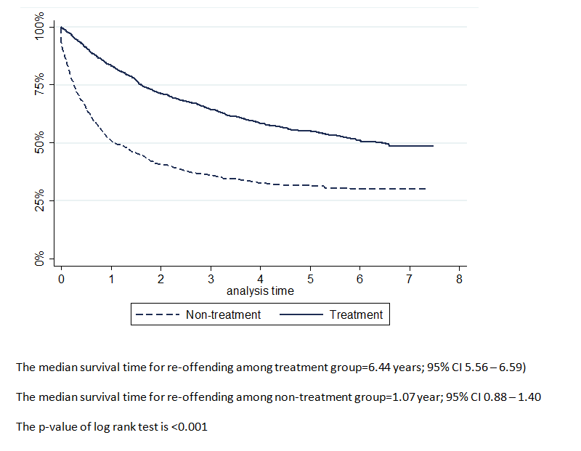
Time to re-offend
(clinical contact group vs no clinical contact groups)

Slide 44
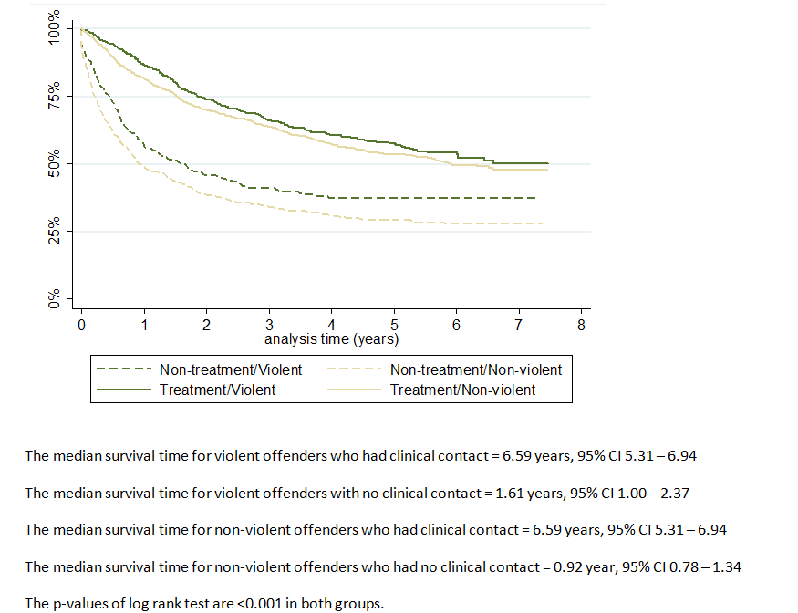
Time to re-offend
(clinical contact vs no clinical contact groups with violent or non-violent first offence)

Slide 45






Predictors of re-offending in men and women during the follow up
 | Men |  | Women
Characteristics | aHR (95% CI) | p-value | aHR (95% CI) | p-value
Age at first offence
<18 years | 1.55 (1.17-2.03) | 0.002 | 1.46 (0.87-2.46) | 0.154
18-25 years | 1.64 (1.27-2.10) | <0.001 | 1.73 (1.06-2.83) | 0.029
26-35 years | 1.63 (1.29-2.07) | <0.001 | 2.40 (1.53-3.76) | <0.001
36-45 years | 1.22 (0.95-1.57) | 0.121 | 1.60 (1.01-2.54) | 0.047
46+ years | 1 |  | 1
Type of psychosis
Affective psychosis | 1 |  | 1
Substance related psychosis | 1.16 (0.89-1.51) | 0.284 | 1.50 (1.04-2.17) | 0.031
Offence type (first)
Violent | 1 |  | 1
Non-violent | 1.24 (1.08-1.41) | 0.002 | 1.10 (0.87-1.38) | 0.425
Contact with health services
No | 1 |  | 1
Yes | 0.43 (0.38-0.49) | <0.001 | 0.45 (0.36-0.56) | <0.001
Number of treatment
0 | 4.53 (3.75-5.48) | <0.001 | 3.67 (2.73-4.94) | <0.001
1-14 | 3.02 (2.50-3.66) | <0.001 | 2.61 (1.92-3.55) | <0.001
15-30 | 1.95 (1.47-2.59) | <0.001 | 1.84 (1.15-2.91) | 0.010
31-40 | 1.67 (1.12-2.48) | 0.012 | 0.97 (0.47-2.02) | 0.935
41+ | 1 |  | 1

Slide 46




Predictors of re-offending by type of offence during the follow up
 | Violent first offenders |  | Non-violent first offenders
Characteristics | aHR (95% CI) | p-value | aHR (95% CI) | p-value
Gender
Female | 1 |  | 1
Male | 0.98 (0.78-1.22) | 0.848 | 1.08 (0.93-1.24) | 0.340
Age at first offence
<18 years | 1.54 (1.00-2.36) | 0.047 | 1.48 (1.10-2.00) | 0.010
18-25 years | 1.49 (0.98-2.26) | 0.058 | 1.70 (1.30-2.22) | <0.001
26-35 years | 1.65 (1.12-2.42) | 0.011 | 1.81 (1.41-2.32) | <0.001
36-45 years | 1.29 (0.86-1.92) | 0.218 | 1.30 (0.99-1.69) | 0.055
46+ years | 1 |  | 1
Indigenous status
No | 1 |  | 1
Yes | 1.36 (1.00-1.84) | 0.048 | 1.06 (0.84-1.34) | 0.629
Contact with health services
No | 1 |  | 1
Yes | 0.46 (0.37-0.57) | <0.001 | 0.43 (0.38-0.49) | <0.001
Number of treatment
0 | 4.11 (3.09-5.47) | <0.001 | 4.30 (3.54-5.21) | <0.001
1-14 | 2.84 (2.14-3.74) | <0.001 | 2.93 (2.41-3.57) | <0.001
15-30 | 2.51 (1.69-3.75) | <0.001 | 1.65 (1.21-2.23) | 0.005
31-40 | 2.03 (1.24-3.34) | 0.005 | 1.09 (0.66-1.80) | 0.736
41+ | 1 |  | 1

Slide 47
Conclusion
<19% of the offenders with a diagnosis of psychosis received court treatment order between July 2001 and December 2005 (low?).
70% of the cohort had [clinical] mental health service contact
96.1% of clinical mental health service contacts occurred at the community mental health services
Risk of re-offending was 44% less for those who clinical mental health service contact compared with those who had no clinical contact.
Risk of re-offending decreased with increased number of clinical contacts
Attention should be paid to treatment for those with substance related psychosis (especially women)

Slide 48
Thank you

