Slide 1
Willingness to pay a fine
Neil Donnelly, Suzanne Poynton & Don Weatherburn
NSW Bureau of Crime Statistics and Research
February, 2017

Slide 2
Introduction
Fines the most widely used sanction in regulatory toolkit
NSW Courts imposed 41,000 fines, 37% of all penalties
476,000 fines for speeding related offences in NSW
Fine default
40% speeding related fines not paid before penalty notice due (2014)
22% not paid before reminder notice due
2,600 people charged with driving while suspended for non-payment of a fine

Slide 3
Introduction
Surprising little theory & research on willingness to pay fines
Fine amount
Mode of detection
Speed camera vs. Police
How fine severity and mode of detection influence willingness to pay speeding fines?

Slide 4
Research questions
What proportion of people (who have received a fine) have not paid it on time or have considered not paying it?
Does increasing fine amount for speeding decrease willingness to pay (WTP)?
Are police issued fines for speeding associated with higher WTP than camera issued fines?
Any interaction between fine amount & mode of detection on WTP?
Does fine amount have different effects on WTP for people from more disadvantaged groups?

Slide 5
Survey methodology
3,158 adults from NSW
71% CATI (36% response rate)
29% online samples
Respondents asked if ever received driving-related fine?
Those who had were randomised to hypothetical speeding scenarios which varied mode of detection and level of fine imposed

Slide 6
Prior parking or speeding fines
Have you received a fine for a parking or traffic offence?
Yes, in the past year (n = 587, 18.6%)
Yes before past year (n = 1,635, 51.8%)
Never (n = 932, 29.5%)

Slide 7
Among those who had been fined (n = 2,222):
419 (19%) had not paid their fine on time at least once
also 40 (2%) who were not sure about this
910 (41%) had considered not paying the fine at all

Slide 8
Factors associated with considering not paying
fined during past 12 mths (53% vs 37%)
knows a non-payer who got away with not paying (56% vs. 38%)
more past speeding fines (none: 33%; one : 44%; two: 56%; 3+: 62%)
aged less than 40 (47% vs. 38%)
males (43% vs. 38%)
in paid employment (42% vs. 37%)
no relationship with location or socio-economic disadvantage

Slide 9
“Imagine you are driving along a major road trying to get to an important appointment”

Slide 10
Fine amount & detection mode scenarios
Detection mode | Fine amount
 | $254 | $436 | $2,252
Speed camera | Group 1 | Group 2 | Group 3
Police | Group 4 | Group 5 | Group 6

Slide 11
Scenario examples
“You are booked by a speed camera and receive a speeding ticket that requires you to pay $254 in 21 days”
“A police officer pulls you over and books you for speeding. The speeding ticket requires you to pay $254 in 21 days”
How likely are you to pay that fine within 21 days?
Likert scale

Slide 12
No. of respondents randomly assigned to detection mode & fine amount scenarios
Detection mode | Fine amount
 | $254 | $436 | $2,252
Speed camera | n = 390 | n = 358 | n = 346
Police | n = 365 | n = 369 | n = 394

Slide 13
Random allocation to six scenarios
no statistically significant associations between the six scenarios and:
age group; gender
region (Sydney vs. other NSW); major city category
employment status; socio-economic disadvantage
had considered not paying fine
prior speeding fines; knows a non-payer who got away with it
always paid fine in time
recently vs. previously fined
sampling frame

Slide 14
Fine amount scenario by willingness to pay
 | Almost certainly would not | Unlikely | Might or might not | Likely | Almost certain | None of these
Scenario
$254 | 3.1% | 7.3% | 8.1% | 22.0% | 59.3% | 0.3%
$436 | 7.0% | 12.2% | 10.5% | 22.8% | 46.5% | 1.0%
$2,252 | 31.5% | 23.8% | 12.2% | 14.2% | 16.6% | 1.8%

Slide 15
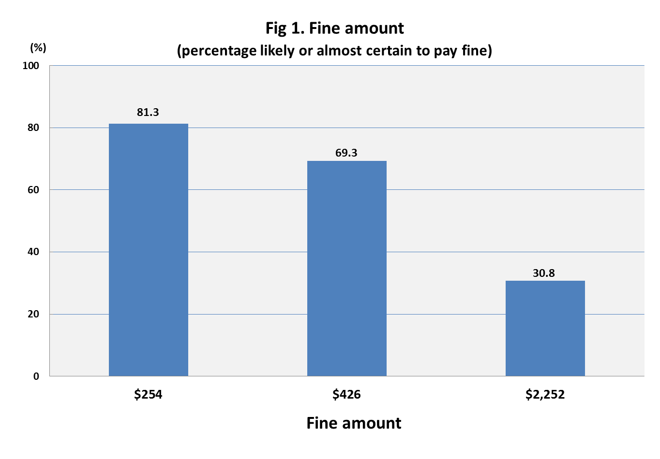

Slide 16
Fine amount scenario as predictor of WTP Poisson regression
Covariates | Incidence Rate Ratio (95% CI) | p value
Scenario
$436 vs. $254 | 0.89 (0.84, 0.94) | < .001 *
$2,252 vs. $254 | 0.49 (0.46, 0.52) | < .001 *

Slide 17
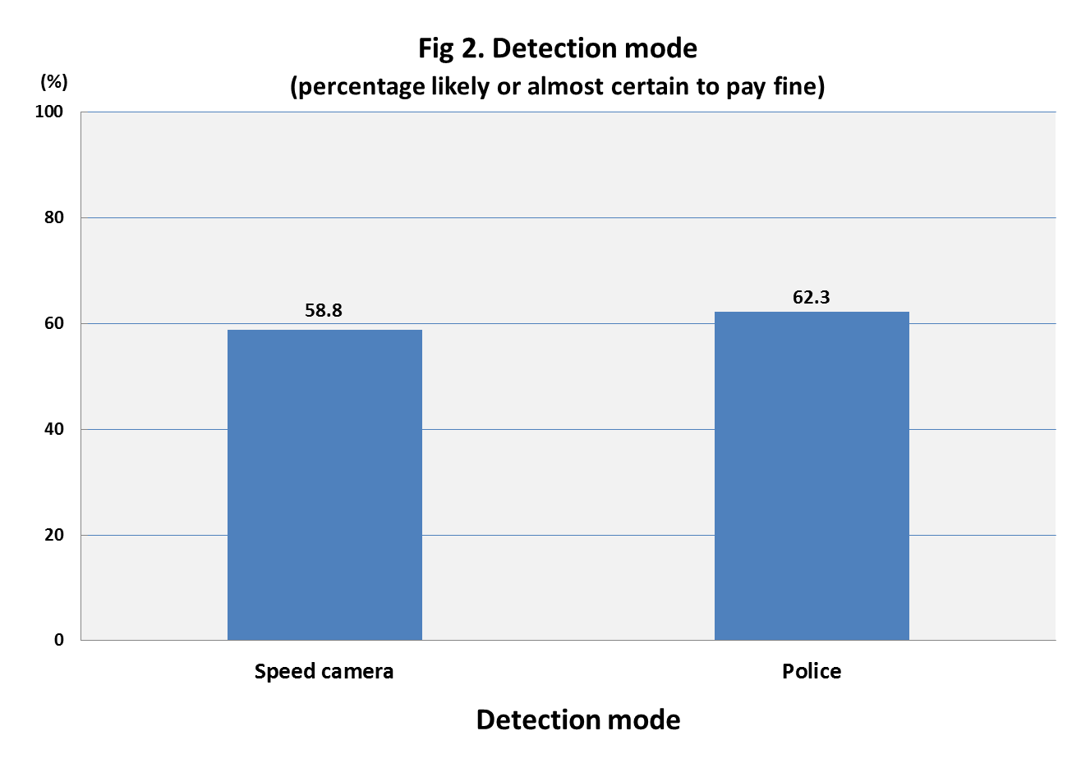

Slide 18
Detection mode scenario as predictor of WTP Poisson regression
Covariates | Incidence Rate Ratio (95% CI) | p value
Scenario
Police vs. Speed camera | 1.02 (0.97, 1.08) | = .384

Slide 20
Interaction between fine amount and mode of detection?
is the nature of the relationship between fine amount and willingness to pay different between the two modes of detection?
no statistically significant interaction found
χ²₂ = 4.1, p = .130
final model with fine amount & mode of detection main effects

Slide 21
Fine & mode as main effect predictors of WTP Poisson regression
Covariates | Incidence Rate Ratio (95% CI) | p value
Fine amount
$436 vs.$254 | 0.89 (0.84, 0.94) | < .001 *
$2,252 vs. $254 | 0.49 (0.45, 0.52) | < .001 *
Detection mode
Police vs. Speed camera | 1.05 (0.99, 1.10) | = .079

Slide 22
Effect of fine amount on WTP among disadvantaged groups
Socio-economic disadvantage (SEIFA ) quartiles & fine amount
no significant interaction
Paid employment status & fine amount
significant interaction
χ²₂ = 6.1, p = .044

Slide 24
Summary
20% of those ever fined have not paid the fine in time
40% have considered not paying the fine in time
Scenarios
Higher speeding fines associated with lower compliance
Police issued speeding fines not associated with greater compliance compared with camera issued fines
No interaction found between fine level & mode of detection

Slide 25
Conclusions
Reason to doubt common assumption that higher fines exert stronger deterrent effects
Might be worth conducting a cost-benefit analysis of the fine system
Court-imposed fines can be adjusted to suit the income of the offender but most fines are not imposed by the courts

