Slide 1

Using Big Data to examine the relationship between parental contact with the criminal justice system and the development of early childhood offspring aggression in a population sample
Stacy Tzoumakis^{1,3}; Kimberlie Dean²⁻⁴; Melissa J Green^{2,3}; Maina Kariuki^{2,3}; Felicity Harris^{2,3}; Vaughan J Carr^{2,3,5}; Kristin R Laurens^{2,3}
¹ School of Social Sciences, UNSW Sydney
² School of Psychiatry, UNSW Sydney
³ Neuroscience Research Australia, Sydney, Australia
⁴ Justice Health & Forensic Mental Health Network, Sydney, Australia
⁵ Department of Psychiatry, School of Clinical Sciences, Monash University
CONTACT:
Dr Stacy Tzoumakis
E: s.tzoumakis@unsw.edu.au
T: +61 (2) 9385 8289

Slide 2

What is Big Data?
“Big data, the analysis of original datasets with large samples ranging from ~30,000 to one million participants to mine unexplored data, has been under-utilized in criminology.”
DeLisi, M. (2016). The big data potential of epidemiological studies for criminology and forensics. Journal of Forensic and Legal Medicine.
http://dx.doi.org/10.1016/j.jflm.2016.09.004

Slide 3
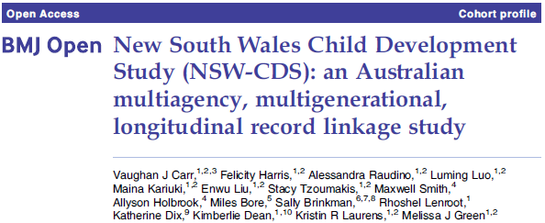
The New South Wales Child
Development Study (NSW-CDS)
State-wide prospective, longitudinal, population-based study (http://nsw-cds.com.au)
  Uses record linkage of administrative data from multiple sources since birth (health, crime, education, welfare)
Linkage conducted by the Centre for Health Record Linkage (www.cherel.org.au)
Cohort is defined by the 2009 Australian Early Development Census (AEDC):
    teacher-reported cross-sectional survey
    99.9% of the eligible New South Wales (NSW) children (N = 87,026) who entered kindergarten at approximately 5 years of age
    a validated measure of childhood developmental vulnerability and school readiness

Slide 4
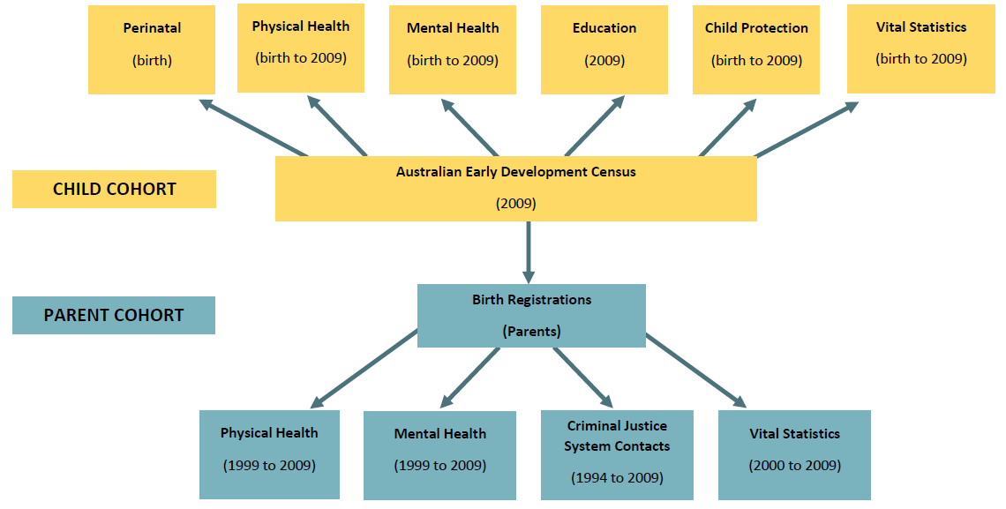
NSW-CDS Record Linkage 1 (2014)

Slide 5
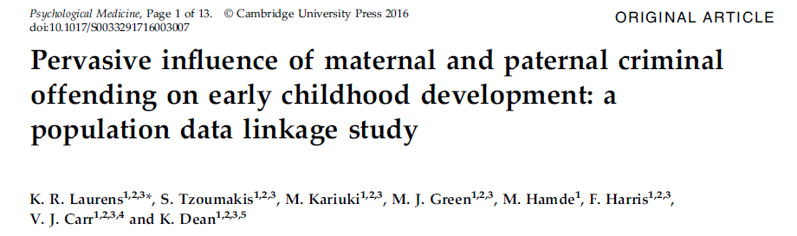
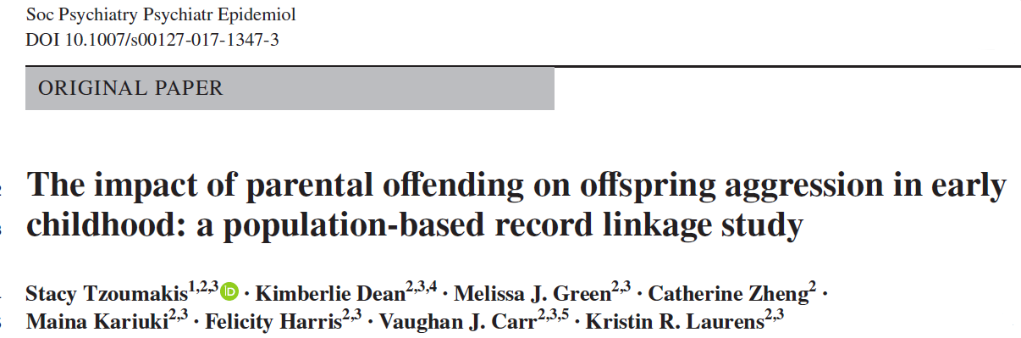

Slide 6
Sample
NSW-CDS cohort n=87,026
Excluded children without linked parental records (n= 14,781)
n=72,245
Excluded children with special needs for whom AEDC data was unavailable (n= 3,129)
Final sample n=69,116

Slide 7
Offspring outcomes at age 5 years
Dichotomous outcomes reflecting child "vulnerability" - bottom 10% of the national AEDC
Australian Early Development Census (AEDC)
Social competence domain (SOCIAL) | Overall social competence, responsibility and respect, readiness to explore new things
Emotional maturity domain (EMOTIONAL) | Pro-social and helping behaviours, anxious behaviour, aggression, hyperactivity and inattention
Language and cognitive skills domain (COGNITIVE) | Basic and advanced literacy, basic numeracy, interest in literacy/numeracy and memory
Communication skills and general knowledge domain (COMMUNICATION) | Broad developmental skills in communication and general knowledge (e.g., understands and uses language effectively)
Physical health and wellbeing domain (PHYSICAL) | Gross and fine motor skills, physical independence, and physical readiness for the school day
Aggression subdomain (AGGRESSION) | Physical fights; bullies others; kicks, bites, hits; takes things; laughs at others discomfort; disobedient

Slide 8
Exposures and covariates
Data source | Measure | Coding
NSW Bureau of Crime Statistics | Maternal and paternal offending (court appearances) | Dichotomous: Any offending / no offending Violent offending / no offending
 |  | Type: None Minor (traffic, vehicle, public safety offences) Nonviolent (theft, fraud, drug offences) Violent (homicide, assault, robbery) Frequency: 0 1 2 to 5 ≥6 offences
Australian Early Development Census (AEDC) | Child sex | Female Male
 | Child English as a second language | Not ESL ESL
 | Socio-Economic Index for Areas | three least disadvantaged quintiles two most disadvantaged
NSW Register of Births, Deaths, and Marriages | Maternal age at child's birth | <26 years of age ≥26 years of age
NSW Mental Health Admitted Patients & Mental Health Ambulatory | Contacts with services for mental illness | No mental illness Any mental illness

Slide 9
Research Question 1:
Does maternal and paternal offending influence a diverse range of early childhood outcomes?

Slide 10
Logistic regression - ANY parental offending

Slide 11
Logistic regression - VIOLENT parental offending

Slide 12
Research Question 2:
What are the characteristics of children with mothers who are involved in offending?

Slide 13
Descriptive statistics stratified by frequency of maternal offending
 | Total sample (n=69,116) | Maternal offending frequency
 |  | 0 offences (n=63,341) | 1 offence (n=2,459) | 2-5 offences (N=2,134) | ≥6 offences (N=1,182)
Child AGGRESSION | 8% | 8% | 11% | 15% | 21%
Male child | 51% | 51% | 51% | 50% | 49%
Child ESL | 16% | 16% | 13% | 10% | 6%
Mother <26 yrs at child’s birth | 22% | 20% | 40% | 49% | 51%
Socioeconomic disadvantage | 45% | 43% | 59% | 67% | 72%
Paternal offending | 26% | 22% | 54% | 66% | 73%
Maternal mental illness | 11% | 9% | 22% | 35% | 64%
Paternal mental illness | 6% | 5% | 14% | 21% | 32%

Slide 14
Research Question 3:
Does parental involvement in frequent or violent offending have a greater impact on offspring aggression?
Research Question 4:
Does the relationship between parental offending and offspring aggression hold while accounting for other known key risk factors including parental mental illness?

Slide 15
Logistic regression - Parental offending FREQUENCY and offspring aggression
 |  | Block 1 | Block 2 | Block 3 | Block 4
 |  | Odds ratio | Odds ratio | Odds ratio | Odds ratio
Male child |  | 3.1*** | 3.1*** | 3.1*** | 3.1***
English second language child |  | 0.8*** | 0.9*** | 0.9** | 0.9**
Mother <26 years at child’s birth |  | 1.7*** | 1.6*** | 1.4*** | 1.4***
Socioeconomic disadvantage |  | 1.3*** | 1.3*** | 1.2*** | 1.2***
Maternal offending frequency ª | 1 |  | 1.3*** | 1.1 | 1.1
2-5 |  |  | 1.7*** | 1.4*** | 1.3***
≥6 |  |  | 2.7*** | 2.1*** | 1.7***
Paternal offending frequency ª | 1 |  |  | 1.3*** | 1.3***
2-5 |  |  |  | 1.4*** | 1.4***
≥6 |  |  |  | 1.7*** | 1.6***
Maternal mental illness |  |  |  |  | 1.4***
Paternal mental illness |  |  |  |  | 1.3***
N=68,655. **p<.01; ***p<.001 ª Reference group is non-offending parents.

Slide 16
Logistic regression - Parental offending TYPE and offspring aggression
 |  | Block 1 | Block 2 | Block 3 | Block 4
 |  | Odds ratio | Odds ratio | Odds ratio | Odds ratio
Male child |  | 3.1*** | 3.1*** | 3.1*** | 3.1***
English second language child |  | 0.8*** | 0.9*** | 0.9*** | 0.9***
Mother <26 years at child’s birth |  | 1.7*** | 1.6*** | 1.4*** | 1.4***
Socioeconomic disadvantage |  | 1.3*** | 1.3*** | 1.2*** | 1.2***
Maternal offending type ª | Minor |  | 1.3** | 1.2 | 1.1
Nonviolent |  |  | 1.6*** | 1.4*** | 1.2***
Violent |  |  | 2.3*** | 1.9*** | 1.6***
Paternal offending type ª | Minor |  |  | 1.3*** | 1.3***
Nonviolent |  |  |  | 1.4*** | 1.4***
Violent |  |  |  | 1.6*** | 1.5***
Maternal mental illness |  |  |  |  | 1.4***
Paternal mental illness |  |  |  |  | 1.3***
N=68,639. **p<.01; ***p<.001 ª Reference group is non-offending parents.

Slide 17
Summary of findings
Impact of parental offending is NOT limited to aggression but extends to a range of offspring outcomes including language and cognition
  Frequent offending mothers more likely to be young, have mental illness, socioeconomic disadvantage, and a partner with a criminal history
BOTH mothers’ and fathers’ offending matter – similar in magnitude
Highest impact → FREQUENT (≥6 offences) and VIOLENT parental offending
Parental offending influences early childhood aggression even after accounting for parental mental illness and socio-demographic factors
    Mothers’ involvement in one offence/minor offences loses significance
    Magnitude of association decreased after accounting for these risk factors

Slide 18
Conclusion
Offending mothers experience greater adversity than non-offending mothers
  Transmission of aggression and antisocial behaviour is evident from early in the life course → pervasive impact of parental offending
  Supports intervening with ‘at-risk’ families during this key developmental period
    Early parent/family training programs are effective in the prevention of delinquency and offending (e.g., Piquero et al., 2016)
  Important to intervene with female offenders, especially when they become mothers
Future directions:
The Middle Childhood Survey and Record Linkage 2

Slide 19
2015 Middle Childhood Survey (MCS)
Online self-report survey of children’s mental health and wellbeing at ~11 years of age
Targeted same cohort of children assessed within the AEDC in 2009 - all Year 6 students enrolled at government and non-government schools in NSW during 2015

Slide 20
NSW-CDS Record Linkage 2 (2017)
2018
Age 14 –
NSW Police contacts
…
…

Slide 21
Acknowledgments
This research was conducted by UNSW Sydney with financial support from:
Australian Institute of Criminology Research Grant (CRG19/14-15)
Australian Research Council Linkage Project (LP110100150; Partners: NSW Ministry of Health, NSW Department of Education and Communities, and the NSW Department of Family and Community Services)
National Health and Medical Research Council Project Grant (APP1058652)
Australian Rotary Health Mental Health Research Grant (RG104090)
MJ Green was supported by a National Health and Medical Research Council R.D. Wright Biomedical Career Development Fellowship (APP1061875)
We would like to acknowledge Enwu Liu and Alessandra Raudino for assistance with the preparation of linked data.
This research was conducted using population data owned by the:
Department of Education
NSW Bureau of Crime Statistics and Research, and
NSW Ministry of Health
However the information and views contained in this study do not necessarily, or at all, reflect the views or information held by these Departments.

