Slide 1

Lifting the lid
on jury reasoning
and decision-making
Jane Goodman-Delahunty
Annie Cossins,
Natalie Martschuk

Slide 2
Introduction
Notes:
This is a complex topic and an intricate study, and we will not be able to cover all aspects today, but will present the highlights and key outcomes.

Slide 3
Perceptions of jury competence
Juries are perceived as arbitrary, unreliable, easily swayed by passion and prejudice, studies of unconscious biases.
  Individual juror biases and jury group influences
Psychology underpinning rules of evidence: based on these notions, e.g., inadmissible evidence, unfairly prejudicial evidence.
  Exclude relevant, probative evidence if confusing, undue weight
Difficult to assess jury competence as deliberations are secret.
Contrary insights from jury simulation research on deliberations.
  Gruesome evidence, filicide, terrorism, child sexual abuse
Inappropriate reasoning process inflamed by emotional responses to negative information about a particular defendant:
“This guy is terrible; he should pay” (Saks & Spellman, 2016).
Balancing test: avoid joint trials due to risk of unfair prejudice?

Slide 4
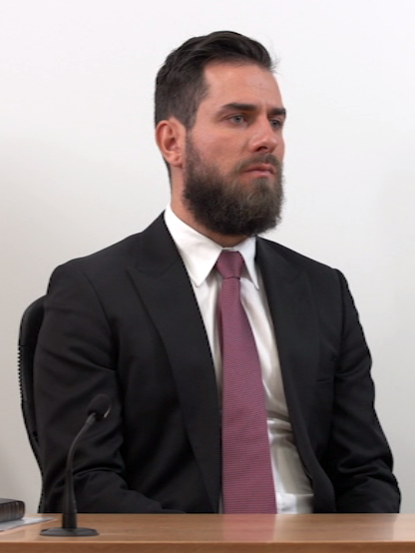
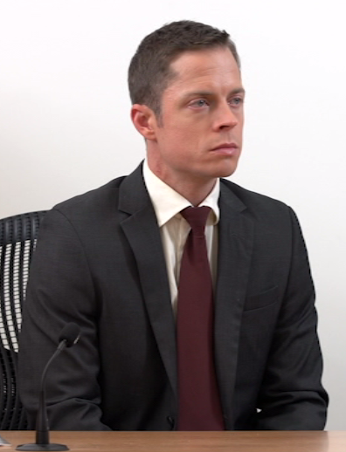
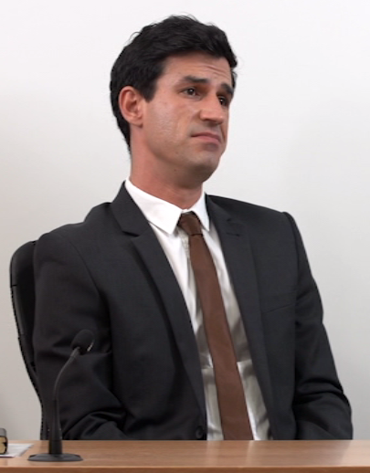
Prior studies of joinder
No experimental studies in child sexual abuse cases
Archival research: 9% higher conviction rate in joint versus separate trials
Controlled simulations: 10 studies, yielded mixed results, all over 30 years old
Meta-analysis: “joinder effect” requires 3 or more similar offences
Limitations of past research:
Only individual mock juror verdicts
Conviction rate focus, not reasoning
No jury deliberation
No assessment of unfair prejudice
Evidence is not unfairly prejudicial because it inculpates the accused
Dupas v The Queen [2012] VSCA 328
(21 Dec 2012)
Notes:
To set this research in context, I want to mention a few prior studies of joint versus separate trials, though notably, aside from some 1994 outcomes in the NSW District Court, none of the joinder researchers has looked at child sexual abuse cases – cases of burglary, robbery, conspiracy and adult sexual assault have been examined. While large data sets drawn from actual cases tend to show an average increase in conviction rates of about 9% for joined versus separate trials. This increase is referred to as the ‘joinder effect.” The cases are unmatched, and what produces the effect is unknown.
Approximately 10 published experimentally controlled trial simulation studies of joinder were conducted, with mock jurors, all over 30 years ago. Some found an increase in convictions in joint trials, some did not. A meta-analysis confirmed that without joining at least 3 or more similar offences in the same trial, there is no significant increase in convictions. The most serious shortcoming of all past joinder research was the exclusive focus on conviction rates, with no consideration of the fact that the cross-admissible evidence has some probative inculpatory value that might logically increase the likelihood of conviction. In other words, an increase in the conviction rate in a joint as opposed to a separate trial was itself, presumed to be unfairly prejudicial. To avoid the same research error, we realized that it was vital to explore the reasoning processes of deliberating juries to discern increases in convictions due to logical and permissible uses of the additional inculpatory evidence in a joint trial, and to identify the types of impermissible reasoning leading to increased conviction rates that comprise unfair prejudice to the defendant.
Aside from that problem, al of the prior mock jury studies were limited methodologically: None of them studied juries at all—all measures were from individuals, mostly pencil and paper studies in which a mock juror reads a short vignette, and offers a verdict. In only one prior study was there any group deliberation in the simulation – but the deliberation content was not recorded or observed, and no jury verdict was obtained, just individual verdicts. This made it difficult to assess the findings.

Slide 5
Research overview
What is the actual probative value of the evidence?
How probative does the jury think it is?
Did the rulemakers, courts or legislatures, get it right?
IS THE CONVICTION RATE SIGNIFICANTLY HIGHER IN JOINT THAN SEPARATE TRIALS?
NO
no joinder effect
YES
joinder effect
Based on
permissible
reasoning?
Based on impermissible reasoning?
Notes:
Drawing some lessons from the past research, our research approach to jury reasoning in joint versus separate trials: went the next step:
Step 1 like past research, was to ascertain whether in the context of child sexual abuse allegations, a joint trial yielded a significantly higher conviction rate than the same complainant would obtain in a separate trial? The mixed results of past studies allowed no clear prediction of significant increases in conviction rates in joint trials. Without a significant increase, legal barriers to joinder may fall away.
Step 2, assuming there is a significant increase in conviction rates, was to assess whether the increase in convictions was due to legitimate, permissible reasoning, related to the additional inculpatory evidence, or due to impermissible reasoning, logically unrelated to the evidence, and thus unfairly prejudicial to the accused. Verdict is a simple binary dichotomous category, a very blunt instrument or insensitive measure in social science. Used a variety of other measures in addition.
Annie will outline how we undertook to assess unfair prejudice.

Slide 6
Assessing unfair prejudice
Hypothesis 1: Jurors confuse or conflate the evidence adduced to support different charges in a joint trial.
Are juries capable of separating the counts against the defendant in reaching their verdicts in a joint trial?
Hypothesis 2: A defendant in a joint trial is prejudiced because juries assume guilt due to the cumulative amount of evidence against him.
With multiple charges against a defendant in a joint trial, do juries deliver uniform conviction rates for counts based on weak versus stronger evidence?
Hypothesis 3: Jurors use evidence about the D’s other criminal misconduct to infer criminality: ‘if he did it once, he will do it again’.
Do more juries in joint versus separate trials convict on the basis that the defendant has a ‘depraved character or criminal disposition’?

Slide 7
Dual Process Theory to assess unfair prejudice
Two ways of making decisions:
Central Route
Peripheral Route
Superficial cues to assess information (number of counts or witnesses, impression of defendant’s character)
Effortful and systematic examination of the evidence
Verdict logically related to evidence
Verdict logically unrelated to evidence
Brian H Bornstein and Edie Greene, ‘Jury Decision Making: Implications for and from Psychology’ (2011) 20(1) Current Directions in Psychological Science 65; Richard E Petty and John T Cacioppo, ‘The Elaboration Likelihood Model of Persuasion’ in Leonard Berkowitz (ed), Advances in Experimental Social Psychology (vol 19) (Academic Press, 1986).

Slide 8
Method
Notes:
5 minutes and one six through slides.

Slide 9
Two-stage trial simulation
Online mock juror pilot study (N = 300 community participants)
  6 conditions, written case summaries
  Test case strength separately, individual decisions
  Jury direction beyond reasonable doubt
In-person jury simulation (N = 1027 jury eligible citizens; 90 juries)
  10 experimental conditions
  Realistic video-trial, separate and joint trials, 45-110 minutes
  Standard jury directions from NSW Bench Book, group deliberation
  Jury group dependence addressed with multi-level modelling
Individual pre-and post-trial questionnaires
Group deliberations transcribed, coded, analysed

Slide 10
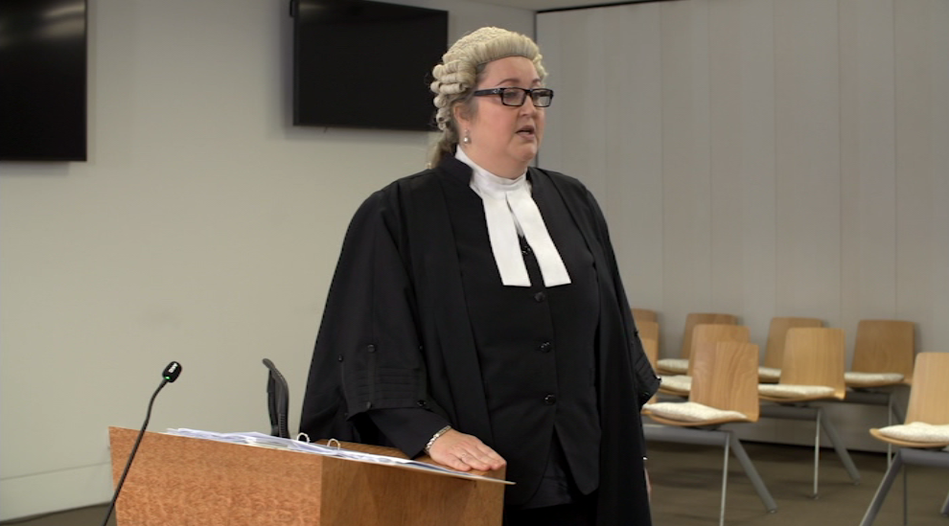
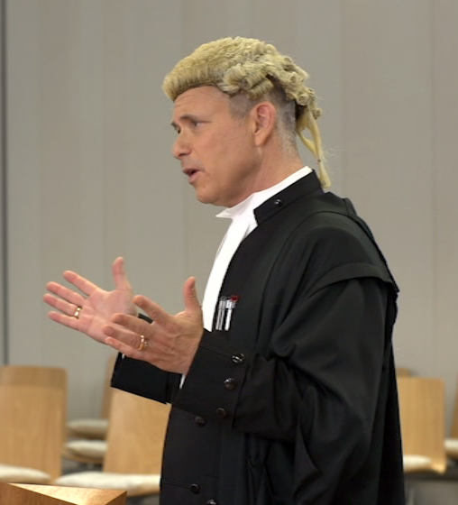
Case materials
3 male complainants: historical claims, institutional child sexual abuse, unacquainted.
Mixed sexual abuse claims:
indecency and/or
sexual intercourse.
Defendant: long-term soccer coach.
Varied number of counts and number of witnesses per claim to produce weak, moderate and strong case facts.

Slide 11
Jury simulation research design
 | Trial | Crown witnesses | Jury directions
1 | Separate 1 complainant 2 counts | 2 (1 neighbour) | baseline
2 |  | 2 with rel evidence | baseline
3 |  | 2 with rel evidence | with rel evid
4 |  | 2 with rel evidence | with rel evid + QT
5 |  | 4 with tendency evid | baseline
6 |  | 4 with tendency evid | with TE
7 | Joint 3 complainants 6 counts | 6 (3 non-complainants) | with TE
8 |  | 6 (3 non-complainants) | with TE + QT
9 |  | 4 (1 non-complainant) | with TE
10 |  | 6 (3 non-complainants) | baseline

Slide 12
Results
Notes:
15 minutes and one third of the way through slides

Slide 13
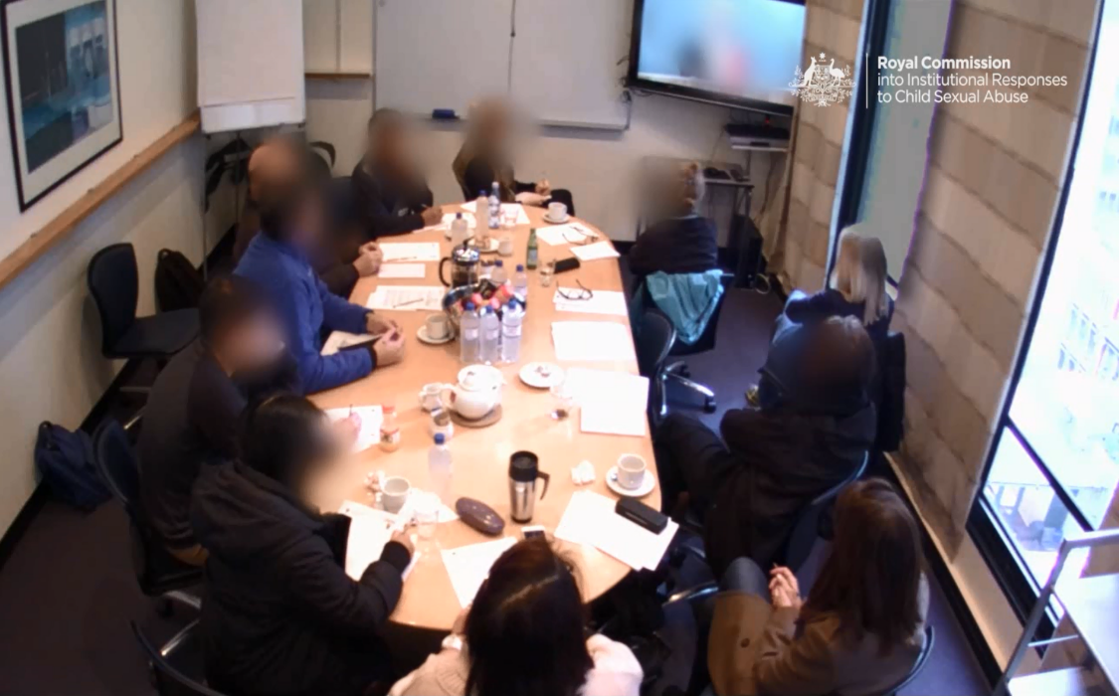
Mock juror sample
Characteristic (percent) | Royal Commission study | NSW Dept of Justice jurors
Sample (N) | 1029 | 9989
Gender
Men | 44 | 53
Women | 56 | 47
Age group
18-29 | 25 | 20
30-39 | 17 | 16
40-49 | 16 | 19
50-59 | 23 | 22
60+ | 19 | 23
Employed | 70 | 71
Closely matched NSW jurors
  fewer men
  more jurors 18-29 years

Slide 14
Mock juror factual accuracy by trial type
Factual accuracy measure:
6 multiple choice Qs, e.g.,
‘Timothy said defendant touched him:
  a. when Timothy tried on his uniform
  b. after Timothy stayed at his house overnight
  c. after he pushed him into the swimming pool’
Averaged one more error as trial length and complexity increased.
Across all trials, individual mock jurors with more errors more likely to convict.
Error rates not associated with joinder.
Notes:
Half-way point? 6:08 to 6:10pm 1 v 2 v 5 v 10 We also looked for factual conflation among individual jurors by trial type, using 6 tricky multiple choice questions that mixed the facts from all 3 complainants. These we answered immediately after deliberation ended. Again the impact of complexity rather than joinder per se affected jurors’ accuracy, which was lower on average by 1 Q in tendency evidence and joint trials. At the juror, but not the jury level, overall, across all trials, individuals who made more mistakes on these Qs were also more prone to convict, but this pattern was not associated with any one type of trial.
Defense counsel who rely on jury confusion hoping to secure acquittals may be surprised that errors and convictions were associated.

Slide 15
No verdict based on inter-case conflation
Inter-case conflation measure:
Coded all fact errors in deliberation.
Inter-rater and intra-rater reliability.
More intra-case than inter-case errors.
One third of deliberations error free.
Few juries with 3 or 4 errors (7.7%).
Errors corrected in deliberation (82%).
No uncorrected inter-case errors.
Errors due to complexity not joinder.
Corrected in both TE and joint trials.
No verdict out of 90 based on inter-case errors.
Notes:
To assess whether the juries could keep the facts straight after hearing from witnesses about multiple offenses in both separate and joint trials, especially when the volume of information more than doubled from 45 mins basic separate trial to 110 minutes in joint trial from 2 Crown witnesses to 6, we had research assistants code the written transcripts of deliberations of all 90 juries to record all factual errors. One third of the deliberations were entirely error free, including some juries exposed to the most complex trials. The rate of errors in discussion was 1-2, 7 juries had 3 or 4 errors. 2 important findings emerged: first, almost all errors were corrected by other jurors 82%, and no uncorrected errors were intercase-confusion of facts about one complainant with another. No increase in joint over separate trials with TE. The key outcome was that not one of the 90 verdicts was premised on intercase evidence confusion. No verdicts was the result of prejudice arising from factual conflation.

Slide 16
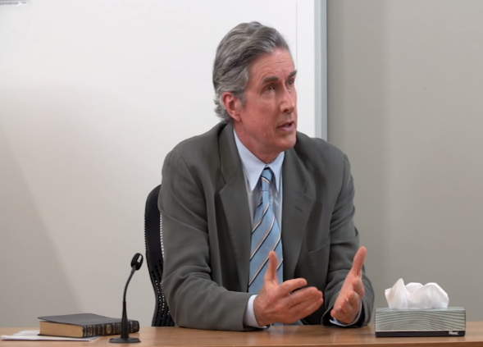
No verdict driven by character prejudice
Deliberation coding revealed:
2 out of 1029 jurors made biased comments
No juror did so in TE or joint trials.
Mock jurors self-monitored bias.
JUROR 4: To me, it sounds like a paedophile who goes free and I can’t accept that.
JUROR 9: We are not supporting him as a paedophile. What we are saying is there is not enough evidence to say that he committed the act for this case.
(Jury 44, separate trial, acquitted)
Notes:
The incidence of character prejudice against the defendant (photo)was tested at the jury level by scrutinising the comments by jurors in deliberations. Very few jurors made comments reflecting bias -2 out of 1029, and those were in separate trials or relationship evidence trials, not TE and joint trials. The excerpt from deliberation shows how others on the jury dealt with this comment by juror who related that her son had been sexually abused by a paedophile. Might have been excused from actual trial. In this case, her views and the story she related did not sway the jury emotionally to convict.

Slide 17
Criminal intent of defendant and juror verdicts
Measure of criminal intent:
4 post-trial items about defendant
(1=strongly disagree, 7=strongly agree)
  abused the trust of others
  abused his position as a coach
  responsible for what happened
  a risk to other boys
Principal Components Analysis score.
Odds of conviction 2.5 times greater when mock jurors perceived that the defendant had more Criminal Intent
Notes:
1 v 2 v 5 v 10 Looking at the same trials this figure displays the individual juror verdicts, gather post-deliberation. You can see that the pattern is the same, but conviction rates slightly higher as is typical if you compare group versus individual verdicts. Another measure we used to gain insight into juror reasoning was their views of the defendant’s intentions, which had to be inferred from the oral evidence. This is a psychological not a legal measure of criminal intent. Scores for answers to 4 questions about the defendant’s behaviour were summed based on a statistical procedure, PCA, to derive a single criminal intent measure. In this figure in each trial group the average scores for inferred intent of jurors who voted to acquit the defendant are shown in blue, and those of jurors who voted to convict the defendant are shown in pink. The pattern of the conviction rates, and of the perceived criminal intent converge as more inculpatory evidence was admitted at trial, irrespective of whether the jurors ultimately voted to convict or acquit. The higher rates of perceived criminal intent by convicting jurors is an indicator of the logical relation between inferences from the evidence and the jurors’ individual verdicts. A higher ratings of inferred intent was a predictor of a vote to convict.

Slide 18
No verdict based on accumulation prejudice
Measures of cumulative impact:
Deliberations coded by lawyers.
Compared tendency evidence and joint trials:
Verdicts for 3 complainants/witnesses.
Factual culpability ratings for all.
No reduced onus of proof with more counts or witnesses: 2 out of 1029 jurors applied a lower standard (balance of probabilities)
Deliberations centred on the weak claim, not glossed over, many acquittals. Convincingness predicted convictions: odds 1.7 times greater when convincing.
No significant difference in conviction rates for focal complainant in
tendency evidence v joint trial or
4 v 6 Crown witnesses in a joint trial.
Notes:
7 v 9 To assess the hypothesis that juries are overwhelmed by the cumulative number of counts or witnesses in a joint trial, deliberations were coded to assess accumulation prejudice among juries in reaching a verdict. The results showed that juries did not reduce the onus of proof when assessing more counts or evidence from more Crown witnesses – 2 mentions by individual jurors, not in TE or joint trials. Of particular interest was how juries would treat the weak claim – would this complainant get a ‘free ride’ based on the evidence against the defendant from other complainants. We saw in a previous figure (15) how conviction rates in joint trials were lower for the weak complainant – 25% vs 75% and 100% for moderately strong and strong claims. The deliberation analysis showed that in joint trials, the juries spent most time on the questionable claim, and did not gloss over the weaknesses, acquitting on that count. When they did convict, it was for a reason logically related to the evidence of that complainant—they rated his evidence more convincing. Conviction rates for the focal complainant were the same, statistically, whether juries assessed that evidence in presence of 2 or 6 counts, or 4 or 6 Crown witnesses. No verdicts were based on accumulation prejudice.

Slide 19
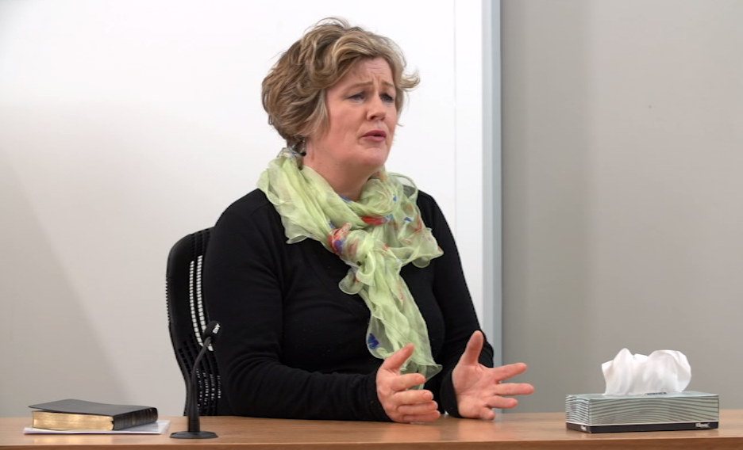
Assessing credibility
JUROR 3: | I don't like thinking of what one person said or the other person said as evidence. It is just "he said/she said". To me, there is only one thing that actually counts as evidence and it is the female, Mrs‑‑
JUROR 5: | The townhouse.
JUROR 3: | That is actual evidence. She has no motive whatsoever …
JUROR 5: | That's right.
JUROR 3: | -- and it is not the victim or the defendant. Everything that the victim says-- to me, that's not evidence. That is just a testimony; and everything that the defendant says, it is just a testimony. So, I don't consider any of it to be fact.
(Jury 15, relationship evidence trial, acquitted).
JUROR 6: Well, if you are going to accuse someone of that, you have to have more than just one other person's word
(Jury 57, relationship evid trial, convicted).
JUROR 11: Thank God they brought in that credible witness.
JUROR 6: There’s no motive or angle either way.
(Jury 77, joint trial, acquitted 1, convicted 2-6).

Slide 20
Credibility of the focal complainant by trial type
Credibility measures:
18-item Observed Witness Efficacy Scale (score 1-5), e.g., ‘behave naturally’; ‘remain calm under cross-examination’; 2 factors: Poise, Communication style
‘The complainant was convincing? (1=strongly disagree, 7=strongly agree)
Convincingness predicted verdict: odds of conviction 2.7 times greater when complainant rated more convincing.
Credibility assessed in context, logically related to inculpatory evidence admitted.
Notes:
6:15 – 6:20 pm Trials 1 v 2 v 5 v 10 (basic directions)
To explore juror reasoning in more depth, we asked them to rate the credibility of the focal complainant in a number of ways. We used a validated scale, with 18 items. the Observed Witness Efficacy Scale which has 2 factors, Poise and Communication Style. We also asked whether the complainant was convincing, rated on a 7-point scale. Results showed that the focal complainant’s credibility varied by type of trial, lowest in the separate and relationship evidence trials, and increased as more inculpatory evidence against the defendant was introduced by the complainant himself, other witnesses or co-complainants in a joint trial. These assessments were further evidence of a logical response to the probative value of the inculpatory evidence.
The defendant by the way, was rated equally convincing in the separate trial, tendency evidence and joint trials, and less convincing in the relationship evidence trial.

Slide 21
Verdict for 2 counts in tendency evidence trial and 6 counts in joint trial
Notes:
5 & 6 v 7 & 10 – 400 mock jurors over 37 juries In TE vs joint trials, the evidence was same, number of counts differed. We gathered factual culpability ratings in both. Dark blue is likelihood defendant committed acts (uncharged) in TE trial and light blue is likelihood the defendant committee the same acts, in joint trial, charged. Notably similar, no significant difference between them though a little higher in joint trial. Identical for the weakest claim in both trials, no difs moderate claim, sig higher in joint trial for strong claim. Show that mock jurors did not react in a markedly different way when cases were formally joined compared to separate trial with tendency evidence. Pink bars are jury conviction rates in joint trial for all six counts. Not uniform, counts distinguished, lower conviction rates for 2 penetrative offences, higher rates for indecency counts. Statistically there is a trend towards a joinder effect in comparing the conviction rates for moderately strong complainant, lower on average in TE than joint trial, but did not reach significance. 59% vs 75 and 88%. Arguably on closest tested comparisons, there was no joinder effect per se, and our study results are like those of several other joinder studies in that respect, no effect or mixed outcomes. The compelling question is what underpins these outcomes -- is it unfair prejudice or some other basis. Turn to that next.

Slide 22
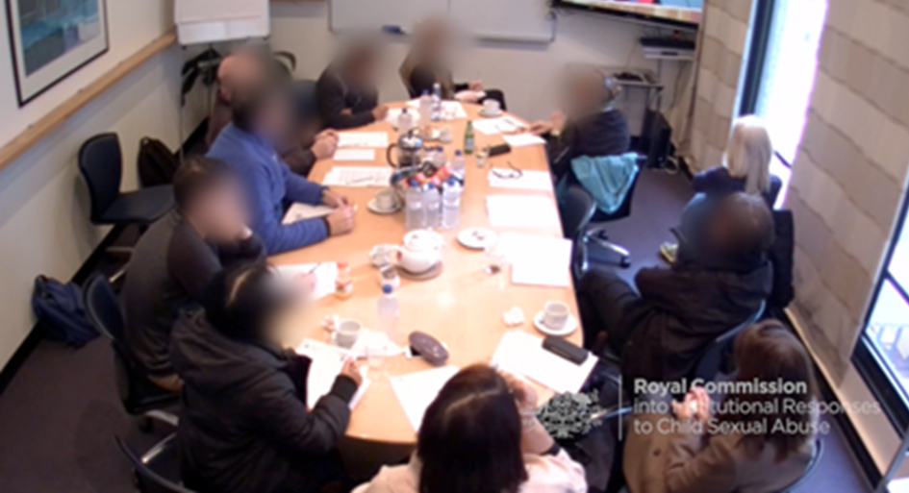
Assessments in joint versus separate trials
JUROR 9: Based on the current evidence, which is basically his word against his word, there’s not enough evidence to convict beyond reasonable doubt.
JUROR 13: There is a history. So, there isn’t just a one-off incident. Something triggers it, and it could come back time and time again. For him to be the only boy—uhm—he could have gotten other people that played soccer with him, and asked, “Has this happened to you?” No other boys were interviewed. So, I mean, a one-off? I don’t know. Paedophiles normally have a habit of repeating ...
(Jury 33, separate trial, acquitted).
JUROR 1: ... If we need more information, then there's doubt.
JUROR 9: .. I'm still 90% sure he was telling the truth, but there's still that 10% where I'm like, “mmm, I'm not too sure". So that's why I can't say …
JUROR 1: Can't be 100%.
(Jury 70, joint trial, acquitted 1, convicted 2-6).

Slide 23
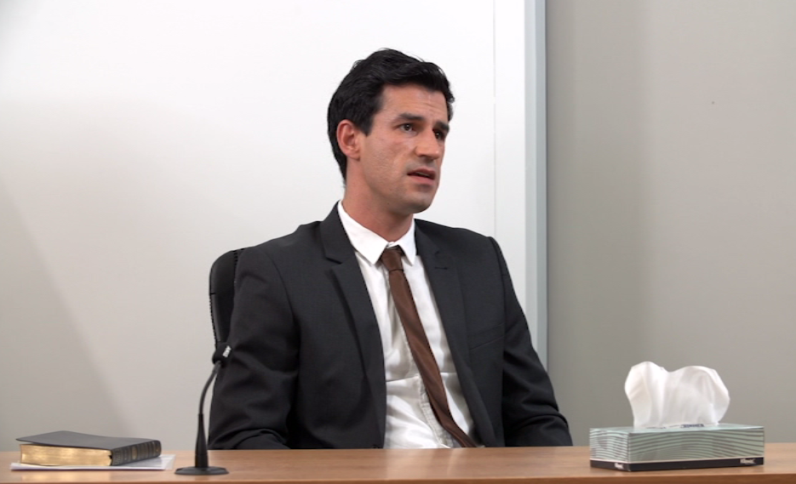
Verdict by type of trial for the moderately strong case
Factual culpability measure:
‘How likely is it that the defendant:
masturbated TL’s penis?
inserted his finger into TL’s anus?’
(1=very unlikely, 7 = very likely)
Verdict measure:
‘Are you satisfied beyond reasonable doubt that the defendant:
masturbated TL’s penis?
inserted his finger into TL’s anus?’
Notes:
37 juries, 9 per trial group (1 v 2 v 5 v 10 with basic directions)
Start by comparing verdicts in the 4 types of trials for the 2 counts of the focal complainant with the moderately strong claim whose evidence in 3 trials was invariant – gave evidence of additional uncharged acts in RE trial. These are averages of about 9 juries per trial type. Group verdicts are shown red for the count of sexual intercourse, and in pink for count of indecency. Conviction rates in the separate trial and RE trial are very low, zero for the penetrative offence. With more inculpatory evidence from other victims, whether as witnesses or co-complainants, the conviction rate escalated dramatically and significantly. However, there is no significant difference with a joint trial, despite higher averages in joint trial. Technically, no joinder effect. These group findings are contrasted with individual juror ratings of the likelihood that the defendant committed the act in issue, on a scale of 1-7, shown in blue lines for each c0ount, lighter blue for nonpenetrative offence and darker blue for the penetrative offence. As you can see, individual juror ratings of the defendant’s culpability are around 50-60 per cent in separate and RE trials, and up to 80-90% range with TE, showing first, that the likelihood estimates increased as more supporting inculpatory evidence was provided, whether by the same complainant, or by other victims, but more so by others. Second, the FC ratings are in line with the verdicts.

Slide 24
Mock jurors’ key reasons for conviction
Measure of individual reasoning:
‘What was the main reason for your verdict?’
Open-ended response, post-deliberation.
Coder blind to study aims and conditions.
Assumed prejudice if ambiguous.
Key reason (per cent) | Sep trial | Rel evid trial | Tend evid trial | Joint trial | Total
Witness consistency | - | 16 | 47 | 35 | 35
Strong evidence | 75 | 53 | 24 | 33 | 34
Pattern of grooming | - | 11 | 20 | 21 | 19
Def evidence weak | - | 10 | 2 | 2 | 3
Character prejudice | - | 3 | 3 | 3 | 3
Tendency evidence | - | - | 3 | 4 | 3
Defendant behaviour | 25 | 8 | 1 | 2 | 2
Accumulation | - | - | - | 1 | 1
Total (n = 489) |  |  |  |  | 100
Very low incidence of character and accumulation prejudice: 3%.
Focus in TE trials and joint trials was witness credibility and evidence strength.
Reasons for verdicts were logically related to evidence.
Notes:
Whether jurors were motivated to convict by character prejudice was cross-checked at the individual juror level by asking every juror to specify the main reason for his or her verdict on the posttrial questionnaire. This was an open-ended question, post-verdict. All 1029 responses were coded, blind to trial type by a researcher unacquainted with the case facts. In this table by trial type, we summarised the 8 themes or clusters of reasons that emerged from mock-jurors who voted to convict (even if their jury was hung) about 500 in all. We specifically looked for instances of character prejudice. An example coded this was: “The defendant seemed like a homosexual” Hard to tell in some instances if summary reason was results of appropriate TE reasoning in deliberation, but we coded ambiguous answers as prejudicial. These analyses showed that the percentage of responses in this category was exceedingly low, 3%, and was not higher in joint trials. Most convictions were based on assessments of the evidence strength and witness consistency, accounting for 70% of the verdicts, and another fifth relied on the evidence of the grooming of the complainants by the defendant. The reasons given by trial type were related to evidence presented in those trials.

Slide 25
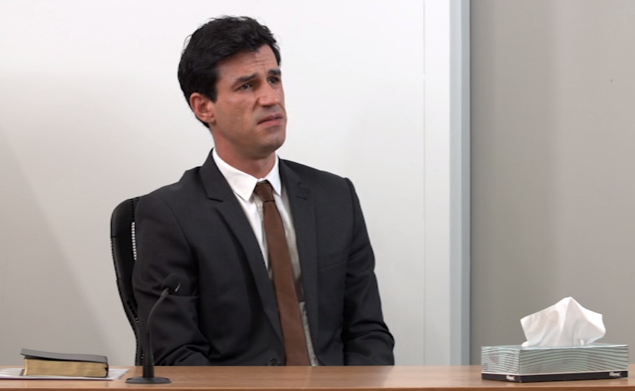
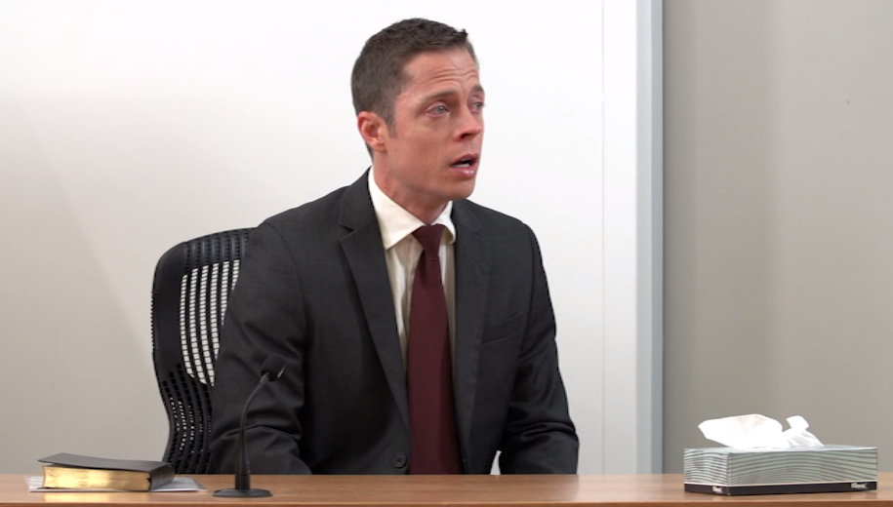
Reticence to convict for most serious counts
JUROR 6: You have also got to think ‘This is sexual intercourse.” The previous three have just been acts of indecency, and they are a big difference. ... So, Timothy has also got two things against him; it doesn't mean that he's said the truth in both cases. Again, I am thinking it is a big jump from indecency to sexual intercourse.
JUROR 5: Yep.
JUROR 6: Even though we agree that Mr Booth is a predator with indecent assault, with the mother being in hospital and the child being that upset, I couldn't see Mr Booth going that extra step to sexual intercourse‑‑
(Jury 60, joint trial, convicted 2, 3, 5, acquitted 1, 4, 6).

Slide 26
Jurors rated joint trials as more fair to the defendant than separate trials
Post-deliberation measures of fairness:
‘The trial was fair to the defendant’
‘The judge’s instructions were fair to the defendant’ (1=strongly disagree, 7=strongly agree)
‘We would have been informed if other charges were made against the defendant’‘ (Yes/No)
‘What number 0-100% represents "beyond reasonable doubt’?’
The separate trial was rated less fair to the defendant than the tendency evidence trial and joint trial.
The judge’s directions in the separate trial were rated less fair than those in the joint trial.
Mock jurors had greater expectations to be informed of other charges against the defendant in the separate (62%) than the joint trial (55%).
The threshold for ‘beyond reasonable doubt’ was more stringent in the joint than a separate trial.
Notes:
1 v 3 v 6 v 7 (special jury directions); We further explored the fairness of the trials by directly asking mock jurors whether they thought the trial was fair to the defendant, whether the judge’s directions were fair to the defendant, and whether they expected to be informed of other charges made against the defendant. We compared the responses from each trial group. Surprisingly, the mock jurors in the separate trial rated that trial as less fair to the defendant (4.95) than their counterparts rated the joint trial (5.75), and similar results were obtained regarding the perceived fairness to the defendant of the judge’s directions . Significantly more jurors in the separate trial expected that they would have been informed had they been other charges of misconducted or prior offending by the defendant. From the lack of information, they infer there are none and that the allegations of the complainant in a separate trial are isolated, or that the complainant is not truthful. Finally, when we compared self-reported numerical standards of BRD, they were significantly lower in the separate than the joint trial , by 7% 85.2 significantly lower than 92.1 (average 89%) . Not entirely sure how to interpret this last finding, but what is noteworthy is that it controverted the hypothesis that mock jurors apply a lower threshold of proof in the joint trials, and supported our observations of jury deliberations showing no such trend. In sum, multiple quantitative indicators, as well as some comments in deliberations, conveyed the mock-jurors impressions that separate trials were less fair to the defendant than joint trials.

Slide 27
Discussion
Notes:
15 mins left

Slide 28
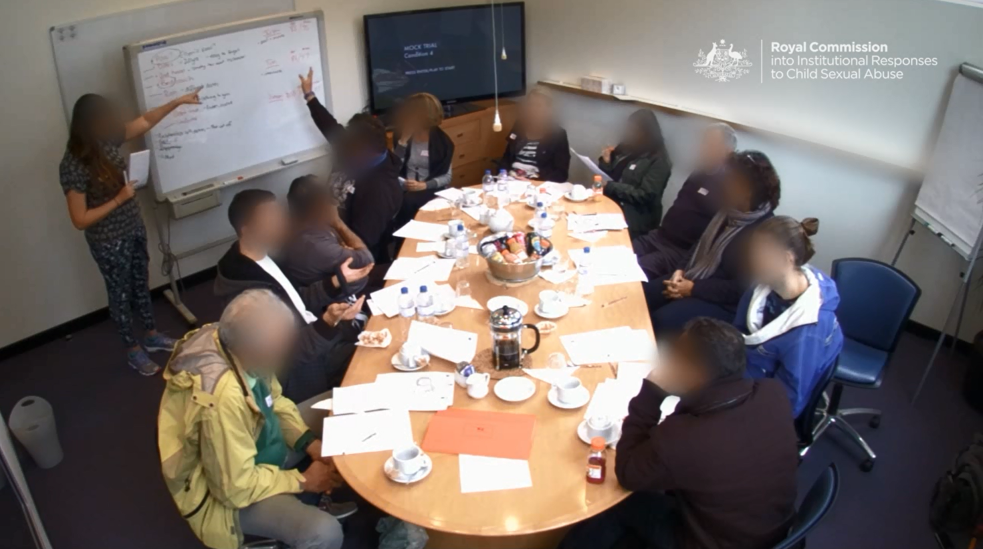
Notes:
End of part 5 of talk

Slide 29
Conclusions
Mock juries were capable of distinguishing between counts, and basing verdicts on the evidence that pertained to each count.
Jury reasoning logically related to the probative value of the evidence.
While some individual jurors made errors, by and large, juries did not.
A complainant’s credibility was enhanced when supported by evidence from an independent source, in both separate and joint trials.
The key to jury verdicts was the credibility of the complainants.
The same benefit to a complainant’s credibility was obtained by admitting tendency evidence whether in a separate and a joint trial.
Conviction rates in joint trials and tendency evidence trials exceeded those in basic separate trials and relationship evidence trials, but there was no evidence that this increase was due to impermissible reasoning.
Given that verdicts were not based on impermissible reasoning, there was no unfair prejudice to the defendant from the joinder of charges.
Notes:
“the probative value of a piece of evidence depends on what other evidence exists in a case

Slide 30


Acknowledgements
Research Assistance |  | Actors | Expert Advice
Rowena Dench | Marco Olea | Nicole Abbey | Nigel Balmer
Rhiannon Fogliati | Rohan Lulham | Bernadette Cranage | Eunro Lee
Megan Fraser | Ida Nguyen | Stephen Geronimos | William E Foote
Karen Gelb | Stella Palmer | Peter Hayes | Judge Yehia SC
Robyn Goodwin | Christian Teixeira | Judge Hock SC | Video Production
Natalie Hodgson | Erin Warrick | Amanda Marsden | Rocket Productions
Peta Kennedy | Nike Waubert de Puiseau | Daniel McBurnie | Aijt Singh
Alexandra Lonergan | Nicholas Watt | Kara Shead | Joel Hamilton-Foster
Tanika Low | Court Services, NSW | Dean Michael Smith | Paul Pallesen
Melissa Martin | Cathrine D’Elia | John Van Putten | Mock jurors
Jake Miyairi | Michael Talbot | Richard Weinstein SC | Anomaly Stable Research
jdelahunty@csu.edu.au

