Slide 1


Exploring the Sentencing Breaches of Domestic Violence Orders
Christine Bond
Griffith University
c.bond@griffitth.edu.au

Slide 2
What are the patterns in sentence outcomes for domestic violence order breaches over time?

Slide 3
Legislative Context
Stand alone legislation for protection orders in 1989
  With amendments in 1992, 1999, 2002 around scope, recognition of interstate orders, length of order
Large scale more contemporary reforms in 2012 legislation

Slide 4
Community Context
Early 1990s → investments in community services in certain locations
By end of 1990s to early 2000s → court support by end of 1990s to early 2000s
  Urban high volume running separate applications lists
  But breaches remain in general criminal lists

Slide 5
What do we know…?
Differing profiles for those with custodial vs non-custodial
Fines = preferred penalty
Increasing use of imprisonment, but fines remain popular

Slide 6
Current Study
Adult court lower court administrative data
  1994-2012; 2000-2012
  Case-based
Population of breach convictions: 49,321
  12.1% female offenders; 29.3% Indigenous
  Median age 33.5 yrs
  Most common sentence outcome = fine (55.6%)

Slide 7
Current Study
Sentencing outcome
  custodial , probation, other community-based, fine, other
Key variables
  Sex of defendant
  Defendant demographic characteristics
  Legal and case characteristics

Slide 8
Trends in sentence outcomes for DVO breaches
N=49,321 (lower court)

Slide 9
Trends in sentence outcomes for DVO breaches
N=49,321 (lower court)

Slide 10
Trends in sentence outcomes for DVO breaches
N=49,321 (lower court)

Slide 11
Adjusted trends in sentence outcomes for DVO breaches
N=36,569 (lower court)
Multinomial model of sentence outcome net of other demographic, case and legal characteristics.
Within year models, all predicted probabilities significant at p<0.05 . Independent variables set at their means. Robust s.e. calculated to adjust for repeat defendants.

Slide 12
Profile of convicted of DVO breach cases (2000-2001)
N=2,191(lower court)
Relative risk ratios reported, net of age, legal and case characteristics.
Robust s.e. (account for repeat defendants). Models estimated with constant.
n.s.
n.s.
n.s.
n.s.

Slide 13
Profile of convicted DVO breach cases (2011-2012)
N=7,675 (lower court)
Relative risk ratios reported, net of age, legal and case characteristics.
Robust s.e. (account for repeat defendants). Models estimated with constant.
n.s.
n.s.

Slide 14
Increasing disparity?
Table reports 95% confidence intervals for the relative risk ratios
Sub-group | Custodial vs Other |  | Fine vs Other
 | 2000-2001 | 2011-2012 | 2000-2001 | 2011-2012
Indigenous male (vs Non-Indigenous male) | 0.98 -2.07 | 1.56-2.19 | 0.43-0.72 | 0.58-0.76
Indigenous female (vs Non-Indigenous male) | 0.19- 1.70 | 0.38-0.80 | 0.29-0.97 | 0.46-0.72
Non-Indigenous female (vs Non-Indigenous male) | 0.10 -1.03 | 0.15-0.41 | 0.25-1.17 | 0.58-0.80

Slide 15
In short…
Custodial sentences vs fines
Increasing influence of prior history
Indigenous males and custodial sentences

Slide 16
So what?
Explanations
  Prior history as an indicator of risk
Implications
  Broader context may shape sentencing practice?
  Role for specialisation

Slide 17
“Accountability?”
Focus on justice response
Focus on offender response

Slide 18
We need…
Better understanding of judicial perceptions of role of fines
Better understanding of nature of breaches

Slide 19
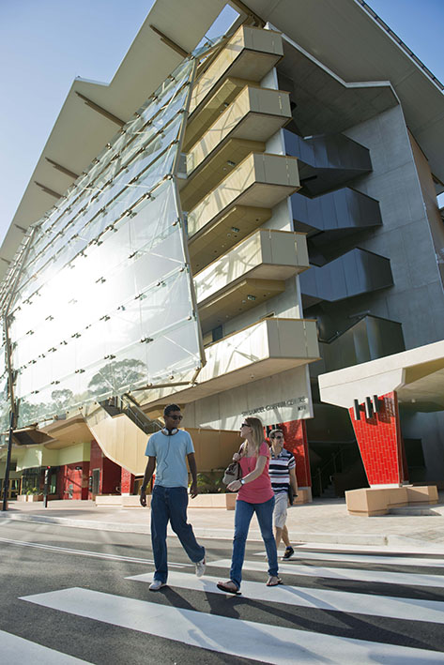
Questions? c.bond@griffth.edu.au
Acknowledgements:
Data collected through funding from an ARC Discovery grant
Shannon Walding for her research assistance

