Slide 1



Australian public opinion & parole
Robin Fitzgerald, UQ; Lorana Bartels, UC; Arie Freiberg AM, Monash; Adrian Cherney, UQ; Shannon Buglar, UQ

Slide 2
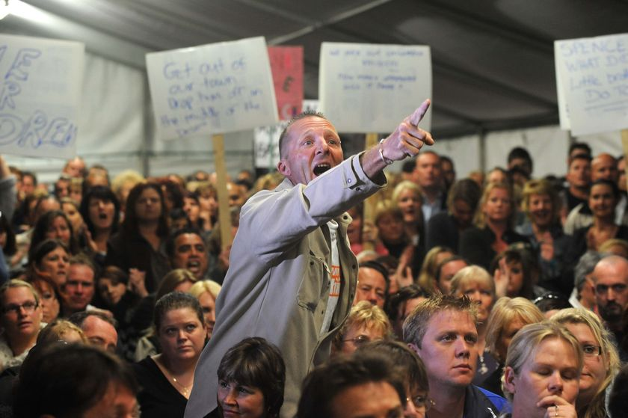
The presumed ‘punitive public’
Penal populism: ‘Allowing the electoral advantage of a policy to take precedence over its penal effectiveness’
Bottoms 1995
‘The public has a tendency to desire and call for harsh treatment of offenders.’
High Court judge Ian Callinan,
Review of Victorian Parole
(2012)

Slide 3
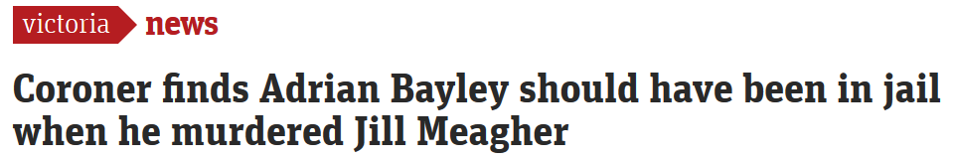
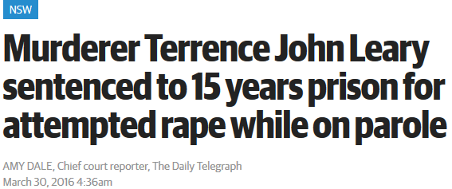
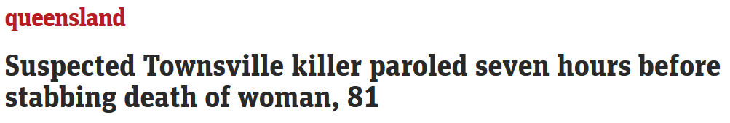

Slide 4
What does the Australian public think about parole?
It’s mixed.
Some support for parole, but there are limits
Mixture of priorities in correctional goals.
Fitzgerald, R., Bartels, L., Freiberg, A., Cherney, A., & Buglar, S. (2016). How does the Australian public view parole? Results from a national survey on public attitudes towards parole and re-entry. Criminal Law Journal, 40(6), 307-324.

Slide 5
Questions for today
Can we identify distinct groups of Australians with unique sets of views on parole, prison and re-entry?
If so, who holds those particular sets of views?

Slide 6
Data: mixed-method
Nationally representative survey
N = 1,200
Telephone
Addresses attitudes toward parole & prisoner re-entry.
Vignette study
N = 30
5 possible parole release vignettes
Asked to make a release decision
Follow-up in-depth interview

Slide 7
The analytical approach
The survey data
Group respondents by their agreement with a range of statements about parole, prison & re-entry (i.e,. correctional goals).
Latent Class Analysis (LCA) is a statistical method for identifying unmeasured class membership among subjects using categorical observed variables.
End product: A ‘typology’ of unique public views on correctional goals.
The interview data
Compare respondents' construction of parole decisions by their identified class.

Slide 8
Australian’s views on correctional goals
Proportion of agreement with statements

Slide 9
We find three subgroups
LCA diagnostic tests indicate the sample can be divided into 3 subgroups with unique orientations toward correctional goals.

Slide 10
Three unique orientations towards correctional goals

Slide 11
Three unique orientations towards correctional goals

Slide 12
Three unique orientations towards correctional goals

Slide 13
Three unique orientations towards correctional goals

Slide 14
What do members of each group believe?
% agreement with statements for each of the 3 classes
Rehabilitator Hybrid Punisher

Slide 15
% grant and deny (interview sample, n=30)

Slide 16
Rehabilitators – Situation rather than choice
I would grant him parole … when you look at his circumstances of what led him to hold up the store in the first place, his ethnicity, economic status, et cetera there would have been – this guy needed a rehab program not jail in my opinion anyway.
Respondent 694: Female, age 38.
Case: Armed robbery
Decision: Grant parole

Slide 17
Rehabilitators – Redeemability
…if someone hurts someone, they can still change. They're still a person, they still deserve a chance to change their life.
Respondent 188: Male, age 66.
…the bottom line is he seems to be trying to change.
Respondent 1264: Male, age 58.
Well it's his first time in prison – and we have a God of second chances.
Respondent 2148: Female, age 58.

Slide 18
Punishers – Respect/Authority
Until he is genuinely remorseful, until he can say look I deserve what I got, I should never have done this, I want to change my life, give some indication of a complete turnaround that would render this person safe, I think he should be kept in there...
Respondent 739: Male, age 66.
Case: Domestic violence
Decision: Deny parole

Slide 19
Punishers – Disgust & Anger
It makes me sick to my stomach that I could be at a park playing with my children and there could be a repeat offender paedophile sitting in the park, and it's like Christmas for them, isn’t it?
Respondent 1: Female, age 40.
Case: Sexual Assault
Decision: Deny parole

Slide 20
Hybrids – Balancing Beliefs
…I think rehabilitation is possible … people can be redeemed and I believe strongly in a second chance … but it’s not a carte blanche thing, so you get one, you take it, you use it and if you don’t treat it with the respect it requires then you’ve lost that and maybe you’ve lost it forever so whilst there’s forgiveness and umm I believe in forgiveness and redemption, justice still needs to be served, so there is a consequence for every action.
Respondent 4: Female, age 48.
Case1: Female burglary, theft, fraud (deny)
Case 2: Male armed robbery (grant)

Slide 21
Concluding thoughts
Misleading to characterise public attitudes as indiscriminately punitive.
Three distinct groups.
The largest subgroup, ‘hybrids’, hold a mixture of views, and present interesting opportunities for thinking about ways of increasing public confidence.

Slide 22
Increasing public confidence…
Results point to the importance of fundamental beliefs or ‘gut reactions’.
A need to increase understanding of emotional responses.
Little evidence indicates ‘facts’ sway opinion on a large scale, or at least any changes may be short-lived.
Future work, we continue to investigate the promise of widely-held belief that people can change (redeemability).

