Slide 1

Economic evaluation of offender treatment programs: A systematic review of the literature with a focus on behavioural studies
Stella Settumba¹
Georgina Chambers², Marian Shanahan³, Peter Schofield⁴, Tony Butler¹
Kirby Institute, UNSW
Centre for Big Data Research in Health, UNSW
National Drug and Alcohol Research Centre, UNSW
University of Newcastle

Slide 2
Presentation Outline
World prisoner statistics
Costs in the justice system
Treatment programs
Economic evaluations of treatment programs
Systematic Review

Slide 3
Prisoner population totals 2000 & 2015
Source: World Prison Brief

Slide 4
Percentage change in global population totals 2000 - 2015
Source: World Prison Brief

Slide 5
Prisoner statistics: Australia
Total prisoner population increased by 80% between 2000 and 2016 (Higher than the 20% global increase)
Prisoner rate is 208 per 100,000 population
Source: Australian Bureau of Statistics

Slide 6
Recidivism
Recidivism is the relapse of criminal behaviour
Globally, approximately 50% recidivism rate within 2 years
Source: Productivity Commission: Report on government services

Slide 7
- Big offender population - Increasing recidivism rates - Large financial strain on society

Slide 8
What are the costs?
Country | Annual Judicial Expenditure (Million USD) | Annual cost of crime (Million USD)
USA | 265,000 | 1,700,000
UK | 12,000 | 91,000
Australia | 12,000 | 51,000
Judicial Expenditure
Police, Prosecutions, Courts, Corrections, other agencies.
Costs of Crime
Justice costs, victim costs, insurance, medical, lost output, intangible costs.
Sources: USA Bureau of statistics (2013), Foundations and trends in microeconomics (2012), UK Min. of Justice (2015), Home Office UK (2000), ROGs (2016), AIC (2011)

Slide 9
Costs in Australia (AUD)
Source: Report on Government Services:

Slide 10
Judicial system and crime costs are substantial.
Economic evaluation studies of programs that reduce offending are needed to efficiently guide resource allocation.

Slide 11
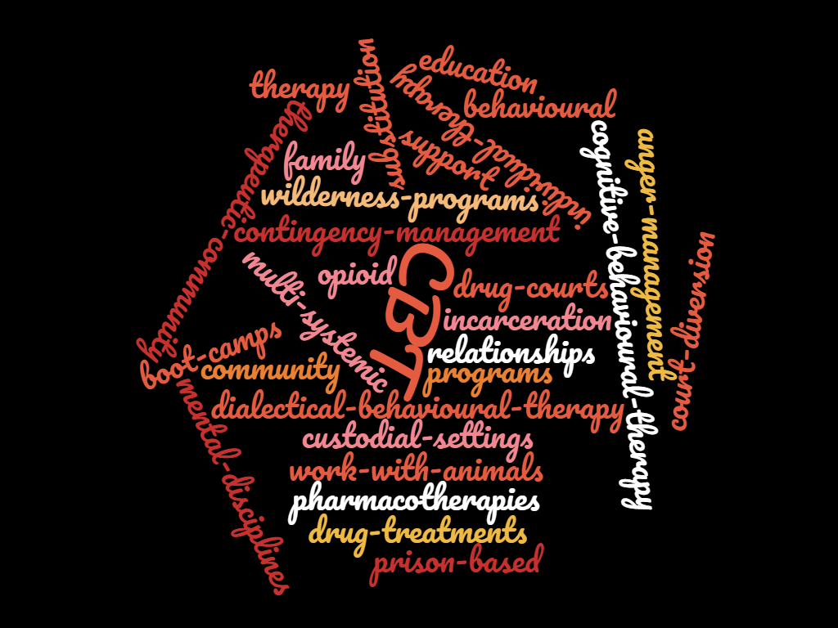
Intervention programs for Offenders
Corrective Services NSW lists at least 34 approved offender behaviour change programs
(Compendium of Offender Behaviour Change Programs in New South Wales, 2016)

Slide 12
Intervention programs
Nothing works
What works
What is cost effective
Review 1945 -1967 (Martinson.1974,
Lipton et al. 1975)
Review 1985 – 2013
(Craig et al. 2013)
This study

Slide 13
Objective of this review
To assess the peer-reviewed literature on economic evaluations of interventions for offenders
What is the scope and quality of economic evaluation studies?
Were the interventions an efficient use of resources?
Notes:
1. a) To assess the scope and quality of economic evaluation studies of offender treatment programs.
b) To assess the cost effectiveness of offender treatment programs from the results of identified studies.
2. a)To determine the cost-effectiveness of SSRIs compared to placebo in improving the quality of life of impulsive, repeat-violent community offenders.
b) To determine the cost-effectiveness of SSRIs compared to placebo in reducing recidivism in impulsive, repeat-violent offenders.
3. a)To assess the characteristics of treatment programs for impulsive violent offenders that could influence the uptake and support choices of offenders and society respectively.
b) To quantify the preferences for and assess trade-offs between characteristics of treatment programs for impulsive violent offenders.
4. a) To estimate the societal and offenders’ average willingness to pay for the treatment of repeat violent offenders using an SSRI.
b) To elicit the factors affecting societal and offenders willingness to pay for offender treatment programs.

Slide 14
Methods
Systematic Review of literature 2003 – 2016 using PRISMA guidelines
Inclusion criteria:
Full economic evaluations
CEA, CUA, CBA, CMA
Both costs and effects
Intervention and comparison group
Intervention group were offenders/prisoners
English
Applied a recommended checklist for quality assessment: Drummond checklist
Synthesis of the results of the economic evaluations

Slide 15
What is an Economic Evaluation?
Economic evaluation is about determining whether an intervention is an efficient use of society's resources and can be defined as the comparative analysis of alternative courses of action in terms of both their costs and consequences (Drummond et al. 1987).
Perspectives:
Provider Perspective
Only includes costs incurred by the provider of treatment services
e.g. Criminal Justice, Intervention provider
Societal Perspective
Broader costs regardless of who meets them
e.g. personal, general population, victim costs

Slide 16
Types of Economic Evaluations
Type of Analysis | Numerator (Costs) | Denominator (Outcomes) | Results
Cost-minimization | $ | - (Proven equal outcome) | Least cost alternative
Cost-effectiveness | $ | Health outcome in natural unit e.g. number of lives saved, number of crimes averted, number of drug free days | Cost per unit of outcome e.g. cost per drug free day
Cost-utility | $ | Quality of life outcome e.g. QALY, DALY | Cost per unit of outcome e.g. Cost per QALY
Cost-benefit | $ | $ | Net benefit ($) Cost: Benefit ratio

Slide 17
Literature search
Multiple databases
Embase, Medline, Cinahl, Cochrane, Tufts registry, Other citation databases
Range of search streams
Mesh terms/Subject headings
Key terms
Prisoners, inmates, offenders, incarcerated, criminal, delinquent, public offenders
Economic evaluation, cost-benefit, cost-effectiveness, cost-utility, cost analysis, cost,
Total number of retrieved articles
802

Slide 18
PRISMA flow chart

Slide 19
Results: Only 17 peer reviewed publications globally

Slide 20
Focus of the 17 studies

Slide 21
Intervention groups

Slide 22
Assessment of Quality of publications
Standard checklist for critical appraisal
Drummond et al, Methods for economic evaluation of health care programs; 2003, 2016
10 Major headings
33 Item checklist
Criteria (Yes, No, Not applicable, Not sure)
Score (% number of Yes scores out of ‘all applicable’

Slide 23
Quality Assessment

Slide 24
Quality Assessment

Slide 25
Quality Assessment

Slide 26
Economic Evaluation results
7 Studies were Cost Benefit Studies
10 Studies were Cost Effectiveness Studies
No CUA & CMA studies
Wide variations in methods:
Costing perspectives
Follow-up period
(6 months – 5 years; 25 years for models)
Type of costs included
Outcome measures
e.g. among substance abuse studies (Drug free days, re-incarceration during follow up, number of days incarcerated, Number of offences committed, etc)

Slide 27
Cost-Benefit Analysis Results
3 Substance Abuse
Perspectives: 2 Societal, 1 provider
Intervention group: 1 men, 1 men & women, 1 Juvenile
Education & residential treatment vs education only
Drug court vs probation & parole/ Incarceration
MST vs IT
1 Sexual Abuse (Juveniles)
Perspective: Societal
MST vs IT
3 Violence (Juveniles)
Perspectives: 2 societal, 1 provider
Specialised mental health treatment vs usual treatment in corrective services
MST vs IT
MST vs IT (Longer follow up)
Positive net benefit or a cost-benefit ratio < 1

Slide 28
Cost-Effectiveness Analysis Results
9 Substance Abuse, all provider perspective
Intervention group: 3 men, 4 men & women, 2 Juvenile
5 were cost-effective
In prison drug treatment + after care vs drug treatment alone (2 studies)
Adult Drug court vs probation & parole/ Incarceration
Juvenile Drug court + MST+ Contingency management vs Family court
Post release opioid substitution therapy vs no treatment
In prison drug treatment + after care (short) vs drug treatment alone
Seamless probation vs traditional probation
Motivational enhancement therapy vs Individual counselling (with and without contingency management)
Prison methadone treatment vs no treatment

Slide 29
Cost-Effectiveness Analysis Results
1 Personality disorders
Men
Dangerous severe personality disorder program (CBT with Dialectical therapy) vs usual treatment
Not Cost effective

Slide 30
Conclusions
Few studies
11 cost-effective/net-benefit.
We need more evaluated to inform policy on efficient use of resources
Quality of studies needs to be improved
Billions Spent
Many programs
Program Effectiveness established
Economic Evaluations

Slide 31

Are you evaluating your programs?
OPTION A
OPTION B

