Slide 1

Are our young people out of control…and do we even know?
Paul Mazerolle, Samara McPhredran, Christine Bond
Griffith University

Slide 2
Background
Juvenile offending – long recognised as a significant social, health, and justice concern.
1990s onwards – expansion of evidence base.
Knowledge about modifiable influences on juvenile offending now spans biological, demographic, cultural, situational/environmental, and socioeconomic spheres.
Particular focus has been given to better understanding the wide range of risk and protective factors associated with the onset, characteristics, and persistence of juvenile offending.
Knowledge about pathways to and from offending, and ‘trajectories’ of offending, has grown substantially.

Slide 3
Public/media perceptions
Concern about juvenile offending – especially when it involves violence – and the consequences for individuals, families, and communities.
Concern about the nature of the problem – its scale and scope – and appropriate responses.
High-profile incidents (e.g., ‘one punch kills’) gain intense attention and drive calls for ‘change’.
Emotive, sensationalised media coverage creates an impression of crisis.
Perceptions of increased juvenile offending, with violence a key focus.

Slide 4
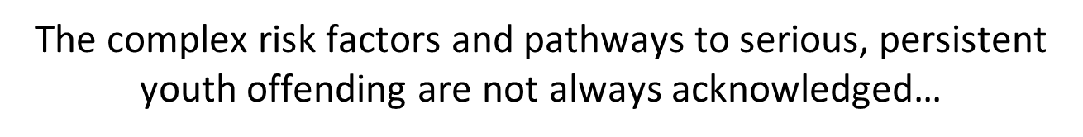
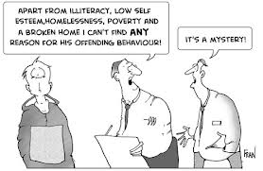
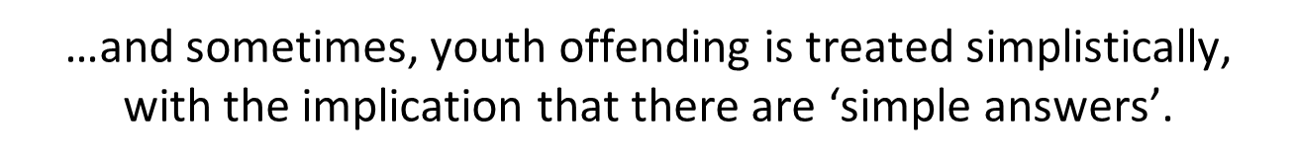

Slide 5
Political/policy context
Steady flow of political discourse around juvenile offending and youth violence in particular.
“System has gone soft”…“Tough new laws”… “Commonsense approach”.
Range of policy interventions, typically underpinned by legislation.
Legislative changes introduced concerning the range of sentencing options that can be applied to young offenders (e.g., QLD – “boot camps”)

Slide 6
Reality, or moral panic?
Despite providing impetus for legislative/policy change, it is unclear whether perceptions of an upwards trend in Australian juvenile offending (offending by persons aged 10-17 years inclusive) are supported by objective data.
Many studies into specific aspects of offending and specific samples, but a relative absence of epidemiological research.
Without epidemiological information, responses to juvenile offending may not be proportional to the magnitude of actual problems, and/or may be inappropriately designed and targeted.
Raises the possibility of resource misdirection and policy failure.

Slide 7
Unanswered questions
Is juvenile offending or delinquency increasing?
Is violent offending, in particular, on the rise?
Have overall offending rates changed? If there are observed changes over time in juvenile offending, are these ‘real’ changes, or are they attributable to changing crime data recording practices, and/or police responses?
Do overall trends disguise changes in particular ‘sub-types’ of offending within a specific offence type?
Can we say anything meaningful about the prevalence of offending, at the general population level?

Slide 8
The present study
Using multiple data sources, the present study seeks to assess, from an epidemiological perspective, whether there is convincing evidence for changing (upwards) trends in Australian juvenile/youth offending.
Particular emphasis is given to violent offending, as this form of offending typically attracts significant concern and drives policy change.

Slide 9
Initial cautions about data…
Official (administrative) statistics – Police records (whether released by police, or provided for use by other agencies e.g., ABS), Childrens Courts…
Data availability, detail, and frequency of collation/release varies greatly over time, both within and across jurisdictions, as well as at the national level.
Unit of measurement/counting rules for some datasets make comparability difficult – ‘offences’ or ‘offenders’?
Self-report datasets on offending prevalence/frequency – very few available! Typically small-scale and ‘one-off’.

Slide 10
Official (administrative) statistics

Slide 11
Historic trends - overview
Throughout the 1980s and 1990s, official statistics were used in a range of Australian studies and suggested increasing violent delinquent behaviour in particular.
E.g., in Victoria, in 1986-1987, 4.9% of all juvenile arrests were for violence. This rose to 8.9% in 1995-1996. In Queensland, at the same time periods, violent offending accounted for 4.7% and 9.3% of juvenile arrests (Mukherjee, 1997).
Similar observations across jurisdictions for the early to mid 2000s, using Australian Bureau of Statistics data.

Slide 12
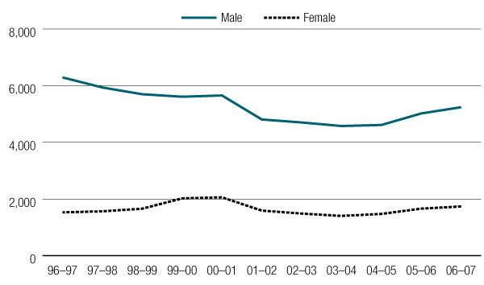
Historic trends
Juvenile offenders from 1996–97 to 2006–07, by sex
(per 100,000 juveniles of that sex per year)
From: Australian Institute of Criminology (2009), Australian Crime: Facts and Figures 2008.

Slide 13
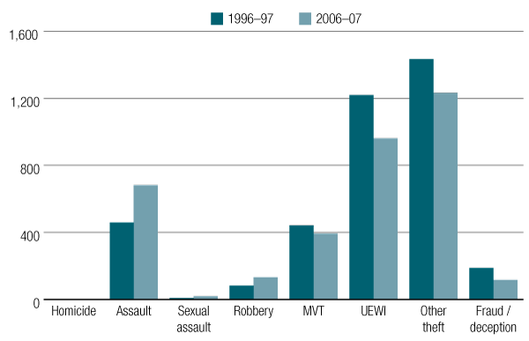
Historic trends
Juvenile offenders in 1996–97 and 2006–07, by offence type
(per 100,000 juveniles per year)
From: Australian Institute of Criminology (2009), Australian Crime: Facts and Figures 2008.

Slide 14
Historic trends
Violent offences as a proportion of total offences (NSW)
Males
Females
15-19 year olds
10-14 year olds

Slide 15
Historic trends
Violent offences as a proportion of total offences (VIC)
Males
Females
15-19 year olds
10-14 year olds

Slide 16
Historic trends
Violent offences as a proportion of total offences (QLD)
Males
Females
15-19 year olds
10-14 year olds

Slide 17
Historic trends - summary
Small decline in overall offender rate among juvenile males from the mid 1990s-mid-2000s
Some modest signs of an increase in female juvenile offender rate.
Evidence for an increase in the proportion of offences involving violence.

Slide 18
The current situation

Slide 19
Number of offenders, all offence types
Year
Source: ABS

Slide 20
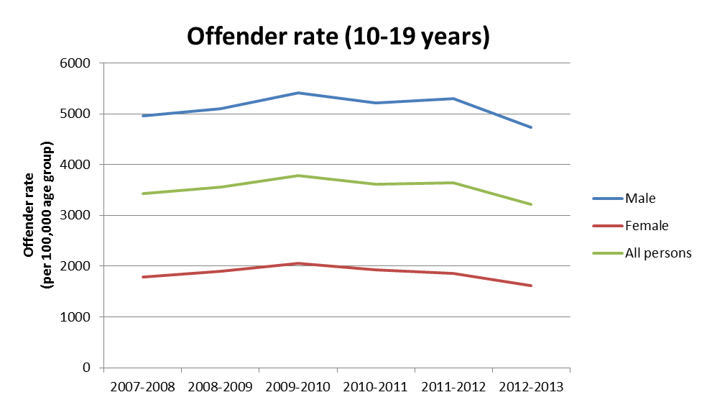
Offender rate, all offence types
Year
Source: ABS

Slide 21
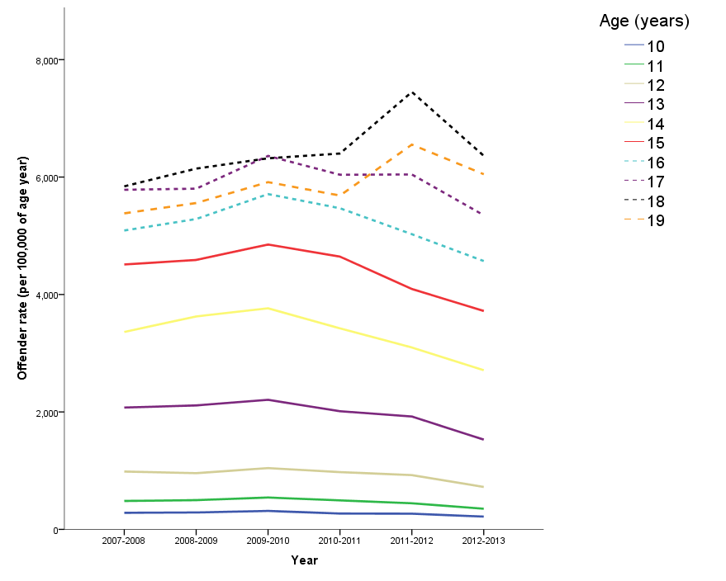
Offender rate, by single year of age
Source: ABS

Slide 22
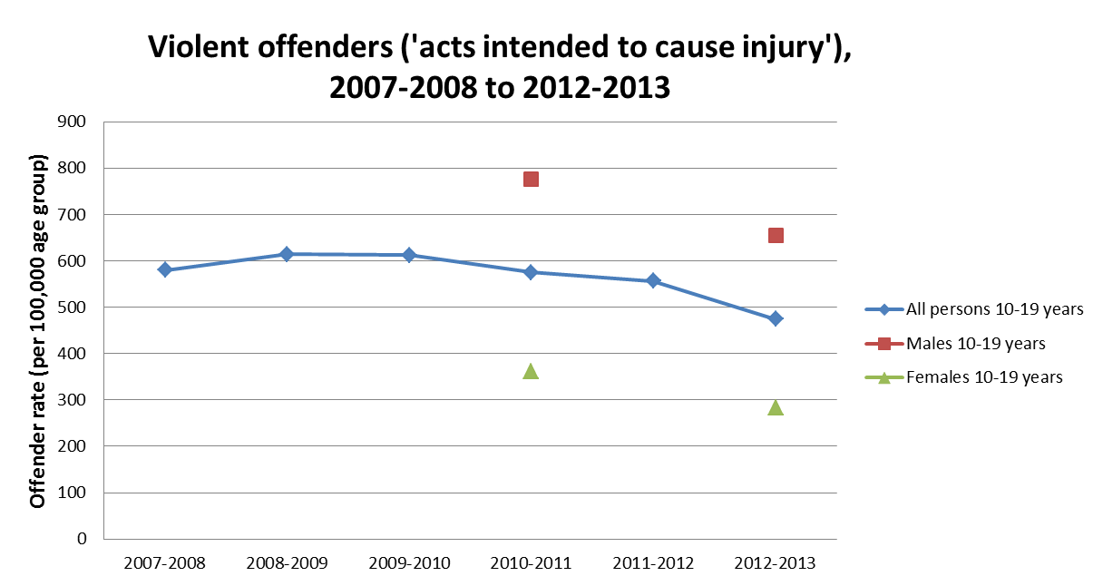
Violent offender rates, by broad age group
Year
Source: ABS

Slide 23
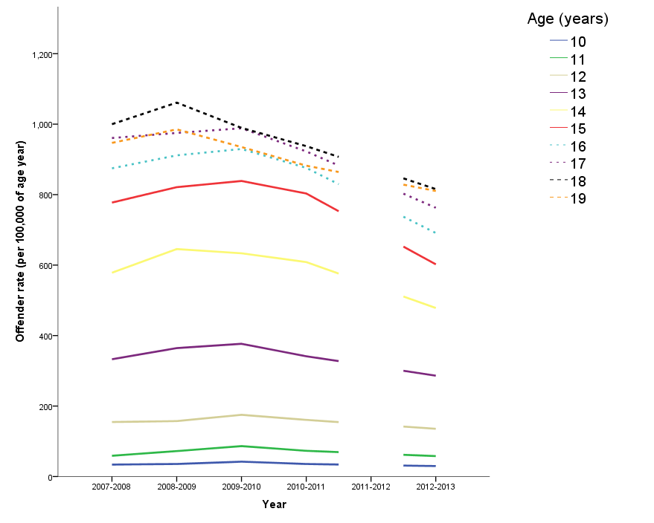
Violent offender rate, by single year of age
Source: ABS

Slide 24
Childrens Courts data
Year
Source: ABS

Slide 25
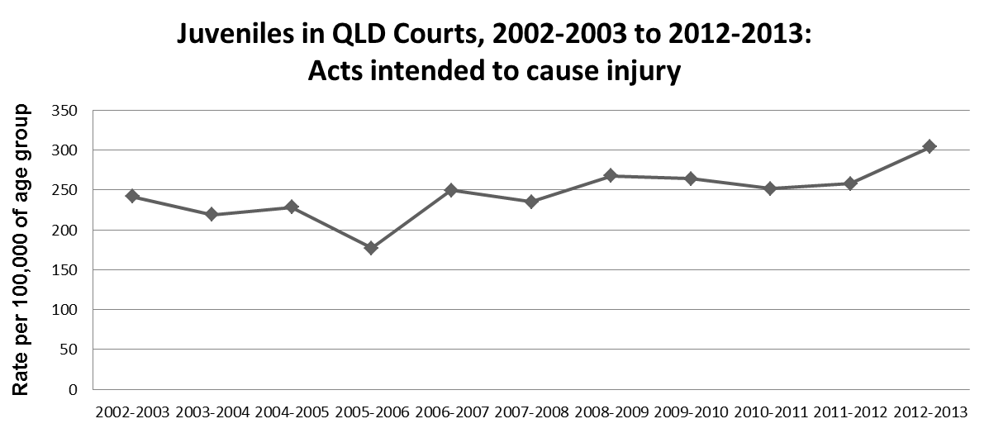
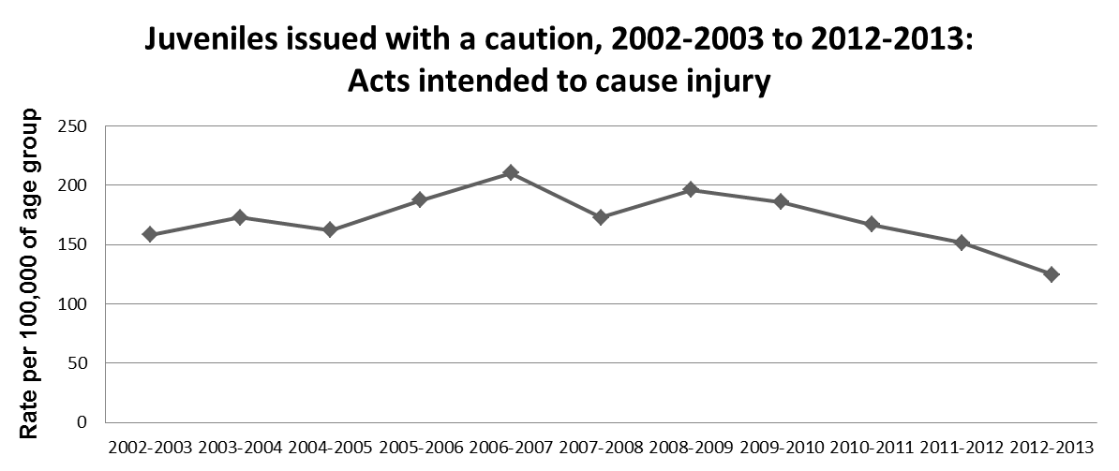
QLD court and police statistics
Changes in policing practice?
Source: Childrens Court of Queensland
Note: Ages include 10 to 17 years

Slide 26
Offence type classification: a hidden story emerging in the details?
Offending among 10-17 year olds, NSW, 2009-2013
Offence | Trend & average annual percentage change over last 60 months from Jan 2009 to Dec 2013
Murder | Not calculable
DV related assault | 4.2
Non DV related assault | -11.8
Sexual assault | Stable
Indecent assault, act of indecency and other sexual offences | Stable
Robbery without a weapon | -13.8
Robbery with a firearm | Stable
Robbery with a weapon not a firearm | Stable
Break and enter dwelling | -15.9
Break and enter non-dwelling | -12.5
Motor vehicle theft | -16.5
Steal from motor vehicle | -8.2
Steal from retail store | -8.1
Steal from dwelling | -2.4
Steal from person | Stable
Fraud | 1.3
Malicious damage to property | -10.1
Source: New South Wales Bureau of Crime Statistics and Research

Slide 27
Official statistics - summary
Available statistics (piecemeal though they are!), whichever way they are examined, do not tend to support perceptions about steadily increasing youth crime…nor about a dramatically increasing proportion of youth offending involving violence.
If anything, the national violent offender rate appears to have declined slightly in recent years.
There may be important changes occurring in specific sub-types of offending, such as DV-related assault.

Slide 28
Official statistics - summary
Changes in (dis)aggregation practices over time make it difficult to draw firm conclusions based on publicly available statistics.
Shift towards the use of broad ‘youth’ age bracket categorisations (10-19 years), rather than providing data by individual year of age makes it difficult (in some cases, impossible) for ‘juvenile’ offenders to be specifically extracted from data.
‘Juvenile’ statistics now include 18+ year olds, however what is happening among those ages may differ from what is happening among 10-17 year olds.
Disaggregated data for males versus females are no longer provided annually at the national (or jurisdictional) level, for specific offence types.

Slide 29
Official statistics - summary
Unable to say whether there is a constant relationship between the number and rate of juvenile offenders in the general population, and the number and rate of juveniles proceeded against for offending – the role of policy changes and shifting policing practices?
What about repeat offenders – relative to earlier years, are a (smaller?) number of youths offending more frequently?
Unclear whether there is increasing/more frequent juvenile participation in behaviours at the more ‘serious’ end of the offending spectrum….

Slide 30
Self-report (survey) data

Slide 31
More caveats…
An illustrative overview - not intended to be an exhaustive summary of all data/studies.
Does not take into account general datasets that may also provide future information on issues relating to juvenile offending.
E.g., Longitudinal Study of Australian Children – initial cohort of children studied are now entering their teens, study contains some questions on drugs, alcohol, bullying/victimisation, frequency of hitting others, weapon carriage.

Slide 32
Scope of behaviours
Most studies focus on a relatively narrow range of behaviours (especially underage drinking, and cannabis use).
Important information, and can act as a ‘flag’ for the presence of other types of offending.
But - need to know about a wider range of behaviours to get the full picture of youth offending.

Slide 33
Age-crime relationship – revisited
Some self-report studies adopt a longitudinal approach (e.g., following a cohort of students from year 8, to year 9, to year 10 – Houghton & Carroll, 2002).
Such studies provide useful insights into types of behaviour juveniles engage in, and confirm that participation levels increase as the teen years progress.
However, this does not tell us whether participation by certain age groups (or youth in general) is increasing.
The key question is not “does a young person participate in offending more at the age of 15 than at the age of 13?” (the age-crime relationship).
We want to know: “does a 15 year old in 2015 participate more in offending behaviour than a 15 year old in 2005?” (the ‘are our young people out of control?’ question).

Slide 34
Self-reported participation
Hemphill et al (2012) – students: ‘non-violent’ antisocial behaviour (e.g., theft); 18.7% for males and 20.3% for females in year 9.
Hemphill et al (2010) – students: 10.8% of males and 3.2% of females aged ~10-15 years had engaged in more than one occasion of ‘violent behaviour’ in the past 12 months.
Houghton & Carroll (2002) – students: ‘public disorder’ offences (e.g., not paying public transport fare or venue entrance fee) the most common among year 8,9, and 10 students, about 20-30% reported violence.
Fagan & Western (2003) – students and ‘at-risk’ youths: two-thirds of 12-17 year olds had engaged in at least one form of offending behaviour in the previous 12 months, most commonly ‘theft’ (44%)…which included not paying entrance fees. Offending participation among the student sample was lower and less frequent than in the ‘at-risk’ sample.

Slide 35
QLD: Sibling Study (1995),
ARC Police-Young People Study (2006)
4 cohorts
  School
  Vulnerable
  Offender
  Indigenous
School cohort
  16 state high schools
  Respondents aged between 12 and 18 years
  Self-report questionnaire
  Mix-sex sibling pairs (12-18 years) < than 3 years apart
Analysis restricted to school cohort (n=679)
School-based sample
  5 state high schools
  Students enrolled in Year 9
  Self-report questionnaire
n=540

Slide 36
Data from year 9 youth in SEQ (1995, 2006)
Self reported violence:
Have you ever ….
Been in a fight
Beaten someone up
Used a weapon
Used force or threat of force

Slide 37
Violent behaviour (%) in previous 3 months
(Year 9 students, 2006)
 | Wave 1 | Wave 2
Deliberately hurt or beat up somebody | 21.74 | 29.91
Used anything as a weapon in a fight | 9.57 | 17.24
Threatened someone or forced someone to give you things | 13.04 | 19.66
Hit a teacher or supervisor | 0 | 4.27
Total (n) | 115 | 116

Slide 38
Self reported frequency of attacking another student in last 12 months
Frequency in past 12 months (year 8&9) | No. | %
Never Once Twice 3-4 times 5+ times | 1,421 593 212 118 189 | 56.1 23.4 8.4 4.7 7.5
Total | 2,533 | 100.1
Source: Grunseit, Weatherburn and Donnelly, 2005

Slide 39
Self-reported participation in violence - trends
Hemphill et al (2013): Occurrence of ‘carrying a weapon’ and ‘attacking someone with intent to harm’ among Victorian high school students in 1999 (n=7998), and in 2009 (n=9364).
There were no significant differences over time in prevalence on either of the behavioural measures.
Around 15% of respondents reporting weapon carriage at both times, and around 7% of respondents reported having attacked someone with intent to harm at both times.
Does not necessarily mean violence participation is stable over time.

Slide 40
Self-report data - summary
Very limited available information, whether in the form of wide-scale datasets, or location-focussed studies.
It is inviting to think that participation in/frequency of juvenile offending has been relatively stable over time…but the data are not robust enough to support any real conclusions.
Variations in methods, questions, and reporting – along with common use of school-based samples which do not capture all young people - place significant caveats around our existing state of knowledge.
Intensity of participation remains largely unquantified, as does onset age.

Slide 41
Gaps in knowledge
Patchy and inconsistent data, lack of fine geographic detail.
Heavy reliance on official statistics (e.g., crimes recorded by police, cases processed by juvenile justice system) – likely to understate magnitude of actual participation in offending behaviour, not uniformly reported, not always disaggregated by age/sex/offence.
Lack of detailed information about specific offence types and details such as frequency of participation, severity of offending, and age of onset.
Lack of longitudinal self-report data – difficult to pick up changes over time in behaviours that may not be detected by authorities.
Lack of general population sample self-report data – school based samples, by their very nature, typically omit youth at highest risk.
Lack of detailed information disaggregated by sex – males and females may be displaying very different patterns of behaviour.

Slide 42
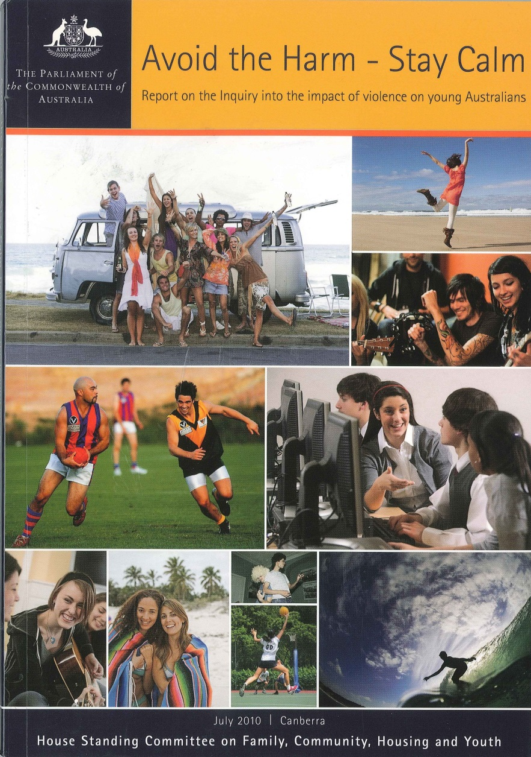
Broader context
House of Representatives Standing Committee on Family, Community, Housing and Youth (2010) - Inquiry into the Impact of Violence on Young Australians, recommendation no. 1: measure the prevalence, nature and severity of youth violence and monitor trends over time.
This recommendation has not been implemented.

Slide 43
Summary
The data do not support claims of escalating youth violence.
However, limits in current knowledge may hide specific changes in behaviour among certain groups of young people, or in specific ‘sub-types’ of violent offending behaviour.
Our young people do not seem to be any more ‘out of control’ in recent years than they were several years ago…but we really do not know.
The Australian community needs an annual or bi-annual community based survey of youth.

