Slide 1
An Australian Actuarial Risk Tool
(AART)
A Risk Assessment Model for Offender Management
Max Maller
Crime and Data Linkage Research Analyst
Email: maxfran2@westnet.com.au

Slide 2
Why we built it:
A request for a robust and accurate risk assessment tool as support in assessing supervised adult offenders
An opportunity to apply a prediction model based on survival analysis that a team of us developed from research into long term criminal careers
Can be applied across a wide range of offending scenarios such as
reimprisonment, re-arrest, court decisions etc.
AART was originally built for adult offenders in Western Australia
- has been in operation in WA Corrective Services since 1999
- won the 2002 Premiers Excellence Award for Management Improvement
and Governance
A version was later built for juvenile offenders
Prototypes were built for specific types of re-offending (adults and juveniles)

Slide 3
The Team
Prof. Rod Broadhurst (ANU): criminological knowledge and insight
Prof. Ross Maller (ANU): mathematical brilliance (survival analysis,
incidence functions, conditional risk,
outliers etc. etc.)
Ms. Nini Loh (UWA): data analysing and patience
and me: system design, construction, maintenance

Slide 4
  Australian Actuarial Risk Tool
  What’s actuarial?
  Covers everything and stays up to date
  Many risk instruments base their predictions on a group or groups of offenders in a particular scenario (such as, released from prison during a 12 month period) who they then follow up for 2 years or so and count whether or not each of them re-offended.
Does this represent population reoffending?
Does it still work later?
Is 2 years flexible enough?
How informative of what’s going on is a count of how many re-offended?
An actuarial model for re-offending
would accurately predict risk for any offender in the population
would accurately predict risk now and in the future by taking into account any changes that occur in reoffending behaviour
… and ideally
should be able to accurately predict the risk of an offender failing within any chosen time interval; and
Is much more informative than a simple count

Slide 5
Example using AART
An Officer requests a risk assessment for an offender he is about to supervise.
The tool requires 5 pieces of information about the offender:
Sex
Aboriginal/Non-Aboriginal
Age
Career arrest point
Current Offence
The Officer enters
Male
Non Aboriginal
19.5
First arrest
Armed Robbery (code = 211)
AART stirs from its slumber and …
. searches a prepared matrix for a group of offenders that EXACTLY match our robber on the above 5 factors.
. if it can’t find an exact match, it looks for the ‘closest’ match it can.
. when it finds this ‘best fit’ group, it extracts risk points from their Kaplan-Meier failure ‘curve’
. and finally it performs some adjustments to produce risk estimates tailored precisely for our robber – the quantum and direction of the adjustments depend on the variance of our robber’s factors from the group ‘average’.

Slide 6






AART RESULT
For Male, Non-Aboriginal, Age=19.5, Arrest = 1, Offence=211
Group Adjusted Found ….
Time Risk Risk after 7 iterations at:
1 year 0.309 0.471 Arrest 1 for M N
2 years 0.381 0.550 Age: group_3 (19+)
3 years 0.448 0.618 Offence: anco (211)
4 years 0.491 0.658 age_av = 24.636
5 years 0.510 0.674 cell_count = 148/75
ever 0.563 0.720 Rowid = 101943

Slide 7
Conditional Risk Example
AART RESULT
For Male, Non-Aboriginal, Age=19.5, Arrest = 1, Offence=211,
Failtime=10 months, Conditional:fail=2years,survived=6 months
Time Group Adjusted LOCATED after 7 iterations AT:
6 months 0.185 0.311 Rowid = 101943
9 months 0.254 0.404 cell_count = 148/75
12 months 0.309 0.471 age_av= 24.636
18 months 0.352 0.519 Found at:
2 years 0.381 0.550 Arrest 1 for M N
3 years 0.448 0.618 Age: group_3 (19+)
4 years 0.491 0.658 Offence: anco (211)
5 years 0.510 0.674
Maximum 0.563 0.720 Found failpoint for max was 3374 days
Requested Adjusted Risk of re-offending within 10 months is 0.413
Found_failpoint = 299 Found_phat = 0.261
Conditional Adjusted Risk of reoffending within 2 years
having already survived 6 months is 0.347

Slide 8
The Data
Police incident reports and court convictions were not viable sources
Police in WA collect a ‘charge’ record for every offence for which a person is arrested or summonsed.
This dataset was clearly the best indicator of reoffending available in WA and was chosen as the basis for AART
Why?
  identified individuals … so
  could group charges into ‘arrests’
  could track offenders
  could determine time between arrests accurately
  included the complete population of arrests (not samples)
  included important recidivism discriminators
  (demographic and offence information)
  available over a long period of time (since 1984)

Slide 9

Arrest Data
1984 to 2005

Slide 10
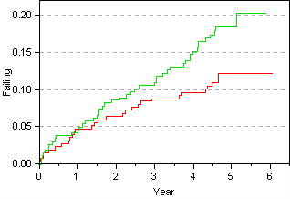
Survival Analysis
is used for light bulbs, in medical studies etc
for offenders, its about how long it takes them to re-offend – or not
Kaplan-Meier (KM) estimator describes failure (or success) distributions
all arrests are used (20 years worth) - no follow-up period – no data wasted
gives probability of re-offending anytime in the future
shows how fast they fail - useful for comparing groups too
This is important …
time-to-fail should be clean ‘street-time
groups MUST be homogeneous in their offending behaviour
(need to identify the KEY discriminating factors)
Survival analysis departs from old traditional research methods here

Slide 11
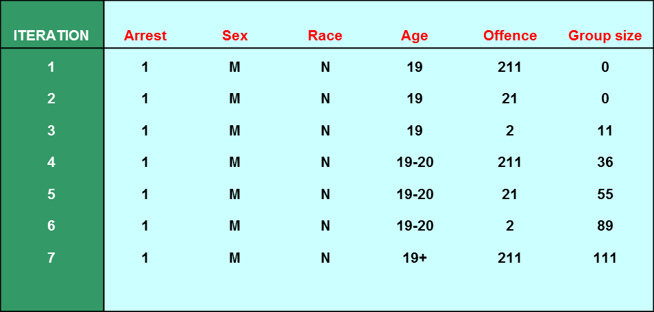
Grouping strategy
Categorise ‘like’ arrests
into groups likely to reoffend in a similar way
using the best data you can
Variables we identified as important:
  sex
  race (aboriginal/non-aboriginal)
  arrest cardinality (current arrest in career)
  age at arrest
  most serious offence for which arrested
Set a minimum Group Size of 100
Find ‘like’ cases using an iterative search mechanism

Slide 12
Adult Actuarial Risk Model
KM Step Function Array
Risk data
Risk Estimation Process
Risk Matrix
Population contingency tables
Iterative Risk Search Engine
OFFENDER BEING ASSESSED
Evaluation data
Risk Adjustment process
Adjusted Risk Estimate

Slide 13
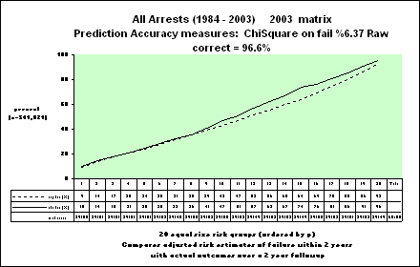

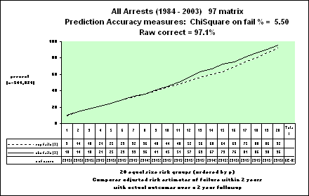
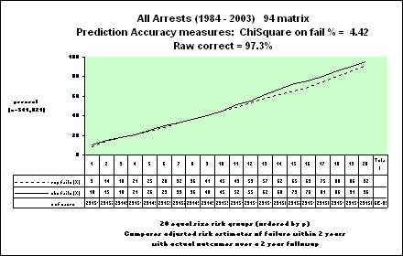
Plots below illustrate the predictive performance of the 2003, 2002, 2001 and 94 probability matrices applied against all arrest events from 1984 to 2003 where a 2-year follow-up was possible.

Slide 14
Example of applying the matrix to new data

Slide 15
Evaluating completeness
The Instrument has been applied against a large number of individual test cases and groups and has been found to predict consistently well.
In theory, it can be applied against any offender or group of offenders and should predict consistently.
Note what probabilistic estimation entails.
If an individual has a risk of 0.8 of re-offending within 2 years, then 8 out of 10 offenders LIKE HIM are expected to re-offend.
Even though all 10 could be considered ‘high risk’ offenders, 2 of them probably won’t re-offend

Slide 16
Thank you for your kind attention
Any questions?

Slide 17
Measurement and Evaluation
Extensions of the model
Instrument:
Competing Risk
Conditional Risk
Research:

Slide 18
A Competing Risk Model
Aim: to determine the risk of reoffending for
particular types of crime.
Instead of simple ‘successes’ or ‘fails’,
a failure could be classified into (say) one of four categories:
  SEXUAL
  VIOLENT
  PROPERTY & OTHER
  DRIVING
A juvenile risk instrument (based on AART) was built for the Justice Department – not yet evaluated

Slide 19
A Conditional Risk Model
Aim: to re-assess risk AFTER a period of time during which reoffending has not occurred.
For example, in the case of a supervised community corrections client, it could be that a re-assessment of risk is desired after a period of 12 months supervision (during which the offender has remained in the community and has not reoffended)
The AART
Currently measures ‘time-to-fail’ from the point of arrest to the next arrest, net of any non-street time.
Its possible to provide a quantitative re-calculation of risk given information about the length of time the offender has ‘survived’ without further offending
So re-assessment at any point in time is possible

Slide 20
Conditional Risk Example
Table 1 shows unconditional risk estimates over time
Table 2 shows conditional risk of failure within 2 years, given the offender has already survived some of that time
Table 3 shows conditional risks over 4 years
Note that Table 1 shows unconditional risk of failure within 2 years of 0.539 or 54%.
As expected, this equals the conditional risk shown in the first row of Table 2 – where survival period so far is zero.
Likewise, the conditional risk of reoffending after surviving 2 years is zero.

Slide 21
Conditional Risk Example for 2-year follow-up
The plot shows that risk decreases as the ‘survived’ period increases.

Slide 22
In developing the Instrument, it was clear to us that survival analysis presented as a most valuable tool in the measurement of recidivism and also in comparing the behaviour of different groups (eg a treated group compared to a control group).
Measurement and Evaluation

Slide 23
Here is a plot of KM estimates:
Measurement and Evaluation

Slide 24
Measurement and Evaluation

