Slide 1

Determining the impact of opioid substitution therapy on crime and mortality among prisoners using data linkage

Slide 2
Collaborators and funding sources
NDARC collaborators : Natasa Gisev, Sarah Larney, Jo Kimber, Marian Shanahan, Richard Mattick, Michael Farrell, Briony Larance, Judy Trevena,
External collaborators: Tony Butler, Don Weatherburn, Amy Gibson, Timothy Dobbins
Indigenous reference group: Anton Clifford, Michael Doyle, Megan Williams, Luke Bell
NHMRC fellowships: Louisa Degenhardt, Sarah Larney
Funding sources: NHMRC and the Australian Institute of Criminology (AIC) through the Criminology Research Grants Program
Conflict of interest statement - untied educational grants from Reckitt Benckiser to conduct post-marketing surveillance of buprenorphine

Slide 3
Background
Many people with opioid dependence have some form of contact with opioid substitution therapy (OST)
People with opioid dependence also have increased contact with the criminal justice system
To date, most studies estimating criminal risk among opioid-dependent individuals are based on convenience or respondent-driven sampling, which may not reflect offending rates in the total opioid-dependent population
Using linked administrative datasets, we have evaluated patterns of OST and contact with the criminal justice system at the population level, and the potential impact of OST upon mortality and crime

Slide 4
Datasets
DATASET | DESCRIPTION
NSW Pharmaceutical Drugs of Addiction System (PHDAS) | Every authority to dispense methadone or buprenorphine in NSW as OST approved by NSW Health, 1985-2010 . Excludes clinical trial participants or those receiving treatment in other states. Around 48,000 people in total since 1985; 15,600 new entrants (from 1st August 2001).
Bureau of Crime Statistics and Research (BOCSAR) Reoffending Database (ROD) | Internally linked dataset of all finalised court appearances in the Local, District and Supreme Courts of NSW between 1993-2011 (n= 639,386 charges in our cohort). Internally linked dataset of all custody episodes obtained from the NSW Department of Corrective Services from 2000-2011 (n=16,715 episodes in our cohort).
Australian Institute of Health and Welfare National Deaths Index (NDI) | Mortality data collected from each of the State and Territory Births, Deaths and Marriage Registers. Information includes date, state, and causes of death (primary causes for all records, secondary causes for deaths occurring 1997 and later) up to March 2012.

Slide 5
What we have covered in our study:
Natural history of criminal justice system involvement among opioid dependent people, 1993-2011;
Extent of imprisonment of opioid dependent people, 2000-2012;
Predictors of treatment retention, including potential differences between buprenorphine and methadone;
Differences in OST engagement and crime among Aboriginal and Torres Strait Islanders;
Gender differences in OST engagement;
Impact of OST provision in prison upon in-prison mortality;
Impact of OST on mortality following release from prison;
Association of opioid substitution therapy (OST) and retention in OST on crime rates among opioid-dependent people;
Cost effectiveness of OST in reducing mortality post-release

Slide 6
Some of our previously reported findings:
76% of the cohort had at least one criminal charge (80% males, 68% females); most commonly property (25%), traffic (17%) or violent (11%) offences
Between 1993-2011, our cohort accounted for 13% of NSW court appearances - $311 million (2012 AUD);
The contribution that cohort members made to these court costs varied dramatically:
  the most frequently appearing 6% had 25% of appearances ($77million)
  10% accounted for 39% of all appearances ($120 million).
  27% accounted for 70% of all appearances ($218 million).
Between 2000-2012, 37% of our cohort had at least one episode of incarceration lasting one or more days (43% males, 24% females)
  Indigenous men and women more likely to have been in prison, on more occasions, and for longer periods
Cost of incarceration of this cohort between 2000-2012 was $3 billion

Slide 7
What we have covered in our study:
Natural history of criminal justice system involvement among opioid dependent people, 1993-2011;
Extent of imprisonment of opioid dependent people, 2000-2012;
Predictors of treatment retention, including potential differences between buprenorphine and methadone;
Differences in OST engagement and crime among Aboriginal and Torres Strait Islanders;
Gender differences in OST engagement;
Impact of OST provision in prison upon in-prison mortality;
Impact of OST on mortality following release from prison;
Association of opioid substitution therapy (OST) and retention in OST on crime rates among opioid-dependent people;
Cost effectiveness of OST in reducing mortality post-release

Slide 8
Impact of OST upon mortality in prison
Larney at el (2014) BMJ Open

Slide 9
Deaths in prison
Deaths in prison raise questions as to the quality of care and supervision provided by correctional authorities
  Reflecting such concerns, deaths in prison usually result in extensive inquiries
  May also lead to litigation against correctional authorities and healthcare providers
Unnatural deaths of particular concern (48-59% of deaths)
  Suicides, overdoses, violence, injuries
Opioid dependent people may be at particular risk
  Drug withdrawal as a trigger for suicide
  Opioid overdose in custody

Slide 10
Cohort definition
All people seeking OST, 1985-2012
People seeking OST who were incarcerated, 2000-2012
N=16,715
79% men
30% Indigenous
30 years (range 16-64 years) at cohort entry
People seeking OST who died, 1985-2012

Slide 11
Characteristics of incarcerations of opioid-dependent people in NSW (n=16,715)
Median incarcerations | 2 (1-34)
Median duration of completed incarcerations | 71 days (1 day-12 years)
Prescribed OST at some point during an incarceration | 12,852 (76.9%)

Slide 12
Method
Crude mortality rates in and out of treatment
Association between OST and mortality:
  Extended Cox models that allowed for discontinuous risk intervals
  OST exposure coded as time-dependent variable
Other variables: sex, Indigenous status, age at release, and variables relating to treatment and criminal justice history (to account for potential differences in mortality risk among people with differing histories of criminal involvement, e.g. violent crime)

Slide 13





Deaths among the cohort in prison (n=51)
Natural deaths
Suicide
Drug-induced
Other injury
Violent
Unknown
Between 2000-2010, deaths in this cohort accounted for 35% of all unnatural deaths in NSW prisons

Slide 14








Deaths in prison (n=51)
Natural deaths
Suicide
Drug-induced
Other injury
Violent
Unknown
Out of OST
In OST

Slide 15
OST and deaths in prison: Total time in custody
Cause | OST status | N deaths | CMR per 1000py | 95% CI
All-cause | Out | 40 | 2.7 | 2.0, 3.7
 | In OST | 11 | 0.7 | 0.3, 1.2
Unnatural | Out | 27 | 2.2 | 1.4, 3.2
 | In OST | 5 | 0.3 | 0.1, 0.8
Suicide | Out | 16 | 1.3 | 0.7, 2.1
 | In OST | 3 | 0.2 | 0.04, 0.6
Drug | Out | 6 | 0.5 | 0.2, 1.0
 | In OST | 0 | - | -

Slide 16
Adjusted effect of OST on death in prison
Cause of death | Adjusted hazard ratio | 95 % confidence interval
All-cause deaths | 0.26 | 0.13, 0.50
Unnatural deaths | 0.13 | 0.05, 0.35
i.e. hazard of unnatural death 87% lower while in OST
Adjusted for sex, Indigenous status, age at prison reception, no. prior incarcerations, duration of prior incarcerations, any prior drug, violent or property offences

Slide 17
Deaths in first 4 weeks of prison (n=17)
Natural deaths
Suicide
Drug-induced
Other injury
Violent
Unknown
Out of OST
In OST

Slide 18
OST and deaths in prison: First 4 weeks of custody
Cause | OST status | N deaths | CMR per 1000 py | 95% CI
All-cause | Out | 16 | 12.7 | 7.2, 20.6
 | In | 1 | 0.8 | 0.2, 4.3
Unnatural | Out | 12 | 11.0 | 5.7, 19.2
 | In | 1 | 0.8 | 0.02, 4.4
Suicide | Out | 9 | 8.2 | 3.8, 15.6
 | In | 1 | 0.8 | 0.02, 4.4
Drug | Out | 1 | 1.0 | 0.02, 5.1
 | In | 0 | - | -

Slide 19
Adjusted effect of OST on death in first 4 weeks of prison
Cause of death | Adjusted hazard ratio | 95 % confidence interval
All-cause deaths | 0.06 | 0.01, 0.48
Unnatural deaths | 0.07 | 0.01, 0.53
i.e. hazard of unnatural death 93% lower while in OST
Adjusted for sex, Indigenous status, age at prison reception, no. prior incarcerations, duration of prior incarcerations, any prior drug, violent or property offences

Slide 20
Impact of OST upon mortality post-release from prison
Degenhardt et al (2014) Addiction

Slide 21
Mortality post-release
High risk of death following release from prison
  A large proportion of deaths in the 2 weeks after release are drug-induced
  Risk of overdose in the first 2 weeks is 3-11 times that in weeks 5-12 post-release
OST reduces mortality of opioid-dependent people by more than one-half
Does OST ameliorate risk of death among released opioid-dependent prisoners?

Slide 22
Method
Cohort: people with an episode of OST who had also been released from prison at least once (n=16,453)
Followed up until death or end of follow-up period
  Assumes chronic opioid dependence
  Any resulting bias would produce more conservative results, as people no longer using opioids would have lower baseline mortality risk
Only those releases from prison during or after the first episode of OST were included (n= 60,161 prison releases)

Slide 23
Cohort definition
All people seeking OST, 1985-2012
People seeking OST who were released from prison, 2000-2012
N=16,453
79% men
30% Indigenous
60,161 prison releases
OST was prescribed in 51% of releases
People seeking OST who died, 1985-2012
1,050 deaths after a prison release

Slide 24
Method
Crude mortality rates in and out of treatment
Association between OST and mortality:
  Extended Cox models that allowed for discontinuous risk intervals
  Post-release OST exposure coded as time-dependent variable
Other variables: sex, Indigenous status, age at release, and variables relating to treatment and criminal justice history (to account for potential differences in mortality risk among people with differing histories of criminal involvement, e.g. violent crime).

Slide 25
Results: Post-release mortality, 2000-2012
N=16,453
  79% (n=12,945) men
  30% (n=4,919) Indigenous
60,161 releases from prison
OST was prescribed in 51% of releases (n=30,397)
1,050 deaths after a prison release

Slide 26
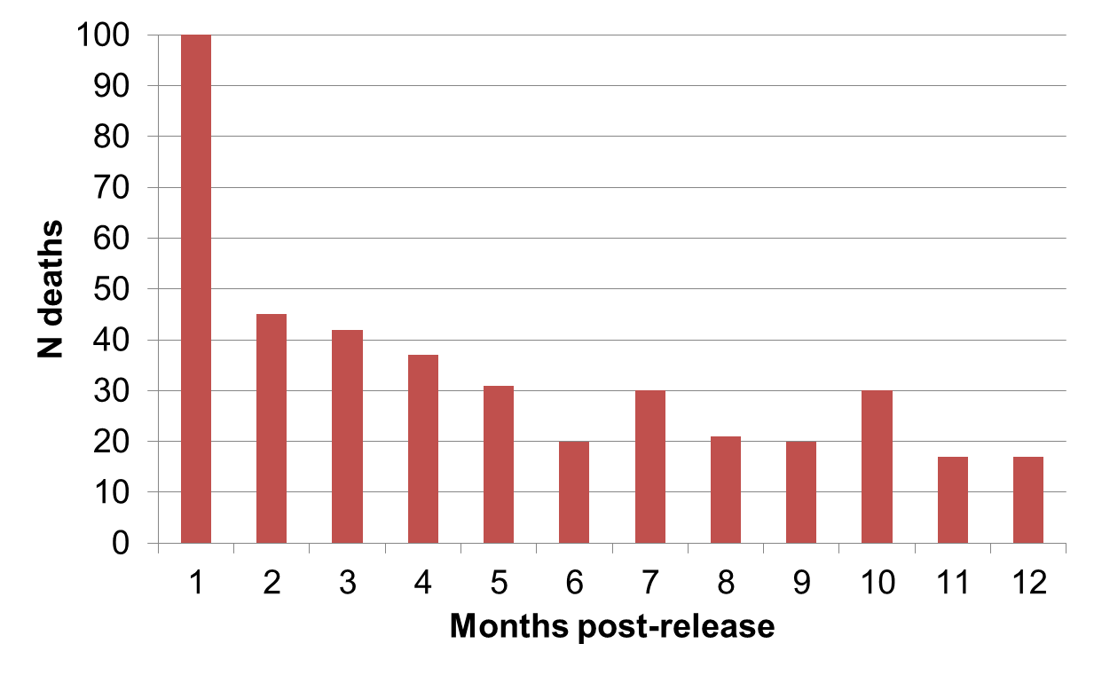
Mortality after release, first year (n=411)

Slide 27
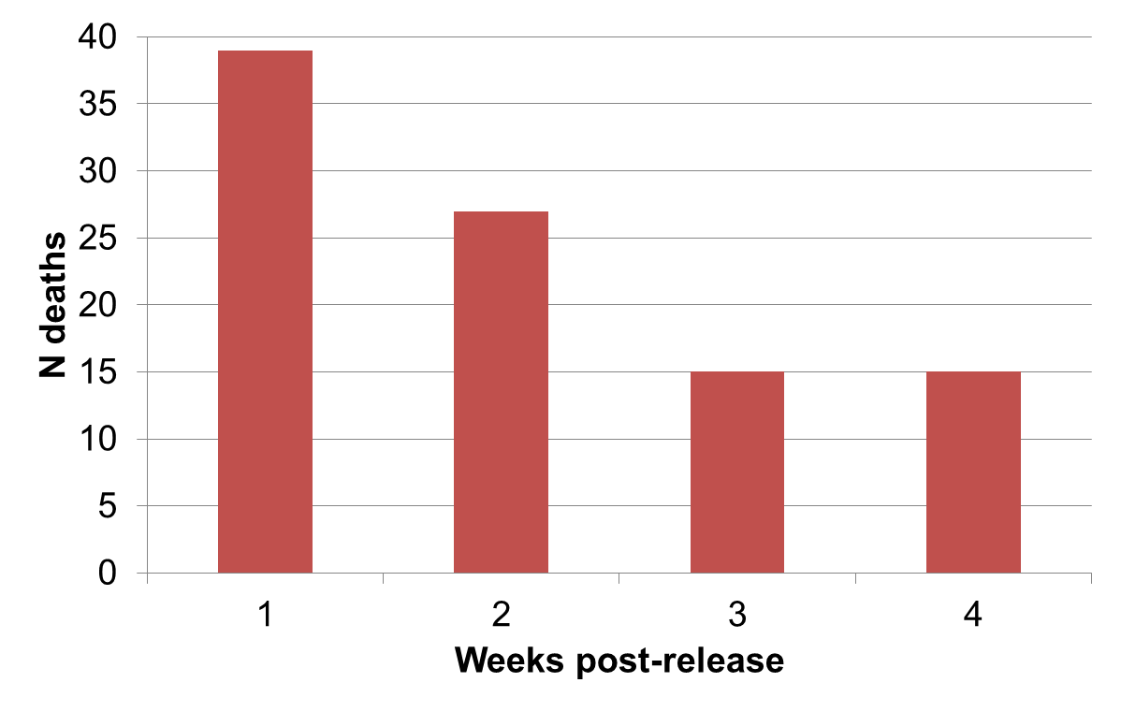
Mortality after release, first month (n=96)

Slide 28
Mortality after release, first week (n=39)

Slide 29
Deaths in the first 4 weeks post-release
 | OST exposure
 | Full | Partial | None
All-cause | 16 | 5 | 75
Accidental drug-induced | 6 | 4 | 46
Suicide | 0 | 0 | 3
Accidental injury | 2 | 1 | 2
Violence | 2 | 0 | 0

Slide 30
Crude mortality rates per 1000PY in the first 4 weeks post-release
 | OST exposure
 | Full | Partial | None
All-cause | 8.8 | 11.5 | 36.7
Accidental drug-induced | 3.5 | 10.4 | 26.5
Suicide | 1.0 | - | 0.8
Accidental injury | 1.6 | - | 1.3
Violence | 0.6 | - | 0.5

Slide 31
OST and mortality post-release
Results of multivariable Cox regression models:
First 4 weeks post-release
  Time in OST associated with a 75% reduction in hazard of death (adj. HR 0.25; 95% CI: 0.12, 0.53)
Total time at liberty post-release from prison
    Time in OST associated with an 83% reduction in hazard of death (adj. HR 0.17; 95% CI: 0.14, 0.20)
Adjusted for sex, Indigenous status, age, no. prior incarcerations, duration of most recent incarceration, prior drug, violent or property offences, OST history

Slide 32
Impact of OST upon crime

Slide 33
OST and crime
Much discussion about the potential impact of OST upon offending behaviour
We are examining a range of questions in this regard
  Crime before first entry to OST, contrasted with post-entry
  Association between cumulative retention in OST and crime
  Association between within OST-episode retention and crime
  Analyses still underway….

Slide 34
Offence rates according to time in OST (per 100PY)

Slide 35
Offence rates according to retention in OST (per 100PY)

Slide 36
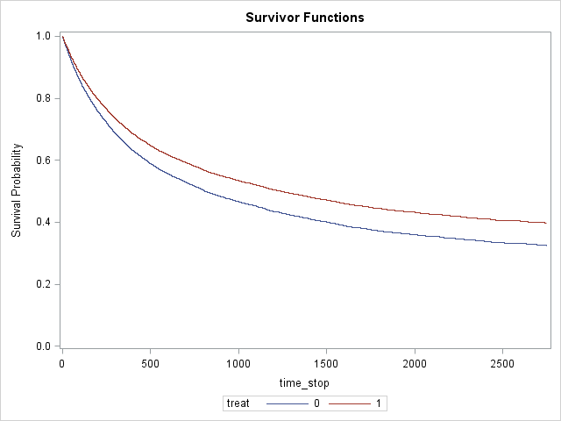
Association between time in OST and time to first offence
OST examined in a time-dependent fashion
In multivariable models the hazard of being charged with any crime was reduced by 13% (adj. HR 0.87, 85%CI 0.83-0.92)
Adjusted for age, sex and Indigenous status

Slide 37
Interaction between retention in OST and incident rate ratio of offending
Generalised Poisson mixed model, limited to people who committed crime due to zero inflated data
Within subject variation controlled for by including participant IDNUM
Protective effect of treatment increases as OST retention increases

Slide 38
Discussion

Slide 39
Discussion
OST in prison is associated with a dramatic decrease in unnatural deaths in opioid-dependent prisoners
  Almost entirely eliminates deaths of opioid-dependent prisoners in first 4 weeks of incarceration
OST is critical to minimising post-release mortality among opioid-dependent prisoners
  Higher rates of post-prison OST if someone is maintained on OST during incarceration
  Confirmation of finding that crime is lower during time spent in OST; also demonstrated that increasing retention increases the protective effect

Slide 40
References
Degenhardt et al (2013). Engagement with the criminal justice system among opioid dependent people: Retrospective cohort study. Addiction, 108(12), 2152-2165.
Degenhardt et al (2014). Imprisonment of opioid dependent people in New South Wales, Australia, 2000-2012: Retrospective linkage study. Australian and New Zealand Journal of Public Health, 38(2) 165-70.
Larney et al (2014). Opioid substitution therapy as a strategy to reduce deaths in prison: retrospective cohort study. BMJ Open, 4:e004666. doi:10.1136/bmjopen-2013-004666.
Degenhardt et al (2014). The impact of opioid substitution therapy on mortality post-release from prison: Retrospective data linkage study. Addiction, 109, 1306-1317.
Gisev et al (2014). A comparative study of opioid substitution therapy utilization among opioid-dependent men and women. Drug and Alcohol Review, 33(5), 499-505.
Gisev et al (2014). Treatment utilisation, offending and custody patterns among opioid-dependent individuals: comparison of Indigenous and non-Indigenous Australians. BMC Public Health, 14, 920. DOI: 10.1186/1471-2458-14-920
Burns et al (2015). A longitudinal comparison of retention in buprenorphine and methadone treatment for opioid dependence in New South Wales, Australia. Addiction. doi: 10.1111/add.12834
Gisev et al (submitted). The cost-effectiveness of opioid substitution therapy upon release in reducing mortality among prisoners with a history of opioid dependence. Addiction.
Kimber et al (submitted). Comparing the mortality risk of methadone and buprenorphine substitution therapy: Retrospective cohort study. British Medical Journal.

