Slide 1
The deterrent effects of drug detection dogs on drug use in NSW, Australia
Caitlin Hughes,¹ Don Weatherburn², Robert MacCoun ³
¹ National Drug and Alcohol Research Centre, UNSW Australia
² NSW Bureau of Crime Statistics and Research
³ Berkeley School of Law, University of California
Applied Research in Crime and Justice Conference 2015

Slide 2
Background
Deterrence has long been a cornerstone to drug law enforcement (DLE) efforts, under the assumption that police can deter, discourage or prevent drug use
Yet, there has remained little research into this area
  For example, in 2000 Weatherburn et al. noted that “although current drug policy relies heavily on deterrence, little research has been conducted to examine its efficacy”
Lack of evidence is increasingly problematic as:
  Drug law enforcement subsumes lion’s share of resources
  And police continue to roll out new and often controversial ‘deterrent’ strategies in the absence of evidence of their intended or unintended effects

Slide 3
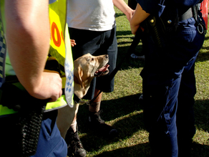

Drug detection dogs
A high visibility policing strategy
Expanded across many parts of the world, including the UK, Europe, USA and Australia
Used in multiple settings including licensed premises, music festivals, public transport – often without warrant
Remains considerable controversy about their use-particularly claims that can deter drug offending

Slide 4
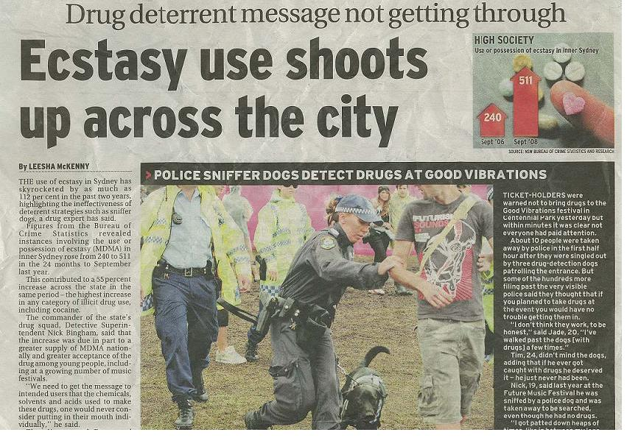
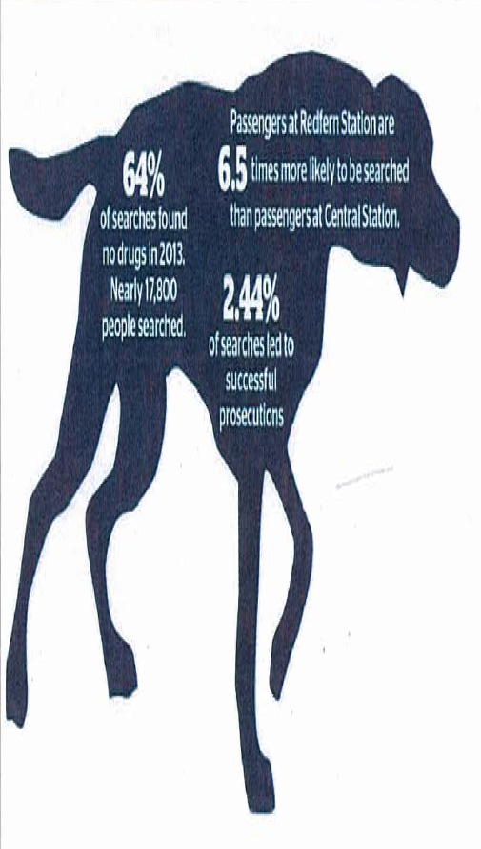
Ongoing media scrutiny
Drug searches: thousands falsely identified by sniffer dogs – SMH – Nov 2014
64% of searches found no drugs in 2013.
Nearly 17,800 people searched.
2.44% of searches led to successful prosecutions.

Slide 5
Drug detection dogs – the evidence/claims?
Controlled studies have showed dogs can accurately detect drugs, but more so cannabis/hashish. And less accurate in outdoor settings
Reviews of drug detection dogs suggest little deterrent effect
  The NSW Ombudsman (2006) found that “[t]here is little or no evidence to support claims that drug detection dog operations deter drug use, reduce drug-related crime, or increase perceptions of public safety”
  Also showed a high false positive rate (74%) and raised concerns that they increase harmful user behaviour
But police continue to argue they do deter:
  “Sniffer dogs are close to 100% accurate”
  “The dogs have a strong deterrence factor: they not only lead to the seizure of drugs from dealers and users, but people also dump their drugs when they see the dogs. Thus these drugs are not consumed and the risk avoided” (NSW Police, 2011).

Slide 6
Methodological stumbling block
To refute or support such claims need to:
1) measure crime that has ’not occurred’ - that by definition will not show up in police data
2) provide a valid counter-factual – how many more (or less) people would have offended in the absence of police presence
3) know whether any change in behaviour is attributable to the police – and to disentangle effects in the real world
In this study we therefore seek to pilot a new approach to assessing deterrent effects using experimental deterrence vignettes
A proven research method used in psychology, behavioural economics, public policy and criminology to provide insight into decision making processes and intended behaviours (Aviram, 2012; Nagin, 2013; Wallander, 2009)

Slide 7
Objectives
To assess the extent to which using police with drug detection dogs at outdoor music festival in NSW reduces the:
  overall prevalence of illicit drug use
  overall quantity of drug consumed
  harmfulness of the drug use, as defined in terms of the type of drug(s) consumed and venue of consumption (inside versus outside the festival venue)
To identify the sub-populations that are most and least likely to change their drug use behavior in response to different policing modalities

Slide 8
Methodology
A purpose built online survey was developed involving three different hypothetical policing scenarios that could be encountered by patrons at an outdoor music festival:
  No police presence
  Police presence in the absence of drug detection dogs
  Police presence in the presence of drug detection dogs
Using a repeated measures design each set of scenarios was administered to 513 people aged 18+ who attend outdoor music festivals and reside in NSW
Under each scenario potential patrons were given the option to use five illicit drugs (cannabis, ecstasy, meth/amphetamine, cocaine and GHB) and asked whether they would engage in illicit drug use and if so the type of drug(s), quantity and location of use (inside or outside festival venue)

Slide 9
Sample (n=513)
Demographics
Mean age 23.85 (SD=7.6)
67.1% male
82.7% completed year 12 or equivalent, and 55.0% had additional qualifications
42.3% attended only 1-2 festivals in last 12 months
Illicit drug use
84.6% any lifetime use
78.0% any recent use
65.3% any use at last festival

Slide 10
Perceptions of likelihood of police detection

Slide 11
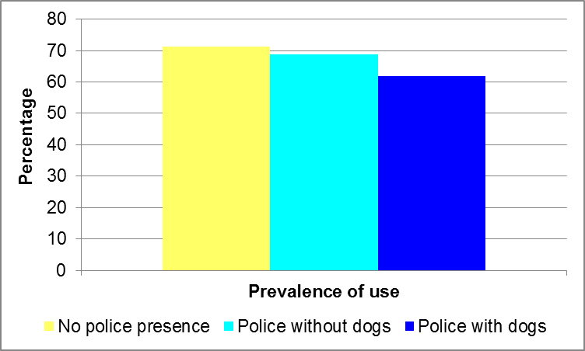
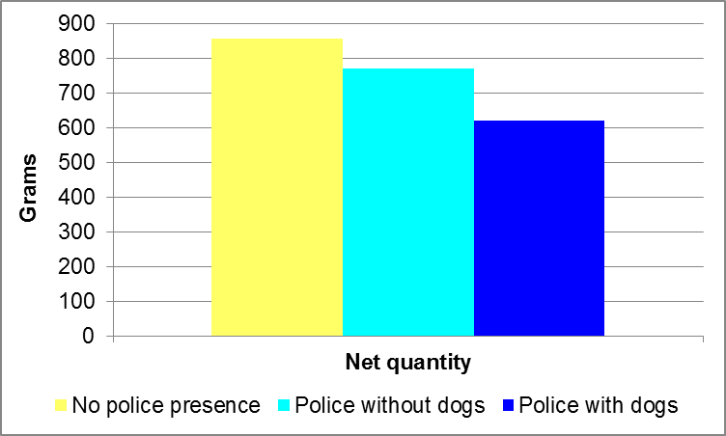
Impact on prevalence and net quantity of use

Slide 12
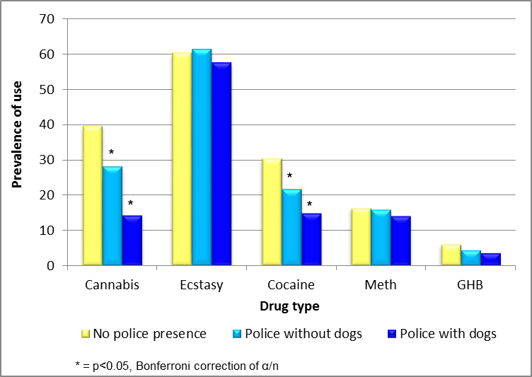
Impact on type of drug use – total pop

Slide 13
Impact on type of use – amongst users only

Slide 14
Discussion and conclusion
Many limitations: intended, not actual behaviour, non-representative sample, NSW context alone, impacts on drug use alone
Provides tentative evidence that police presence with drug detection dogs may elicit some deterrent effects
However, the fact that so many people report that they would continue to use regardless of the presence or absence of police with dogs suggests their effects are less than purported by police
The range of impacts use engagement, drug type, venue of consumption and quantity raises even further questions about the extent to which dogs are ‘consistent’ with harm minimisation principles

Slide 15
Discussion and conclusion
  That said, the findings also suggest net impacts may vary across policing approaches
  This suggests that there may be the capacity to push for strategies that produce the least net harm
  Next steps: extending the current study to assess deterrent effects of multiple policing strategies taking into account impacts on use, possession, purchasing and trafficking and different target settings
  In so doing, we hope to increase the capacity for more informed responses to drug-related offending; both by police and governments

Slide 16
Thank you!
Dr Caitlin Hughes
E: caitlin.hughes@unsw.edu.au
P: 02 9385 0132
W: www.ndarc.med.unsw.edu.au

