Slide 1
Individual and situational predictors of harm in the night-time economy
A/Prof Peter Miller
¹ School of Psychology, Deakin University
² National Addiction Centre, Institute of Psychiatry, King's College London, UK
³ NDRI, Curtin University
⁴ Commissioning Editor, Addiction
⁵ Centre for Addiction and Mental Health, Ontario, Canada

Slide 2
Funded by the National Drug Law Enforcement Research Fund:
An Initiative of the National Drug Strategy

Slide 3







Collaborators
Dr Lucy Zinkiewicz, Dr Beth Costa, Dr Shannon Hyder, Dr Lucy Busija
DANTE:
  Inspector Bill Mathers
  A/Prof Darren Palmer
  Jennifer Tindall
  Anders Sønderlund
  Daniel Groombridge
  Christophe Lecathelinais
  Karen Gillham
  Emma McFarlane
  Florentine de Groot
  Nicolas Droste
  Amy Sawyer
  Dr Ian Warren
  Prof John Wiggers
POINTED:
  Dr Amy Pennay
  Inspector Bill Mathers
  Nicolas Droste
  Dr Rebecca Jenkinson
  Prof Tanya Chikritzhs
  Prof Stephen Tomsen
  Phillip Wadds
  Prof Sandra C. Jones
  A/Prof Darren Palmer
  Lance Barrie
  Dr Tina Lam
  William Gilmore
  Prof Dan I. Lubman

Slide 4
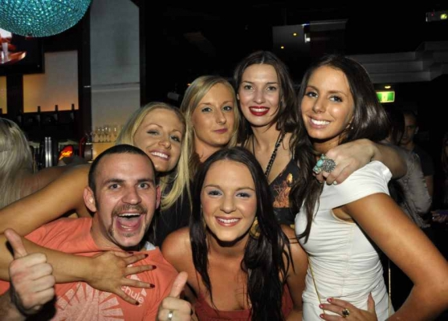
4 studies
Dealing with Alcohol and the Night Time Economy - (DANTE) | 2008-2011 | 4,000 patron interviews (90% response rate) 700 telephone surveys 129 Venue Observations 123 Key informants
Patron Offending and Intoxication in Night-Time Entertainment Districts - (POINTED) | 2011-12 | 7,000 patron interviews (96% response rate) 129 Venue Observations
NSW street intercept | 2012 | 722 patron interviews
POINTED Schoolies | 2012 | 1265 patron interviews

Slide 5
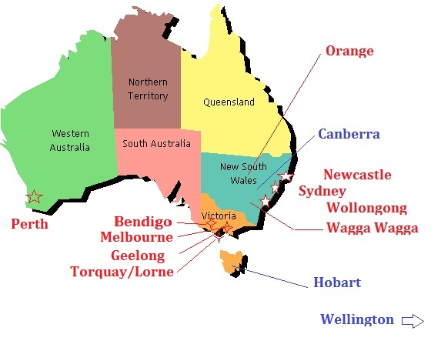

Slide 6
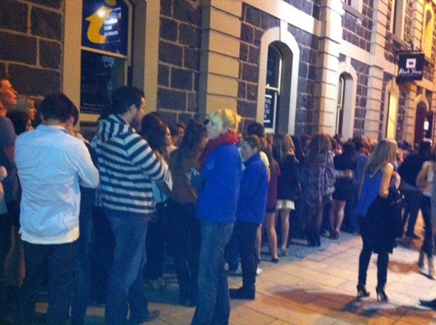
Patron interview methods
Systematic selection
iPhone/iPod data collection
‘Tap forms’ app
10pm-6am
Team 4-10 people

Slide 7
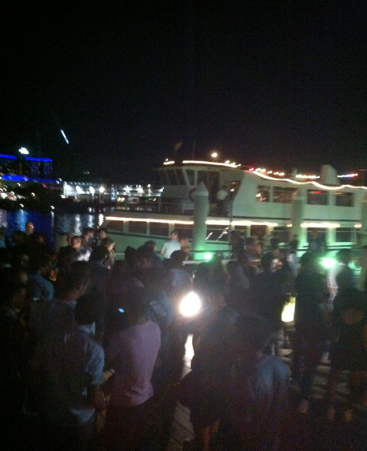
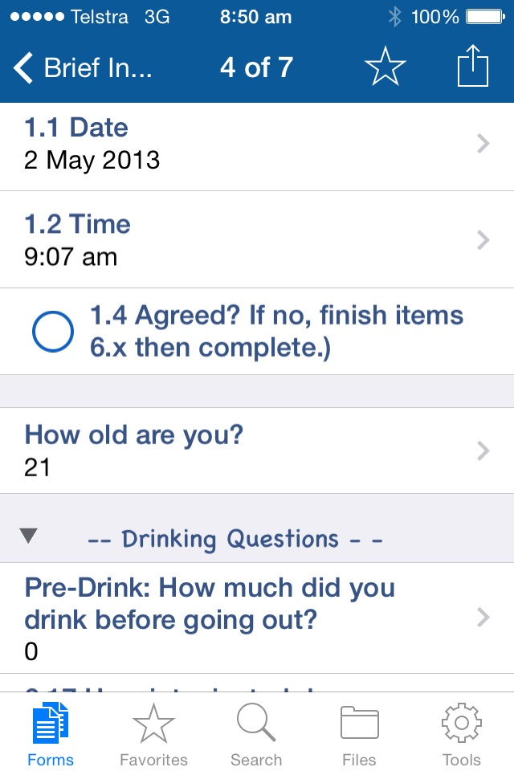

Slide 8
Results

Slide 9
Harm, Risk and Aggression
 |  | DANTE | POINTED | SCHOOLIES | NSW Street
Retrospective period |  | (3 months) | (3 months) | (1 month) | (3 months)
Experience Aggression
 | Physical | 15.5% | 11.0% | 4.8% | 10.8%
 | Verbal | - | 9.0% | 5.7% | 11.5%
 | Sexual | - | 2.0% | 0.5% | 1.7%
Alcohol Related Injury or Accident |  | - | 14.0% | 22.8% | -
DUI |  | - | 14.0% | - | 10.7%
Unprotected Sex |  | - | - | 22.2% | -

Slide 10
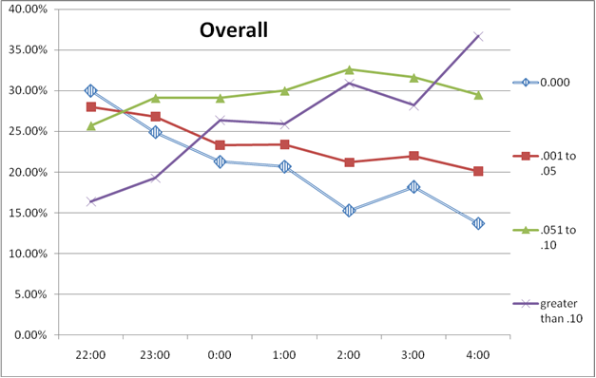
BAC levels for all sites per hour

Slide 11
Individual Risk factors
Pre-drinking
Illicit drugs
Energy drinks

Slide 12
DANTE Pre-drinking
People who pre-drank were significantly more likely to be in a fight (χ²=25.47, p<.000).
  5+ drinks = 2 times more likely
  11-25 drinks = 2.8-3.8 times more likely
  25+ drinks = 4.5 times more likely
side drinking- ‘loading’ also the norm.

Slide 13
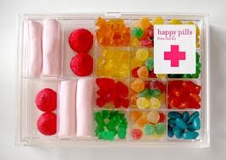
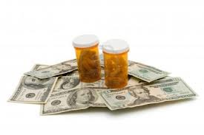
Illicit drugs
16% of the overall sample reported using substances other than alcohol during their current night out (prior to interview)
A small number of participants (n=44, <1%) refused to answer
Drug | TOTAL
 | n | %
Ecstasy | 231 | 3
Cannabis | 196 | 3
Methamphetamine | 179 | 3
Cocaine | 97 | 1
Pharmaceutical stimulants | 30 | <1
LSD | 15 | <1
Opiates | 10 | <1
Benzodiazepines | 8 | <1
GHB | 8 | <1
Mephedrone | 6 | <1
Ketamine | 5 | <1
Other | 32 | 1
ANY | 1,072 | 16
20% of people tested positive for illicit drugs.
20% declined.
Estimated 20-40% of people taking drugs

Slide 14
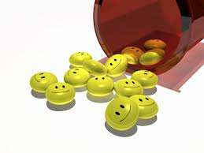
Illicit drugs
People who used illicit drugs were significantly more likely to:
  Physical aggression
  Verbal aggression
  Sexual aggression
  Property Crime
  Drink-driving
  Any alcohol-related injury

Slide 15
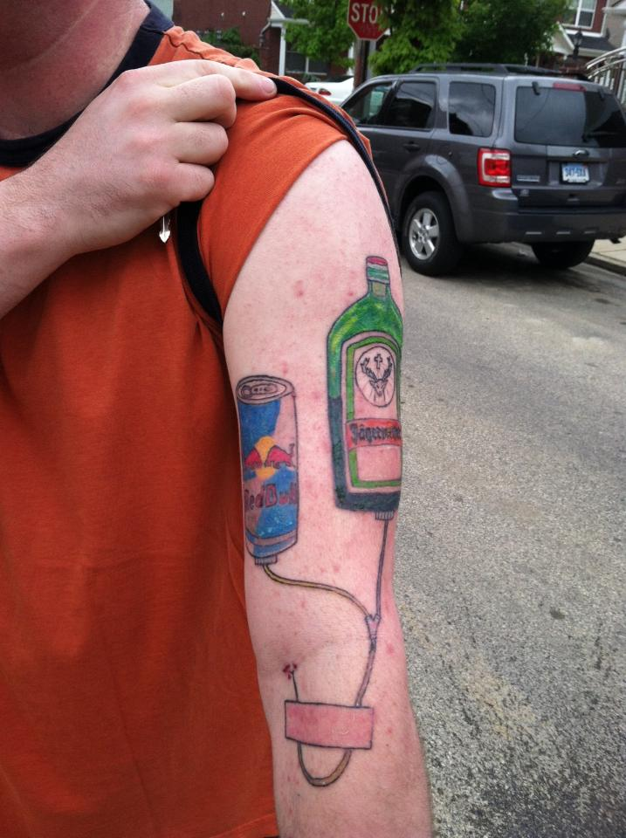
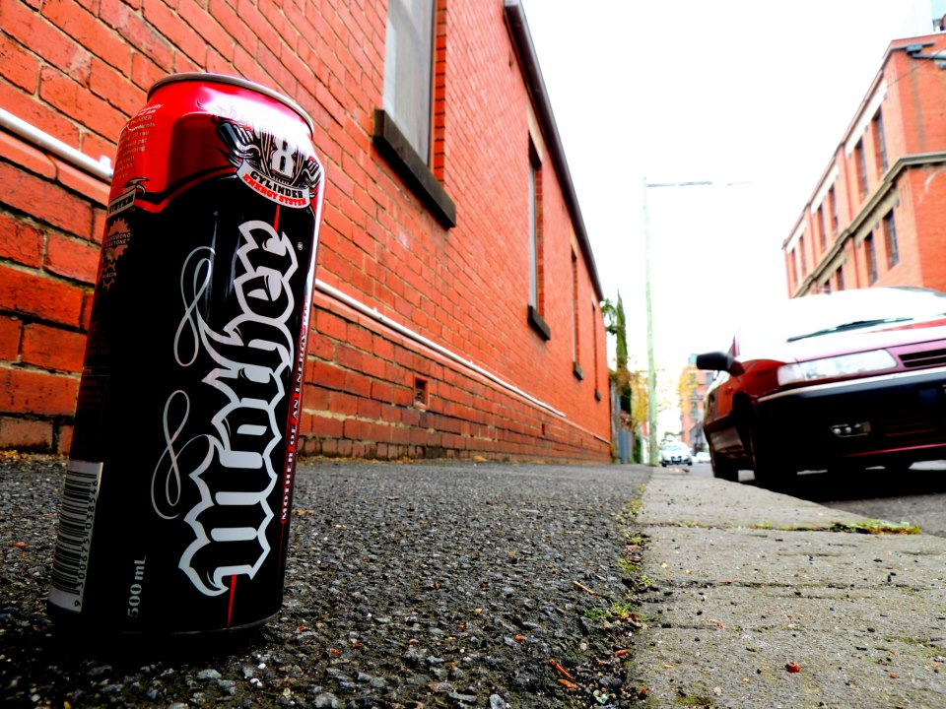
Energy drinks
23% of participants had consumed energy drinks
14.6 % combined energy drinks with alcohol.
Males and females similar.
Participants who consumed energy drinks with alcohol:
consumed significantly more energy drinks
consumed significantly more alcohol
significantly more likely to report illicit drug use

Slide 16
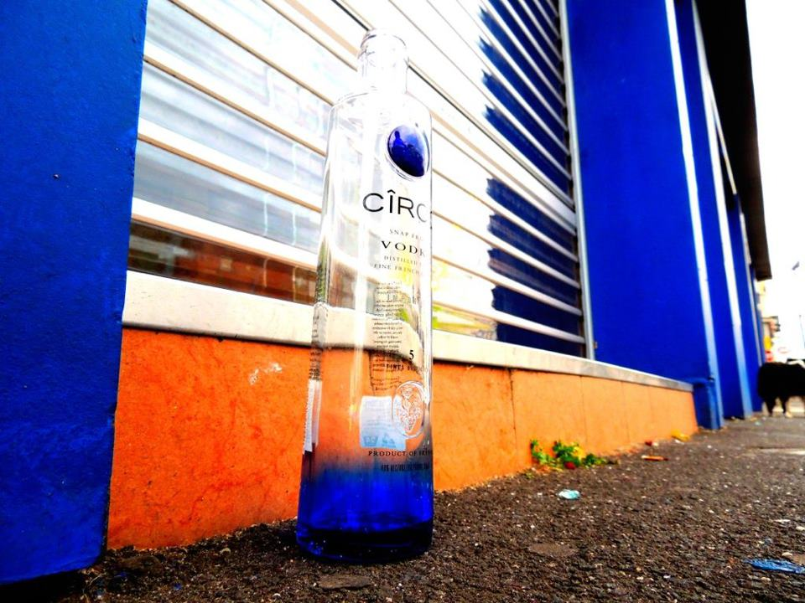
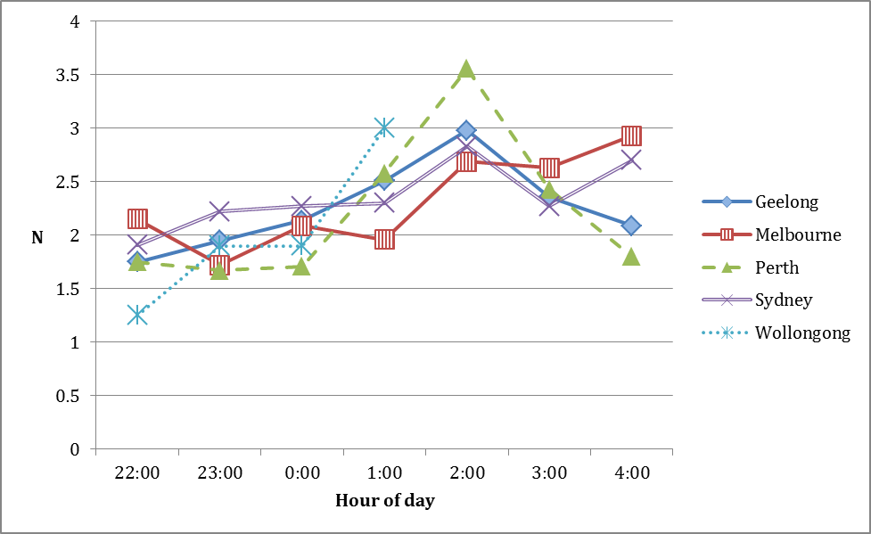
Energy drinks (cont)
participants who reported consuming energy drinks with/without alcohol prior to interview were significantly more likely to experience all forms of harm
Daily recommended limit

Slide 17
Predictors | Bivariate regressions |  |  |  | Stage 1 |  |  |  |  | Random slopes¹
 | ExpB² | 95% CI | P-value |  | ExpB² | 95%CI | P-value |  |  | ExpB² | 95% CI | P-value
Age group (years) |  |  | .048 |  |  |  | .173 |  |  |  |  | .178
Male sex | 1.13 | (1.08-1.17) | <.001 |  | 0.94 | (0.85-1.04) | .229 |  |  | 0.95 | (0.86-1.04) | .268
Interview after midnight | 1.13 | (1.08-1.17) | <.001 |  | 1.07 | (1.02-1.12) | .006 |  |  | 1.07 | (1.02-1.12) | .011
Engagement in pre-drinking | 1.18 | (1.14-1.23) | <.001 |  | 1.12 | (1.07-1.18) | <.001 |  |  | 1.14 | (1.09-1.2) | <.001
Number of pre-drinks | 1.02 | (1.01-1.03) | .001 |  | 0.99 | (0.98-1.01) | .321 |  |  | 0.99 | (0.98-1.01) | .345
Length of drinking session | 1.05 | (1.04-1.06) | <.001 |  | 1.02 | (1.02-1.03) | <.001 |  |  | 1.04 | (1.03-1.05) | <.001
Number of standard drinks | 1.04 | (1.04-1.05) | <.001 |  | 1.04 | (1.03-1.04) | <.001 |  |  | 1.04 | (1.04-1.05) | <.001
Cannabis consumption | 0.93 | (0.80-1.06) | .300 |  | 0.84 | (0.71-0.97) | .007 |  |  | 0.84 | (0.70-0.97) | .011
Stimulants consumed
Illicit stimulants | 1.12 | (1.02-1.22) | .021 |  |  |  |  |  |  | 0.92 | (0.80-1.05) | .198
Energy drinks (yes/no) | 1.08 | (1.02-1.13) | .009 |  |  |  |  |  |  | 1.09 | (0.99-1.2) | .112
Number of energy drinks | 1.02 | (1.00-1.04) | .065 |  |  |  |  |  |  | 0.98 | (0.95-1.00) | .098
Illicit stimulants by hours ‘going’ | 0.96 | (0.94-0.98) | <.001 |  |  |  |  |  |  | 0.97 | (0.95-0.99) | .013
Energy drinks by hours ‘going’ | 0.97 | (0.95-0.99) | <.001 |  |  |  |  |  |  | 0.98 | (0.96-0.99) | .007

Slide 18
What works?

Slide 19
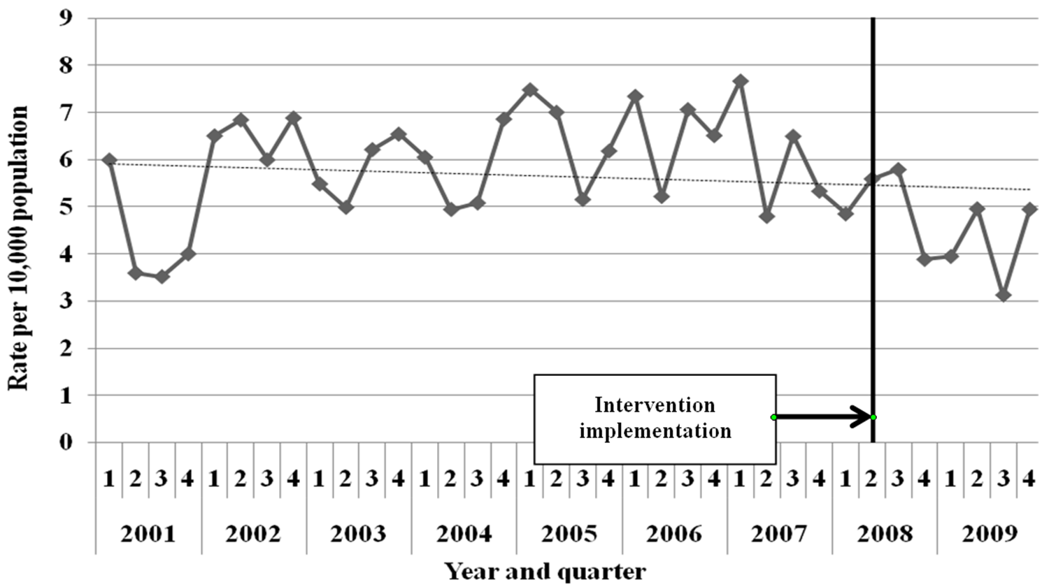
Closing venues earlier
Previous research confirmed
And extended

Slide 20
Injury during high alcohol hours by year,
2005-2011

Slide 21
Impact on drinking culture?
Interviews commenced in Newcastle at 9pm,
Could not start in Geelong until 11:30pm
Item | Geelong | Newcastle | Total
Money spent tonight ($): 0–20 21–50 51–100 101–200 | 44.8% 27.7% 16.7% 7.5% | 35.2% 30.1% 21.8% 8.4% | 39.6% 29.0% 19.4% 8.0%

Slide 22
Venue closures
Newcastle
Reported that 2 venues closed due to implementation of S104 conditions.
Newcastle now has MORE licenses than before 2008 (small bars)
Geelong
No trading hours or mandatory conditions in place
12 venues closed since 2009, 1 by court order

Slide 23
What doesn’t work?

Slide 25
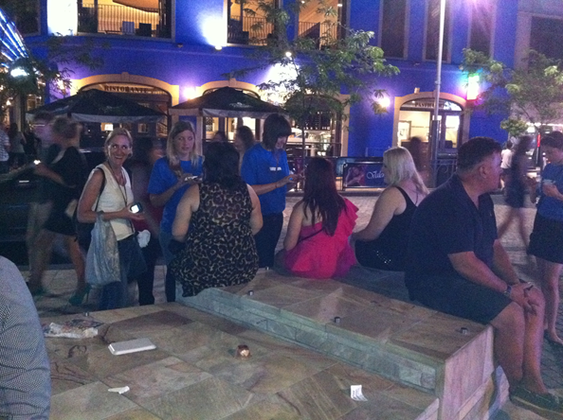
Liquor Accords
Geelong since 1990/1
Impact dependent on dynamics
Poor membership in past 5 years
No effective measures introduced
Voluntary participation means it is vulnerable to ‘capture’
Time for further research and debate
  Cost effectiveness
  Impact

Slide 26
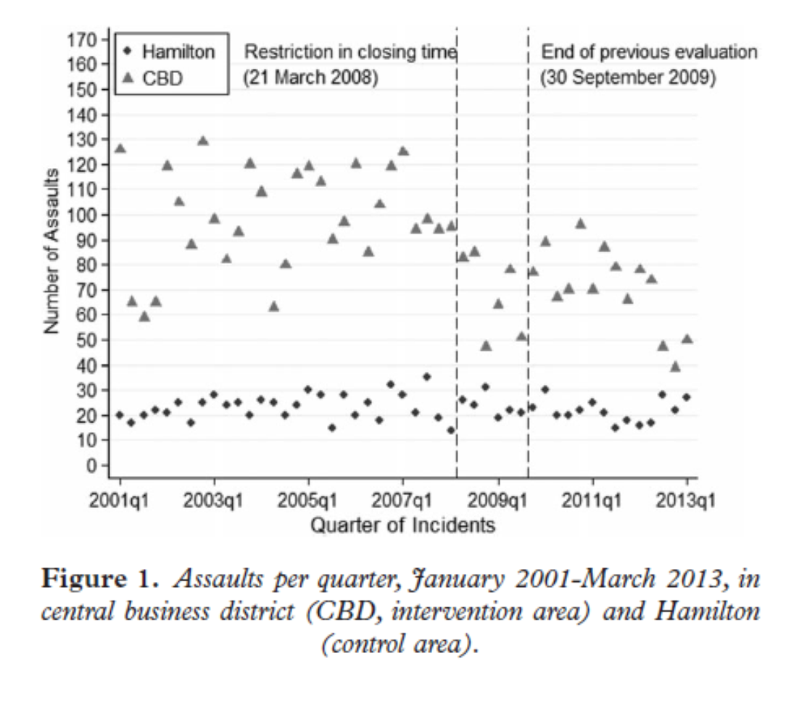
Lockouts

Slide 27
Lockouts

Slide 28
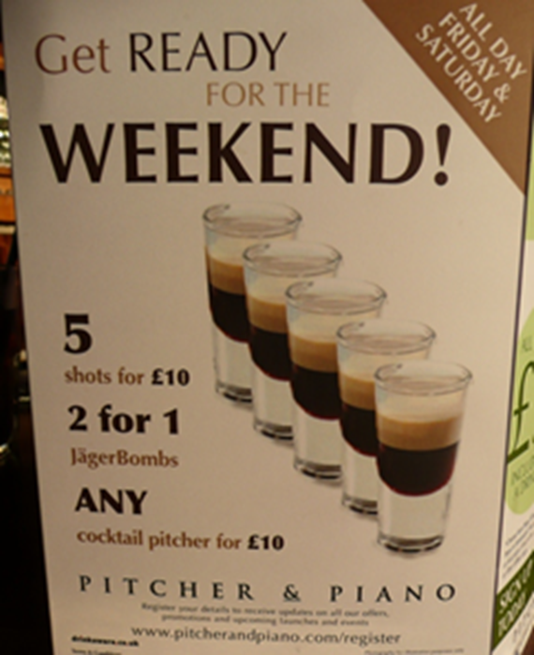
DANTE Conclusions
Newcastle intervention had an immediate effect which has continued to push trends downwards, 5 years later
    AT NO COST
The Geelong interventions studied had no positive effect, and even possibly a negative effect
    AT SUBSTANTIAL COST
Geelong rates finally show non-significant decline (Fines)
Ideally, a mandatory combination of measures will prevent, detect and solve crime.

Slide 29
POINTED conclusions
Pre-drinking is a major – and growing – problem with very few viable approaches
Illicit drug use predicts much greater harm
People who use energy drinks are typically higher risk nightlife patrons
Responsible Service of Alcohol laws are failing demonstrably and need far greater enforcement

Slide 30
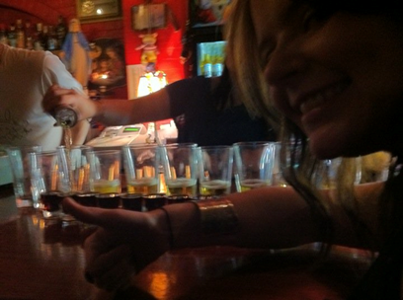
Overall
Plenty of individual risk factors
Situational interventions are by far the most effective
An integrated strategy with a clearly-defined enforcement pyramid.
Trading hour restrictions, applied consistently across regions
Consequence policing strategies for intoxication and anti-social behaviour
Levies on packaged liquor outlets to recover costs (or raise taxes)

Slide 31
THANK YOU
“the alcohol industry has no role in the formulation of alcohol policies, which must be protected from distortion by commercial or vested interests” (BMJ, 2013).
Margaret Chan, Director of the WHO
Our team:
Nic Droste, Darren Palmer, Ashlee Curtis, Lucy Zinkiewicz, Florentine Martino, Arlene Walker, Elise Cox, Kerri Coomber, Beth Costa, Shannon Hyder, Steven Litherland, Anders Sonderlund, Molly Bickerton, Eric Koukounas, Emma McFarlane, Andrew Day.

