Slide 1
Examining Adult-Onset Offending:
A case for Adult Cautioning
Carleen Thompson
Anna Stewart
Troy Allard
April Chrzanowksi
Funded by a Criminology Research Council Grant

Slide 2
Why Adult-Onset Offending?
  30-40% of offenders (!!)
    First contact CJS at 18 years or older
  Predominantly low rate, less serious offenders

Slide 3
What does this mean for the CJS?

Slide 4
  CJS Intervention & Low Risk Offenders
CJS contact may actually increase likelihood reoffending esp. for low risk offenders
  Labelling, stigmatisation
Costly

Slide 5
  Could we caution first-time, less serious adult-onset offenders?
Less intervention consistent with risk-needs-responsivity
Evidence cautioning = less reoffending
Swift
Less stigma & labelling
Opportunity ‘mature out of’ crimes commonly perpetrated in tumultuous period of emerging adulthood
For many of these reasons- adult cautioning has been introduced in some jurisdictions (varying levels of inclusiveness)

Slide 6
Research Questions
What do adult-onset offenders look like in our cohort?
Could we caution less serious, first time adult-onset offenders?
  Appropriate?
  Cost and resource implications?

Slide 7
Data Source
1983/1984 Queensland Longitudinal Dataset N = 40,523
  25.9% female; 8.9% Indigenous Australian
  Official offence histories to age 25 for all offenders born in 1983 or 1984

Slide 8
Data Source
1983/1984 Queensland Longitudinal Dataset N = 40,523
  25.9% female; 8.9% Indigenous Australian
  Official offence histories to age 25 for all offenders born in 1983 or 1984
    Court finalisations
    Youth cautioning and conferencing
    Excludes minor traffic and breach offences

Slide 9
Data
  Adulthood = 18 + (e.g., Eggleston & Laub 2002)
  Official contacts
    Not self-reported offending
  Therefore: Emerging adulthood-onset
    Unique developmental period (18-25 years)

Slide 10
What is the extent and nature of adult-onset offending?
52.3% of offenders first contact 18years+ (n = 21,213)
Heterogeneity:
  Offences ranged 1 – 118

Slide 11
Allard et al., 2014

Slide 12
Low rate classification

Slide 13
High rate classification

Slide 14
Low rate v. high rate ‘adult-onset’ offenders
Low rate (93.4%)
  ⬇ offences (M = 1.8)
  ⬇ events (M = 1.4)
  ⬇ serious (8% ever serious)
  ⬇ supervised order (6%)
  ⬇ prison (1.5%)
  ⬇ versatility
  ⬇ violence
High rate (6.6%)
  ⬆ offences (M = 12.1)
  ⬆ events (M = 4.6)
  ⬆ serious (39% serious)
  ⬆ supervised orders (49%)
  ⬆ prison (20%)
  ⬆ versatility
  ⬆ violence

Slide 15
So nearly 95% of ‘Adult-Onset’ Offenders…
Just one or two offences, minor or moderate in nature, resulted in non-supervised orders

Slide 16
In fact….
Similar offending patterns to low-rate early-onset offenders
  Adult-onset - low
  M = 1.8 offences ≈
  M = 1.4 event ≈
  8% ever serious ≈
  6% supervised order ≈
  1.5% prison ≈
  Early-onset - low
  M = 2.4 offences
  M = 1.8 event
  14% ever serious
  7% supervised order
  0.7% prison

Slide 17
Low Rate Adult- v. Early-Onset Offenders
Differences in types of offences (ever v. never)
  Adult-onset - low
  25% property
  40% public order
  24% dangerous or negligent acts endangering persons (principally driving under the influence of alcohol or other substances and dangerous or negligent operation of a vehicle)
  Early-onset - low
  70% property
  24.5% public order
  12% dangerous or negligent acts endangering persons

Slide 18
Low Rate Adult- v. Early-Onset Offenders
Differences in types of offences (ever v. never)
  Adult-onset - low
  25% property
  40% public order
  24% dangerous or negligent acts endangering persons (principally driving under the influence of alcohol or other substances and dangerous or negligent operation of a vehicle)
  Early-onset - low
  70% property
  24.5% public order
  12% dangerous or negligent acts endangering persons

Slide 19
But for both groups….
  Offences reflect period of development
  Adult-onset – low v. Early-onset – low
culture young adults→
binge drinking
nightclubbing
‘partying’ (Druginfo 2009)
other forms of risk-taking behaviours (eg associated with driving; Arnett 2000)
adolescent-limited offending patterns
shoplifting
other property offences
status offences

Slide 20
  Adult-onset – low
  49% cohort v.
  Early-onset – low
  35% cohort

Slide 21
So…
Adult-onset low offenders more normative in cohort than early-onset low!

Slide 22
But….treated very differently by CJS
  Adult-onset – low
  Not cautioned
  Early-onset – low
  75% cautioned
      Number would be even higher but
      17yo offenders due to QLD legislation

Slide 23
Cost & resource implications?
Could we caution less serious, first time adult-onset offenders?

Slide 24
If we cautioned low rate Adult-Onset Offenders for…
First events only (i.e. First-time offenders)
Magistrates Court events only
Received non-supervised orders only
I.e. First time, less serious, low-rate
Just a rough approximation of what cautioning may look like

Slide 25
If we cautioned low rate, first-time, less serious ‘Adult-Onset’ Offenders…
18,646 could have been cautioned (94.1%)

Slide 26
If we cautioned low rate, first-time, less serious ‘Adult-Onset’ Offenders…
Magistrates Court
  18,646 fewer finalisations
  Savings = reduction of 1.2% of annual workload
Police time saved
  Caution = 4.5 hours v. Court prep = 11 hours
  Savings = approx 8 fulltime policing positions

Slide 27
If we cautioned low rate, first-time, less serious ‘Adult-Onset’ Offenders…
Cost savings?
Using Allard et al’s (2014) costings methodology
Caution = $1103 v. Court = $3090

Slide 28
If we cautioned first-time, less serious, low rate ‘Adult-Onset’ Offenders…
Using Allard et al’s (2014) costings methodology
Caution = $1103 v. Court = $3090
After adjusting for lost revenue from fines
= $32.5 million
    Instead target to high risk offenders, who pose ongoing risk, cause greatest harm

Slide 29
But we cannot tell who is going to be a low rate offender?

Slide 30
Conclusions
Large proportion of offenders no contact CJS until 18 years+
95% adult-onset offending: career brief, less serious
More appropriate respond using diversionary schemes like adult cautioning
Doing so saves considerable CJS resources that could be targeted towards higher risk offenders who pose an ongoing risk

Slide 31
Limitations
Emerging Adulthood
Data only to 25 years of age
Unique developmental period- ‘emerging adulthood’
Low rate adult-onset offending seemed to reflect social factors associated with emerging adulthood
Therefore older adult-onset offenders may produce different results

Slide 32
Other limitations
Official data
Migration
Variation between jurisdictions in the costs of criminal justice practices
Variation between jurisdictions in responses to adult offending (eg differences in the use of infringement notices, cautions, forum sentencing, diversion programs)
Variation over time in responding to adult-onset offenders will impact
Costs based on a bottom-up costing approach
CJS costs were average opportunity costs (versus marginal costs)

Slide 33
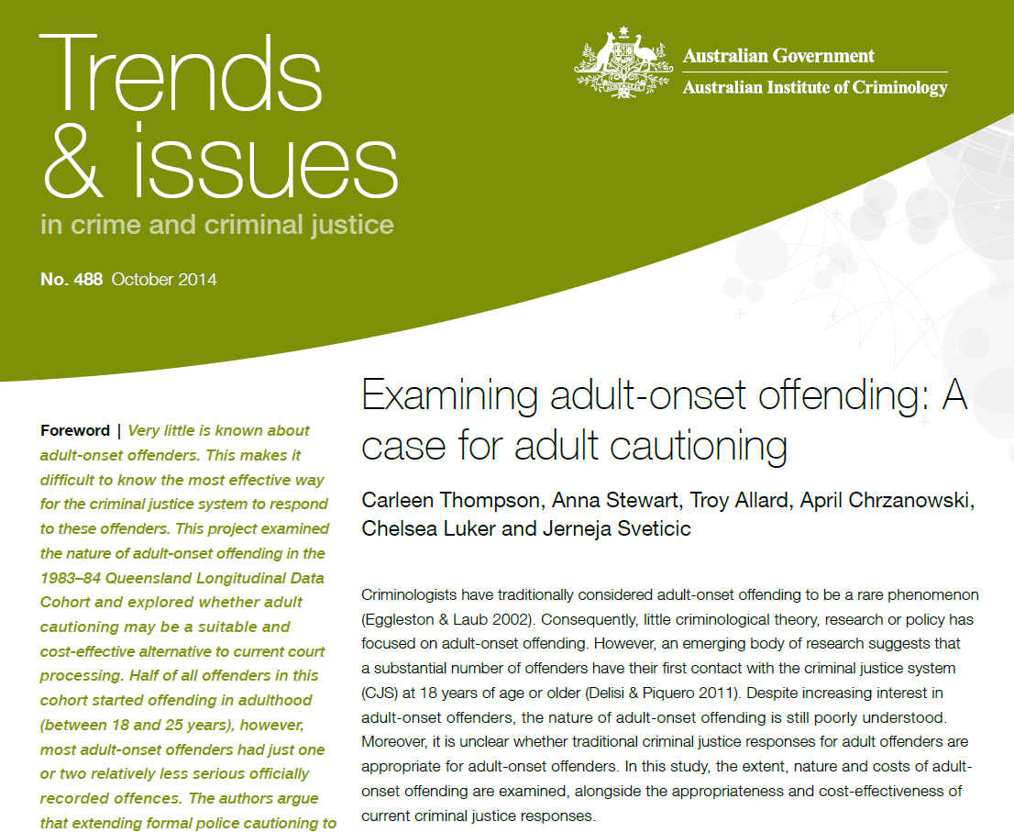

Slide 34
Thank you!
Carleen Thompson
C.Thompson@griffith.edu.au

Slide 35
Key references
Allard T, Stewart A, Smith C, Dennison S, Chrzanowski C & Thompson C 2014. The monetary cost of offender trajectories: Findings from Queensland (Australia). Australian and New Zealand Journal of Criminology, 47: 81-101
Allard T, Stewart A, Chrzanowski A, Ogilvie J, Birks D & Little S 2009. The Use and Impact of Police Diversion for Reducing Indigenous Over-Representation. Report for Criminological Research Council.
Farrington DP, Loeber R & Howell JC 2012. Young adult offenders: The need for more effective legislative options and justice processing. Criminology and Public Policy, 11: 729 – 750
McGee TR & Farrington DP 2010. Are there any true adult-onset offenders? British Journal of Criminology, 50: 530 – 549
Thompson CM, Stewart A, Allard T, Chrzanowski A, Luker C. & Sveticic J 2014. Examining Adult-Onset Offending: A Case for Adult Cautioning. Trends & Issues in Crime and Criminal Justice, no. 488, 1-8
Zara G & Farrington DP 2010. A longitudinal analysis of early risk factors for adult onset offending: What predicts a delayed criminal career? Criminal Behaviour and Mental Health, 20: 257-273
Zara G & Farrington DP 2013. Assessment of risk for juvenile compared with adult criminal onset: Implications for policy, prevention, and intervention. Psychology, Public Policy, and Law, 19(2): 235-24

