Slide 1

Piloting the Washington State approach to public policy in NSW
Ophelia Cowell and Russell Taylor
18 February 2015

Slide 2
Presentation overview
Purpose of the NSW pilot project
The Washington State approach
    Outcomes in Washington State
    Policy potential in NSW
    Results of the pilot
Methodology and model
    Key inputs
    Worked example
    Inventory of policy options
Lessons learned

Slide 3
Purpose of NSW pilot project
The program inventory

Slide 4



Purpose of NSW pilot project
PURPOSE
Test feasibility of the Washington State Institute for Public Policy cost-benefit assessment model
Using NSW criminal justice sector data
For NSW:
Establish evidence base of ‘what works’ to support policy decisions
Develop tool to link the evidence base to resource allocation
Strictly Confidential – Limited for Distribution

Slide 5
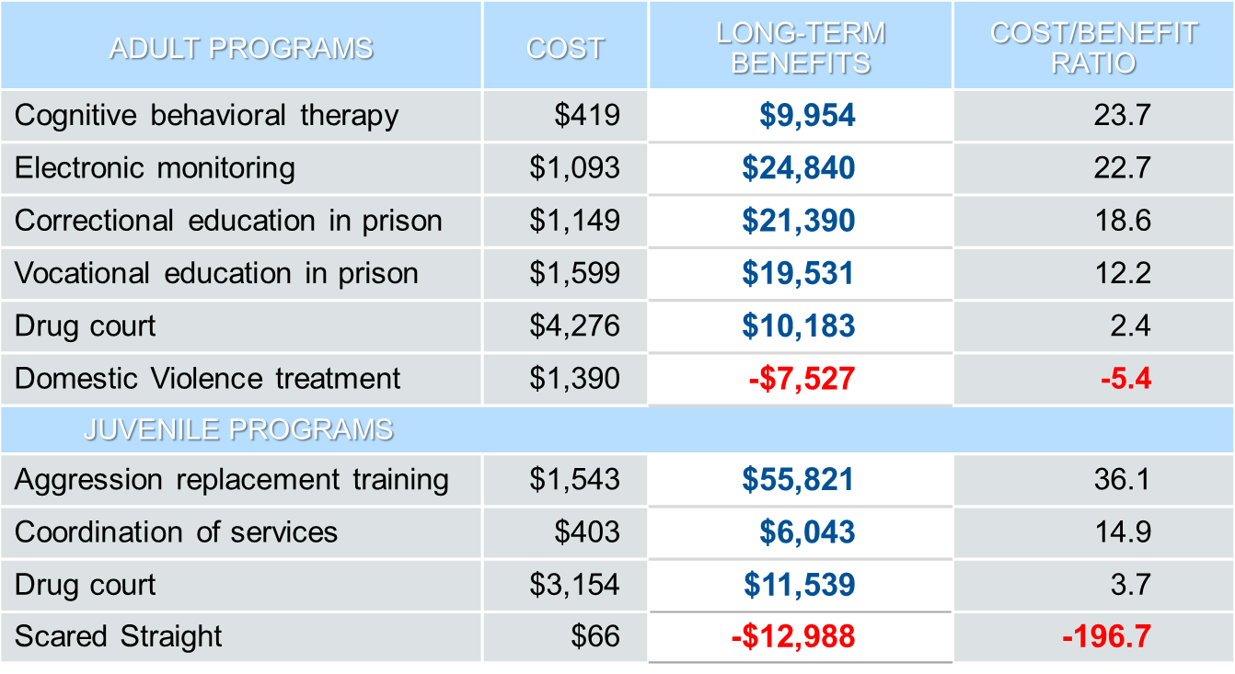
The Washington State approach
Compare Return on Investment of Programs - “Consumer Reports”
Picture here
Focus on Return on Investment to tax payers
Peer-reviewed
Transparent
Published
*Washington State 2012 dollars
Source: Washington State Institute for Public Policy and Pew-MacArthur Foundation

Slide 6
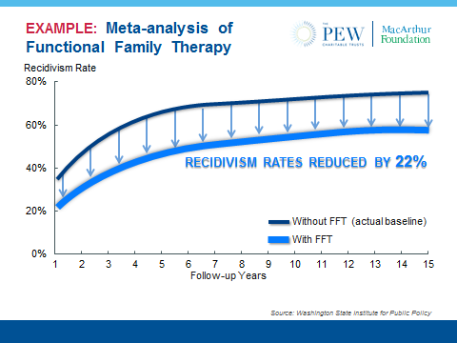
The Washington State approach
Outcomes in Washington State
Policy effort
Directed to areas of higher value
Crime
Juvenile arrest rates declined 62% relative to national rate of 48% (since 1990)
Return on public investment
Frees resources for most productive purposes
Non drug crime rate dropped (each year since 2005)
Crime rates down without increased incarceration
State incarceration rate ~56% of national rate
Reconviction rates (1990-2006) across all prison release cohorts show downward trends.
Maximises benefit
Source: Washington State Institute for Public Policy and Pew-MacArthur Foundation

Slide 7
Results of NSW Pilot
Proven feasibility of Washington State model in NSW
Collection and adaptation of NSW data
Estimated system costs and victim costs for NSW
Demonstrated potential to support policy reform and resource allocation in NSW criminal justice cluster.

Slide 8
Methodology and the model
Inputs
Effect Size
Library
Macroeconomic
Data
Agency Resource Use
Quality adjusted
International evidence
NSW demographics
GDP deflator
Health costs
NSW marginal costs
NSW recidivism rates
Program costs
Process
Outputs
Program impacts
Investment
  NPV, ROI and cashflow
  Risk-return
  metric analysis of defined interventions
Investment portfolio analysis
Inventory of policy options
Source: Washington State Institute for Public Policy

Slide 9
Key CJ Model Inputs
Marginal costs of detection, conviction and custodial care.
Victim costs.
Recidivism rates, resource usage rates, offending base rates:
ATOD (assessing long-term consequences of recreational drugs, CAN, DSM-IV epidemiology.
Incapacitation, simultaneity and elasticity metrics: evolving in Washington State policing and prison population headcounts
Earned income by single year of age and educational attainment.
Evidence library: Effect sizes of intervention outcomes.

Slide 10
An example - Functional Family Therapy
Effect Size | -0.341
Absolute Risk Reduction (ARR) | 14%
Base rate of juvenile reoffending | 60.9%
Expected number lifetime felony convictions (w/out FFT) | 3.39
FFT cost | $3300 pp
Cost to crime victims averted | $48 392
Cost of CJ resources averted | $12 982
NPV = [.14 * 3.39 * ($48,392 + $12,982)] - $3300
= $25,828 pp
Source: Washington State Institute for Public Policy

Slide 11
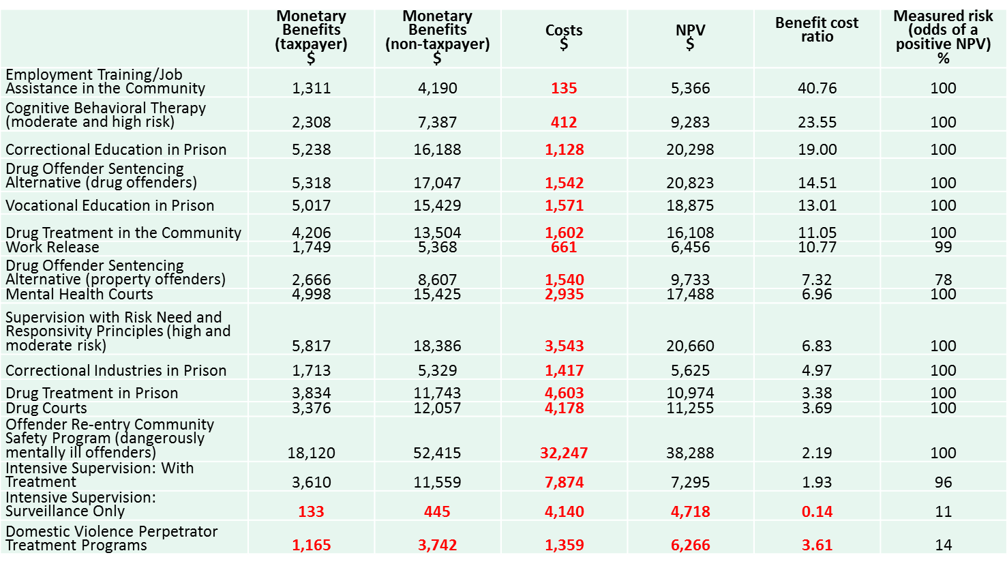
WSIPP inventory of policy options
Adult criminal justice options
Source: Washington State Institute for Public Policy

Slide 12
Lessons learned
Required skill sets for implementing the model are broad
  data wrangling
  advanced analytic skills, econometrics, epidemiology, statistics
  stakeholder management for access and buy-in
Need for durable capability within justice cluster: data collection and analysis must be repeatable on an 18-24month cycle
Collaborative project model provides a basis for future cooperation between justice agencies
Clear need for quality evidence about ‘what works’ - evidence of market failure – and a clear role for government.
Aligns with established Government objectives for economically and evidence informed policy options.

Slide 13
Questions and discussion…

